Slide 1
University Astronomy
Professor Don Figer
Telescopes II

Slide 2
Aims and outline for this lecture
continue telescope lecture
relate telescope performance to ability to measure distances to stars
give examples of modern telescopes
discuss future telescopes

Slide 3
telescopes and measuring distances to stars

Slide 4
Heliocentric Parallax
Parallax is the apparent shift of an object due to viewpoint.
As an example, watch your thumb shift with respect to objects far away as you view it from each eye.
The angular shift depends on distance.
We can use this effect to estimate distance to nearby stars by viewing them when the Earth is on opposite sides of the Sun.

Slide 5
Parallax Effect in the Focal Plane
Notes:
On March 25th, 1934, in Corning, New York, the largest disk, made of a special glass containing borax (borosilicate glass), was poured. It was 16.6 feet across, and referred to as the 200 inch disk. It was 26 inches thick, and weighed 20 tons. Its ultimate destination, when ground, polished and coated with a layer of bright aluminum, was the Hale Telescope on Mt. Palomar in north San Diego County, California.
The 200-inch disk in the Innovations Center
During the manufacture, the furnace was so hot that several cores in the brick mold broke away from the metal anchor rods and floated on top of the molten glass. Though the accident meant that the disk would never be used as the great mirror, it wasn't considered a complete failure. It was used to test the annealing process for the pouring of the second disk, and for experimenting with packing and crating methods to be chosen for shipping it to California. The first disk, displayed in Corning, New York, is pictured to the left. You can see the reinforced back of the disk that looks like a giant waffle.
The second disk was cast six months later, cooled, packed and shipped by railroad to California. It took 7½ years to grind and polish nearly 5 tons of glass from the flat side of the original 20 ton blank. The reason the job took so long to finish was because a world-wide war (World War II) interrupted the process for about 5 years. Skilled people and materials were diverted to the war effort.

Slide 6
Measuring Distance through Parallax
Notes:
On March 25th, 1934, in Corning, New York, the largest disk, made of a special glass containing borax (borosilicate glass), was poured. It was 16.6 feet across, and referred to as the 200 inch disk. It was 26 inches thick, and weighed 20 tons. Its ultimate destination, when ground, polished and coated with a layer of bright aluminum, was the Hale Telescope on Mt. Palomar in north San Diego County, California.
The 200-inch disk in the Innovations Center
During the manufacture, the furnace was so hot that several cores in the brick mold broke away from the metal anchor rods and floated on top of the molten glass. Though the accident meant that the disk would never be used as the great mirror, it wasn't considered a complete failure. It was used to test the annealing process for the pouring of the second disk, and for experimenting with packing and crating methods to be chosen for shipping it to California. The first disk, displayed in Corning, New York, is pictured to the left. You can see the reinforced back of the disk that looks like a giant waffle.
The second disk was cast six months later, cooled, packed and shipped by railroad to California. It took 7½ years to grind and polish nearly 5 tons of glass from the flat side of the original 20 ton blank. The reason the job took so long to finish was because a world-wide war (World War II) interrupted the process for about 5 years. Skilled people and materials were diverted to the war effort.

Slide 7
Parallax of Nearest Star
The distance at which a star has a parallax of exactly one arcsecond is one parsec.
The nearest star to the Sun, Proxima Centauri, has a parallax of 0.76 arcseconds.
The distance to Proxima Centauri is ~1.3 pc, or ~4.2 ly.
Notes:
On March 25th, 1934, in Corning, New York, the largest disk, made of a special glass containing borax (borosilicate glass), was poured. It was 16.6 feet across, and referred to as the 200 inch disk. It was 26 inches thick, and weighed 20 tons. Its ultimate destination, when ground, polished and coated with a layer of bright aluminum, was the Hale Telescope on Mt. Palomar in north San Diego County, California.
The 200-inch disk in the Innovations Center
During the manufacture, the furnace was so hot that several cores in the brick mold broke away from the metal anchor rods and floated on top of the molten glass. Though the accident meant that the disk would never be used as the great mirror, it wasn't considered a complete failure. It was used to test the annealing process for the pouring of the second disk, and for experimenting with packing and crating methods to be chosen for shipping it to California. The first disk, displayed in Corning, New York, is pictured to the left. You can see the reinforced back of the disk that looks like a giant waffle.
The second disk was cast six months later, cooled, packed and shipped by railroad to California. It took 7½ years to grind and polish nearly 5 tons of glass from the flat side of the original 20 ton blank. The reason the job took so long to finish was because a world-wide war (World War II) interrupted the process for about 5 years. Skilled people and materials were diverted to the war effort.

Slide 8
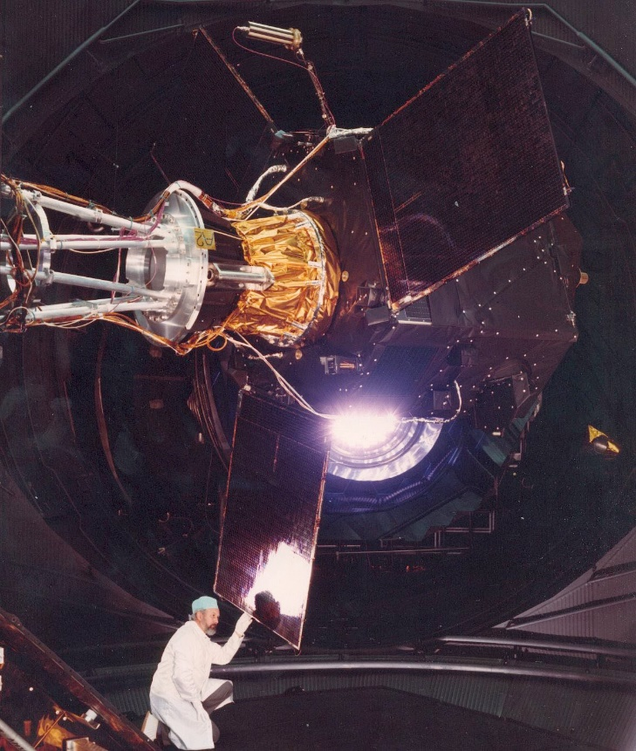
Hipparcos Space Astrometry Mission
Hipparcos is the high precision parallax collecting satellite.
From 1989-1993, Hipparcos conducted an all sky survey to measure the parallax and proper motions of stars.
It measured parallax of over 2.5 million stars with an accuracy of ~0.025”
Notes:
On March 25th, 1934, in Corning, New York, the largest disk, made of a special glass containing borax (borosilicate glass), was poured. It was 16.6 feet across, and referred to as the 200 inch disk. It was 26 inches thick, and weighed 20 tons. Its ultimate destination, when ground, polished and coated with a layer of bright aluminum, was the Hale Telescope on Mt. Palomar in north San Diego County, California.
The 200-inch disk in the Innovations Center
During the manufacture, the furnace was so hot that several cores in the brick mold broke away from the metal anchor rods and floated on top of the molten glass. Though the accident meant that the disk would never be used as the great mirror, it wasn't considered a complete failure. It was used to test the annealing process for the pouring of the second disk, and for experimenting with packing and crating methods to be chosen for shipping it to California. The first disk, displayed in Corning, New York, is pictured to the left. You can see the reinforced back of the disk that looks like a giant waffle.
The second disk was cast six months later, cooled, packed and shipped by railroad to California. It took 7½ years to grind and polish nearly 5 tons of glass from the flat side of the original 20 ton blank. The reason the job took so long to finish was because a world-wide war (World War II) interrupted the process for about 5 years. Skilled people and materials were diverted to the war effort.

Slide 9
Hipparcos Accuracy
For the brighter stars, Hipparcos could measure to 0.001 arcseconds (1 milliarcsecond).
At what distance could Hipparcos make measurements for those bright stars?
d=1/0.001”=1 kpc
Notes:
On March 25th, 1934, in Corning, New York, the largest disk, made of a special glass containing borax (borosilicate glass), was poured. It was 16.6 feet across, and referred to as the 200 inch disk. It was 26 inches thick, and weighed 20 tons. Its ultimate destination, when ground, polished and coated with a layer of bright aluminum, was the Hale Telescope on Mt. Palomar in north San Diego County, California.
The 200-inch disk in the Innovations Center
During the manufacture, the furnace was so hot that several cores in the brick mold broke away from the metal anchor rods and floated on top of the molten glass. Though the accident meant that the disk would never be used as the great mirror, it wasn't considered a complete failure. It was used to test the annealing process for the pouring of the second disk, and for experimenting with packing and crating methods to be chosen for shipping it to California. The first disk, displayed in Corning, New York, is pictured to the left. You can see the reinforced back of the disk that looks like a giant waffle.
The second disk was cast six months later, cooled, packed and shipped by railroad to California. It took 7½ years to grind and polish nearly 5 tons of glass from the flat side of the original 20 ton blank. The reason the job took so long to finish was because a world-wide war (World War II) interrupted the process for about 5 years. Skilled people and materials were diverted to the war effort.

Slide 10
How Far Did Hipparcos Reach?
Notes:
On March 25th, 1934, in Corning, New York, the largest disk, made of a special glass containing borax (borosilicate glass), was poured. It was 16.6 feet across, and referred to as the 200 inch disk. It was 26 inches thick, and weighed 20 tons. Its ultimate destination, when ground, polished and coated with a layer of bright aluminum, was the Hale Telescope on Mt. Palomar in north San Diego County, California.
The 200-inch disk in the Innovations Center
During the manufacture, the furnace was so hot that several cores in the brick mold broke away from the metal anchor rods and floated on top of the molten glass. Though the accident meant that the disk would never be used as the great mirror, it wasn't considered a complete failure. It was used to test the annealing process for the pouring of the second disk, and for experimenting with packing and crating methods to be chosen for shipping it to California. The first disk, displayed in Corning, New York, is pictured to the left. You can see the reinforced back of the disk that looks like a giant waffle.
The second disk was cast six months later, cooled, packed and shipped by railroad to California. It took 7½ years to grind and polish nearly 5 tons of glass from the flat side of the original 20 ton blank. The reason the job took so long to finish was because a world-wide war (World War II) interrupted the process for about 5 years. Skilled people and materials were diverted to the war effort.

Slide 11
Gaia
Gaia is the European Space Agency (ESA) successor to Hipparcos.
It can measure parallax with an accuracy of 0.00001” (10 microarcseconds).
It can measure distances up to 100 kpc away!
It can reach across the Milky Way and even nearby galaxies (for bright enough objects)
For more info: http://www.cosmos.esa.int/web/gaia
Notes:
On March 25th, 1934, in Corning, New York, the largest disk, made of a special glass containing borax (borosilicate glass), was poured. It was 16.6 feet across, and referred to as the 200 inch disk. It was 26 inches thick, and weighed 20 tons. Its ultimate destination, when ground, polished and coated with a layer of bright aluminum, was the Hale Telescope on Mt. Palomar in north San Diego County, California.
The 200-inch disk in the Innovations Center
During the manufacture, the furnace was so hot that several cores in the brick mold broke away from the metal anchor rods and floated on top of the molten glass. Though the accident meant that the disk would never be used as the great mirror, it wasn't considered a complete failure. It was used to test the annealing process for the pouring of the second disk, and for experimenting with packing and crating methods to be chosen for shipping it to California. The first disk, displayed in Corning, New York, is pictured to the left. You can see the reinforced back of the disk that looks like a giant waffle.
The second disk was cast six months later, cooled, packed and shipped by railroad to California. It took 7½ years to grind and polish nearly 5 tons of glass from the flat side of the original 20 ton blank. The reason the job took so long to finish was because a world-wide war (World War II) interrupted the process for about 5 years. Skilled people and materials were diverted to the war effort.

Slide 12
Where should telescopes be located?

Slide 13

Telescopes on Earth
The best ground-based sites for astronomical observing are:
Calm (not too windy)
High (less atmosphere to see through)
Dark (far from city lights)
Dry (few cloudy nights)
Notes:
On March 25th, 1934, in Corning, New York, the largest disk, made of a special glass containing borax (borosilicate glass), was poured. It was 16.6 feet across, and referred to as the 200 inch disk. It was 26 inches thick, and weighed 20 tons. Its ultimate destination, when ground, polished and coated with a layer of bright aluminum, was the Hale Telescope on Mt. Palomar in north San Diego County, California.
The 200-inch disk in the Innovations Center
During the manufacture, the furnace was so hot that several cores in the brick mold broke away from the metal anchor rods and floated on top of the molten glass. Though the accident meant that the disk would never be used as the great mirror, it wasn't considered a complete failure. It was used to test the annealing process for the pouring of the second disk, and for experimenting with packing and crating methods to be chosen for shipping it to California. The first disk, displayed in Corning, New York, is pictured to the left. You can see the reinforced back of the disk that looks like a giant waffle.
The second disk was cast six months later, cooled, packed and shipped by railroad to California. It took 7½ years to grind and polish nearly 5 tons of glass from the flat side of the original 20 ton blank. The reason the job took so long to finish was because a world-wide war (World War II) interrupted the process for about 5 years. Skilled people and materials were diverted to the war effort.

Slide 14

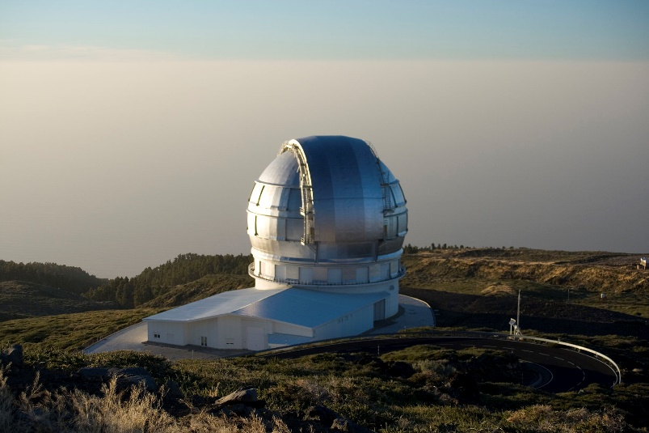
Mauna Kea, Atacama, Canary Islands
Notes:
On March 25th, 1934, in Corning, New York, the largest disk, made of a special glass containing borax (borosilicate glass), was poured. It was 16.6 feet across, and referred to as the 200 inch disk. It was 26 inches thick, and weighed 20 tons. Its ultimate destination, when ground, polished and coated with a layer of bright aluminum, was the Hale Telescope on Mt. Palomar in north San Diego County, California.
The 200-inch disk in the Innovations Center
During the manufacture, the furnace was so hot that several cores in the brick mold broke away from the metal anchor rods and floated on top of the molten glass. Though the accident meant that the disk would never be used as the great mirror, it wasn't considered a complete failure. It was used to test the annealing process for the pouring of the second disk, and for experimenting with packing and crating methods to be chosen for shipping it to California. The first disk, displayed in Corning, New York, is pictured to the left. You can see the reinforced back of the disk that looks like a giant waffle.
The second disk was cast six months later, cooled, packed and shipped by railroad to California. It took 7½ years to grind and polish nearly 5 tons of glass from the flat side of the original 20 ton blank. The reason the job took so long to finish was because a world-wide war (World War II) interrupted the process for about 5 years. Skilled people and materials were diverted to the war effort.

Slide 15

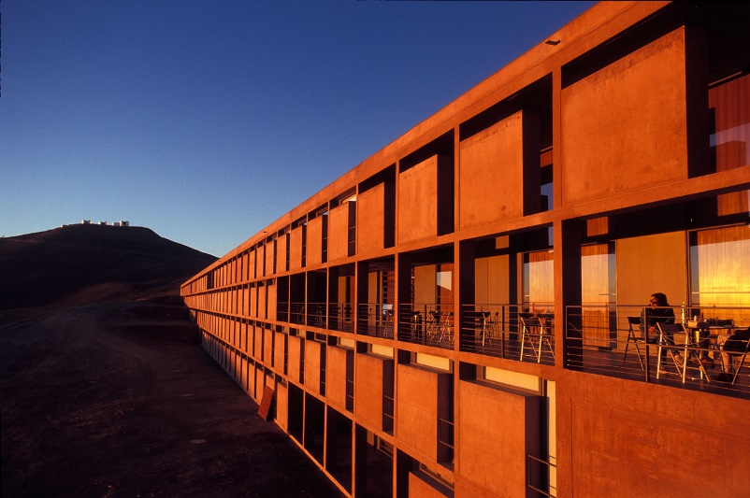
“Shaken, not stirred…” – J. Bond
Notes:
On March 25th, 1934, in Corning, New York, the largest disk, made of a special glass containing borax (borosilicate glass), was poured. It was 16.6 feet across, and referred to as the 200 inch disk. It was 26 inches thick, and weighed 20 tons. Its ultimate destination, when ground, polished and coated with a layer of bright aluminum, was the Hale Telescope on Mt. Palomar in north San Diego County, California.
The 200-inch disk in the Innovations Center
During the manufacture, the furnace was so hot that several cores in the brick mold broke away from the metal anchor rods and floated on top of the molten glass. Though the accident meant that the disk would never be used as the great mirror, it wasn't considered a complete failure. It was used to test the annealing process for the pouring of the second disk, and for experimenting with packing and crating methods to be chosen for shipping it to California. The first disk, displayed in Corning, New York, is pictured to the left. You can see the reinforced back of the disk that looks like a giant waffle.
The second disk was cast six months later, cooled, packed and shipped by railroad to California. It took 7½ years to grind and polish nearly 5 tons of glass from the flat side of the original 20 ton blank. The reason the job took so long to finish was because a world-wide war (World War II) interrupted the process for about 5 years. Skilled people and materials were diverted to the war effort.

Slide 16

“Whoa” – Keanu Reeves
Notes:
On March 25th, 1934, in Corning, New York, the largest disk, made of a special glass containing borax (borosilicate glass), was poured. It was 16.6 feet across, and referred to as the 200 inch disk. It was 26 inches thick, and weighed 20 tons. Its ultimate destination, when ground, polished and coated with a layer of bright aluminum, was the Hale Telescope on Mt. Palomar in north San Diego County, California.
The 200-inch disk in the Innovations Center
During the manufacture, the furnace was so hot that several cores in the brick mold broke away from the metal anchor rods and floated on top of the molten glass. Though the accident meant that the disk would never be used as the great mirror, it wasn't considered a complete failure. It was used to test the annealing process for the pouring of the second disk, and for experimenting with packing and crating methods to be chosen for shipping it to California. The first disk, displayed in Corning, New York, is pictured to the left. You can see the reinforced back of the disk that looks like a giant waffle.
The second disk was cast six months later, cooled, packed and shipped by railroad to California. It took 7½ years to grind and polish nearly 5 tons of glass from the flat side of the original 20 ton blank. The reason the job took so long to finish was because a world-wide war (World War II) interrupted the process for about 5 years. Skilled people and materials were diverted to the war effort.

Slide 17

“Tiger Blood!” – Charlie Sheen
Notes:
On March 25th, 1934, in Corning, New York, the largest disk, made of a special glass containing borax (borosilicate glass), was poured. It was 16.6 feet across, and referred to as the 200 inch disk. It was 26 inches thick, and weighed 20 tons. Its ultimate destination, when ground, polished and coated with a layer of bright aluminum, was the Hale Telescope on Mt. Palomar in north San Diego County, California.
The 200-inch disk in the Innovations Center
During the manufacture, the furnace was so hot that several cores in the brick mold broke away from the metal anchor rods and floated on top of the molten glass. Though the accident meant that the disk would never be used as the great mirror, it wasn't considered a complete failure. It was used to test the annealing process for the pouring of the second disk, and for experimenting with packing and crating methods to be chosen for shipping it to California. The first disk, displayed in Corning, New York, is pictured to the left. You can see the reinforced back of the disk that looks like a giant waffle.
The second disk was cast six months later, cooled, packed and shipped by railroad to California. It took 7½ years to grind and polish nearly 5 tons of glass from the flat side of the original 20 ton blank. The reason the job took so long to finish was because a world-wide war (World War II) interrupted the process for about 5 years. Skilled people and materials were diverted to the war effort.

Slide 18
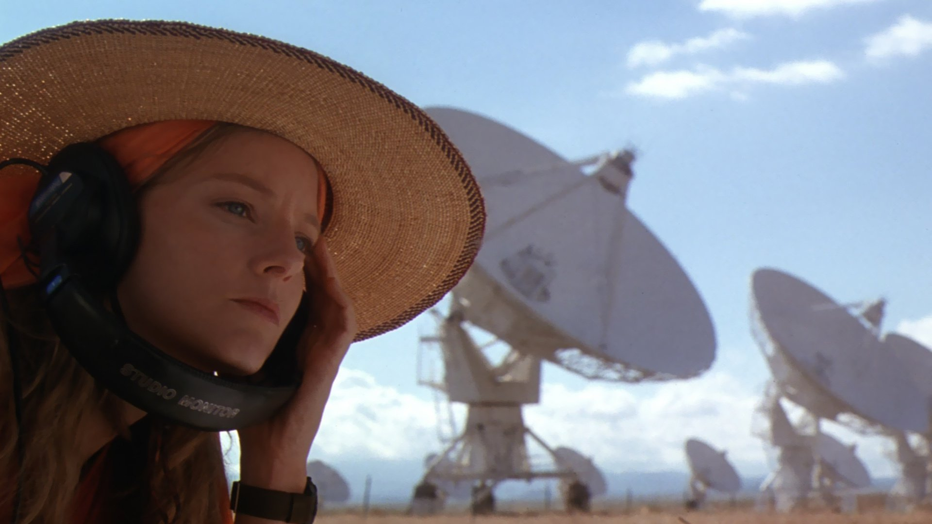
“Those are primes! 2,3,5,7, those are all prime numbers and there's no way that's a natural phenomenon!” – Jodie Foster
Notes:
On March 25th, 1934, in Corning, New York, the largest disk, made of a special glass containing borax (borosilicate glass), was poured. It was 16.6 feet across, and referred to as the 200 inch disk. It was 26 inches thick, and weighed 20 tons. Its ultimate destination, when ground, polished and coated with a layer of bright aluminum, was the Hale Telescope on Mt. Palomar in north San Diego County, California.
The 200-inch disk in the Innovations Center
During the manufacture, the furnace was so hot that several cores in the brick mold broke away from the metal anchor rods and floated on top of the molten glass. Though the accident meant that the disk would never be used as the great mirror, it wasn't considered a complete failure. It was used to test the annealing process for the pouring of the second disk, and for experimenting with packing and crating methods to be chosen for shipping it to California. The first disk, displayed in Corning, New York, is pictured to the left. You can see the reinforced back of the disk that looks like a giant waffle.
The second disk was cast six months later, cooled, packed and shipped by railroad to California. It took 7½ years to grind and polish nearly 5 tons of glass from the flat side of the original 20 ton blank. The reason the job took so long to finish was because a world-wide war (World War II) interrupted the process for about 5 years. Skilled people and materials were diverted to the war effort.

Slide 19
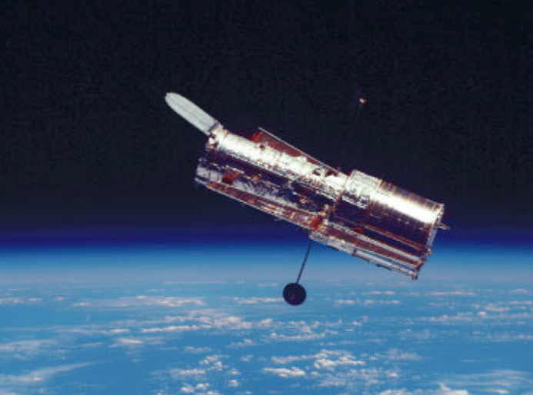
Telescopes in Space
Escape from atmospheric distortion (seeing)
Escape from atmospheric airglow and light pollution
Observe other regions of electromagnetic spectrum
Notes:
On March 25th, 1934, in Corning, New York, the largest disk, made of a special glass containing borax (borosilicate glass), was poured. It was 16.6 feet across, and referred to as the 200 inch disk. It was 26 inches thick, and weighed 20 tons. Its ultimate destination, when ground, polished and coated with a layer of bright aluminum, was the Hale Telescope on Mt. Palomar in north San Diego County, California.
The 200-inch disk in the Innovations Center
During the manufacture, the furnace was so hot that several cores in the brick mold broke away from the metal anchor rods and floated on top of the molten glass. Though the accident meant that the disk would never be used as the great mirror, it wasn't considered a complete failure. It was used to test the annealing process for the pouring of the second disk, and for experimenting with packing and crating methods to be chosen for shipping it to California. The first disk, displayed in Corning, New York, is pictured to the left. You can see the reinforced back of the disk that looks like a giant waffle.
The second disk was cast six months later, cooled, packed and shipped by railroad to California. It took 7½ years to grind and polish nearly 5 tons of glass from the flat side of the original 20 ton blank. The reason the job took so long to finish was because a world-wide war (World War II) interrupted the process for about 5 years. Skilled people and materials were diverted to the war effort.

Slide 20
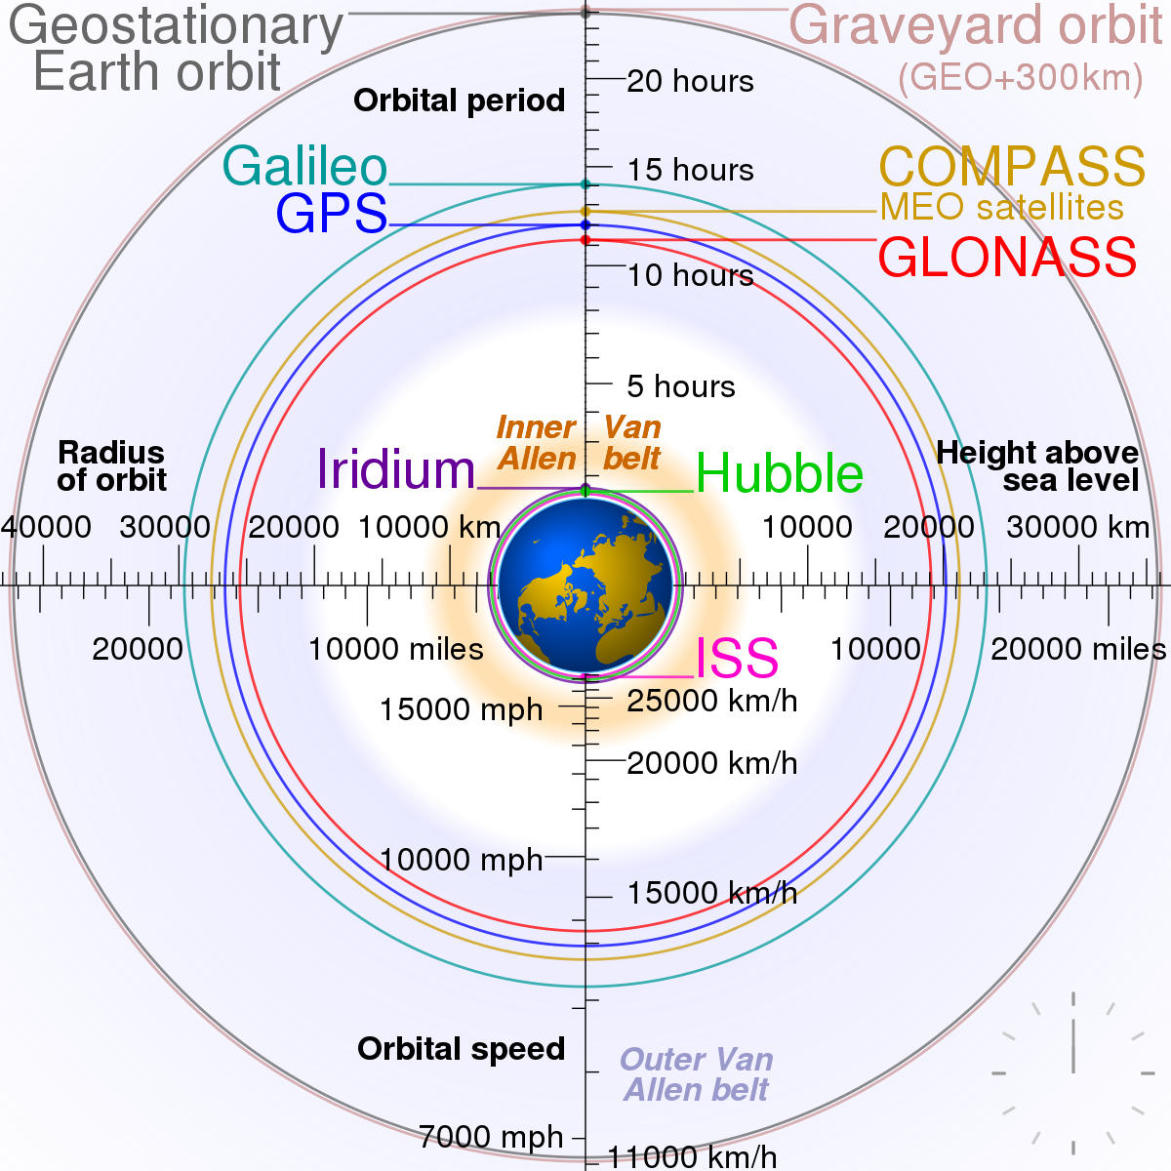
LEO
Notes:
On March 25th, 1934, in Corning, New York, the largest disk, made of a special glass containing borax (borosilicate glass), was poured. It was 16.6 feet across, and referred to as the 200 inch disk. It was 26 inches thick, and weighed 20 tons. Its ultimate destination, when ground, polished and coated with a layer of bright aluminum, was the Hale Telescope on Mt. Palomar in north San Diego County, California.
The 200-inch disk in the Innovations Center
During the manufacture, the furnace was so hot that several cores in the brick mold broke away from the metal anchor rods and floated on top of the molten glass. Though the accident meant that the disk would never be used as the great mirror, it wasn't considered a complete failure. It was used to test the annealing process for the pouring of the second disk, and for experimenting with packing and crating methods to be chosen for shipping it to California. The first disk, displayed in Corning, New York, is pictured to the left. You can see the reinforced back of the disk that looks like a giant waffle.
The second disk was cast six months later, cooled, packed and shipped by railroad to California. It took 7½ years to grind and polish nearly 5 tons of glass from the flat side of the original 20 ton blank. The reason the job took so long to finish was because a world-wide war (World War II) interrupted the process for about 5 years. Skilled people and materials were diverted to the war effort.

Slide 21
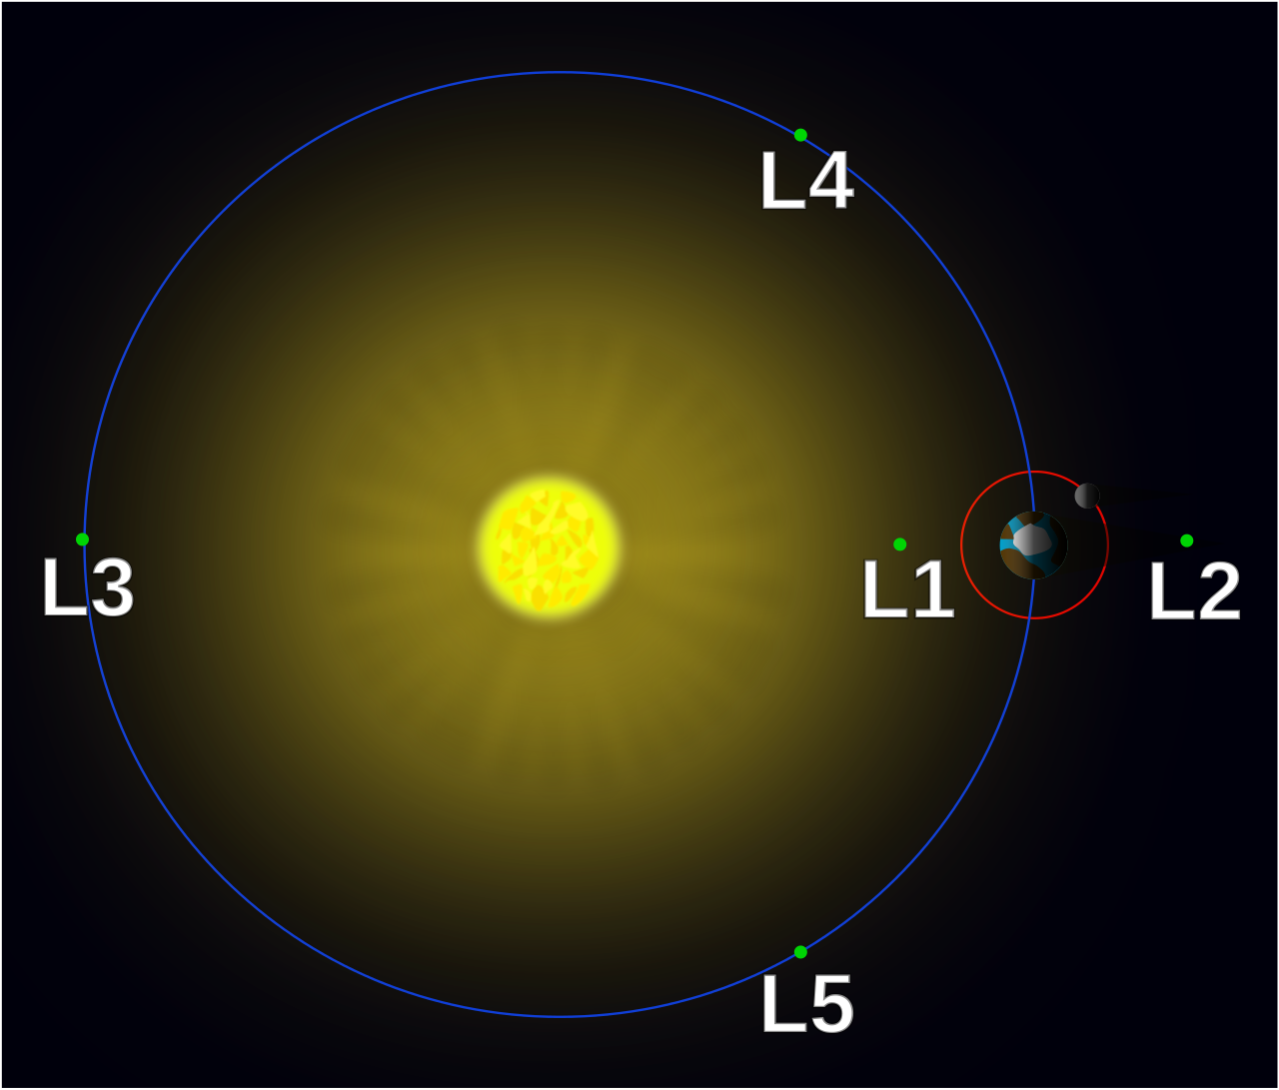
L2
Notes:
On March 25th, 1934, in Corning, New York, the largest disk, made of a special glass containing borax (borosilicate glass), was poured. It was 16.6 feet across, and referred to as the 200 inch disk. It was 26 inches thick, and weighed 20 tons. Its ultimate destination, when ground, polished and coated with a layer of bright aluminum, was the Hale Telescope on Mt. Palomar in north San Diego County, California.
The 200-inch disk in the Innovations Center
During the manufacture, the furnace was so hot that several cores in the brick mold broke away from the metal anchor rods and floated on top of the molten glass. Though the accident meant that the disk would never be used as the great mirror, it wasn't considered a complete failure. It was used to test the annealing process for the pouring of the second disk, and for experimenting with packing and crating methods to be chosen for shipping it to California. The first disk, displayed in Corning, New York, is pictured to the left. You can see the reinforced back of the disk that looks like a giant waffle.
The second disk was cast six months later, cooled, packed and shipped by railroad to California. It took 7½ years to grind and polish nearly 5 tons of glass from the flat side of the original 20 ton blank. The reason the job took so long to finish was because a world-wide war (World War II) interrupted the process for about 5 years. Skilled people and materials were diverted to the war effort.

Slide 22

L2 Moving Around Sun
Notes:
On March 25th, 1934, in Corning, New York, the largest disk, made of a special glass containing borax (borosilicate glass), was poured. It was 16.6 feet across, and referred to as the 200 inch disk. It was 26 inches thick, and weighed 20 tons. Its ultimate destination, when ground, polished and coated with a layer of bright aluminum, was the Hale Telescope on Mt. Palomar in north San Diego County, California.
The 200-inch disk in the Innovations Center
During the manufacture, the furnace was so hot that several cores in the brick mold broke away from the metal anchor rods and floated on top of the molten glass. Though the accident meant that the disk would never be used as the great mirror, it wasn't considered a complete failure. It was used to test the annealing process for the pouring of the second disk, and for experimenting with packing and crating methods to be chosen for shipping it to California. The first disk, displayed in Corning, New York, is pictured to the left. You can see the reinforced back of the disk that looks like a giant waffle.
The second disk was cast six months later, cooled, packed and shipped by railroad to California. It took 7½ years to grind and polish nearly 5 tons of glass from the flat side of the original 20 ton blank. The reason the job took so long to finish was because a world-wide war (World War II) interrupted the process for about 5 years. Skilled people and materials were diverted to the war effort.

Slide 23
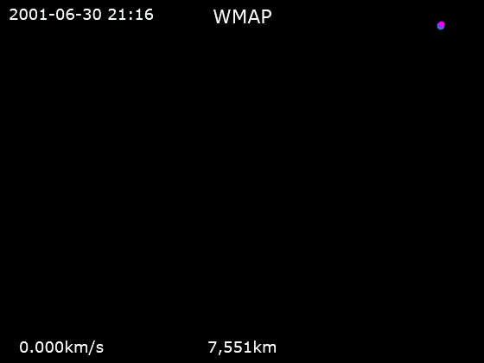
L2 Trajectory for WMAP
Notes:
On March 25th, 1934, in Corning, New York, the largest disk, made of a special glass containing borax (borosilicate glass), was poured. It was 16.6 feet across, and referred to as the 200 inch disk. It was 26 inches thick, and weighed 20 tons. Its ultimate destination, when ground, polished and coated with a layer of bright aluminum, was the Hale Telescope on Mt. Palomar in north San Diego County, California.
The 200-inch disk in the Innovations Center
During the manufacture, the furnace was so hot that several cores in the brick mold broke away from the metal anchor rods and floated on top of the molten glass. Though the accident meant that the disk would never be used as the great mirror, it wasn't considered a complete failure. It was used to test the annealing process for the pouring of the second disk, and for experimenting with packing and crating methods to be chosen for shipping it to California. The first disk, displayed in Corning, New York, is pictured to the left. You can see the reinforced back of the disk that looks like a giant waffle.
The second disk was cast six months later, cooled, packed and shipped by railroad to California. It took 7½ years to grind and polish nearly 5 tons of glass from the flat side of the original 20 ton blank. The reason the job took so long to finish was because a world-wide war (World War II) interrupted the process for about 5 years. Skilled people and materials were diverted to the war effort.

Slide 24
examples of modern telescopes

Slide 25
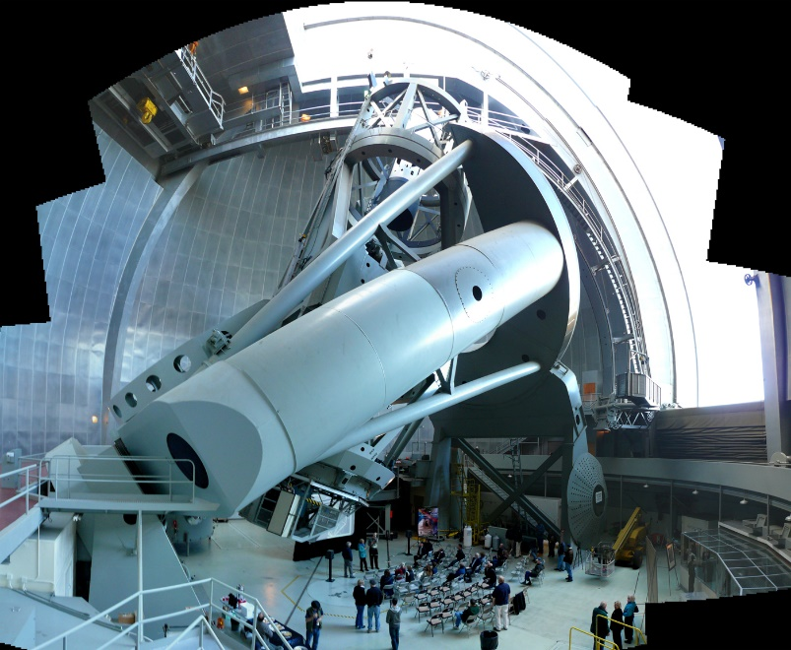
Hale 200" Telescope
Palomar Mountain, CA
Monolith (one piece)
Several feet thick
10 months to cool
7.5 years to grind (although 5 years was a pause for WWII)
Mirror weighs 20 tons
Telescope weighs 400 tons
“Equatorial” Mount
  follows sky with one motion
Notes:
On March 25th, 1934, in Corning, New York, the largest disk, made of a special glass containing borax (borosilicate glass), was poured. It was 16.6 feet across, and referred to as the 200 inch disk. It was 26 inches thick, and weighed 20 tons. Its ultimate destination, when ground, polished and coated with a layer of bright aluminum, was the Hale Telescope on Mt. Palomar in north San Diego County, California.
The 200-inch disk in the Innovations Center
During the manufacture, the furnace was so hot that several cores in the brick mold broke away from the metal anchor rods and floated on top of the molten glass. Though the accident meant that the disk would never be used as the great mirror, it wasn't considered a complete failure. It was used to test the annealing process for the pouring of the second disk, and for experimenting with packing and crating methods to be chosen for shipping it to California. The first disk, displayed in Corning, New York, is pictured to the left. You can see the reinforced back of the disk that looks like a giant waffle.
The second disk was cast six months later, cooled, packed and shipped by railroad to California. It took 7½ years to grind and polish nearly 5 tons of glass from the flat side of the original 20 ton blank. The reason the job took so long to finish was because a world-wide war (World War II) interrupted the process for about 5 years. Skilled people and materials were diverted to the war effort.

Slide 26
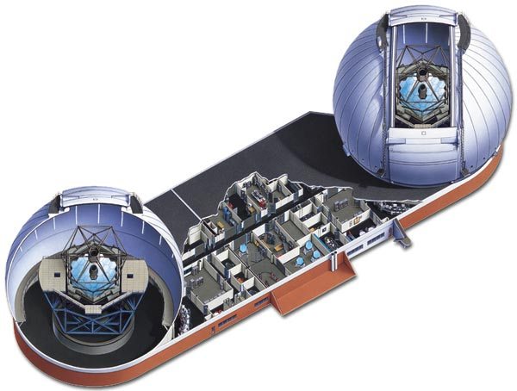
Keck telescopes, Mauna Kea, HI
36 segments
3" thick
Each segment weighs 400 kg (880 pounds)
  Total weight of mirror is 14,400 kg (< 15 tons)
Telescope weighs 270 tons
“Alt-azimuth” mount (left-right, up-down motion)
  follows sky with two motions + rotation

Slide 27
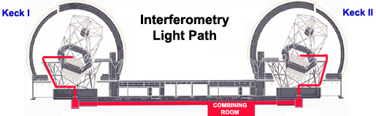
Keck Interferometry

Slide 28
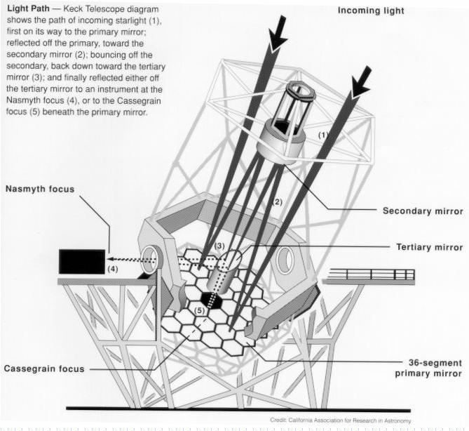
Segmented Mirrors: Keck
Schematic of 10-meter Keck telescope
The primary mirror is composed of small segments.
The mirrors collectively mimic the optical properties of a single primary mirror.
It would be difficult to make a single primary mirror of the same size.

Slide 29
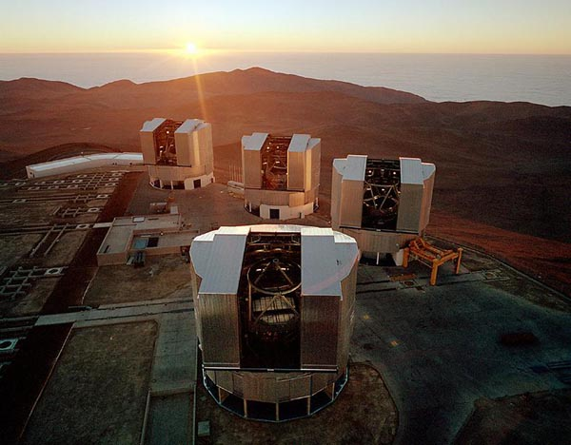
Monolithic Mirror: VLT
The Very Large Telescope (VLT) uses individual monolithic mirrors having 8 m diameter each.
The mirrors are made in Roger Angel’s lab in Arizona.
Similar mirrors are used in Gemini and Subaru.

Slide 30
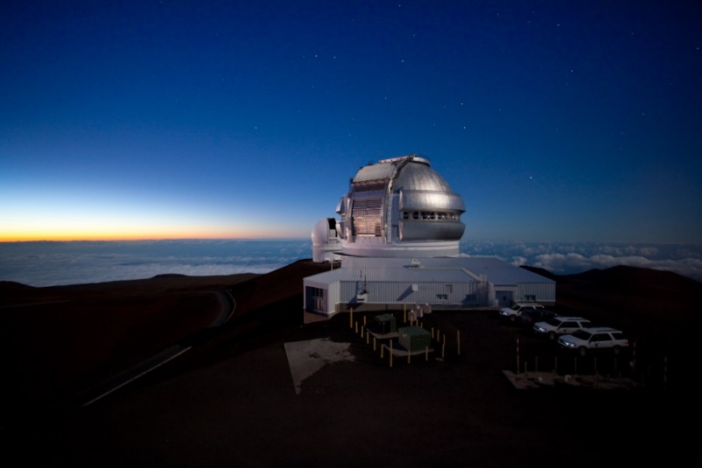
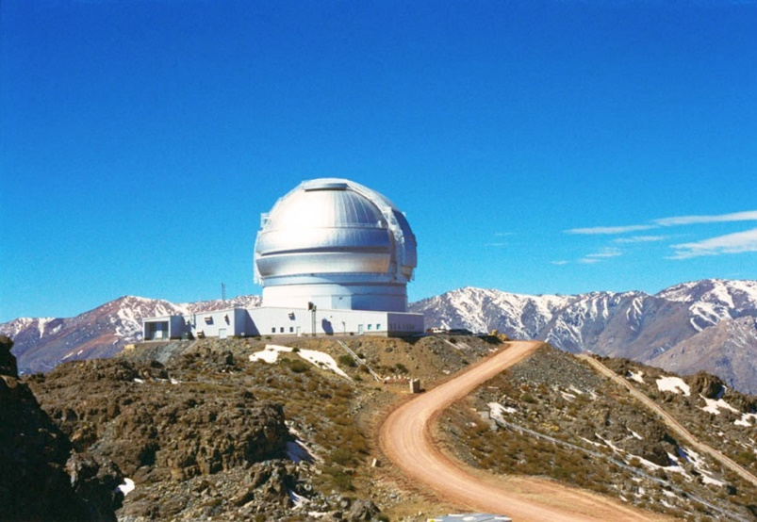
Gemini Telescopes

Slide 31
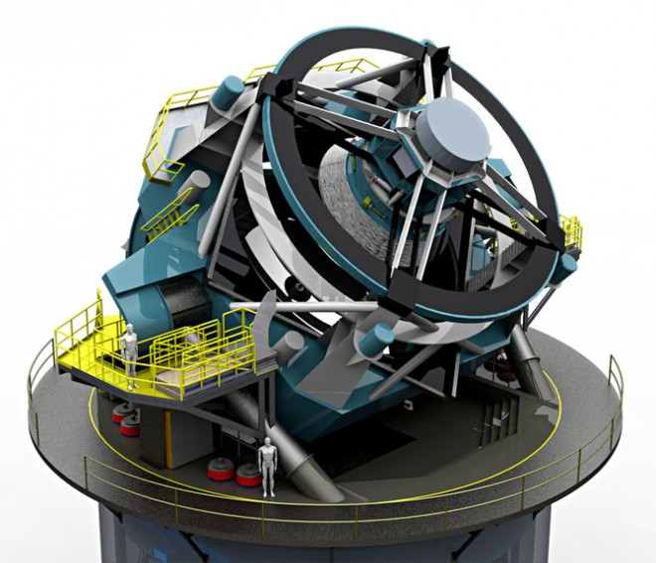
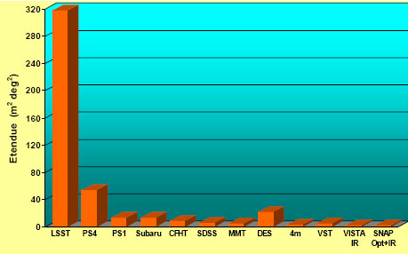
Optical Telescopes: LSST
person!

Slide 32
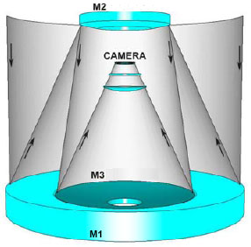
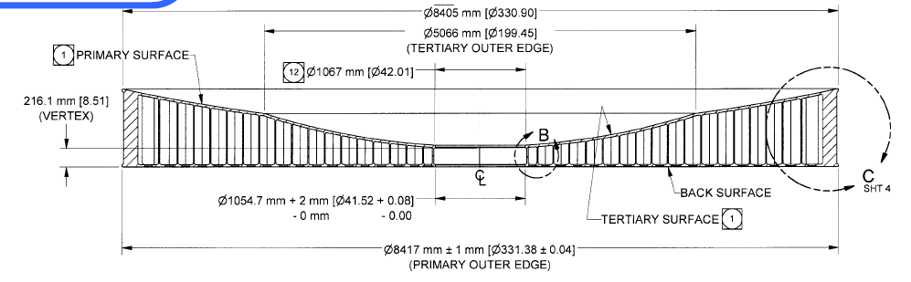
Optical Telescopes: LSST

Slide 33

Optical Telescopes: LSST Fly Through

Slide 34
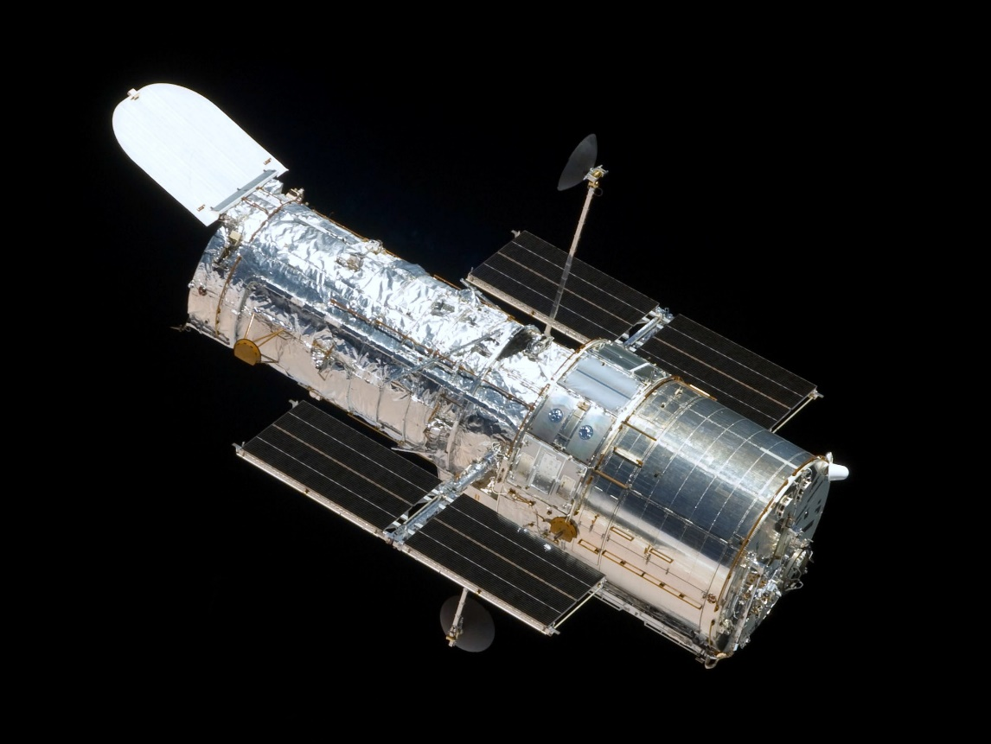
Hubble Space Telescope

Slide 35
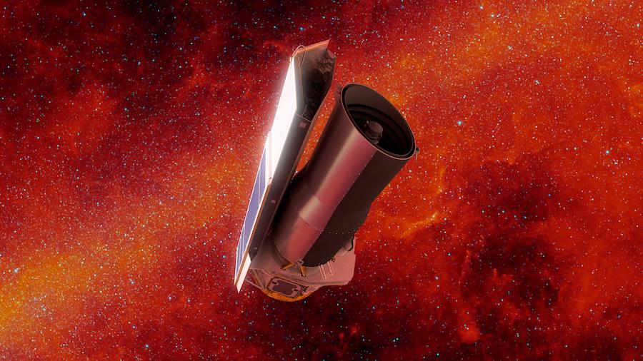
Spitzer (just died….)

Slide 36
next-generation telescopes

Slide 37
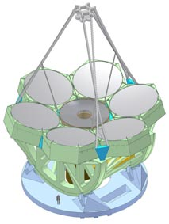
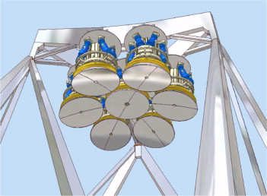
Optical Telescopes: Giant Magellan Telescope

Slide 38
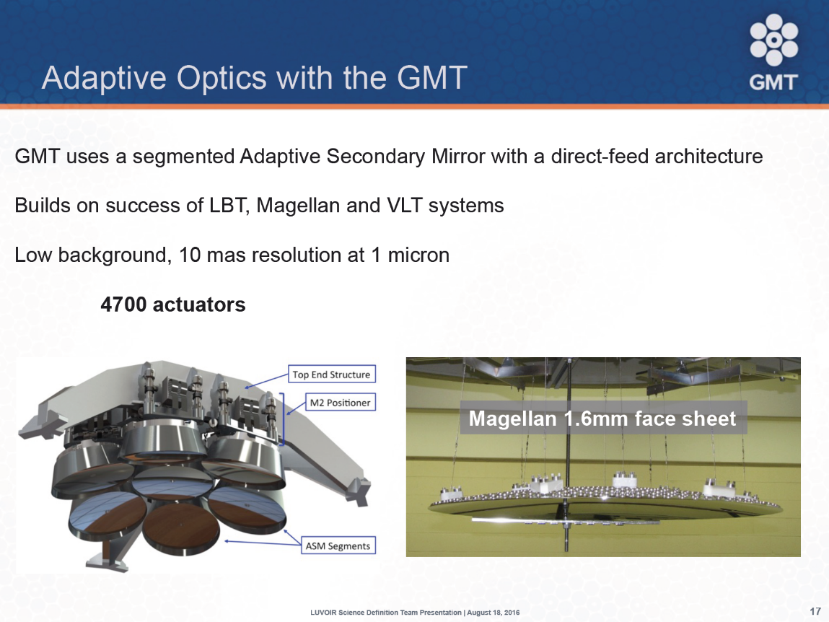
Optical Telescopes: GMT AO System

Slide 39
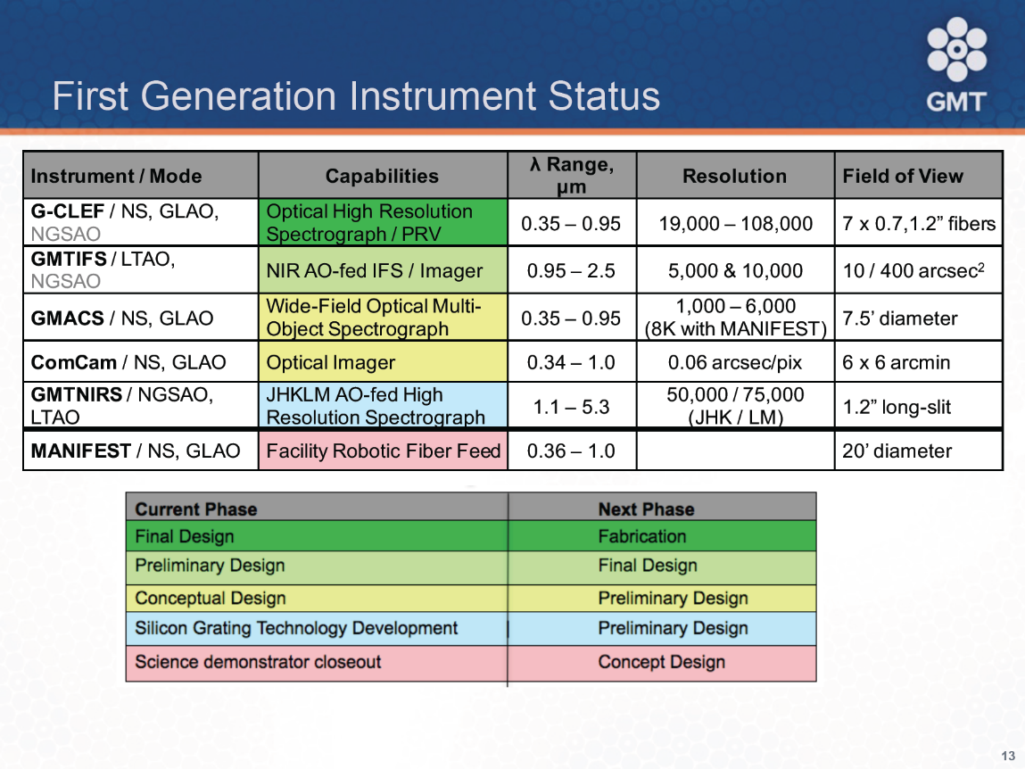
Optical Telescopes: GMT Instruments

Slide 40
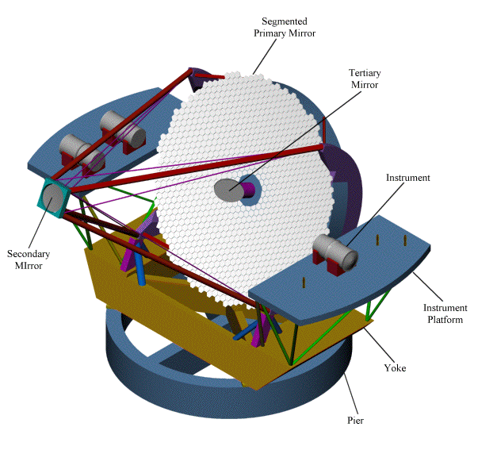
Optical Telescopes: Thirty Meter Telescope
person!

Slide 41

Optical Telescopes: TMT AO System

Slide 42

Optical Telescopes: TMT Instruments

Slide 43
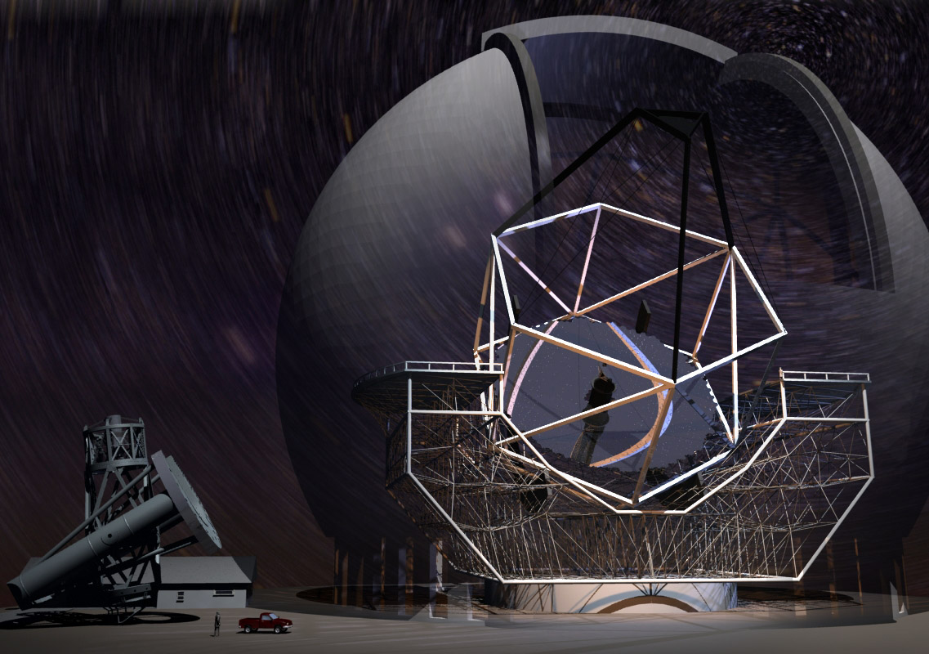
Thirty Meter Telescope vs. Palomar

Slide 44

Optical/IR Telescopes: TMT

Slide 45

Optical Telescopes: E-ELT

Slide 46
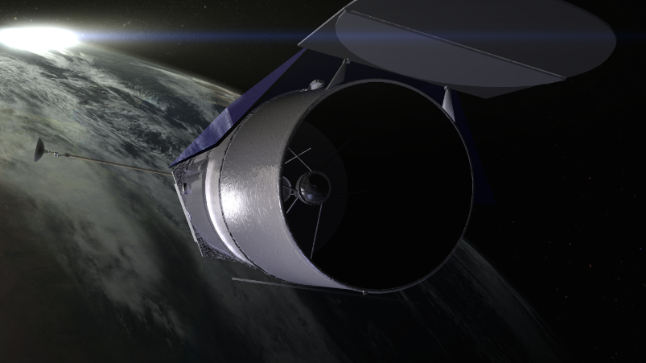
Optical/IR Telescopes: WFIRST
WFIRST is a NASA observatory designed to settle essential questions in the areas of dark energy, exoplanets, and infrared astrophysics.
The current design of the mission makes use of an existing 2.4m telescope, which is the same size as the Hubble Space Telescope. The Wide Field Instrument will provide a field of view of the sky that is 100 times larger than images provided by HST. The coronagraph will enable astronomers to detect and measure properties of planets in other solar systems.

Slide 47

Spy Telescope!

Slide 48
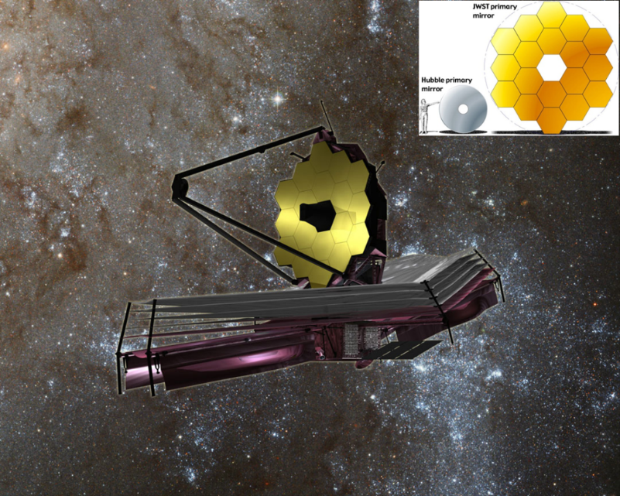
Optical/IR Telescopes: JWST
The James Webb Space Telescope will be a large infrared telescope with a 6.5-meter primary mirror. The telescope will be launched on an Ariane 5 rocket from French Guiana in God knows when.
JWST will be the premier observatory of the next decade, serving thousands of astronomers worldwide. It will study every phase in the history of our Universe, ranging from the first luminous glows after the Big Bang, to the formation of solar systems capable of supporting life on planets like Earth, to the evolution of our own Solar System.

Slide 49
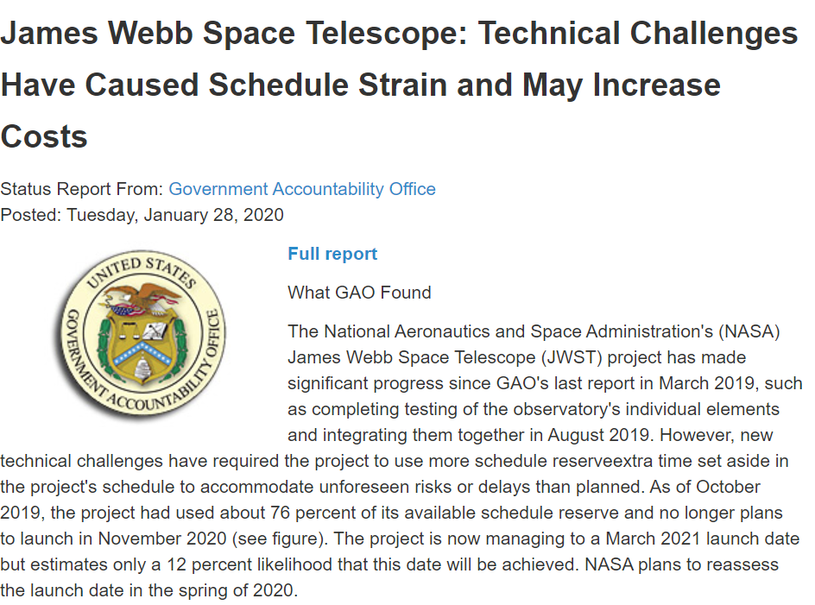
JWST Launch?
20070809101112131415161718192021?
12%!

Slide 50

JWST Launch? 2026?

Slide 51
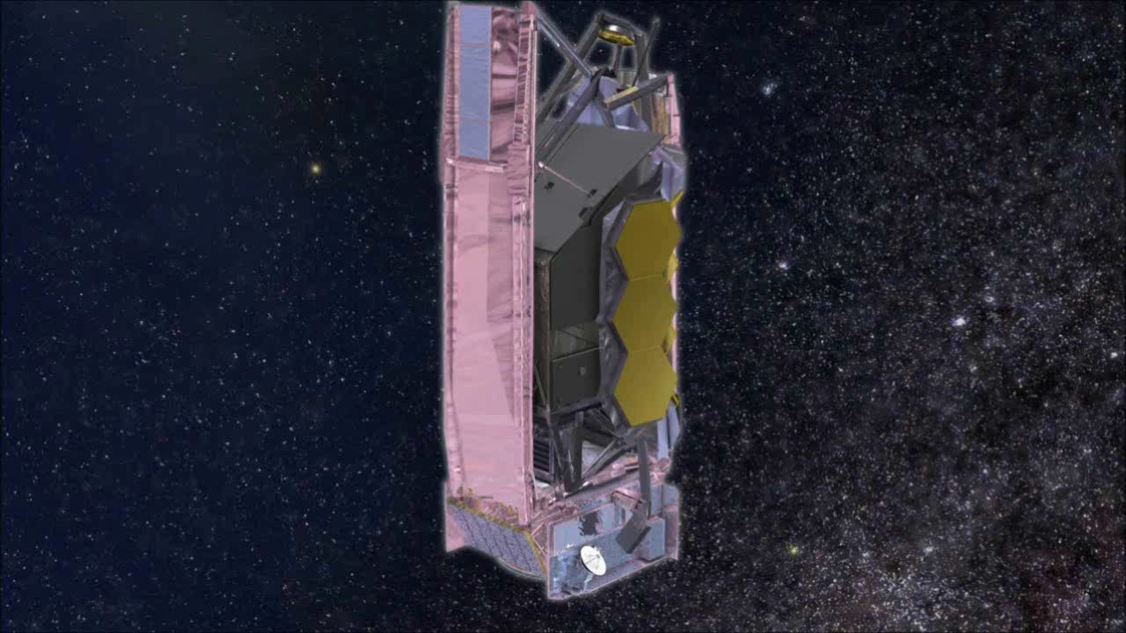
Optical/IR Telescopes: JWST Deployment

