Slide 1
University Astronomy
Professor Don Figer
Solar System Formation

Slide 2
Aims and outline for this lecture
discuss models that explain how Solar System was formed
review historical models
introduce the concept of the Solar Nebula
examine other planetary systems

Slide 3
formation models

Slide 4
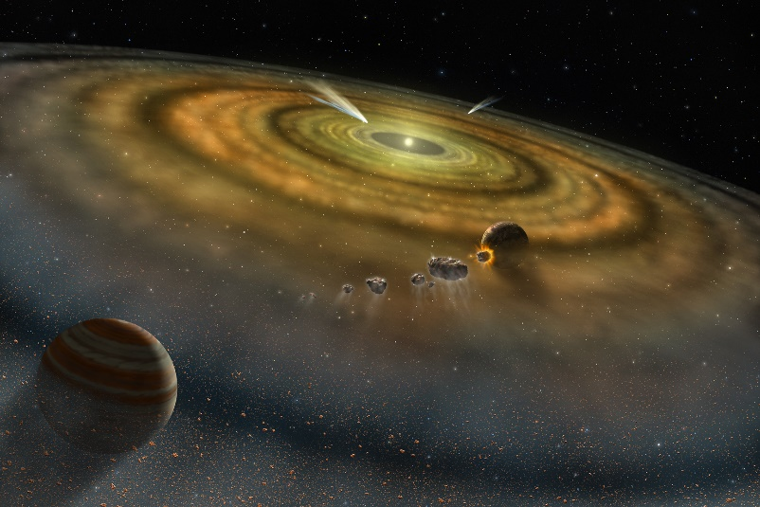
Solar System Formation Models
As with any good scientific model, a Solar System formation model must predict the observables.
  objects (Sun, planets, etc.)
  chemical compositions
  orbits (locations, inclinations, etc.)
  rotation (direction, tilt, etc.)
  ages
Perhaps it would fit other planetary systems?

Slide 5
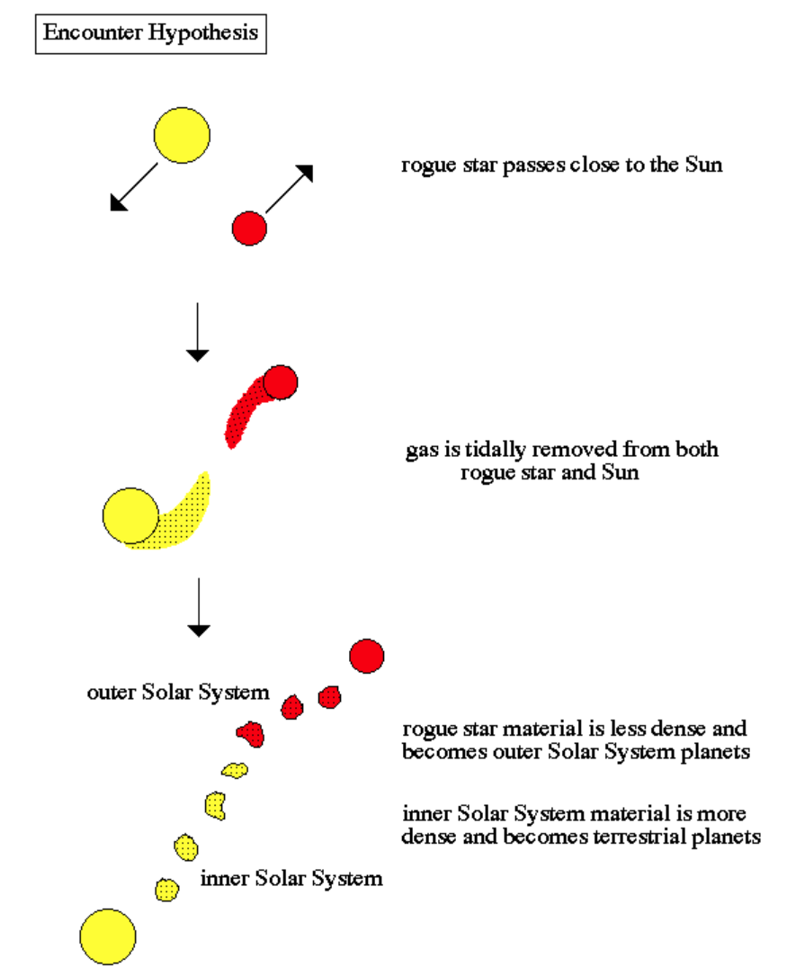
Close Encounter Hypothesis
In this hypothesis, a nearby star passes by the Sun and strips some material that condenses to form all the objects in the Solar System.
This does not make sense because the stripped gas will be hot (and will expand, not contract). Also, such an interaction is very rare.

Slide 6
Nebular Hypothesis
Immanuel Kant proposed (1755) that the Solar System formed when an interstellar gas cloud collapsed.
This “nebular hypothesis” forms the basis of modern day formation models.
A dense cloud collapses under its own self-gravity, forming clumps that eventually gain enough mass to form a star.
As the star grows in mass, the remaining matter flattens into a disk.
The angular momentum of the matter prevents it from being accreted on to the star.
The material in the disk begins to clump.
The clumps (“planetesimals”) collide to form planets.

Slide 7
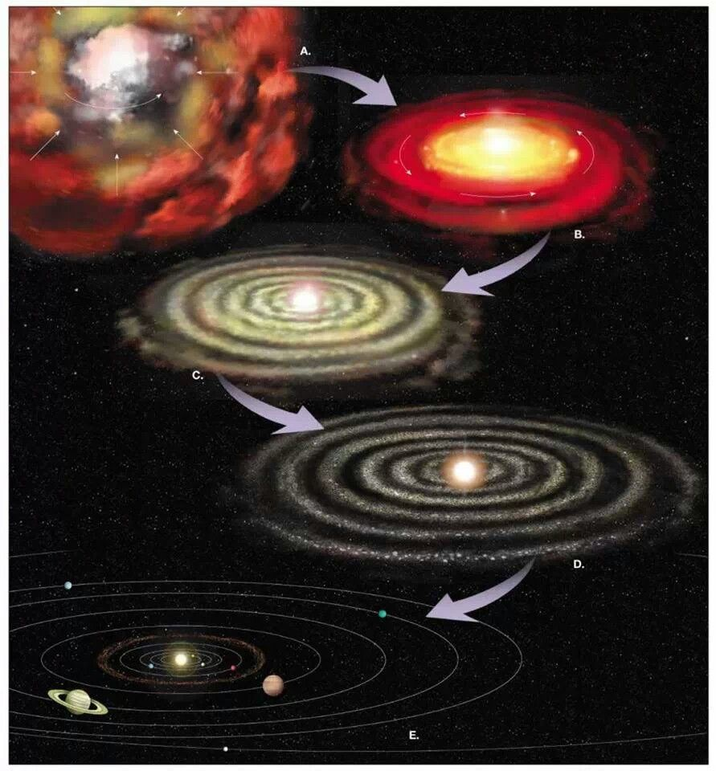
Nebular Hypothesis Picture

Slide 8
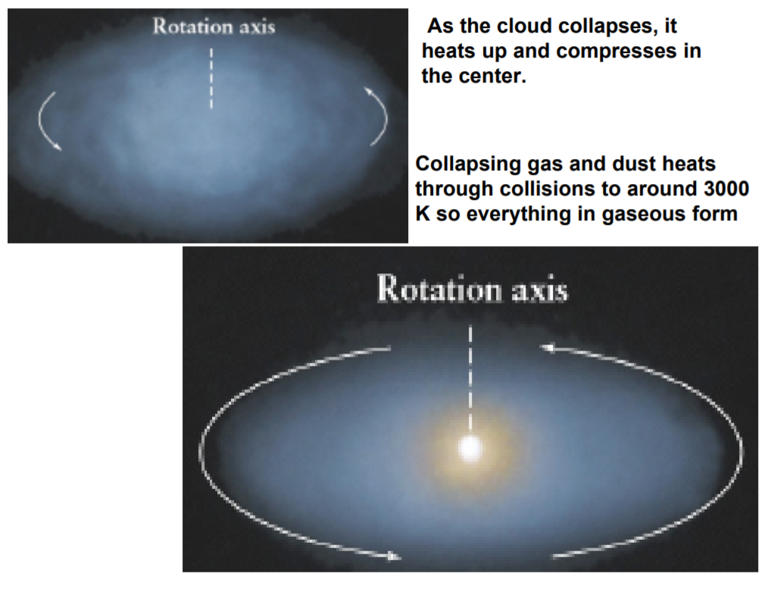
Collapse of the Solar Nebula
Once collapse started, it would continue under the influence of its own self-gravity.
The initial rotation would be very small but increase as angular momentum is conserved (like arms of an ice skater).
The cloud would become more dense, hotter, and spin faster.
It would collapse into a disk.

Slide 9
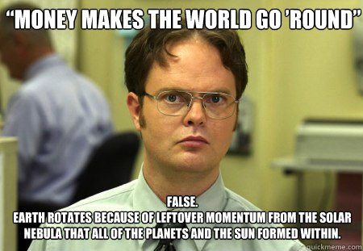
Why Do Planets Rotate?

Slide 10
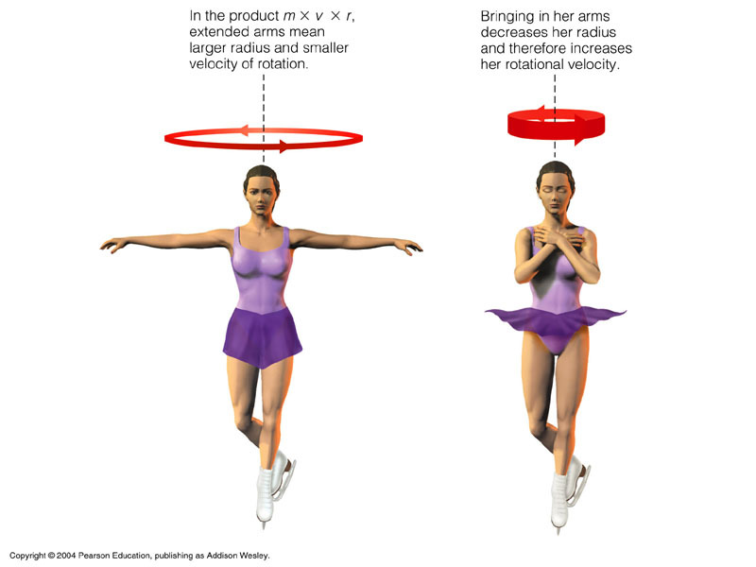
Conservation of Angular Momentum

Slide 11
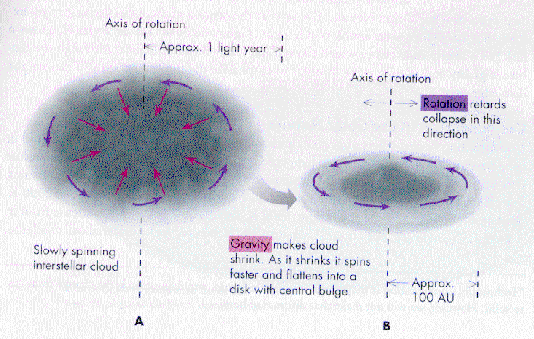
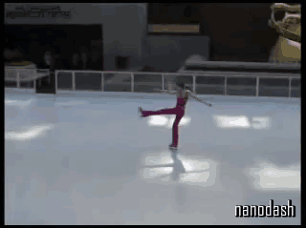
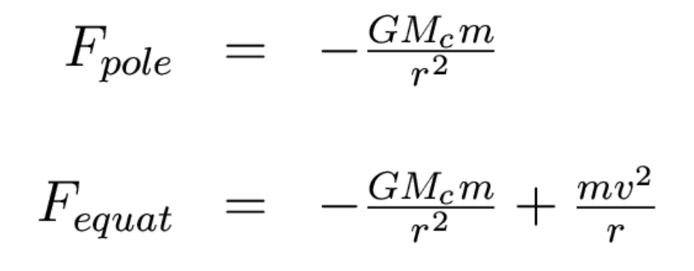
Disk Flattening

Slide 12
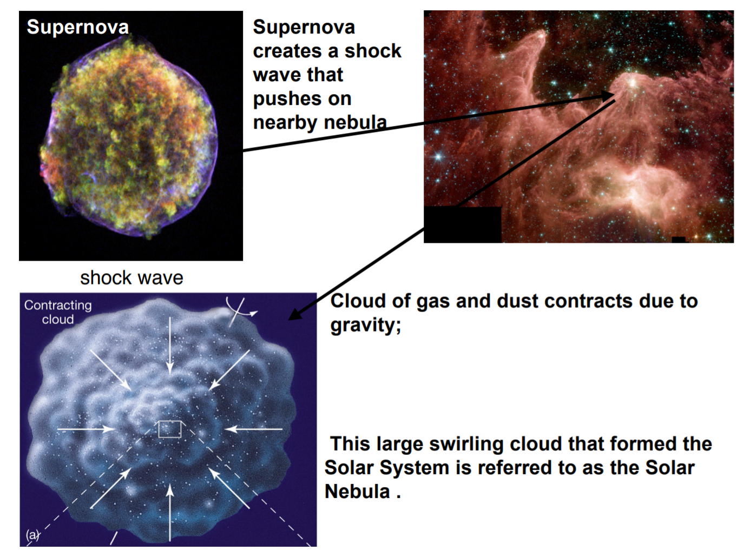
Is Collapse Triggered?

Slide 13
evidence

Slide 14
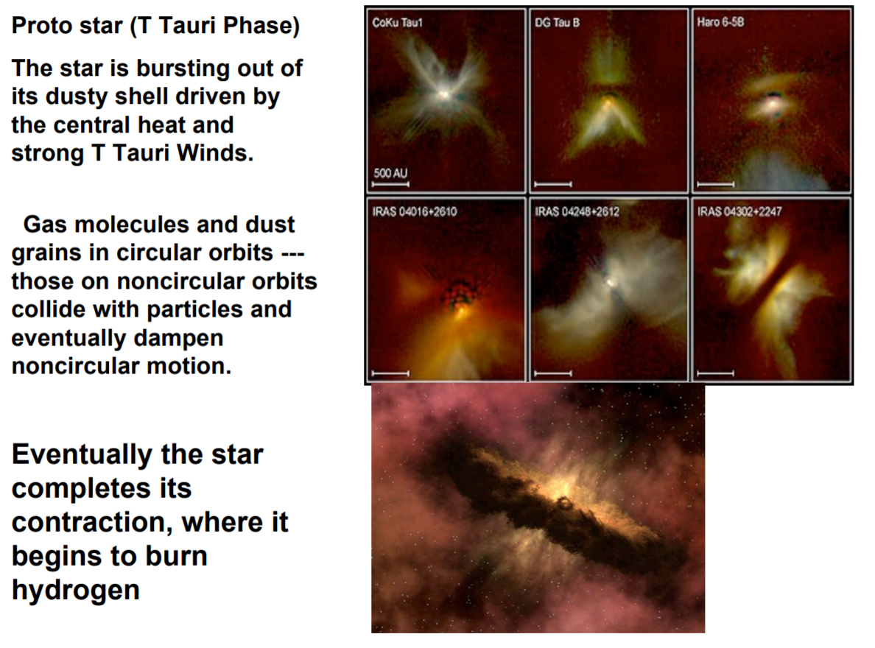
Evidence of Disk Formation

Slide 15
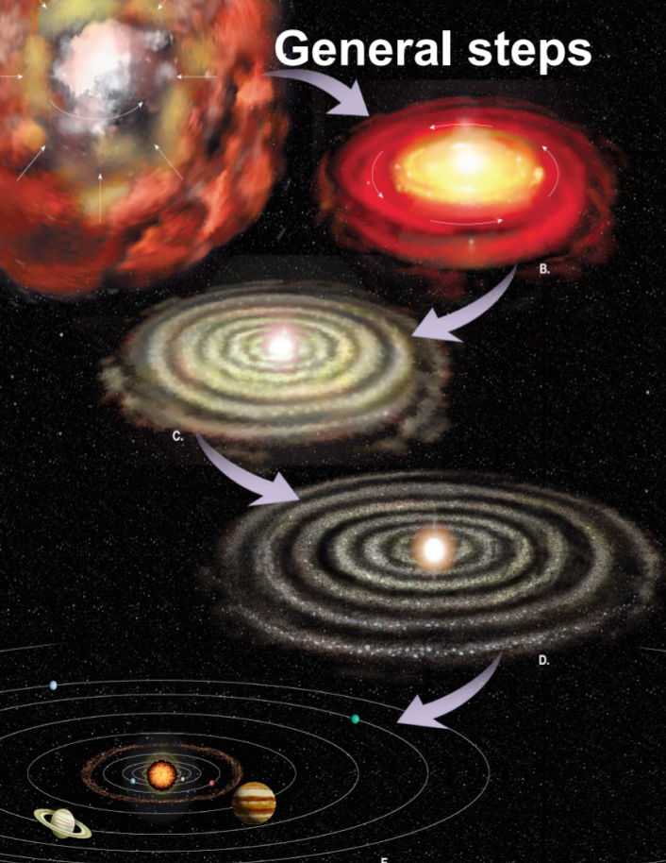
Formation of Planetesimals
Small particles collide and coalesce, forming larger particles.
These collisions continue until the particles are a few hundred km across, when they are called planetesimals.
These planetesimals begin to have enough gravity to pull particles from the vicinity of their orbits.
The orbits become cleared.

Slide 16
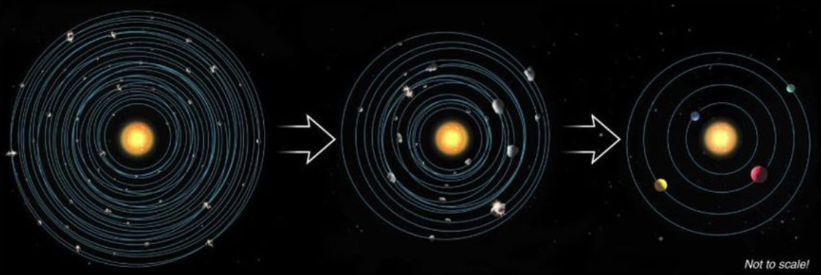
Planetesimals Orbit Clearing

Slide 17
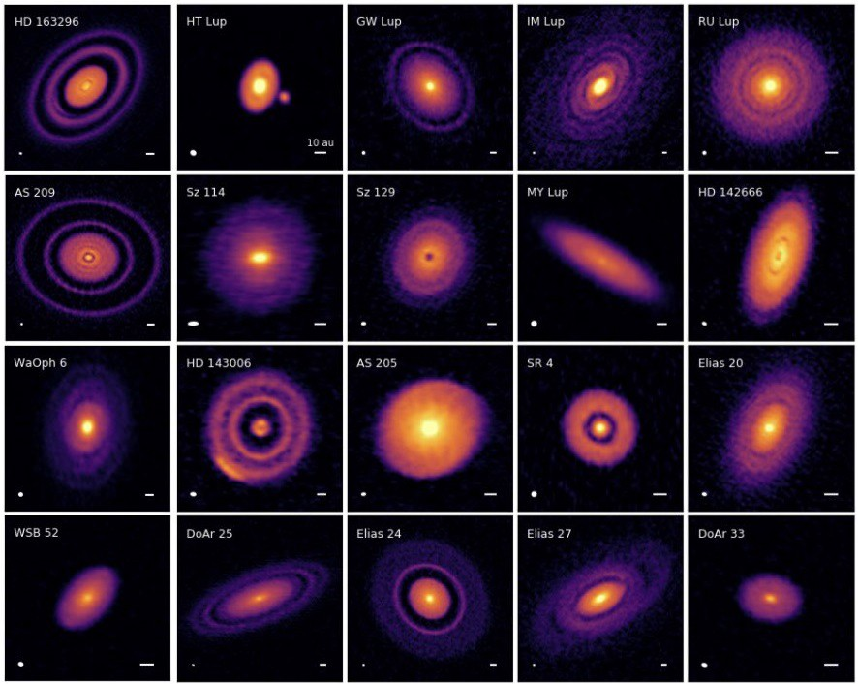
Evidence of Orbit Clearing
Notes:
These 20 protoplanetary disks, as they appear in the most recent ApJ letters paper (in press), showcase the diversity and intricate details found in both face-on and tilted protoplanetary disks imaged by the DSHARP team. (S. M. ANDREWS ET AL. AND THE DSHARP COLLABORATION, ARXIV:1812.04040)

Slide 18
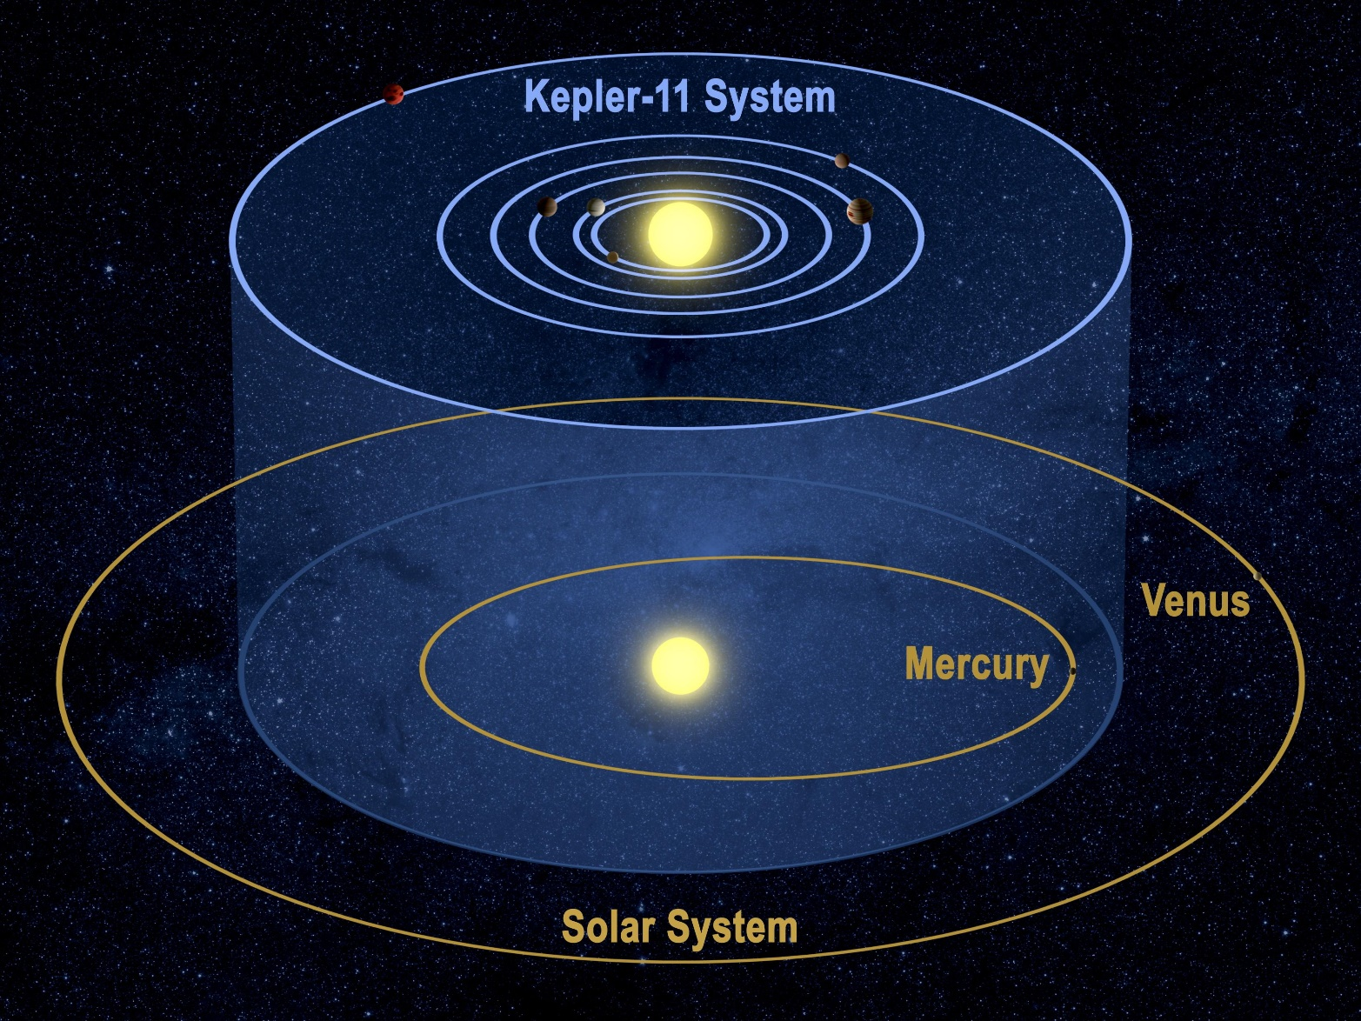
Evidence of Other Systems
Notes:
These 20 protoplanetary disks, as they appear in the most recent ApJ letters paper (in press), showcase the diversity and intricate details found in both face-on and tilted protoplanetary disks imaged by the DSHARP team. (S. M. ANDREWS ET AL. AND THE DSHARP COLLABORATION, ARXIV:1812.04040)

Slide 19
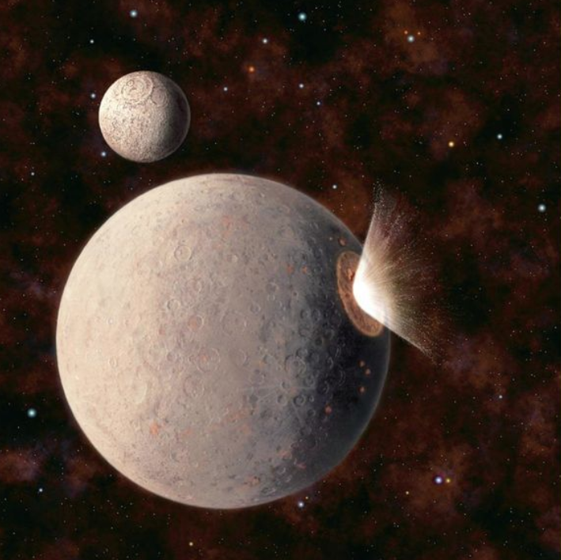
Evidence of Collisions
There are several pieces of evidence for planetesimal collisions.
  craters
  retrograde rotation of Venus
  tilt of Uranus
  Mercury lost most of its rocky mantle
  Moon made from collision

Slide 20
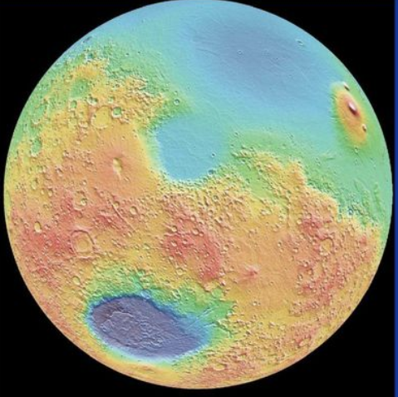
Giant Impact on Mars

Slide 21
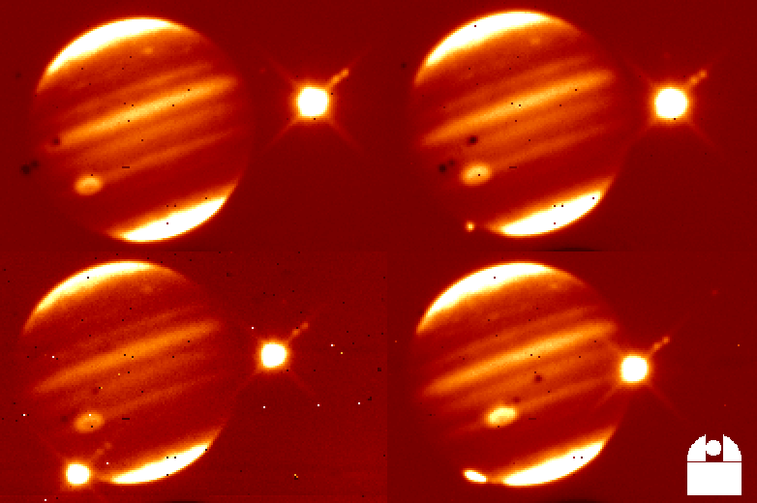
Collisions with Jupiter

Slide 22
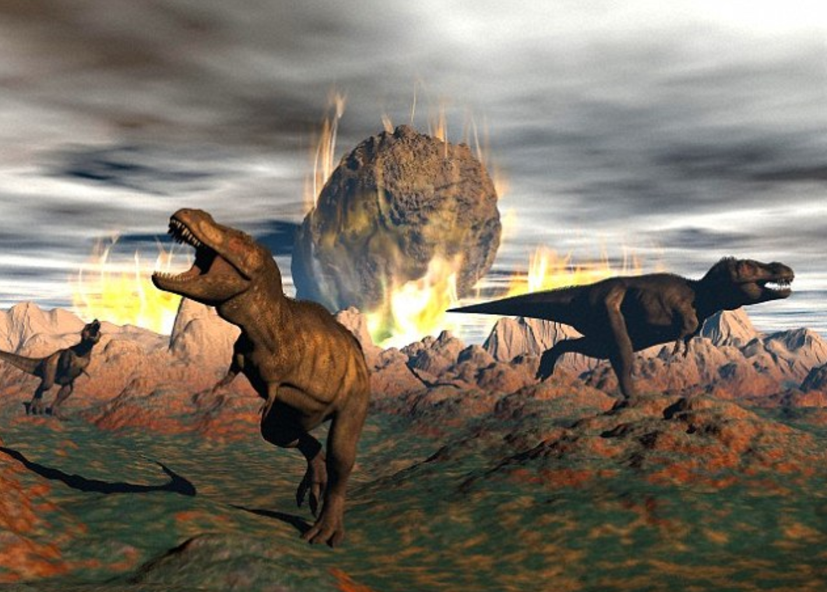
Death of Dinosaurs

Slide 23
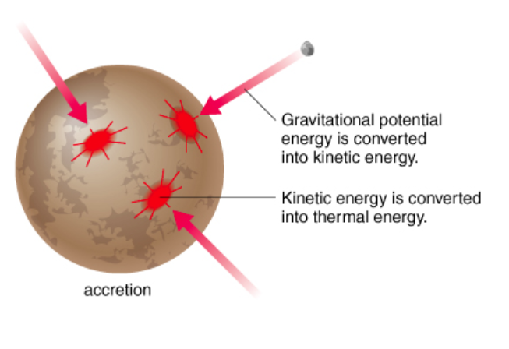
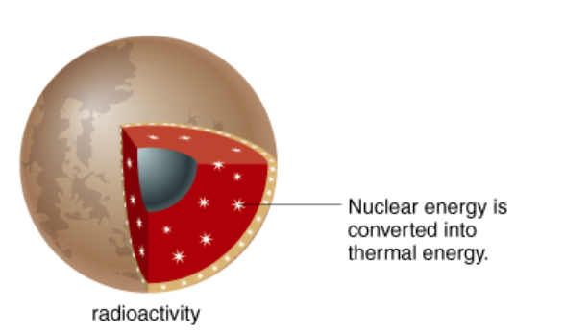
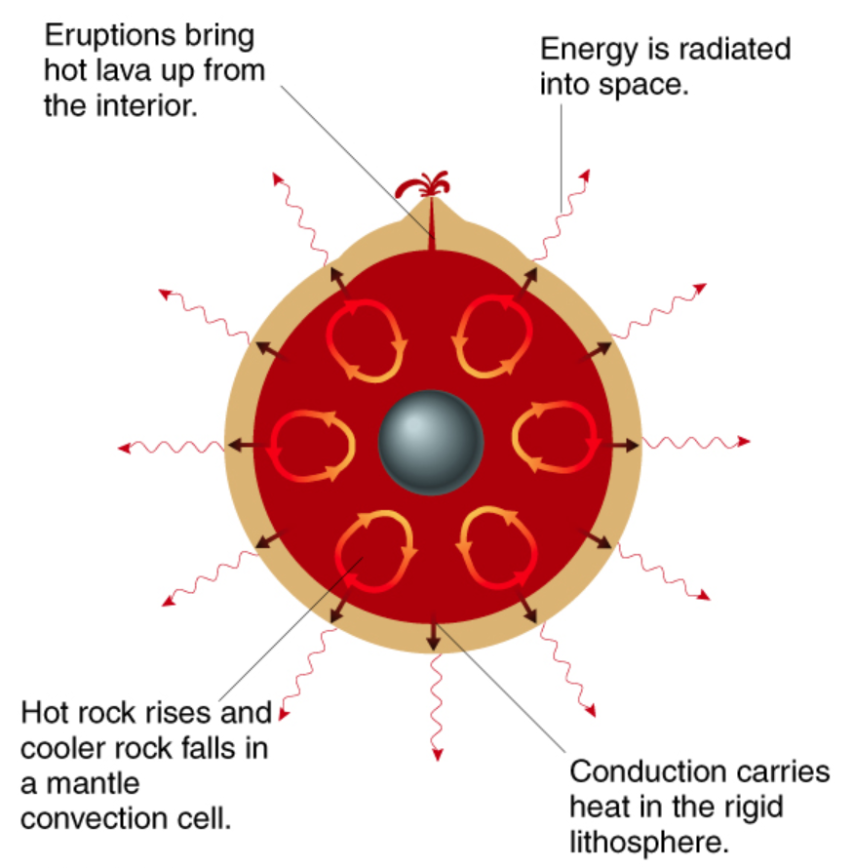
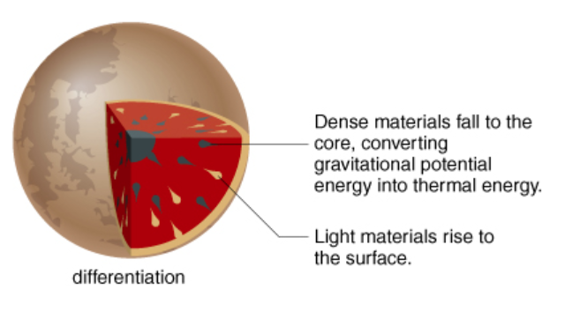
Planet Cooling

Slide 24
Sun Formation
A good Solar System formation model must explain the formation of the Sun.
One of the best ways to guess how the Sun was formed is to examine other stars like it being formed now.
Stars form in gas clouds. For a star like the Sun, it takes a few hundred thousand years to accrete enough material to begin burning hydrogen (a star is born!).
The composition of the Sun includes elements heavier than hydrogen and helium, sometimes called “metals.” This suggests that the material in the Solar Nebula must have been previously processed by an earlier generation of star(s).
Solar wind halted further accretion of material no to planetesimals.

Slide 25
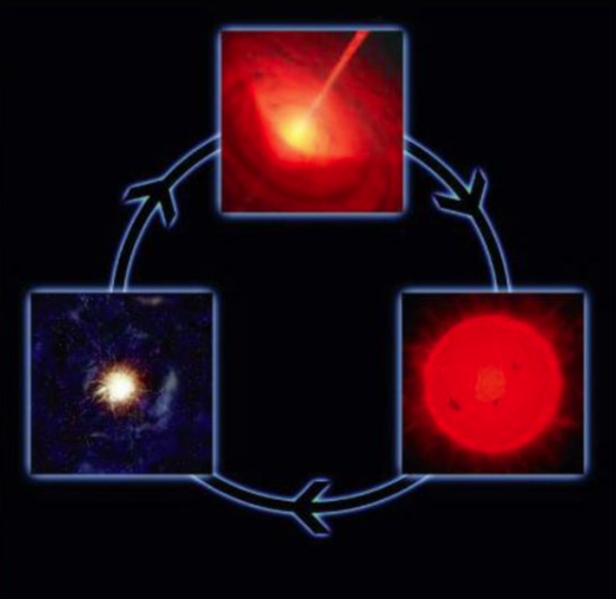
Galactic Recycling
Stars form out of a gas cloud.
The stars build heavy elements via nucleosynthesis.
When the stars have exhausted their fuel, they collapse/explode and push the enriched material into the interstellar medium.
The newly enriched material can now form more stars.

Slide 26
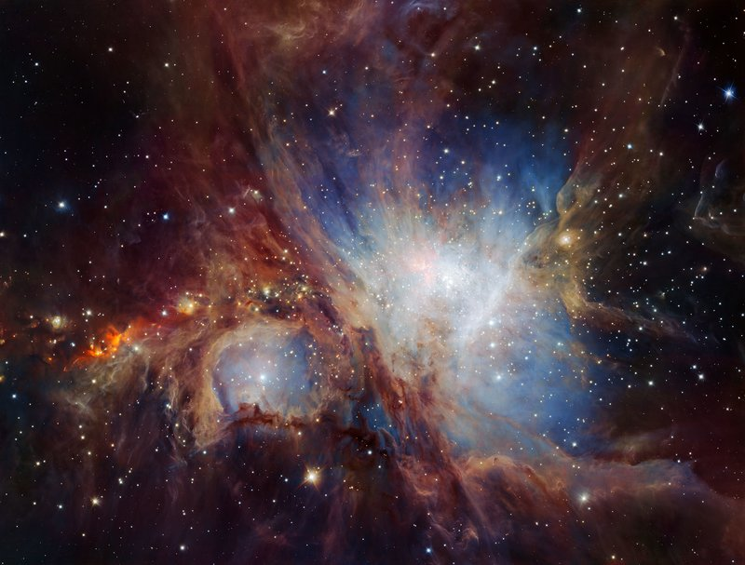
Star Formation Site - Orion

Slide 27
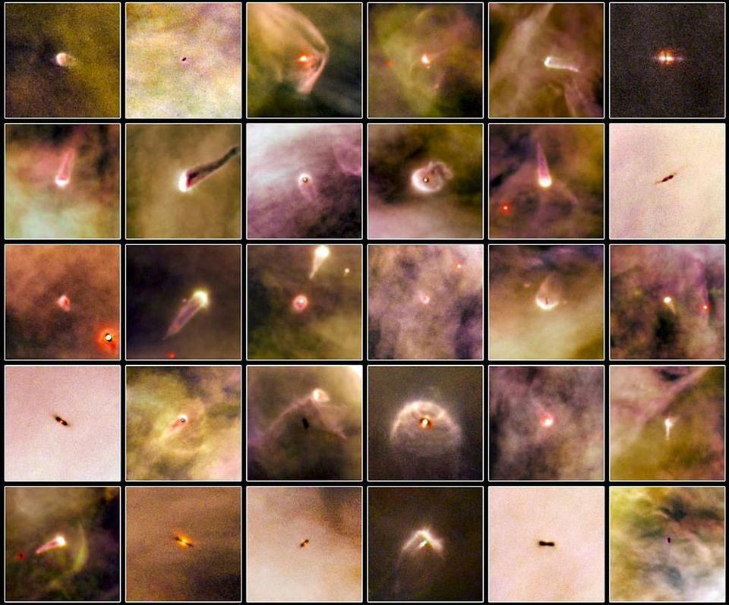
Proplyds in Orion
Notes:
30 protoplanetary disks, or proplyds, as imaged by Hubble in the Orion Nebula. Hubble is a brilliant resource for identifying these disk signatures in the optical, but has little power to probe the internal features of these disks, even from its location in space. (NASA/ESA AND L. RICCI (ESO))

Slide 28
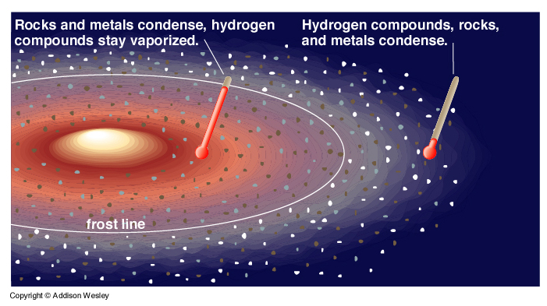
Differentiation and the Frost Line
The inner parts of the disk are nearer to the Sun and therefore are hotter than the outer parts of the disk.
Ice will tend to melt if the heat is sufficiently high (think about comets).
Taken together, this suggests that there would be more gas/ice in planets far from the Sun.
The “frost line” is the line that delineates where ice can form.

Slide 29
Distribution of Planets
Planets near the Sun have small orbits, and thus can only sweep up small amounts of material during accretion.
Planets that are far from the Sun can sweep up much more material, thus making them bigger.
The light gases are more abundant further from the Sun, so planets that are far from the Sun have more gas.
The small planets near the Sun don’t have as much gravity to hold on to what little gas they have.
All of these processes explain the two types of major planets, their size differences, locations, and composition.

Slide 30
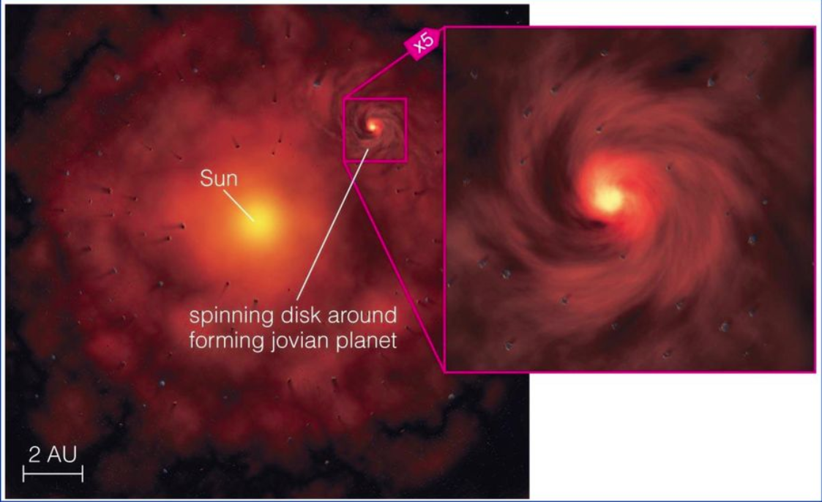
Moons
Moons were generally formed in similar processes.
That is, material around a forming planet accreted material into mini disks.
Some moons were also gravitationally captured from objects on inclined orbits.

Slide 31
Water on Earth
Water could have come from collisions with icy planetesimals.
Comets also have water. Perhaps the comet impact rate was higher in the early Solar System.
Another suggest is that water trapped in the Earth escaped through volcanism and rained down on the surface.
Note that the D/H ratio for some comets is different than that of Earth, so most water did not come from comets.
The D/H ratio is similar for Earth and Moon, suggesting a common origin.

Slide 32
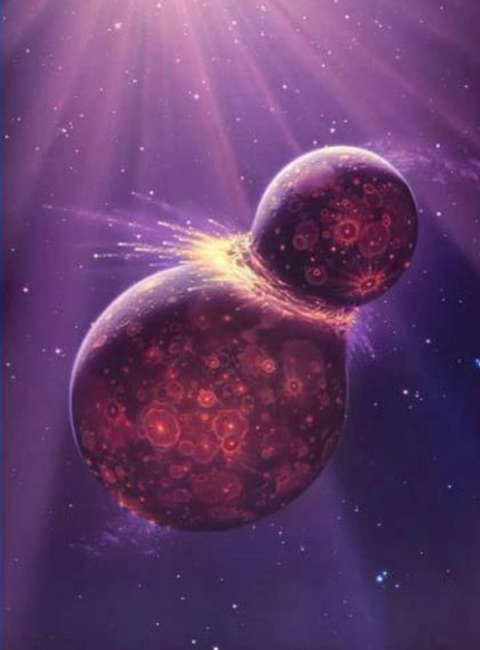
The Origin of the Moon
Some hypotheses for the formation of the Moon include:
  the Earth and Moon formed simultaneously
  the Earth captured the Moon
  the Moon broke off the Earth
  the Moon was formed in an impact between the Earth and another body

Slide 33
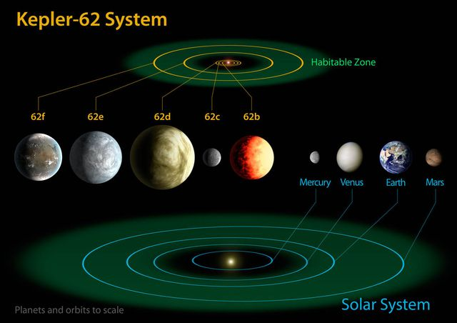
Water in Other Systems

Slide 34
Comets and Asteroids
Asteroids
  rocky leftover planetesimals of the inner solar system
  most in asteroid belt between the orbit of Mars and Jupiter
  perhaps represent destroyed planet
  “shepherded” by Jupiter’s strong gravity
Comets
  leftover planetesimals of the outer solar system
  cleared out by Jupiter and Neptune and sent to the Kuiper belt or the Oort cloud
  beyond orbit of Neptune have time to grow larger, and stay in stable orbit -> Pluto?

Slide 35
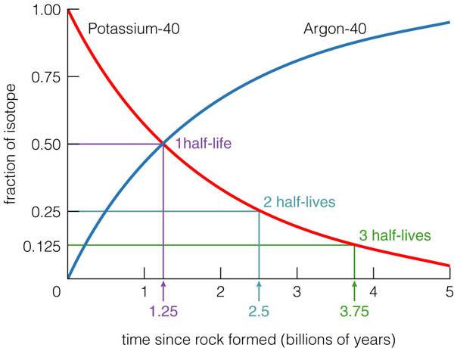
Solar System Age
Through radioactive dating, we have determined that the age of the solar system is about 4.6 billion years.
Potassium-40 decays to Argon-40.
Potassium-40 exists naturally, but Argon is an inert gas that never combines with anything, and did not condense in the solar nebula.
By determining the relative amount of Potassium-40 to Argon-40 trapped in rock, we can determine the age of rock, assuming that there was no Argon-40 initially.
For every 1.25 billion years, half of the Potassium-40 decays and turns into Argon-40
1.25 billion years is called the half-life of Potassium-40.

Slide 36
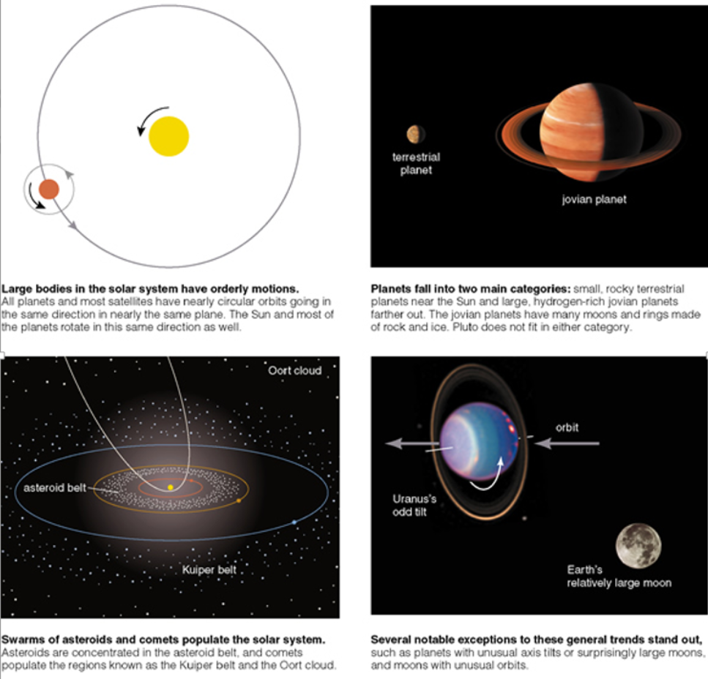
Do We Have a Good Model?

Slide 37

RIT Center for Detectors

Slide 38
homework

Slide 39
Homework
Approximately what fraction of the total mass in the Solar System is in the Sun?
How old are comets compared to the age of the Solar System?
What is the source of elements heavier than helium in the Sun?
Calculate the approximate maximum distance from the Sun for a rapidly rotating planet to have liquid water, assuming the planet is a blackbody.

