Slide 1
Performance of Science Grade HgCdTe H4RG-15 Image Sensors
Majid Zandian¹, Mark Farris¹, William McLevige¹, Dennis Edwall¹, Erdem Arkun¹, Eric Holland¹, James E Gunn², Stephen Smee⁴, Donald N. B. Hall³, Klaus W. Hodapp³, Atsushi Shimon⁵, Naoyuki Tamura⁵, René Doyon⁶, Derrick Salmon⁷, Doug Simons⁷, Derek Ives⁸, Michael Carmody¹, John Auyeung¹, and James W. Beletic¹
¹Teledyne Imaging Sensors, 5212 Verdugo Way, Camarillo, CA 93012, USA
²Princeton University, 23 Payton Hall, Princeton, NJ 08544, USA
³University of Hawaii, Institute for Astronomy, 640 North A’ohoku Place, Hilo, HI 96720, USA
⁴John Hopkins University, 3400 N. Charles Street, Baltimore, MD 21218, USA
⁵Kavli Institute for the Physics and Mathematics of the Universe, 5-1-5 Kashiwanoha, Kashiwa, 277-8583, Japan
⁶University of Montreal, 2900 Edouard Montpetit Blvd, Montreal, QC H3T 1J4, Canada
⁷The Canada–France–Hawaii Telescope, 65-1238 Mamalahoa Hwy, Waimea, HI 96743, USA
⁸European Southern Observatory, Karl-Schwarzschild-Strasse 2, D-85748 Garching bei Munchen, Germany
2017 Scientific Detector Workshop
Space Telescope Science Institute, Baltimore, USA
25 - 29 September 2017
Supported by National Science Foundation Grant No. AST-0804651 through the University of Hawaii to Teledyne Imaging Sensors as well as contracts from University of Tokyo, Princeton University, University of Montreal, CFHT, and European Southern Observatory

Slide 2
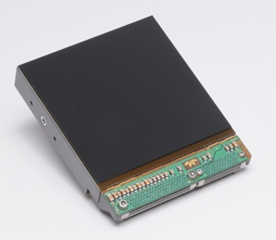
Outline
MBE HgCdTe Material for Large Format Arrays
H4RG-15 ROIC
H4RG-15 NIR and SWIR SCA Results
  Dark Current
  Quantum Efficiency
  Spectral Response
  CDS Noise
  Well Capacity
  Cross Talk
  SCA Flatness
Summary
4Kx4K H4RG-15

Slide 3
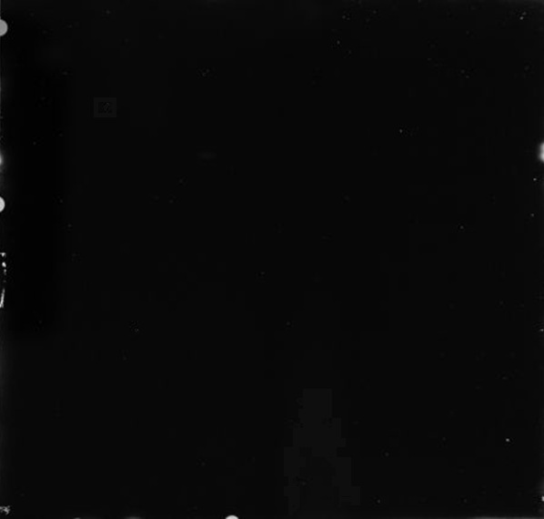
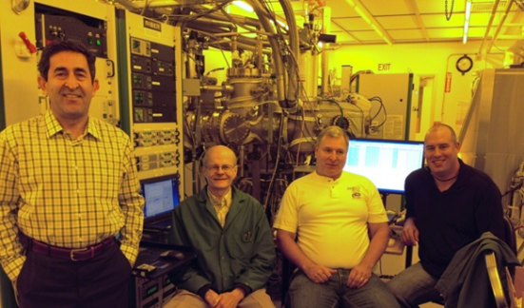
MBE produces the highest performance HgCdTe
Molecular Beam Epitaxy (MBE)
  Enables very accurate deposition ⇒ “bandgap engineering”
  Teledyne has 4 MBE machines for detector growth
Key Growth Parameters | Unit
Etch Pit Density | cm⁻² | < 1E5
Carrier Concentration | cm⁻³ | 1.E+15
Micro Defect Density | cm⁻² | < 1E4
Image of 7×7.5 cm HgCdTe layer grown in MBE-5
The black featureless surface is an excellent sign of HgCdTe quality.
More than 10,000 HgCdTe wafers grown to date
RIBER 5-inch MBE System
3

Slide 4
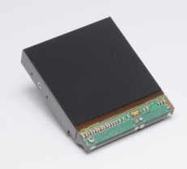
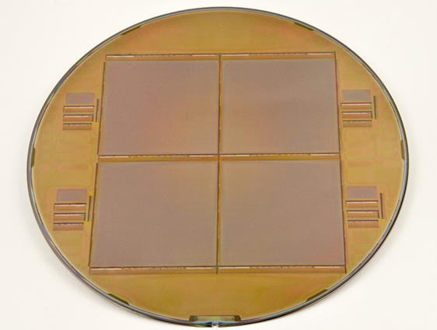
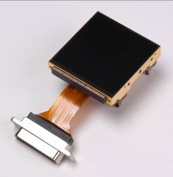
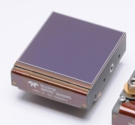
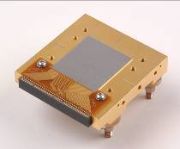
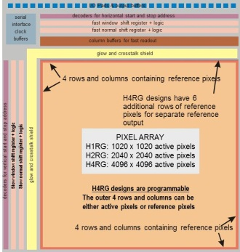
H4RG-15 ROIC Features
H4RG-15
H4RG-10
H1RG
H2RG
Preserved established features and performance of the H1RG and the H2RG
Add functionality and improved performance
All pads located on one side (top)
146 doubled I/O pads (probing and bonding)
Three-side close buttable
15 µm pixels
4k x 4k array.
Total dimensions:
63.36 x 66.17 mm²

Slide 5
Outline
MBE HgCdTe Material for Large Format Arrays
H4RG-15 ROIC
H4RG-15 NIR and SWIR SCA Results
  Dark Current
  Quantum Efficiency
  Spectral Response
  CDS Noise
  Well Capacity
  Cross Talk
  SCA Flatness
Summary
4Kx4K H4RG-15

Slide 6

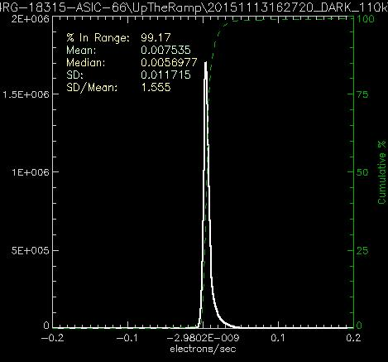
Dark Current for NIR λ_{c} = 1.79 μm at 110K
I _{dark} Map
I _{dark} Histogram
T=110K SCA S/N 18315
Median I_{dark} = 0.005 e⁻/sec/pixel
I_{dark} Operability > 99 %

Slide 7

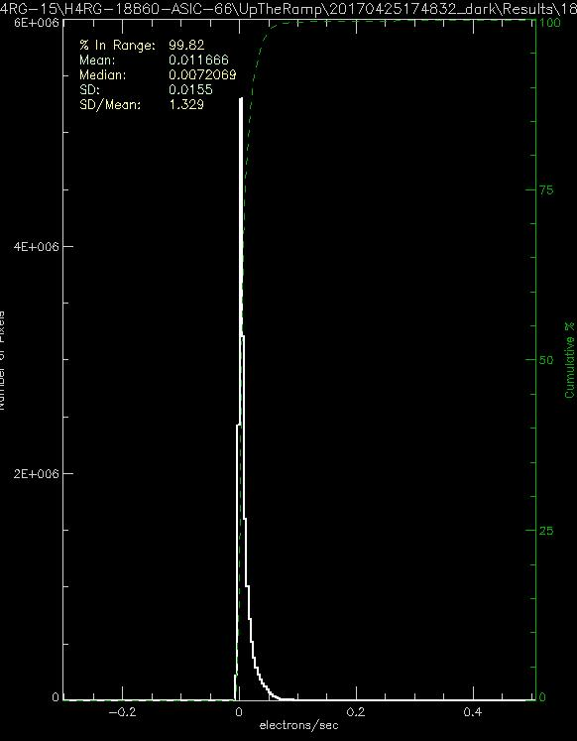
Dark Current for SWIR λ_{c} = 2.45 μm at 80K
I _{dark} Map
I _{dark} Histogram
T=80K SCA S/N 18860
Median I_{dark} = 0.007 e⁻/sec/pixel
I_{dark} Operability > 99.8 %

Slide 8
Dark Current vs Temperature
NIR 1.7 μm
SWIR 2.5 μm

Slide 9

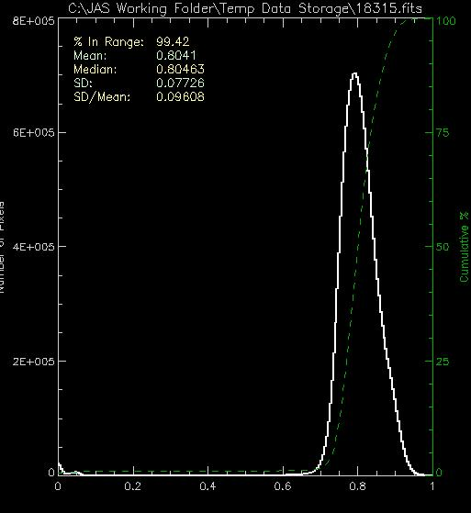
QE at 1230 nm for NIR λ_{c} = 1.79 μm at 120K
QE Map
QE Histogram
T=120K at 1230 nm SCA S/N 18315
Median QE > 80%
QE Operability > 99.4 %

Slide 10
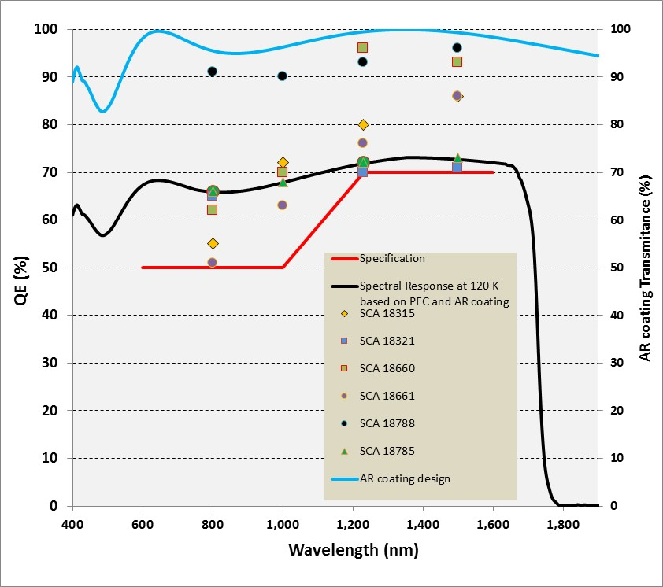
Spectral Response for NIR λ_{c} = 1.7 μm at 120K

Slide 11

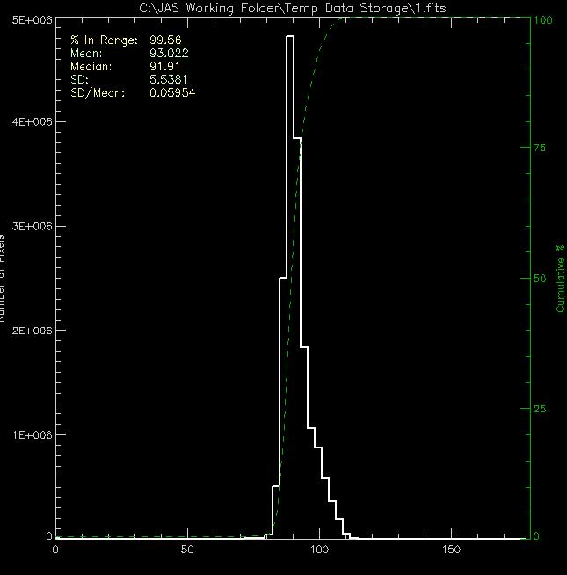
QE at 1230 nm for SWIR λ_{c} = 2.45 μm at 80K
QE Map
QE Histogram
T=80K at 1230 nm SCA S/N 18859
Median QE > 92%
QE Operability > 99.5 %

Slide 12
Spectral Response for SWIR λ_{c} = 2.50 μm at 80K

Slide 13

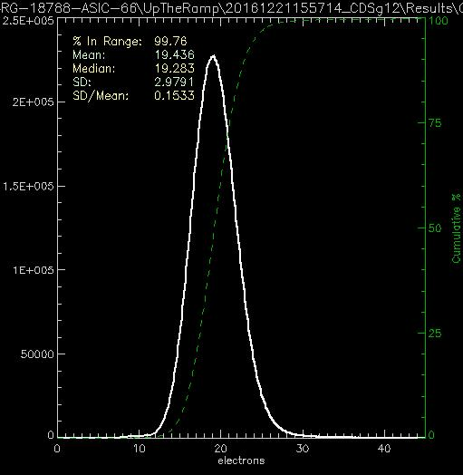
CDS Noise for NIR λ_{c} = 1.72 μm at 120K
CDS Noise Map
CDS Noise Histogram
T=120K SCA S/N 18788
Median CDS Noise = 19.4 e⁻
CDS Noise Operability > 99.7 %

Slide 14

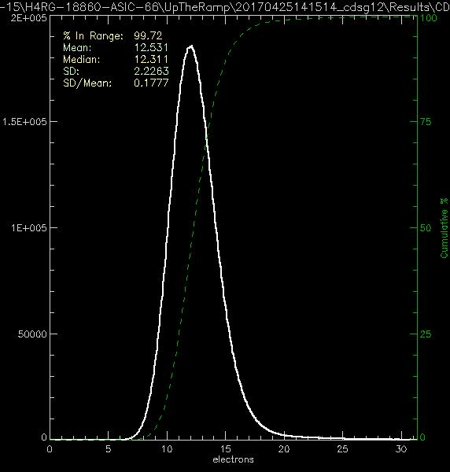
CDS Noise for SWIR λ_{c} = 2.45 μm at 80K
CDS Noise Map
CDS Noise Histogram
T=80K SCA S/N 18860
Median CDS Noise = 12 e⁻
CDS Noise Operability > 99.7 %

Slide 15
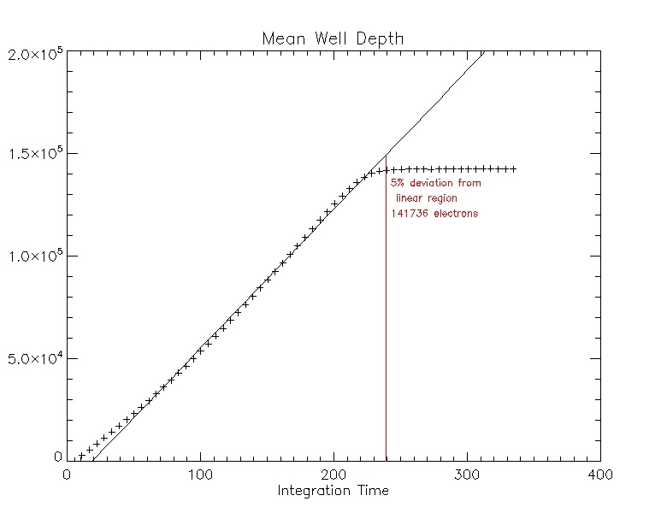
Well Capacity for NIR and SWIR
T=120K SCA S/N 18315
Full Well >79 Ke @ -350 mV
NIR λ_{c} = 1.79 μm at 120K
T=80K SCA S/N 18575
Full Well >140 Ke @-250 mV
SWIR λ_{c} = 2.45 μm at 80K

Slide 16
Total Cross Talk for NIR and SWIR
0.00%
0.9%
0.00%
1.30%
100%
1.30%
0.00%
1.00%
0.00%
T=120K SCA S/N 18315
Total Cross Talk < 1.1%
Results consistent with detector model calculations
Total crosstalk results shows no dependence on temperature
189 events with charge in the 4,000 – 12,000 e- range.
We find a nearest neighbor total cross talk below about 1.1% and indistinguishable from the noise in the corner neighbors confirming the theoretically expected cross talk.

Slide 17
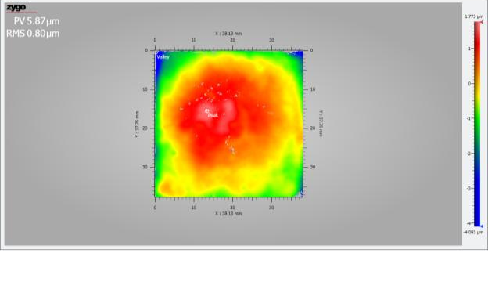
Flatness of H4RG-15 SCAs as Low or better than H2RG
Peak to Valley =5.9 μm
RMS =0.8 μm
Maximum variation (peak-to-valley) to best fit plane was measured
Note: The flatness of SCA was measured using white light interferometry and entire SCA surface was imaged and analyzed.

Slide 18
Performance Summary of Science Grade H4RG-15 SCAs

Slide 19
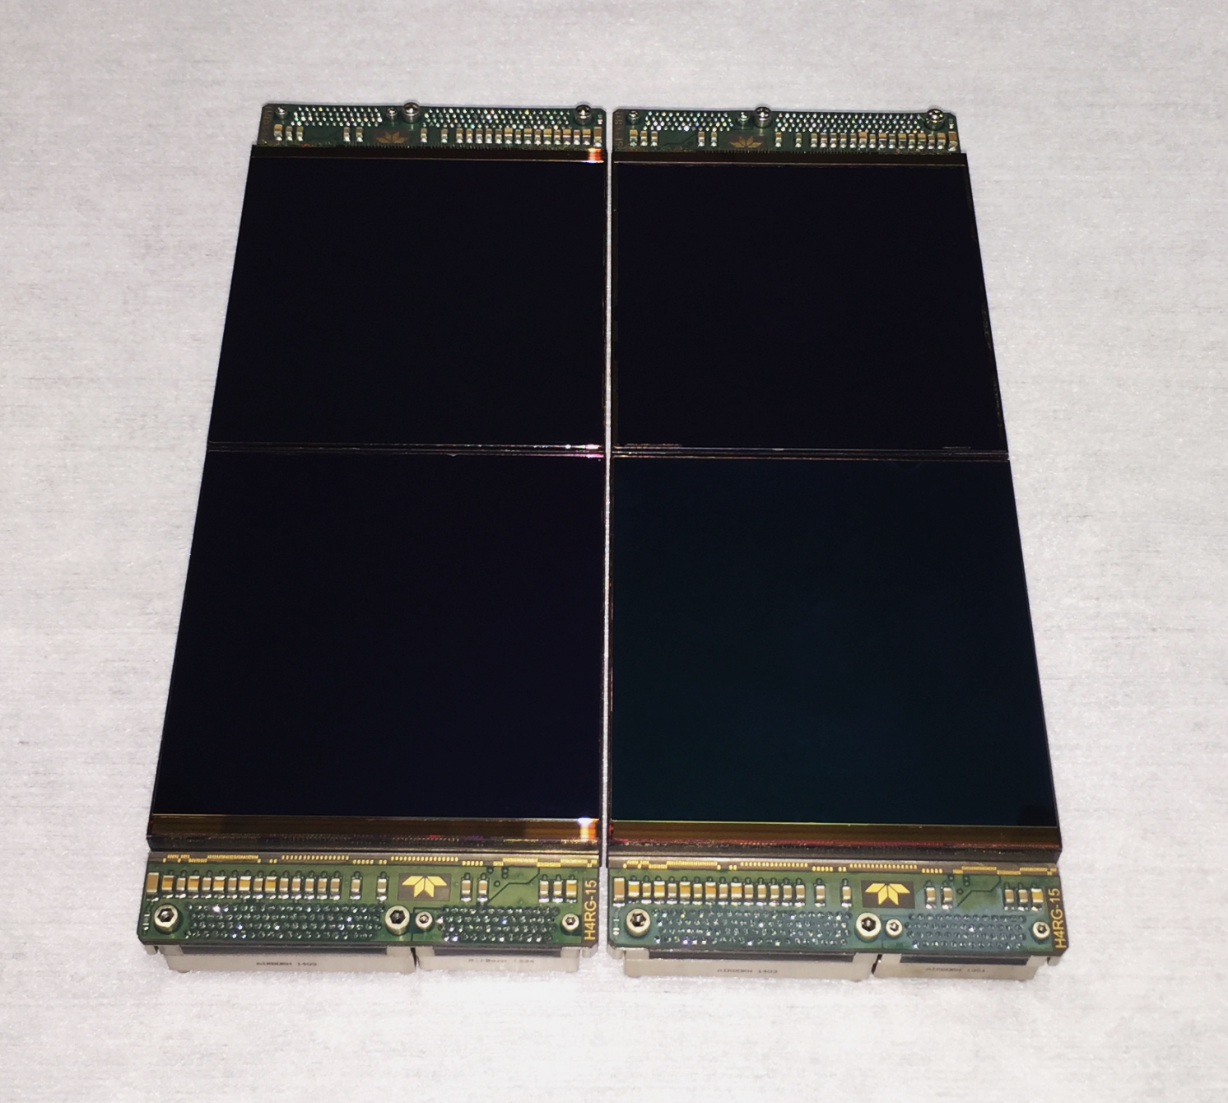
Four SWIR H4RG-15 SCAs (64 Mega Pixel FPA)

Slide 20
Summary
  Fabricating and Testing Science Grade H4RG-15 NIR and SWIR SCAs
    Dark Current < 0.01 e⁻/s/p
    Quantum Efficiency > 70 %
    CDS Noise < 20 e⁻
    Well Capacity > 70 Ke⁻
    Cross Talk < 1 %
    Operability > 95 %
    SCA Flatness < 20 μm
  Growing Low Defects Density MBE Layers on 7x7.5 cm² CdZnTe Substrates
  H4RG-15 ROIC Fabrication at ON-Semiconductor. Preserved Established Features and Performance of H1RG and H2RG
  Using Invar Pedestal for H4RG-15 Package

