Slide 1
IUCAA SIDECAR ASIC DRIVE ELECTRONICS CONTROLLERS (ISDEC) FOR
HxRG TYPE DETECTORS

Slide 2
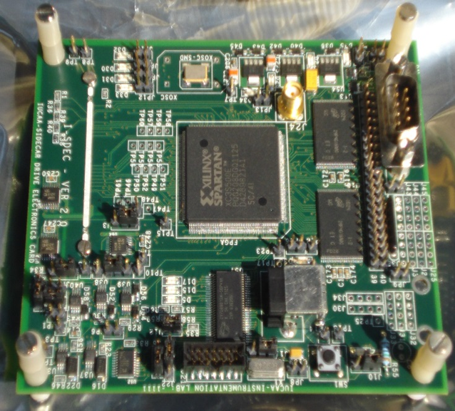
ISDEC-2
Designed to operate at -40 Deg.
Compatible with 15” JADE2 flex cable
Fully compatible with the Teledyne HxRG code
Linux based host software (Standalone as well as API mode)
SMA for Ext clock Sync
Xilinx Spartan-3 based board
2 GB Flash
USB 2.0 interface

Slide 3
ISDEC New Readout modes
Differential Multi accumulate Readouts
Implemented on Keck (TRICK camera), using Leach controller
Read noise for a 2.5µm cutoff Teledyne H2RG at 1-1000Hz frame rates
Roger M. Smith^{[1]}, David Hale California Institute of Technology, 1200 East California Blvd, Pasadena CA 91125, USA
SPIE_8453-35
ISDEC for TMT IRIS On Instrument Wave-front Sensing application ??

Slide 4
ISDEC-2 – Guide and LO AO / tip tilt sensing application
Special readout modes implemented in SIDECAR and FPGA
Multiple region of interest readouts with programmable cadence per window
Guide star acquisition using 32 output FF / Strip followed by small window with single output
Two window mode to adjust window location in real time to follow telescope dither

Slide 5
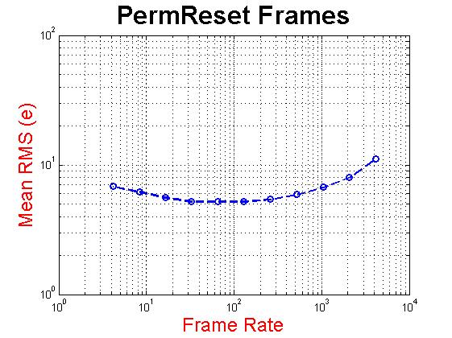
Noise graphs for synthesized frame rates
Noise graph of 4x4 window RESET frames taken at 4.1 KHz frame rates
Large number of frames acquired and co-added offline
SIDECAR used in eight channel averaging mode to minimise the ADC noise
Pre Amp, ADC and MUX biases tuned.
Single ended mode operation
Noise drops to 5 e at 100 Hz

Slide 6
Cold end board for Bias Loop Back, Bias Filter
Capacitors for filtering biases
SIDECAR Cryogenic
Kit
Small Flex cable to interface with H2RG
Cold end HIROSE to interface with ISDEC

Slide 7
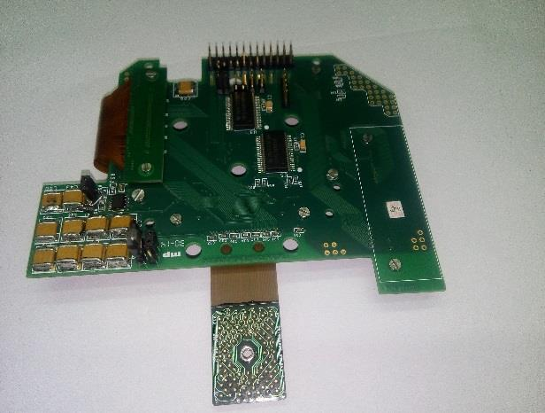
Software controlled Analog Switches to switch between normal and loop back mode
Clean stable voltage source

Slide 8
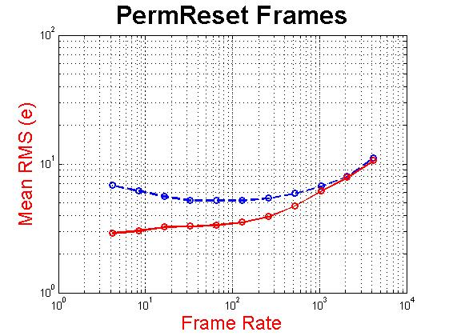
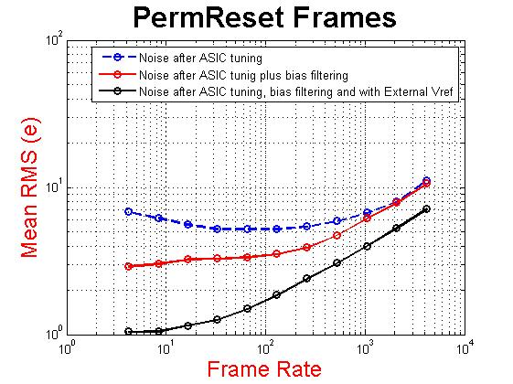
Noise improvements with Filter Board
Noise drops further to 3.5 e at 100 Hz after filtering MUX biases
Evaluating noise performance of the IUCAA SIDECAR DRIVE ELECTRONICS CONTROLLER (ISDEC) based system for TMT
On-Instrument Wave-front Sensing (OIWFS) application
SPIE Vol. 9915 991520-1

Slide 9
ISDEC2 – for LMIRCam
Strip readouts in 1,4 and 32 output mode
26 Hz Frame rate for 2048 x 256 frame size
Adjustable 50 KSPS to 500 KSPS pixel clock rates in slow (16 bit ADC) mode
Option to switch between fast (few ms) to normal (one frame time) RESET
Multi extension FITS file output with detail and accurate header information / API to transfer raw plus meta data
Currently in use in this mode at LBT

Slide 10
ISDEC-3
H2RG fast mode operation
Dual ASIC Control for H2RG slow mode operation
USB 3.0 (5 Gbps) as main interface
Gigabit Ethernet interface for H2RG slow mode
On board fast DDR3 memory
Expansion through SFP to control FOUR ASICS
Fully compatible with SIDECAR Cryo kit, JADE2 and SAM interface flex cables
Fully backward compatible with ISDEC-2

Slide 11
ISDEC-3 BOARD
1 GB ETH. Through SFP Modules
DC 5V ANA.
USB 3.0 HW
DC 5V DIG.
Voltage regulators for all on board chips.
ASIC voltage regulators and power sequencing HW
DDR3
ARTIX FPGA
SMA FOR EXT. CLK I/F
SAM compatible 200 pin MOLEX connector for ASIC interface

Slide 12
ISDEC-3 with SAM cable and Cryo Kit

Slide 13
ISDEC-3 ROIC images in fast mode
32 o/p mode at 1 MSPS (fast mode)
32 o/p mode at 5 MSPS (fast mode)

Slide 14
ISDEC-3 Current status and future plans
SIDECAR and ISDEC board and firmware ready for H2RG fast mode operations
Checked for 36 Hz frame rate operation, higher frame rates may be possible with strip mode operations
320 MBPS sustained data rate with USB 3.0
ISDEC-3 characterisation to start in Nov. 2017 (expected to receive new H2RG ROIC by end of Oct. 2017)
Dual SIDECAR operation
1 Gb Ethernet interface
On board (chip) data processing
H4RG in 64 output mode

Slide 15
ISDEC instruments
Robert Strobie Spectrograph Near Infrared RSS-NIR at South African Large Telescope (SALT)
Infrared Camera Experiment (CIRCE) at Gran Telescopio Canarias (GTC)
MIRADAS, a third generation Infrared spectrograph at GTC
LMIRcam at Large Binocular Telescope (LBT)

Slide 16
THANK YOU

