Slide 1


Superlattice-doped Imaging Detectors
Structure, Physics, and Performance
National Aeronautics and Space Administration
M. E. Hoenk, A. Carver, T. Jones, M. Dickie, and S. Nikzad
Jet Propulsion Laboratory
California Institute of Technology
J. Sgro
Alacron, Inc.
S. Tsur
Applied Materials Inc., Product Development Division, Israel
October 11, 2013
Scientific Detectors Workshop
Florence Italy
The work described here was carried out by the Jet Propulsion Laboratory, California Institute of Technology, under a contract with the National Aeronautics and Space Administration.
© 2013. All rights reserved.

Slide 2
Outline
Instability of 3D doped detectors
Stability of 2D doped detectors
DUV lifetime test with pulsed laser irradiation
Practical Issues

Slide 3
Instability of 3D-doped detectors

Slide 4
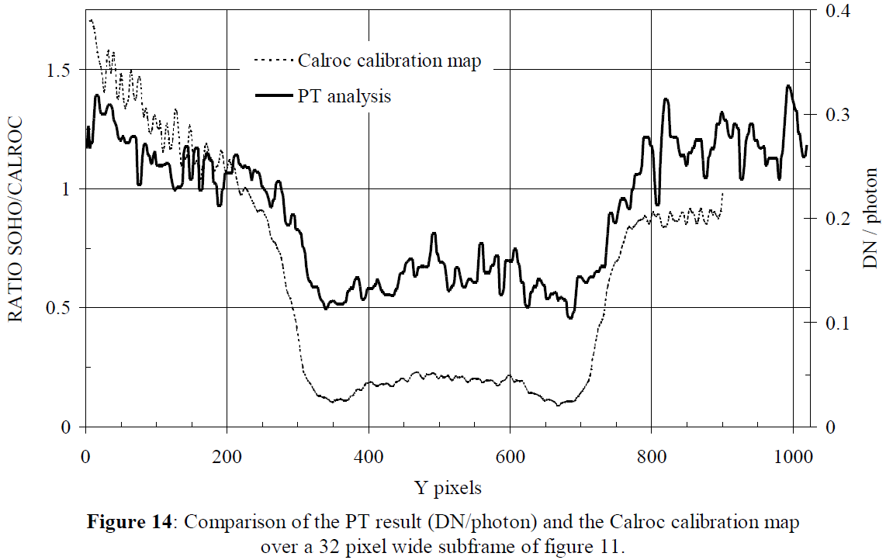
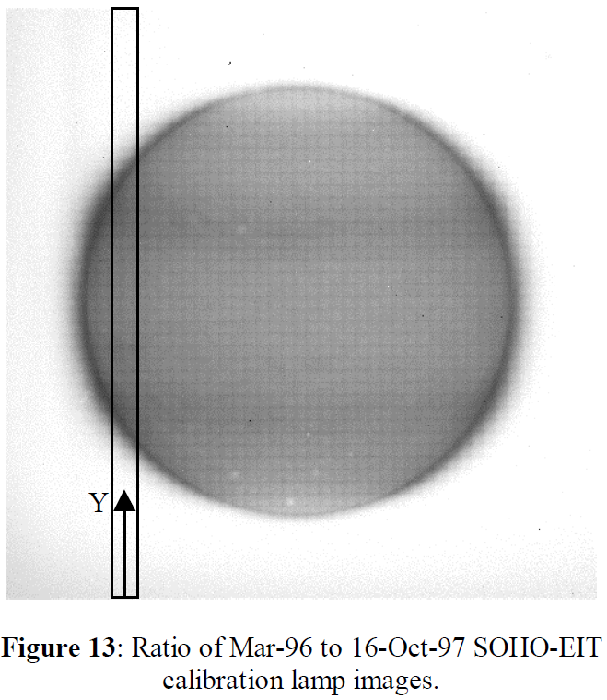
Damage to EUV CCD on SOHO
J. M. Defise, J. D. Moses, Frédéric Clettec,and the EIT Consortium, “In-orbit performances of the EIT instrument on-board SOHO and intercalibration with the EIT Calroc Sounding rocket program,”
Proc. SPIE 3442, Missions to the Sun II, 126 (November 2, 1998)

Slide 5
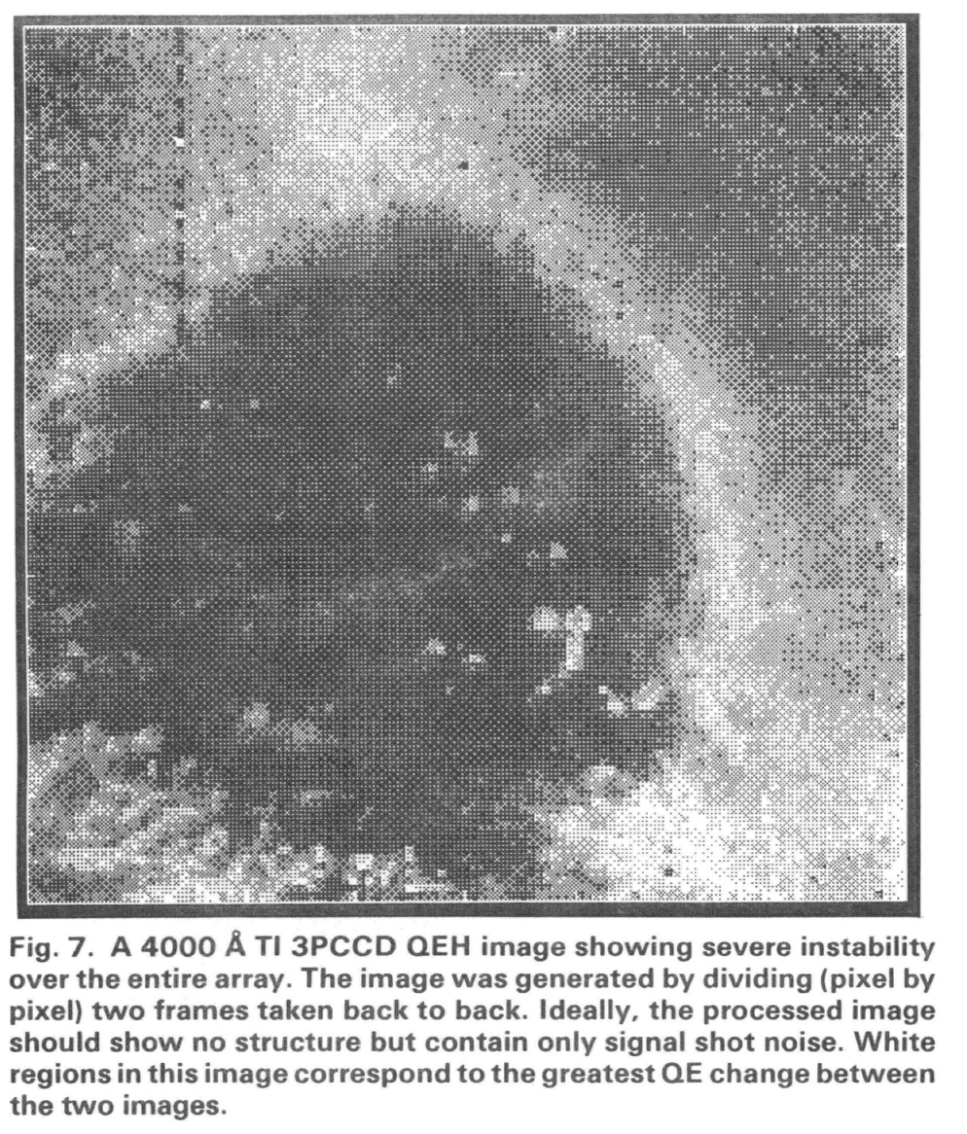
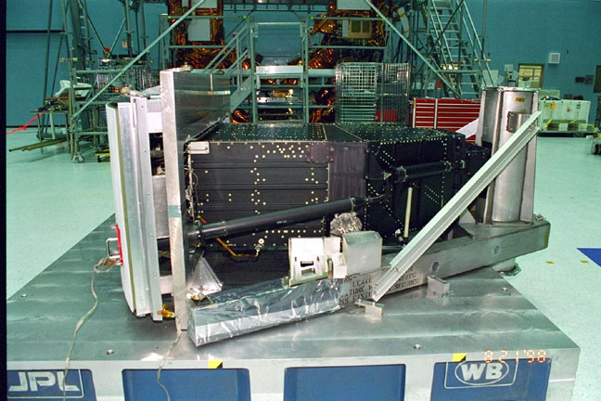
Quantum Efficiency Hysteresis on Hubble
Janesick et al., “Scientific Charge Coupled Devices,” Optical Engeering, 26(8): 692-714, August1987.
Light pipe added to WF/PC instrument to expose detectors to UV from sunlight
QEH mitigation: WF/PC 1 retrofitted for on-orbit UV flood

Slide 6
3D Doping and The Dead Layer
Mostly
Surface
Depletion region
Detector bulk
Dead Layer
-
⁺
Fermi level
⁺
Interface
traps (D_{it})
Radiation damage causes instability and failure
Notes:
Eliminating the traps is not enough – still have to stabilize the surface

Slide 7
Quantum Efficiency Hysteresis and Backside Charging
3D doping forces a tradeoff between efficiency and stability
Surface
Depletion region
Detector bulk
-
+
-
+
-
+
-
-
+
-
+
-
-
+
-
+
-
+
-
+
-
+
-
+
-
+
-
+
Negative charge → Accumulation
Positive charge → Depletion

Slide 8
Stability and High QE of 2D doped detectors

Slide 9
Delta doping for Surface Passivation
Self-ordered surface phase:
Boron on Silicon <100>
2D doping → Delta-doping
Dopant density as high as 10²²cm⁻³
Delta-doped layer
(dopant in single atomic layer)
original Si
CCD
frontside
circuitry
Native oxide
1 nm
MBE growth
3 nm
Hoenk et al., Applied Physics Letters, 61: 1084 (1992)
Fully-processed devices are modified using Molecular Beam Epitaxy (MBE)

Slide 10
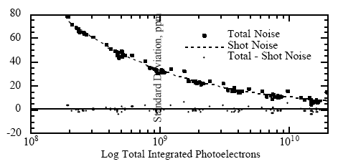
Photometric Stability of Delta-doped CCDs
Standard Deviation (ppm)
J. M. Jenkins, W. J. Borucki, E. W. Dunham, J. S. McDonald
“High Precision Photometry with Back-Illuminated CCDs,”
ASP Conf Ser ,16-18 Oct. 1996 STScI
…the [delta-doped] CCD performed as a nearly shot-limited photometer
with only a few ppm of error at a flux level of 10¹⁰e⁻ per sample

Slide 11
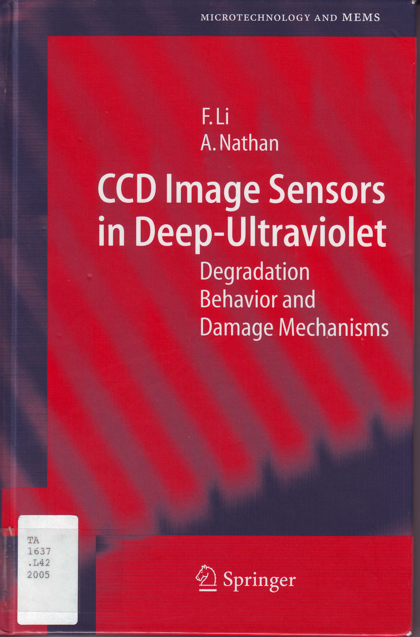
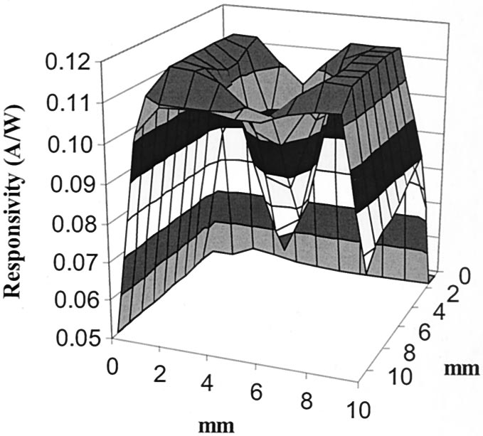
Damage Ultraviolet Damage
Very high interface trap densities are possible
  Passivated thermal oxide: n_{2D} ~ 10¹⁰ cm⁻²eV⁻¹
  Thermal oxide “as-grown”: n_{2D} ~ 10¹² cm⁻²eV⁻¹
  Damaged oxide: n_{2D} ~ 10¹⁴ cm⁻²eV⁻¹
References:
  Afanas’ev, V.V., de Nijs, J. M. M., and Balk, P., “Degradation of the thermal oxide of the Si/SiO2/Al system due to vacuum ultraviolet radiation,” J. Appl. Phys., 78(11): 6481-6490, 1995.
  Arp, U., Shaw, P.S., Gupta, R. and Lykke, K.R., “Damage to solid-state photodiodes by vacuum ultraviolet radiation,”
  J. Electron Spectroscopy and Related Phenomena, 144-147: 1039-1042, 2005.
  Li, FM & Nathan, A, “CCD image sensors in deep-ultraviolet: degradation behavior and damage mechanisms,”
  Springer, Berlin, 2005.

Slide 12
Surface Passivation by Quantum Exclusion
Structure
  2D-doping Superlattice
  Self-organized boron surface phases
  Equivalent density > 10²¹cm⁻³
Physics
  Quantum confinement
  Quantum transport
Performance
  Near 100% internal QE
  Stable against several billion pulses of high intensity DUV laser radiation
“Surface Passivation by Quantum Exclusion Using Multiple Layers,”
Michael E. Hoenk, U.S. Patent 8,395,243, issued March 12, 2013.
Notes:
Delta-doping = Single 2D doped layer
Superlattice = Multilayer 2D doping

Slide 13
Surface Passivation by Quantum Exclusion
Surface
Super-
lattice
Surface
Surface
SL
Bulk
Bulk
Bulk
-
Electron subband
Hole subbands
Conduction band
+
Valence band
  Quantum confinement eliminates dead layer
  Ballistic transport suppresses recombination of hot carriers

Slide 14
Dead layer vs. Trap density
3D doping
2D doping

Slide 15
DUV Lifetime Tests
Superlattice vs. Laser

Slide 16
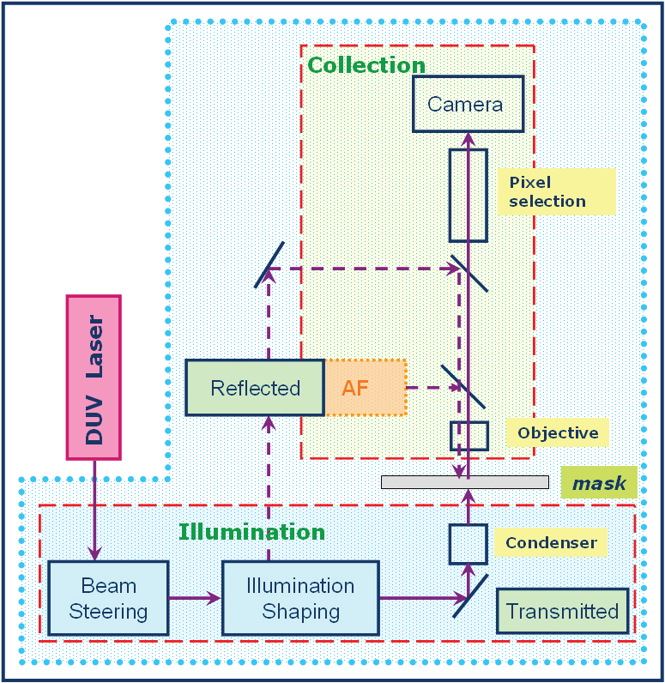
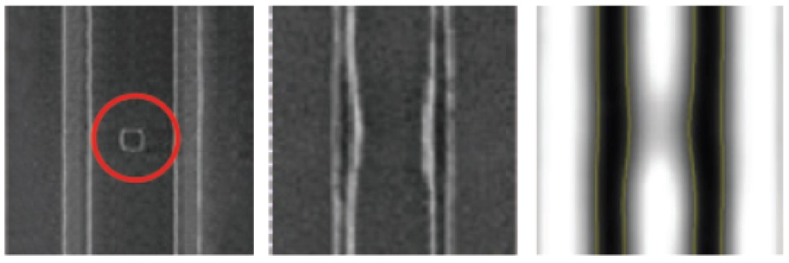
Aerial Imaging Mask Inspection System
Mask defect
(SEM)
Wafer defect
(SEM)
Wafer defect
(Aerial)
Applied Aera2™
Mask inspection imaging optics.

Slide 17
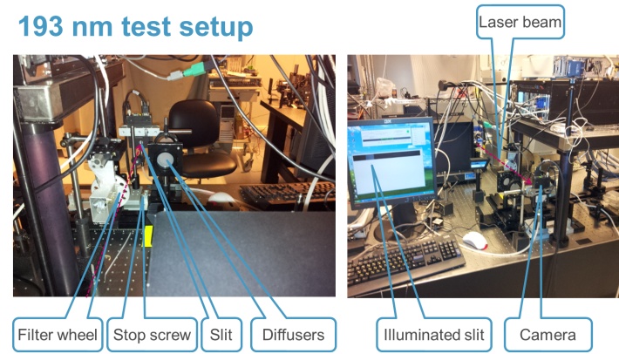
Lifetime Testing with Pulsed DUV Lasers

Slide 18
Calibrating DUV laser damage with test wafers
Traps decrease conductivity
Trap density ~ 10¹⁴ cm⁻²eV⁻¹

Slide 19
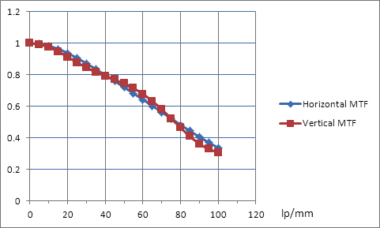
Superlattice-doped detector stability
263nm Results
Pulsed 263 nm laser up to x257 camera saturations
QE = 64% with AR-coated sensor – 28nm Al2O3
QE and dark current stable to maximum tested dose (3.1 kJ/cm²)
No blooming and no image memory were present even at the high saturation levels.
High modulation transfer function (MTF)

Slide 20
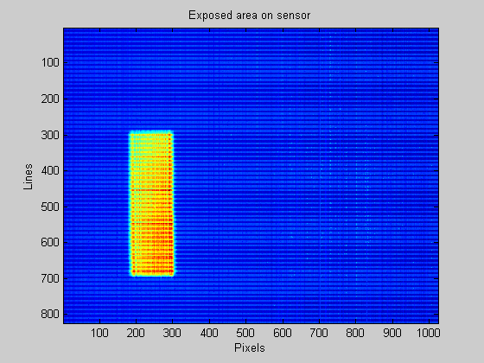
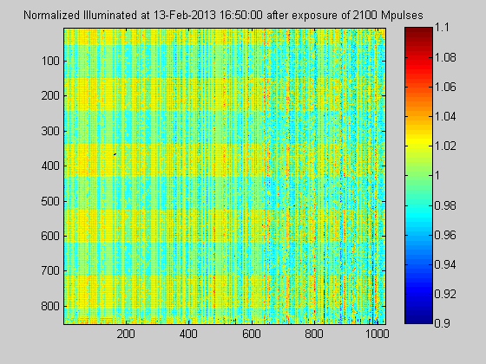
Superlattice-doped detector stability
193nm Results
>2 Billion laser pulses at full saturation
No measureable change (within +1%)
Estimated Lifetime > 10B laser pulses.
Internal QE ~100% (excluding Quantum Yield)
No blooming and no image memory at 1000 fps.
Exposure slit position on sensor
Normalized Spatial Response following 2.1 B pulses

Slide 21
Practical issues

Slide 22
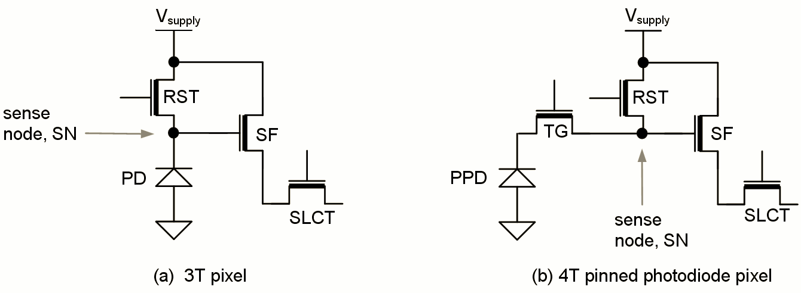
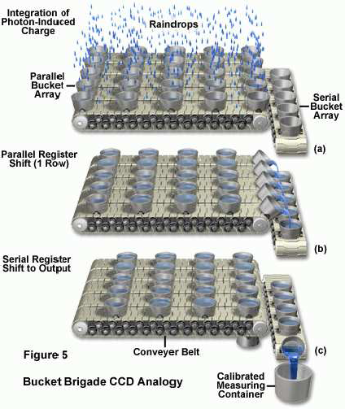
Versatility of 2D Passivation
Charge-coupled Device (CCD)
Serial readout device with charge transfer and one (or few) readout amplifiers.
CMOS APS Imaging Array
Parallel readout with few charge transfers and one readout amplifier per pixel.
CCD
CMOS APS
Superlattice doping has been demonstrated on CCDs (multiple types), CMOS APS imaging arrays, photodiode arrays, and fully-depleted photodiodes.
Notes:
22
Delta-doping is equally applicable to back-illuminated CCDs and CMOS imaging arrays.

Slide 23
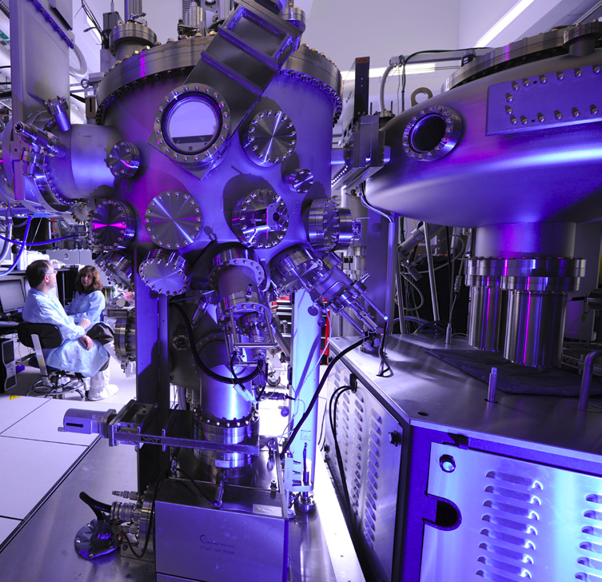
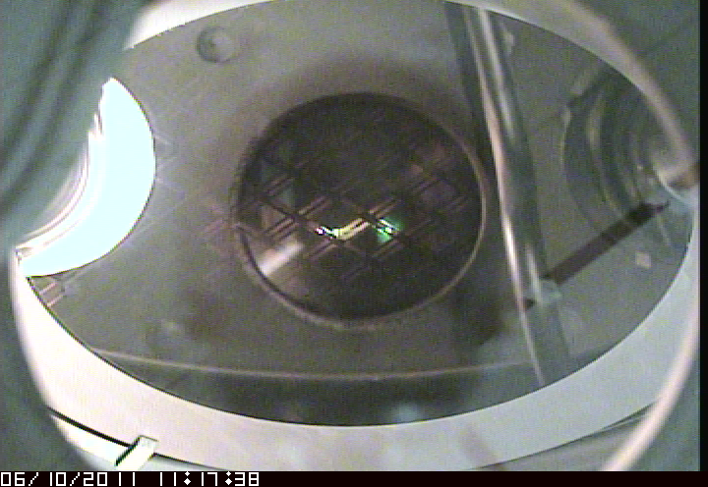
Wafer-scale Superlattice Doping
8-inch CMOS wafer during MBE growth at JPL’s Microdevices Lab
Veeco 8-inch Silicon MBE at JPL’s Microdevices Lab
High throughput production of superlattice-doped, 200 mm wafers

Slide 24
Technology Transfer
Alacron Inc. BSI DUV camera with superlattice-doped, AR-coated CMOS imaging array.
“Surface Passivation by Quantum Exclusion Using Multiple Layers,”
Michael E. Hoenk, U.S. Patent 8,395,243, issued March 12, 2013.

Slide 25
Conclusions
  Instabilities of 3D doping
    Quantum efficiency hysteresis and the “mostly dead” layer
    Radiation-induced interface traps
  Stability of 2D doping
    Near 100% internal QE, no QE hysteresis
    Quantum exclusion eliminates trapping and surface recombination
  DUV lifetime tests superlattice-doped CMOS
    Insensitive to surface traps and DUV damage ~ 10¹⁴cm⁻²eV⁻¹
    193nm: STABLE at >2 Billion laser pulses at full saturation
    263nm: STABLE at >2 Billion laser pulses at 257x saturation
  Practical matters
    Versatile
    Manufacturable
    Technology transfer
We are very interested in partnerships for development, delivery, and deployment of high performance detectors.

