Slide 1
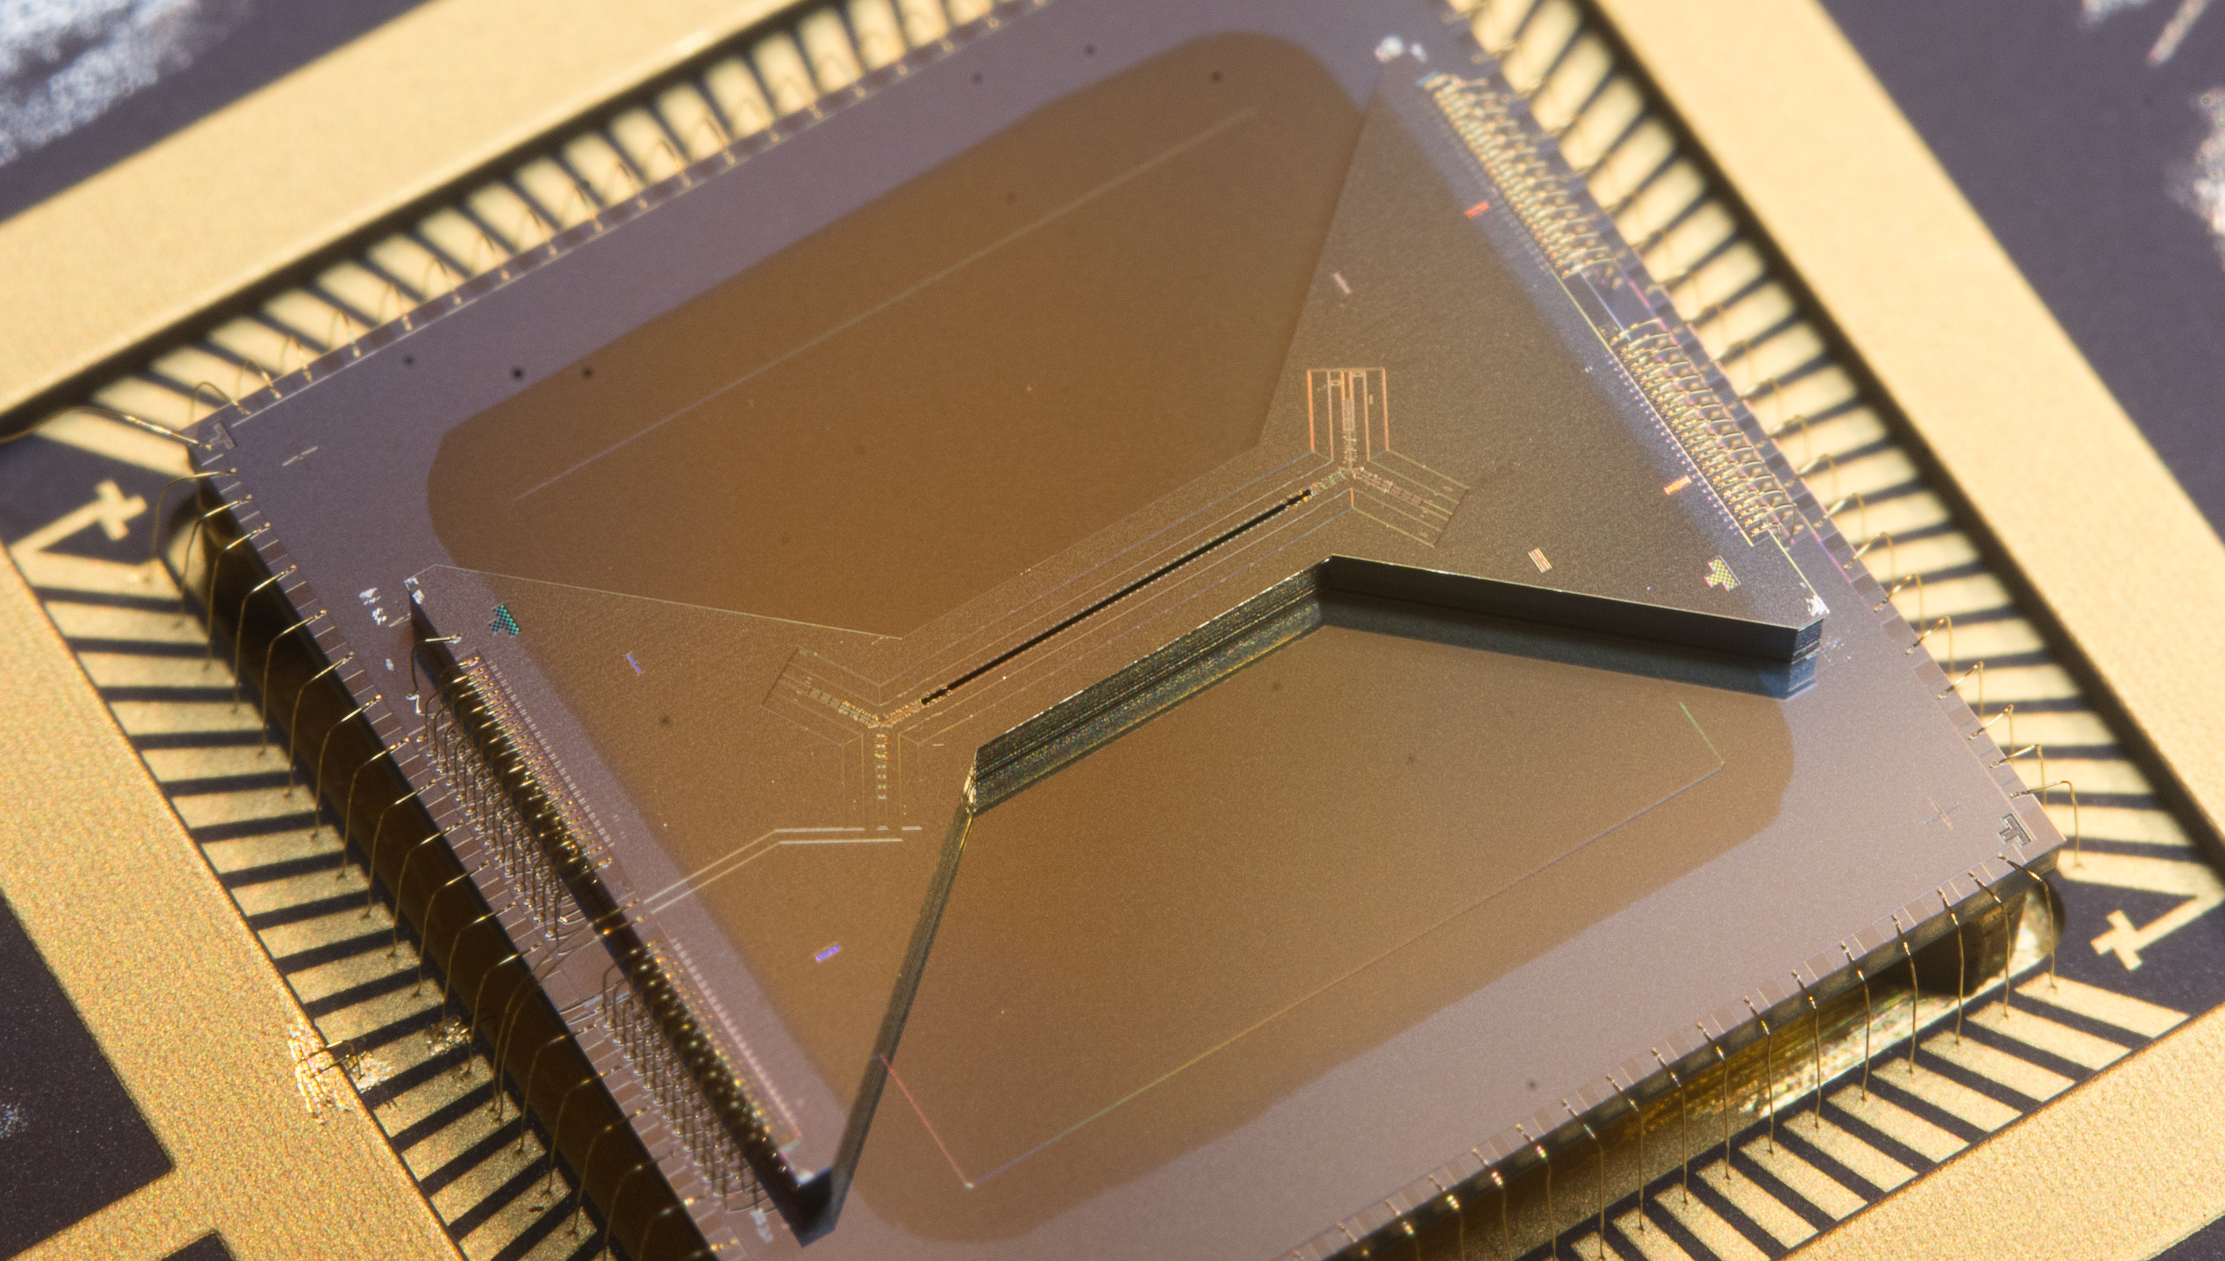
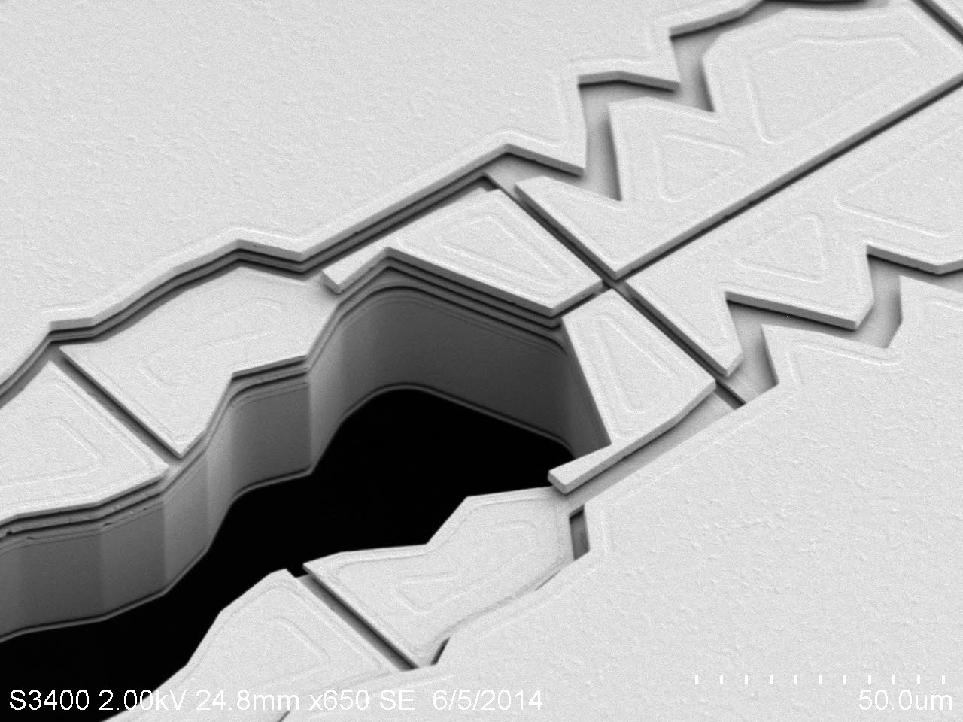
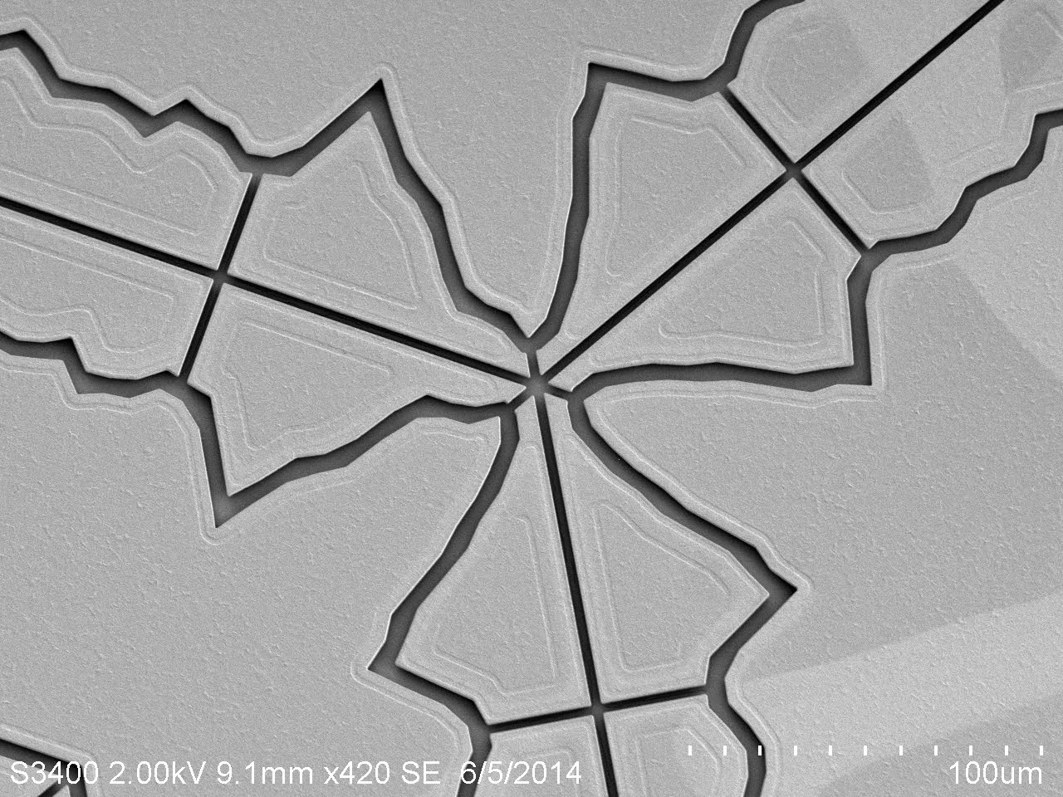


High-fidelity quantum and classical control in microfabricated surface ion traps
Daniel Lobser
Sandia National Laboratories

Slide 2

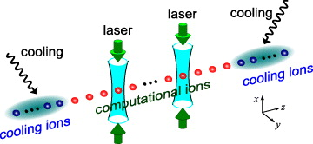
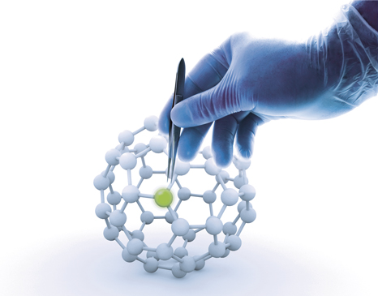
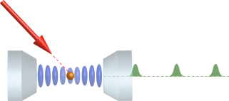

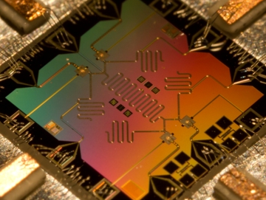
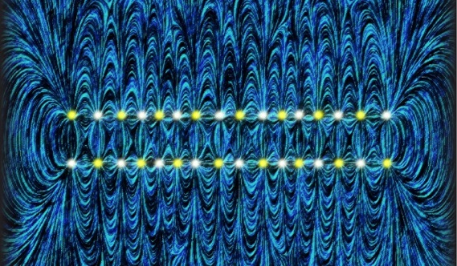
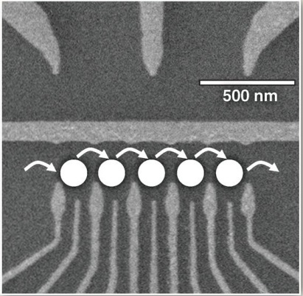
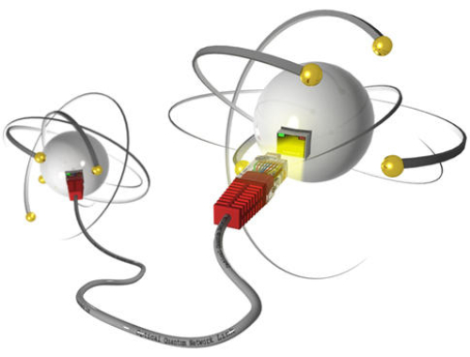
Motivation
Quantum Information
Qubit Implementations
Quantum chemistry
Calculation of molecular potentials
Nitrogen and Oxygen fixation, development of catalytic converters
Medicine
Structure-based drug development
Quantum computing
Number factorization (Shor’s algorithm)
Search in unstructured data, searching for solutions to hard problems
(Grover’s search algorithm)
Quantum simulation
Simulating many-body systems
Already for about 20 qubits not possible to simulate classically.
Quantum Communication
Securing a quantum channel
Trapped Ions
Blatt and Wineland “Entangled States of Trapped Atomic Ions.” Nature 453, 1008–15 (2008).
Monroe and Kim. “Scaling the Ion Trap Quantum Processor.” Science 339, 1169 (2013)
Neutral Atoms
Rydberg states
Atoms in cavities
Superconducting Josephson junctions
Devoret and Schoelkopf. “Superconducting Circuits for Quantum Information: An Outlook.” Science 339, 1169 (2013).
Quantum dots
Awschalom, et al., “Quantum Spintronics: Engineering and Manipulating Atom-Like Spins in Semiconductors.” Science 339, 1174 (2013).

Slide 3
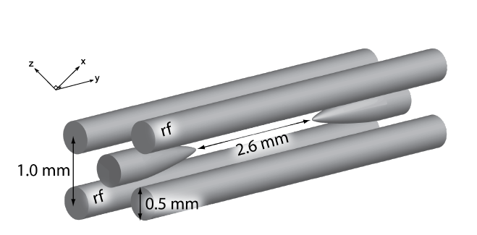
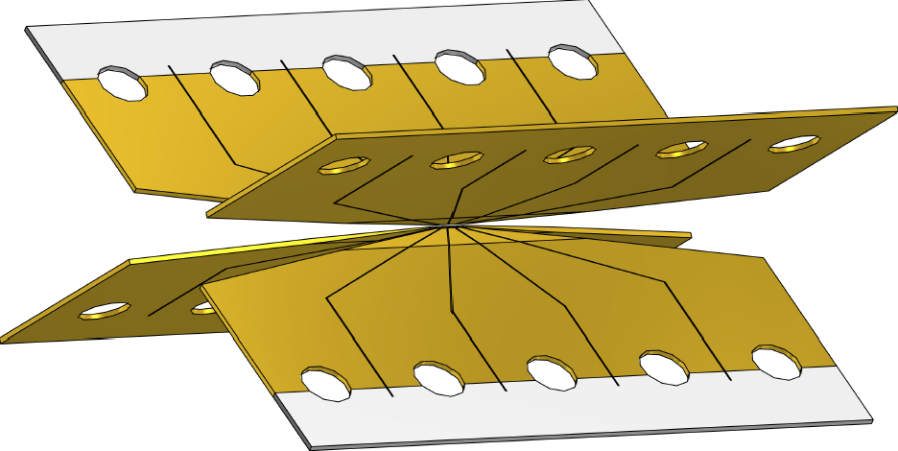
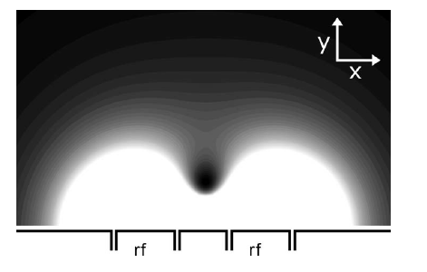
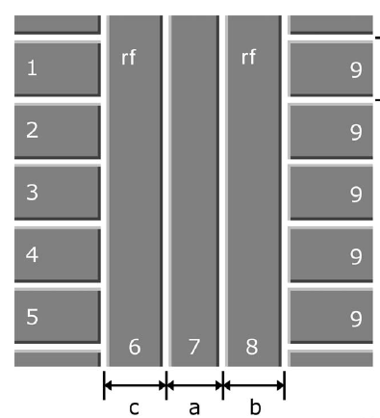
Brief Overview of Ion Trapping
Earnshaw’s Theorem: Static electric fields can’t create a stable confining potential for charged particles
r.f. Paul Trap
Segmented Paul Trap
Better control over confining potential
Difficult to construct
Doesn’t scale well
r.f. pseudopotential
Microfabricated Surface Trap
Consistent, well-defined electrode layout
Microfabrication supports a lot of exotic electrode geometries
Excellent control over potential
Very scalable
Time-averaged potential is close to harmonic at the saddle point
Off the saddle point, ions experience micromotion
Works well for linear chains of ions
Doesn’t support fine control of ion position or confining potential
House, PRA 78 033402 (2008)

Slide 4
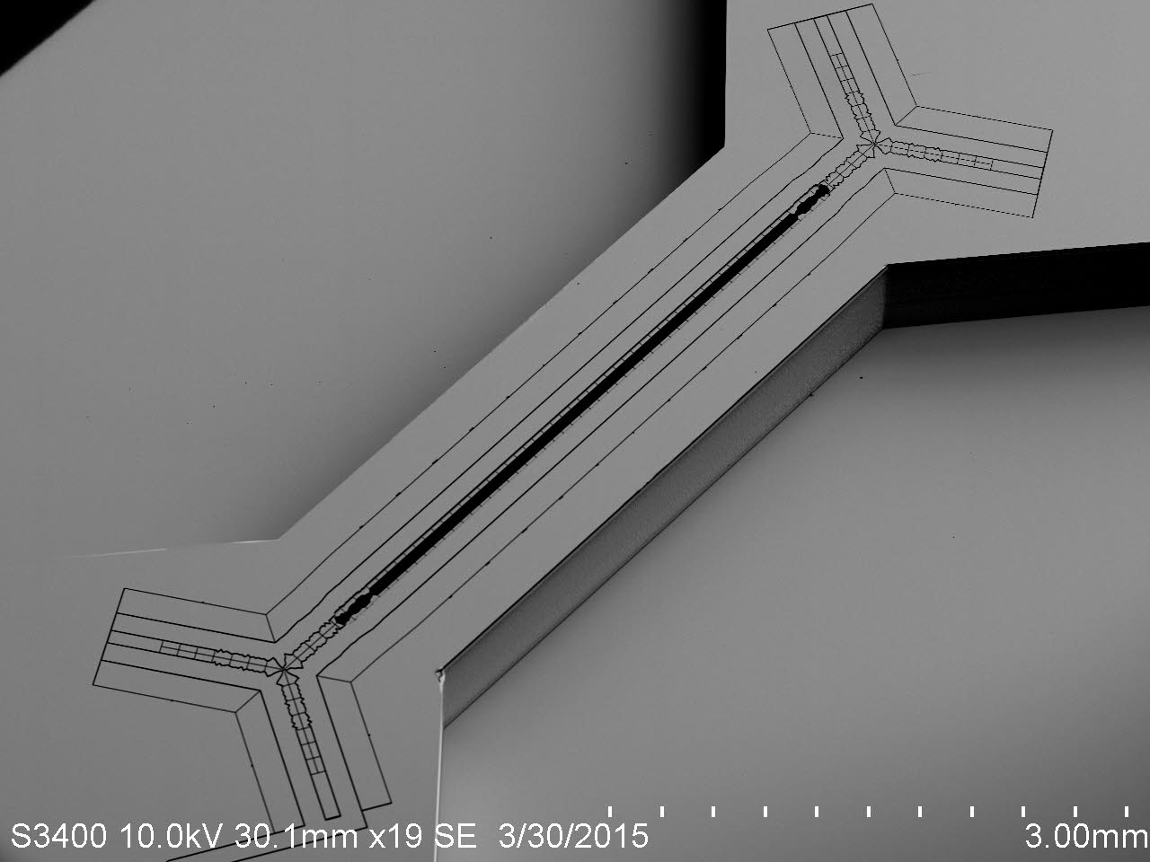
Surface Ion Traps
  Challenges
  Proximity of ions to the trap increases heating rates
  Ions are more sensitive to small features such as dust
  Possible charging of trap due to scattered laser light
Our Goal
Demonstrate that microfabricated surface traps can be used for high-fidelity quantum operations
Benefits
Microfabricated traps are scalable
They support complicated geometries
The technology keeps improving
Optimize traps for quantum information processing
We will demonstrate that microfabricated surface traps can be used for high fidelity quantum operations

Slide 5
Outline
Sandia’s Surface Ion Traps
Quantum Control
Specialized Ion Traps
Classical Control

Slide 6
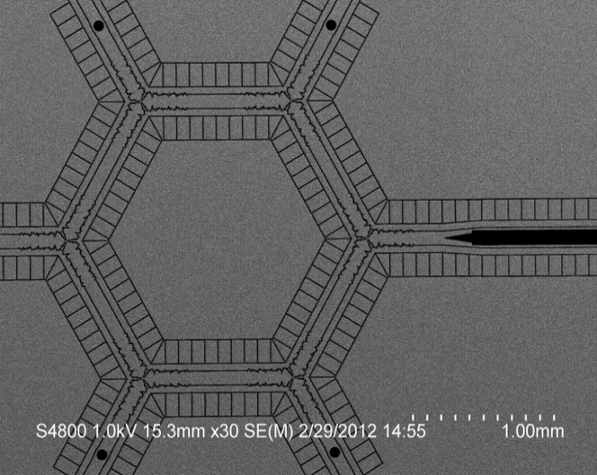
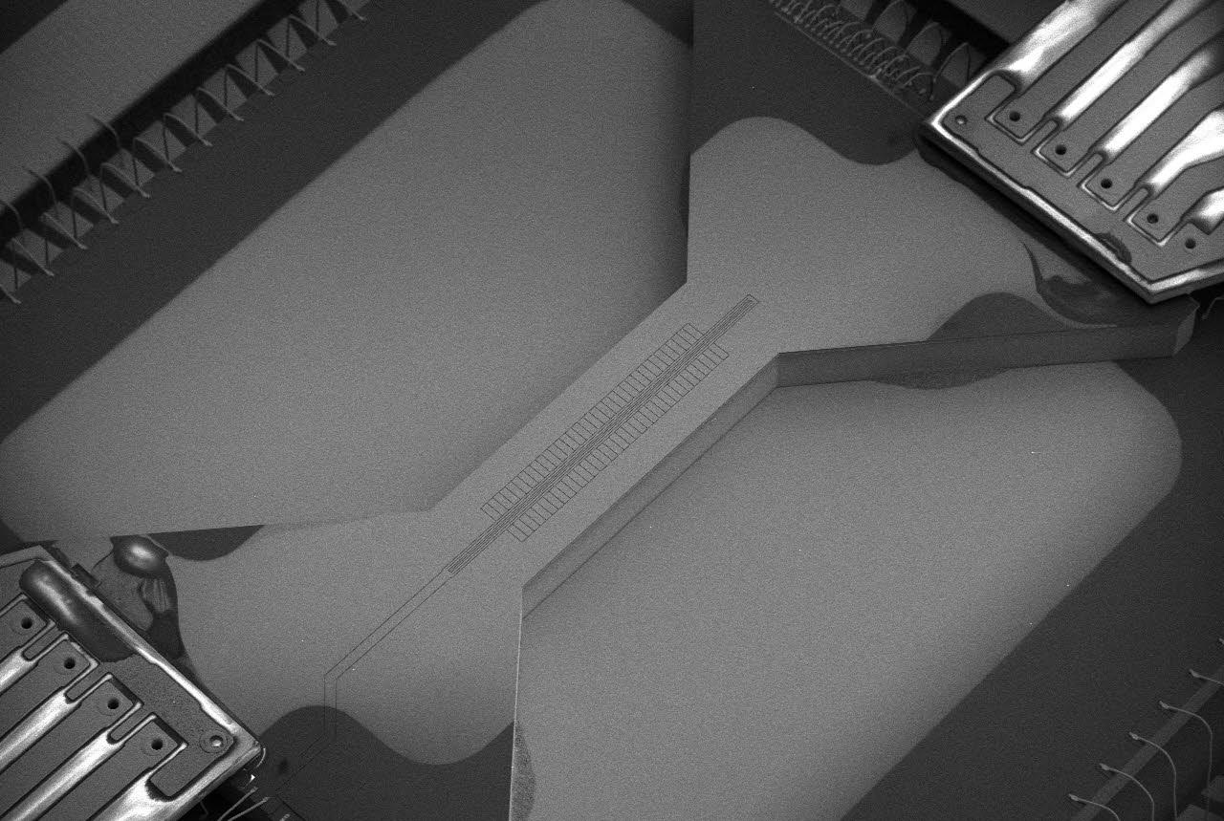
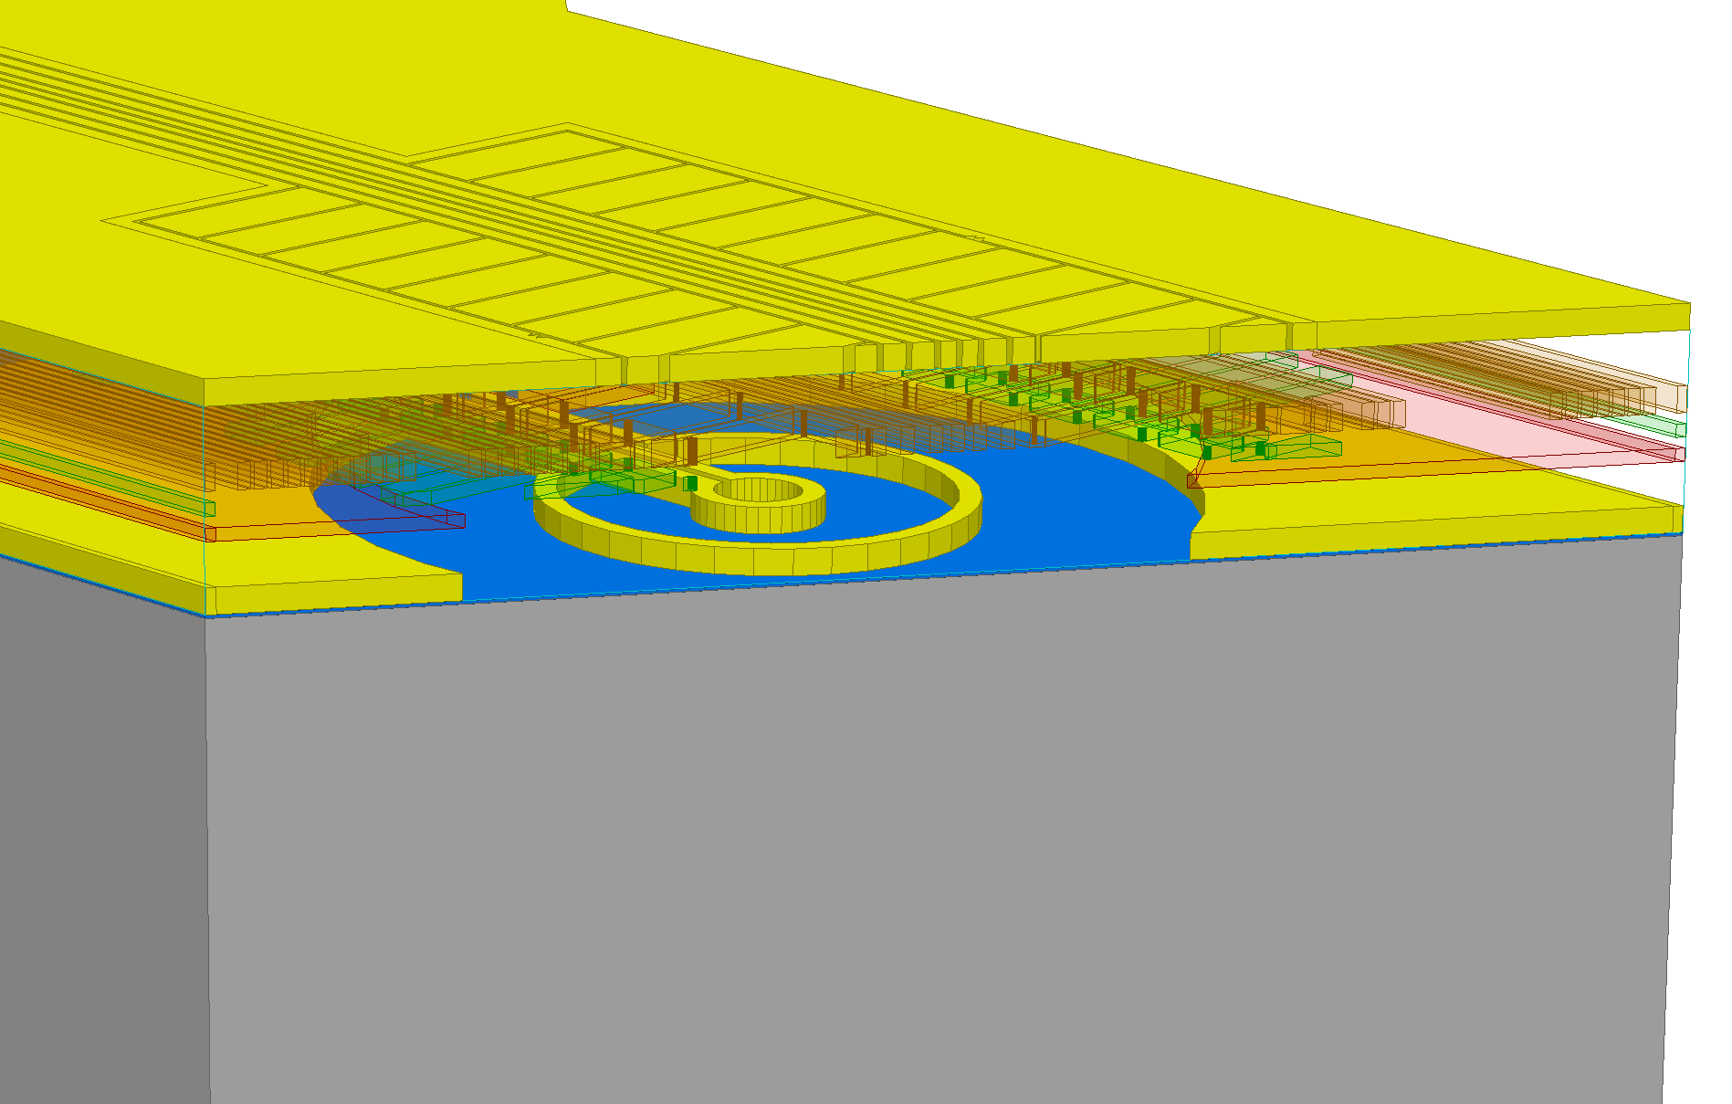
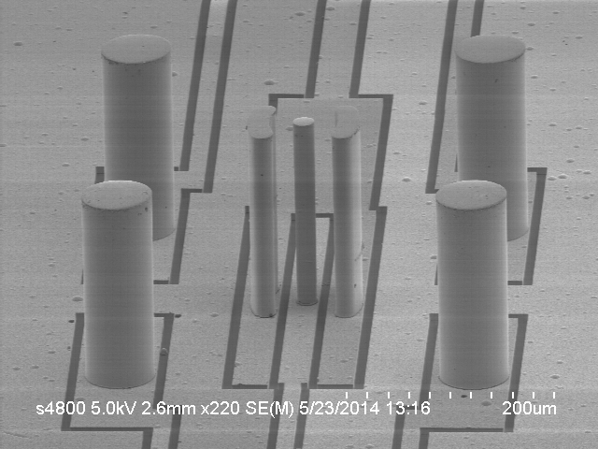
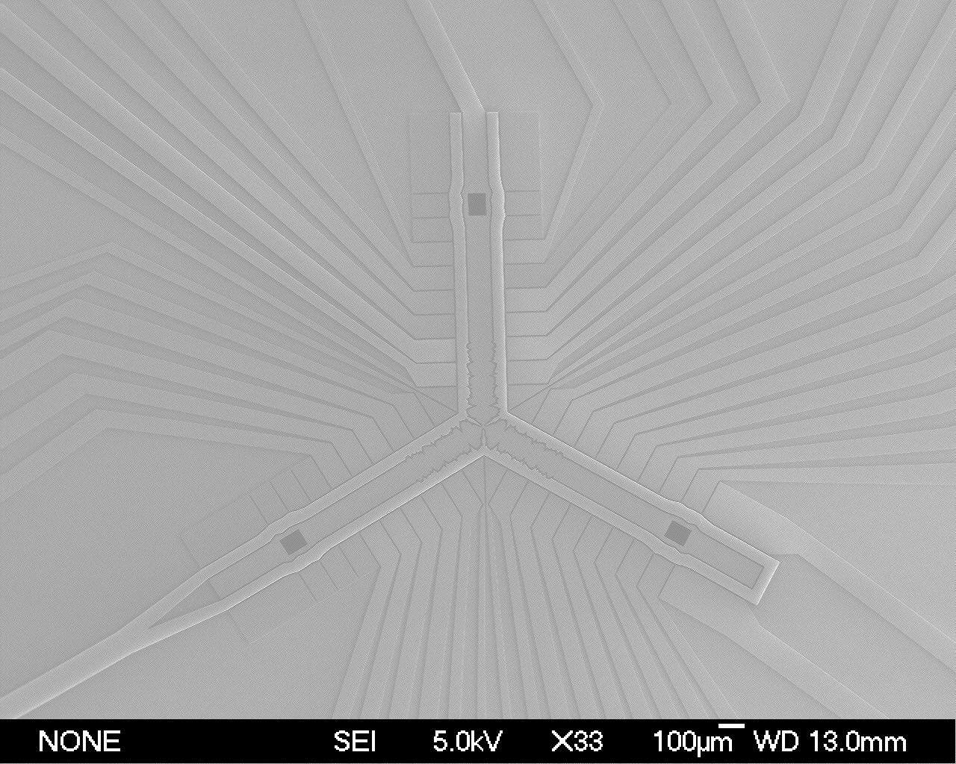
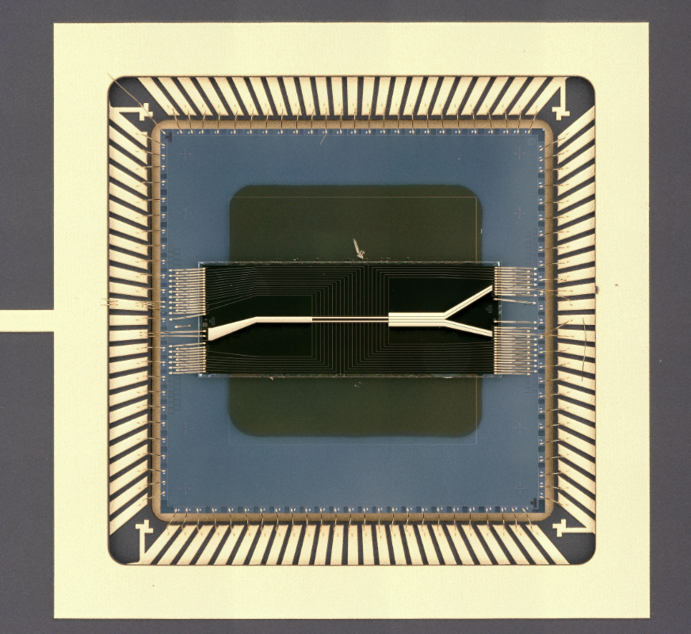
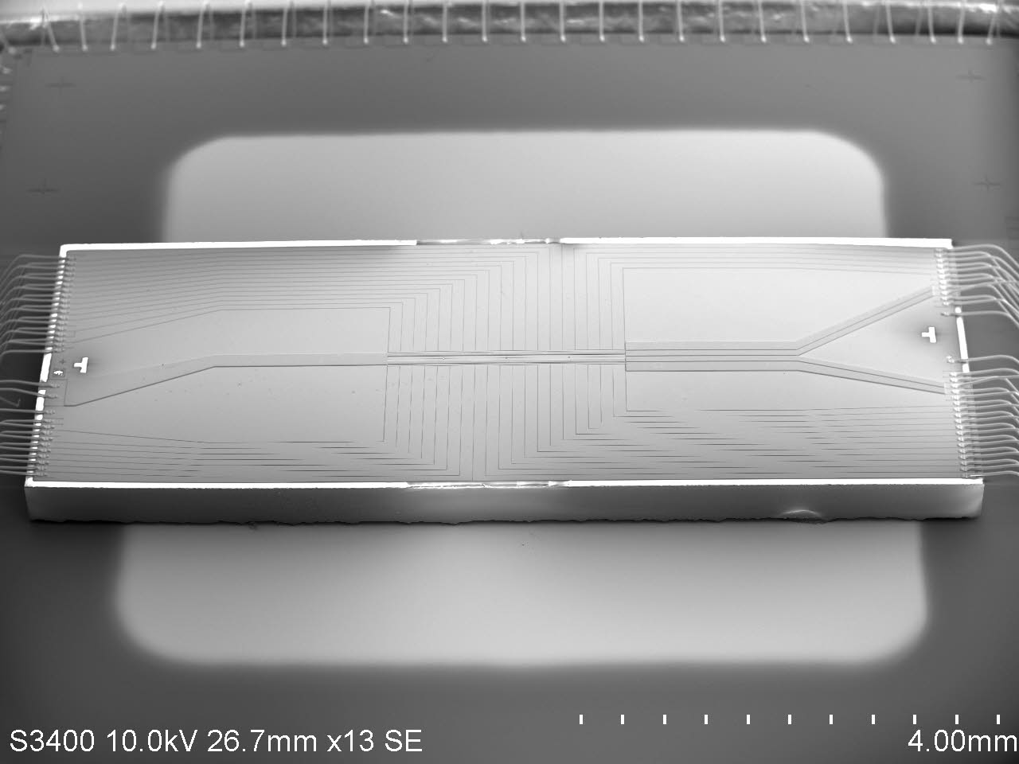
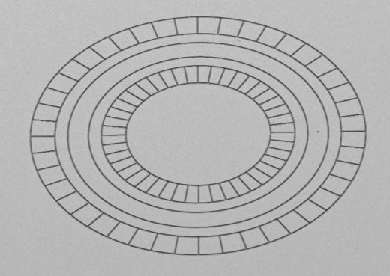
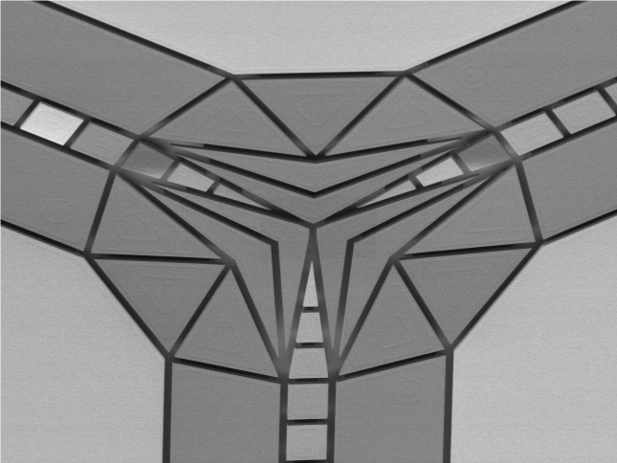
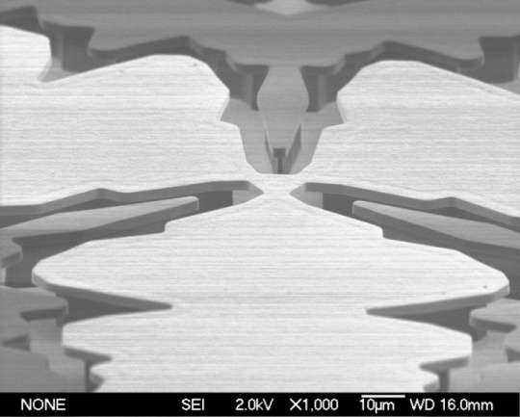
Some of Sandia’s Traps
HOA-1 Y Junction
High Optical Access (HOA) trap
Circulator trap
Microwave trap
Stylus trap
Y-junction traps
Localized near-field microwaves
EPICS trap
Ring trap
Tabakov, B et al. Phys. Rev. Applied 4, 031001 (2015).

Slide 7
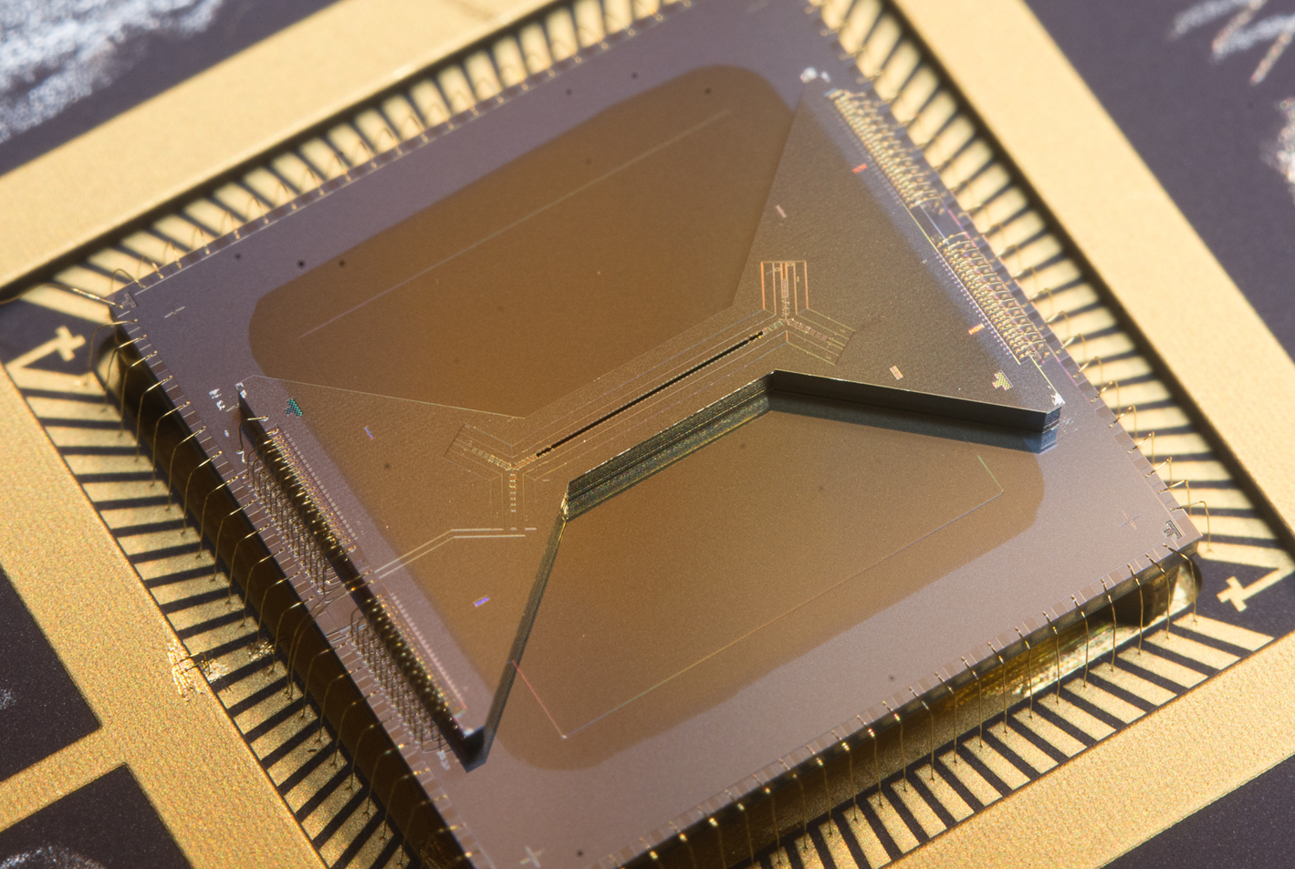
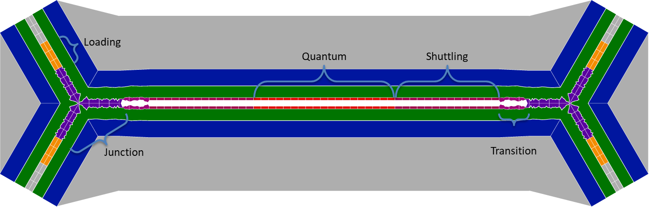
High Optical Access (HOA)
Optical access
Excellent optical access rivaling 3D
NA 0.25 vertical, NA 0.12 lateral
Trap strength (Typical Yb⁺)
Radial trap frequency 2 - 5 MHz
RF frequency 50 MHz
Stable for long ion chains
Low heating rates (30 q/s parallel to surface, 125 q/s perpendicular)
>100 h observed (while running measurements)
>5 min without cooling
70 µm ion height
Notes:
Requirements
High Optical Access for across chip laser beams, specifically the ability to focus a 4um beam at the ion.
A slotted linear trap section that allows one to focus a laser beam on the ion perpendicular to the trap surface with a waist of 2 um.
Radial secular frequencies > 2MHz for Yb⁺ with < 300V of RF applied.
Full control of principal axes rotation.
Compatibility with a trench capacitor interposer.
Good axial voltage efficacy to enable the separation and recombination of ion chains.
Junctions for re-ordering ions with the ability to co-shuttle ions with mass ratio up to 5:4.

Slide 8
Outline
Sandia’s High-Optical-Access Trap
Quantum Control
Specialized Ion Traps
Classical Control

Slide 9
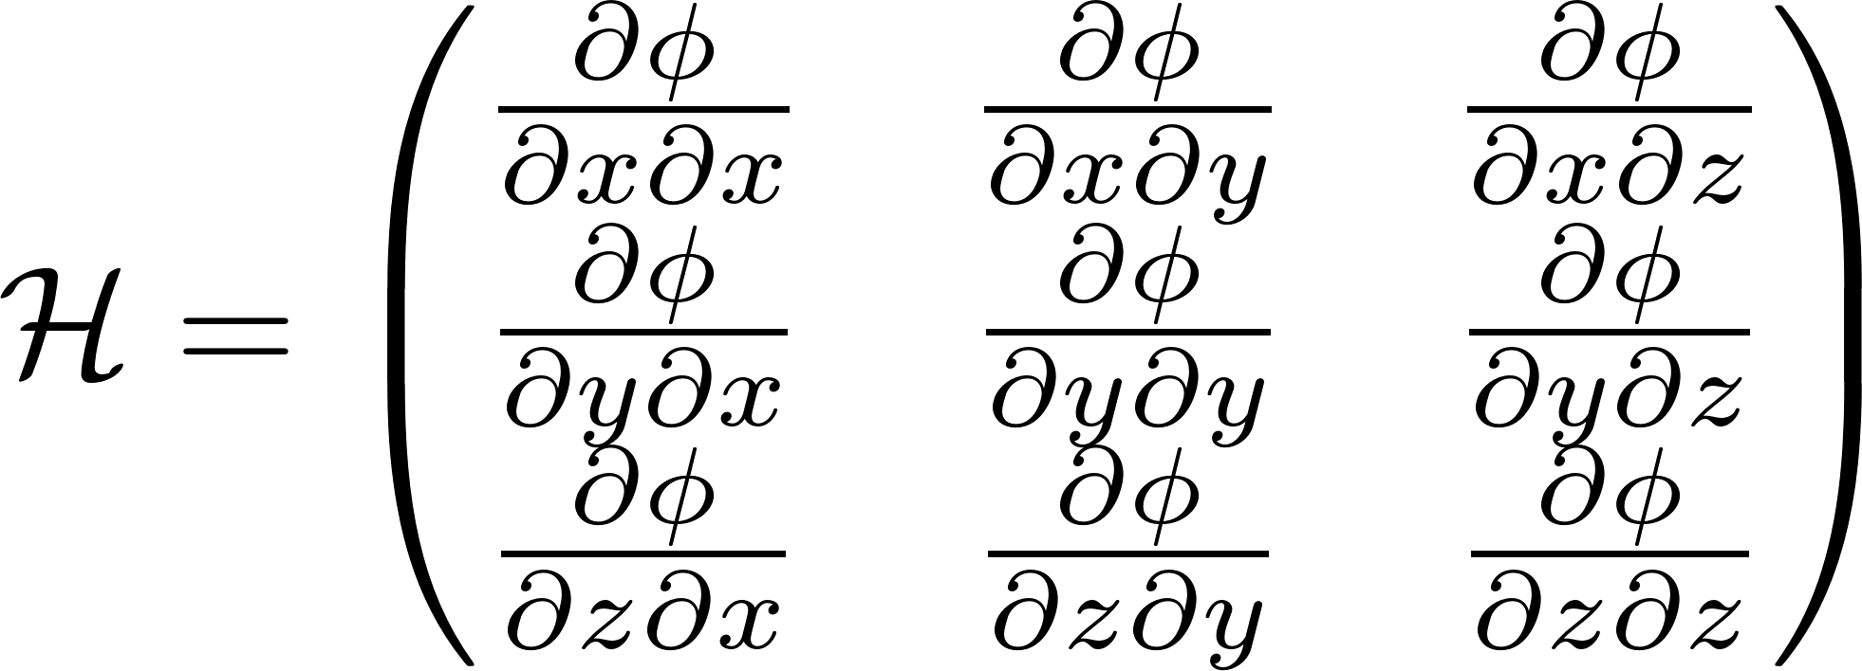
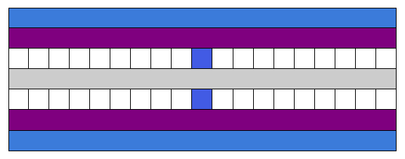
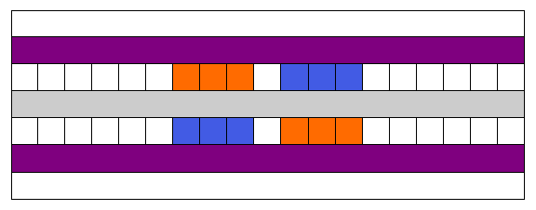
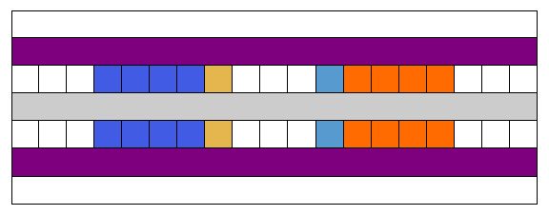
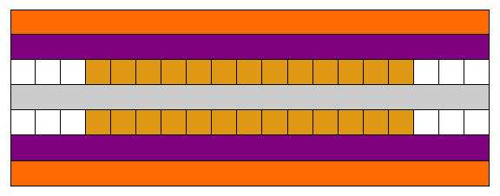
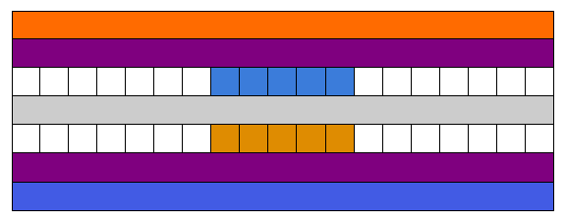
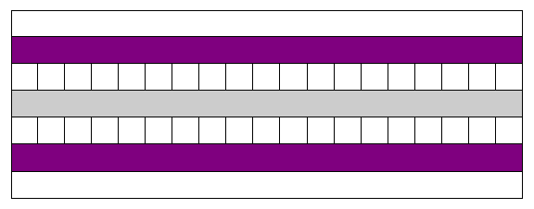
Control of Confining Potential
Symmetric curvature tensor
6 degrees of freedom
Determines trap frequencies and principal axes rotations
Traceless for static fields
Trace is generated by rf pseudopotential
Symmetric
r.f.

Slide 10
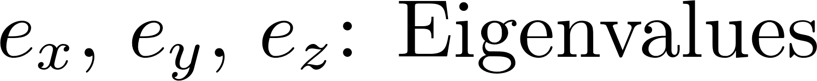
Parametric Rotation Amplitudes

Slide 11
Application To Complicated Electrode Geometries
YZ basis (rotation of the radial axes) near the junction on the HOA 2.1
XY basis (rotation in the plane of the trap) on the microwave trap with tied electrodes

Slide 12
Principal Axis Rotation
Do we understand the trapping fields?
Principal axes rotation realized as in simulation
No change in trap frequencies
Measured angle [deg]
Slope 0.99
Applied Angle [deg]
Measure trap freq [MHz]
Applied Angle [deg]
The simulations accurately describe the fields and curvatures generated by the trap

Slide 13



Applications
Controlled rotation
Combined rotation and translation
Separation and merging
Long Chains
Compression of chains
3D Crystal Structures

Slide 14
Outline
Sandia’s High-Optical-Access Trap
Quantum Control
Specialized Ion Traps
Classical Control

Slide 15
The ¹⁷¹Yb⁺ Qubit
Good clock-state qubit
Coherence time (T₂*) > 3 s
¹D[5/2]_{5/2}
³D[3/2]_{1/2}
F=0
F=1
935 nm
²P_{1/2}
2.1 GHz
²D_{5/2}
638 nm
369 nm
F=2
F=1
²F_{7/2}
²D_{3/2}
²S_{1/2}
12.6 GHz
Qubit Transition

Slide 16
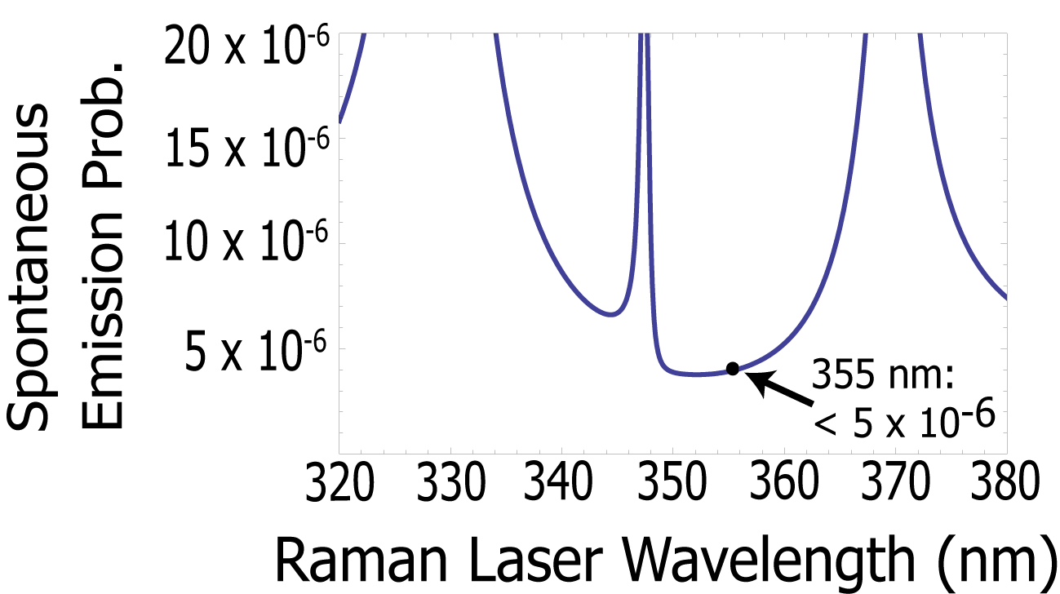


The ¹⁷¹Yb⁺ Qubit
²P_{3/2}
²P_{3/2}
66 THz
67 THz
33 THz
329 nm
²P_{1/2}
33 THz
²P_{1/2}
355 nm
369 nm
3x Nd:YVO₄ (355 nm) near minimum
in Differential AC Stark Shift and
spontaneous emission for ¹⁷¹Yb⁺
(Δ_{Stark}/Ω_{Rabi}< 3 x 10⁻⁴ at 355 nm)
369 nm
355 nm
3x Nd:YVO₄ (355 nm) near minimum
in Differential AC Stark Shift and
spontaneous emission for ¹⁷¹Yb⁺
(Δ_{Stark}/Ω_{Rabi}< 3 x 10⁻⁴ at 355 nm)
²S_{1/2}
12.6 GHz
²S_{1/2}
12.6 GHz
¹D[5/2]_{5/2}
³D[3/2]_{1/2}
F=0
F=1
935 nm
²P_{1/2}
2.1 GHz
²D_{5/2}
638 nm
369 nm
F=2
F=1
²D_{3/2}
²F_{7/2}
1
²S_{1/2}
12.6 GHz
0

Slide 17
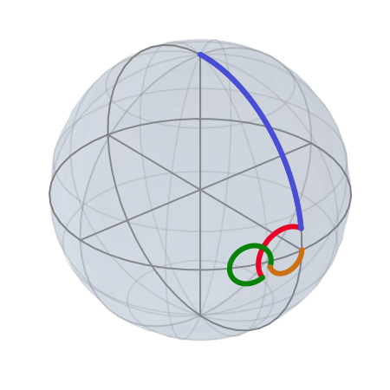
Single-Qubit Gates
Gates performed with microwaves or lasers
Ions addressed with 355 nm frequency comb
Raman beams are power stabilized
Counter-propagating
Higher overall beam intensity at ion decreases gate times
Necessary for motional addressing and two-qubit gates
Co-propagating
Immune to doppler shifts
Not affected by timing errors and pulse overlap
Compensated Pulses (BB1)
Corrects pulse-length errors
Notes:
Precursor to 2 qubit work
Mention phase lock on comb instead of repetition rate?
Variation in repetition rate corrected by feeding back on AOM frequency
Pygsti.info

Slide 18
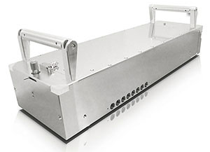
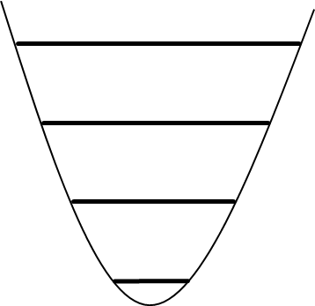
Single-Qubit Gates
Ions addressed via Raman transitions using a 355 nm frequency comb
Coherent Paladin pulsed laser
  Internal cavity is not stabilized!
  Cavity drift leads to comb “breathing”
  → Corrected with repetition rate lock
Gate Primitives
Repetition Rate Lock
AOM
Beam Configurations
Motional Addressing
Co-propagating
Immune to Doppler shifts
Not affected by timing errors and pulse overlap
Phase insensitive
Counter-propagating
Higher overall beam intensity at ion decreases gate times
Need for motional addressing
Phase sensitive
Necessary for sideband cooling to motional ground states, thermometry, two-qubit gates
Notes:
Precursor to 2 qubit work
Mention phase lock on comb instead of repetition rate?
Variation in repetition rate corrected by feeding back on AOM frequency
Pygsti.info

Slide 19
Error Mitigation
Compensated Pulses
BB1-type dynamical-decoupling pulses used
Corrects pulse-length errors
“Gapless” Pulses
Phase changed discontinuously on DDS
Avoids finite turn-on time effects
Removes errors caused by asynchronous pulse arrival
Allows for continuous power stabilization
Finite
turn-on
time
Corrects pulse-length errors
Gapless
pulse
sequence
Drift Control
(Drive Frequency)
Single-shot calibrations increase or decrease a control parameter by a negligible value
Small corrections either average out or slowly accumulate
small dephasing
prep
wait
Notes:
Just a couple examples of improvements in our system
-drift control
-gapless pulses
fixes timing errors ie pulse overlap
----- Meeting Notes (5/4/16 13:55) -----
limit discussion of drift control
648.58
162505111622

Slide 20
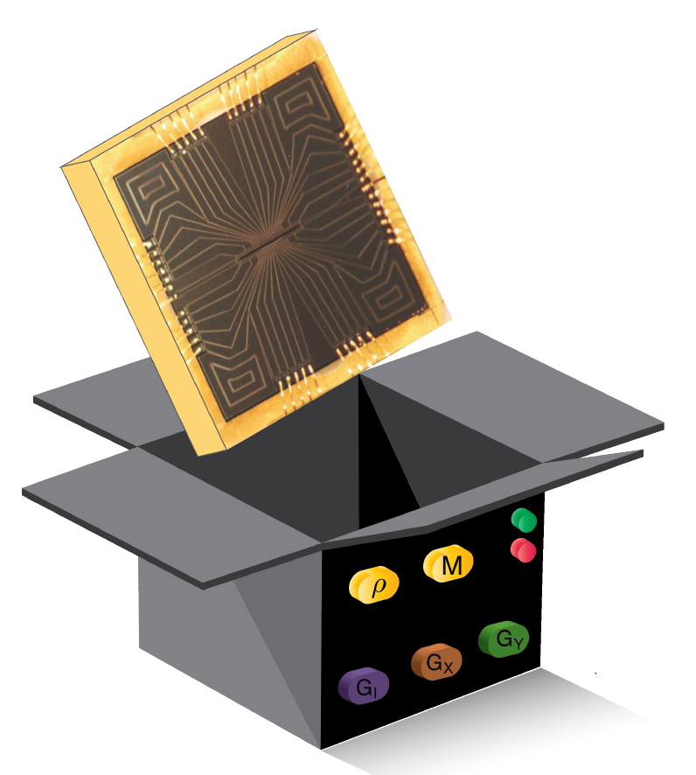
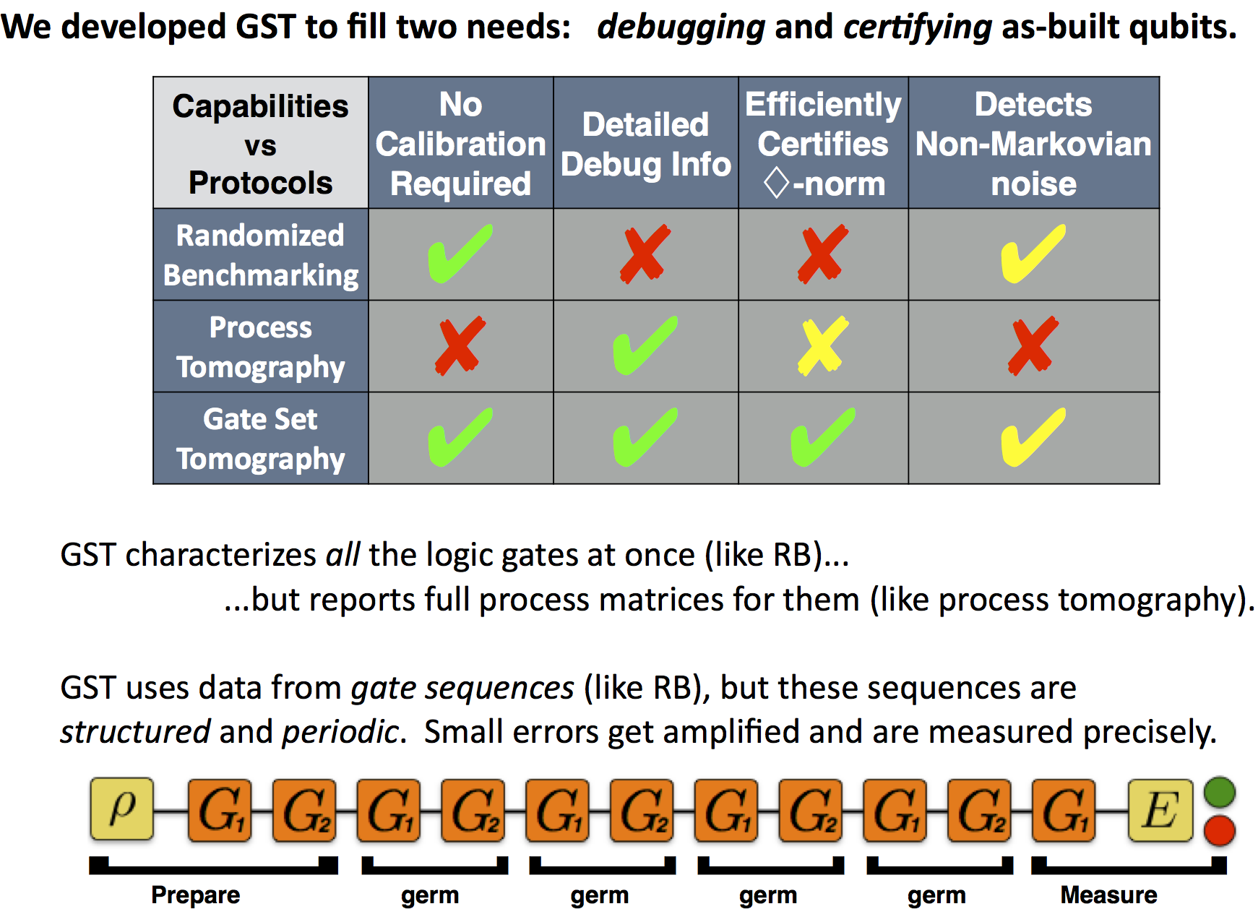
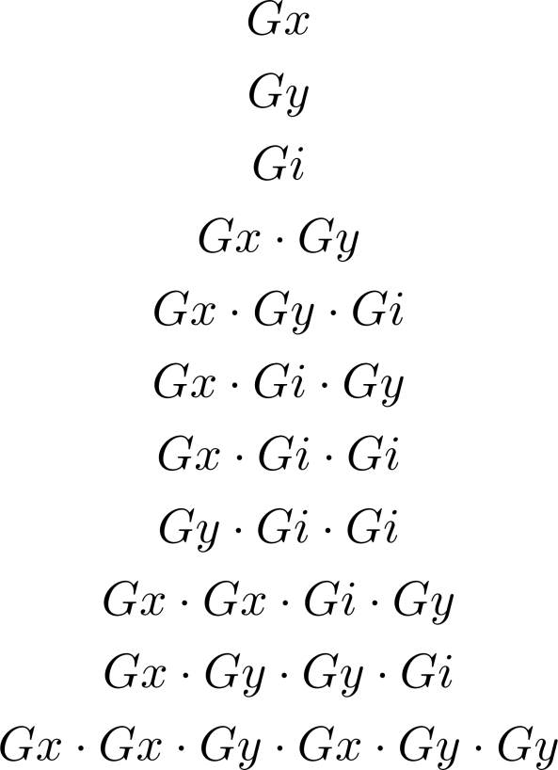
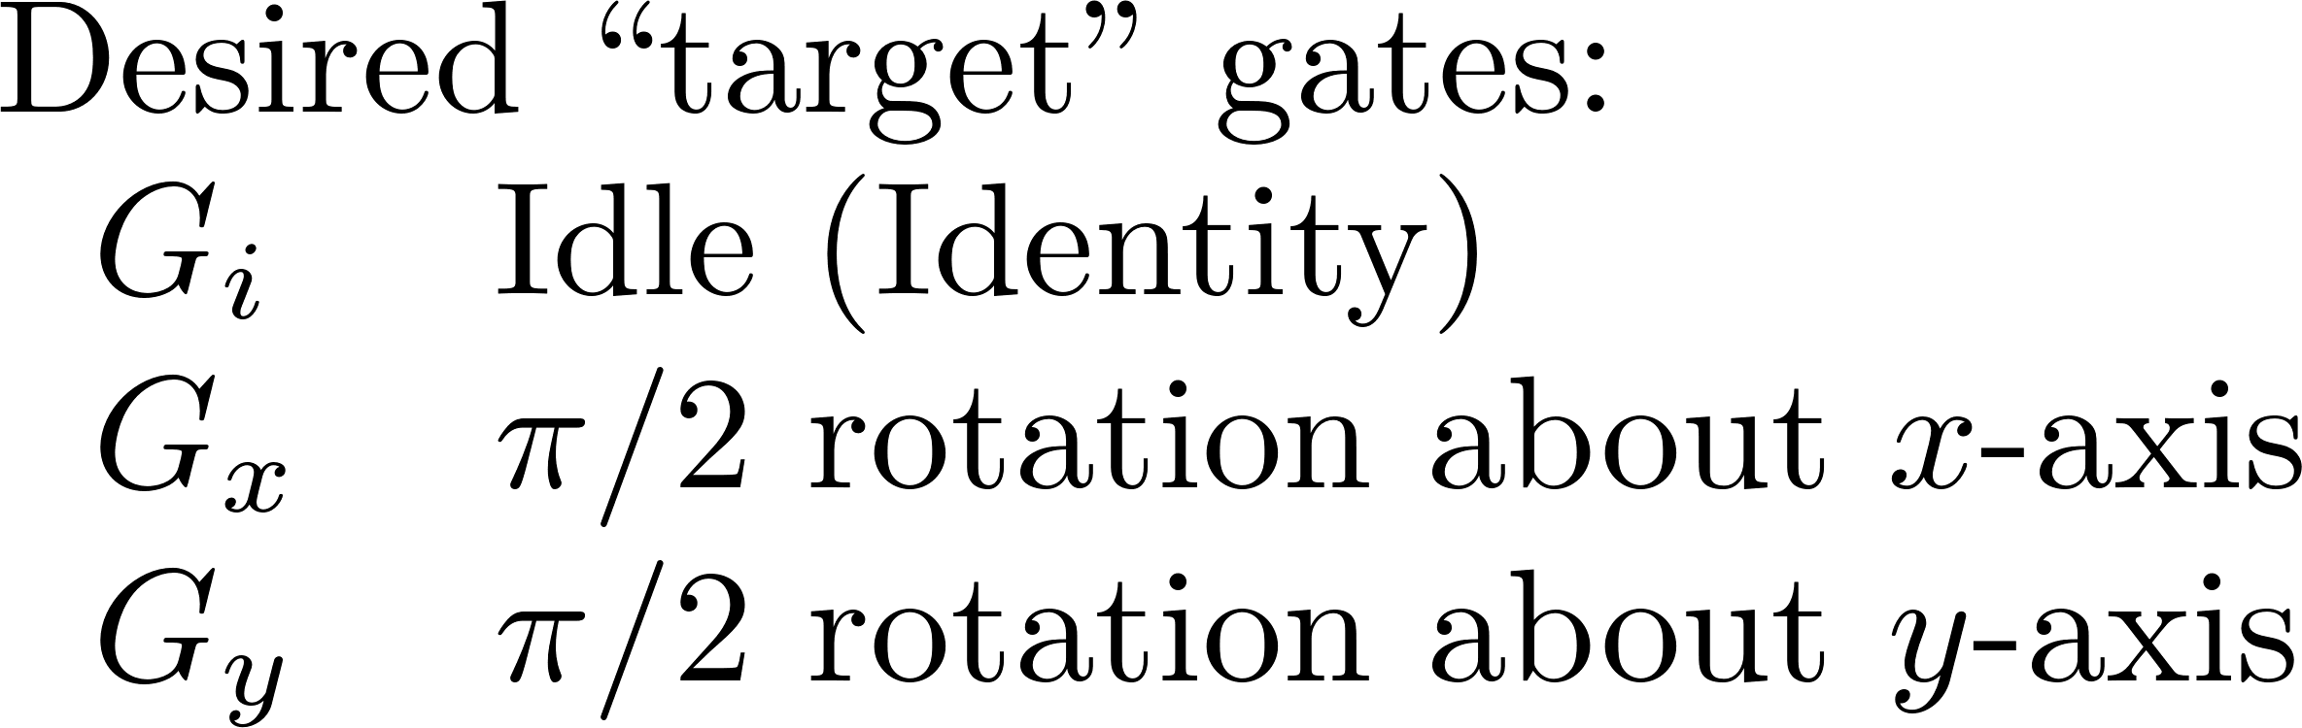
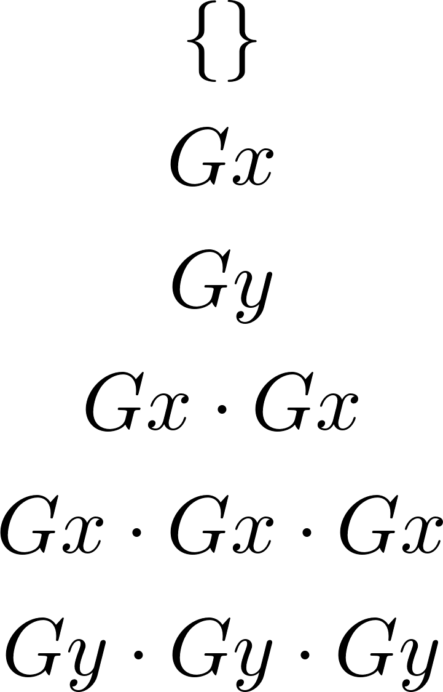
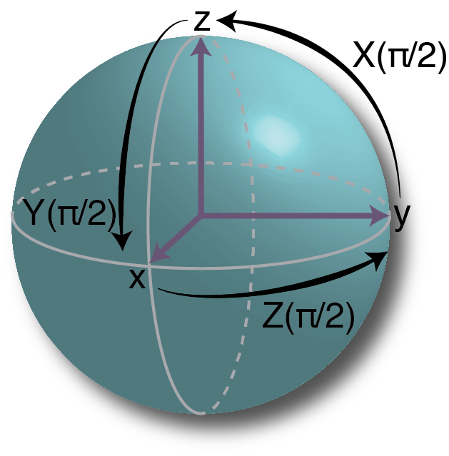
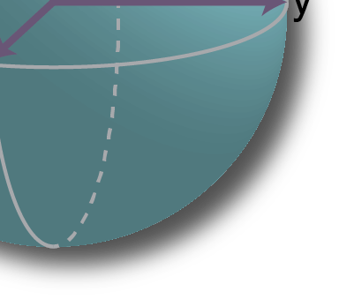
Gate Set Tomography
Developed at Sandia
www.pygsti.info
No calibration required
Detailed debug information
Detects non-Markovian noise
Efficiently measures performance characterizing fault-tolerance (diamond norm)
Uses structured sequences to amplify all possible errors
Fiducials: Used for preparing and measuring on all 6 poles of the Bloch sphere
Germs: Carefully chosen set of gate sequences applied repeatedly
Germs
Fiducials

Slide 21
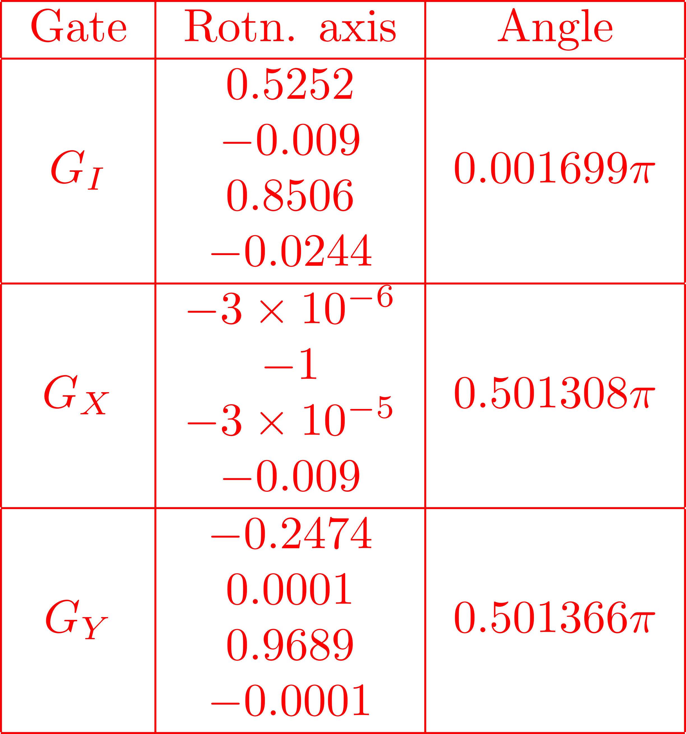
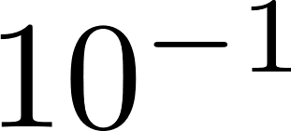


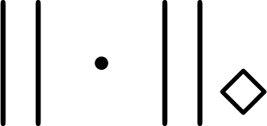

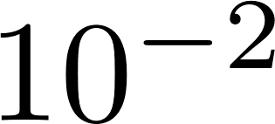


GST: debugging microwave gates

Slide 22
Error Mitigation
Compensated Pulses
BB1-type dynamical-decoupling pulses used
Corrects pulse-length errors
“Gapless” Pulses
Phase changed discontinuously on DDS
Avoids finite turn-on time effects
Removes errors caused by asynchronous pulse arrival
Allows for continuous power stabilization
Finite
turn-on
time
Gapless
pulse
sequence
Drift Control
(Drive Frequency)
Single-shot calibrations increase or decrease a control parameter by a negligible value
Small corrections either average out or slowly accumulate
small dephasing
prep
wait
Notes:
Just a couple examples of improvements in our system
-drift control
-gapless pulses
fixes timing errors ie pulse overlap
----- Meeting Notes (5/4/16 13:55) -----
limit discussion of drift control
648.58
162505111622

Slide 23

GST: debugging microwave gates
Fixed pi/2 rotations
with BB1 pulses
Fixed drift and context dependency

Slide 24
Single-Qubit GST Results
Microwave Gates
Process infidelity ≈ diamond norm
  This indicates that we have gotten rid of all systematic errors
Below the threshold for fault-tolerant error correction!
See P. Aliferis and A. W. Cross, Phys. Rev. Lett. 98, 220502 (2007)
Laser Gates
co-propagating
Co-propagating gates have infidelity comparable to microwave gates, but diamond norm indicates some residual control errors
Counter-propagating gates are noticeably worse, but are necessary for two-qubit gates
Lower fidelity presumably results from anomalous heating and optical phase sensitivity
counter-propagating

Slide 25

Two-Qubit Gate
Bichromatic entangling “Mølmer-Sørensen” gate
Gate time and detuning from motional sidebands is set so that population in motionally (de-)excited states is zero corresponding to a closed loop in phase space
Does not require ground state cooling
Requires a number of extra calibrations
  Rabi frequencies of red/blue detuned transitions matched
  Ions need to be evenly illuminated
  Phase of beat note needs to be calibrated and stable
Optimal Gate Detuning
|11>
|01>+|10>
|00>
Notes:
Phonon-mediated entangling gate that is resistant to thermal noise
Tilt mode heating rate <8 quanta/s vs 60 quanta/s for COM

Slide 26
Characterizing the
Mølmer-Sørensen Gate
Typical Approach: Entangled State Fidelity
Entangled state fidelity determined by
|11>
|01>+|10>
|00>
Repeated application of gate
Measure average population of entangled state
Apply gate followed by analyzing pulse of varying phase
Measure the resulting contrast
Notes:
Much more rigorous than entangled state fidelity measurements typically used for benchmarking the MS gate
----- Meeting Notes (5/4/16 13:55) -----
fault tolerance threshold citation
mention noise model from paper
really use the diamond norm
and the limit uses adversarial noise model
66

Slide 27

Two-Qubit GST
Raw Data
Provides a true process fidelity
Much more rigorous than entangled state fidelity
Currently limited to the symmetric subspace
Requires an extremely stable gate to take long GST measurements without constant recalibration
2 bright
Probability
1 bright
0 bright
Sequence Number
95% confidence intervals
Much more rigorous characterization
Gate is stable for several hours

Slide 28
Two-Qubit GST
Typical Approach: Entangled State Fidelity
Two-Qubit GST
Provides a true process fidelity
Currently limited to the symmetric subspace
Requires an extremely stable gate to take long GST measurements
without constant recalibration
95% confidence intervals
Much more rigorous characterization
Gate is stable for several hours

Slide 29
Outline
Sandia’s High-Optical-Access Trap
Quantum Control
Specialized Ion Traps
Classical Control

Slide 30


Microwave Surface Trap
Benefits:
Microwave radiation is easier to control and cheaper to implement than lasers
Low power for Rabi oscillations
Near field allows to generate microwave gradient fields
Challenges:
Microwave delivery
Dissipation, heating, thermal management
Localized near-field
microwaves
Large Flex cables connect directly between die and chamber

Slide 31




Microwave Magnetic Fields
Two-Current Loop Design
“Ideal” Two-Loop Design
Inner current carrying loop
z
B_{inner}
B_{outer}
$$\vec{B}=0$$
$$I_{outer}$$
$$I_{inner}$$
I_{inner}
I_{outer}
Outer current carrying loop
B_{z}
B_{inner}
x- and y- fields cancel along z-axis
Generates uniform B_{z} and dB_{z}/dz with B=0
Location of null determined by geometry and ratio of currents
B_{z total}
z
B_{outer}
Two-loop concept developed at Sandia in 2012 (SAND2015-9513)
(C. Highstrete, S. M. Scott, J. D. Sterk, C. D. Nordquist, J. E. Stevens, C. P. Tigges, M. G. Blain)

Slide 32


Microwave trap
Rabi oscillations
Losses between chamber and device ≈17dB
Realized fast Rabi flopping
330ns with 15dBm at chamber, -2dBm at device
Access to range of relevant
π-times
Will characterize gates as function of π-times.

Slide 33









EPICS Trap
  Ion trap with integrated cavity
  and detector
Optomechanical Integration
SNSPD Detector
Development
& Integration (NIST/JPL)
Ion Trap Fabrication (Duke/SNL)
JPL/NIST
SNSPD die
EPICS trap die
SNL Si
interposer

Slide 34


EPICS Trap
  Integrated Superconducting Nanowire Single-Photon Detector (SNSPD) detector and reflective backplane
    Detector developed by JPL/NIST
  SNSPD provides higher photon detection (>80% vs <30%)
  Cavity-QED provides higher photon collection efficiency
  Strong coupling regime enables qubit measurement via fast cavity transmission
  Extra rf electrodes enable alignment
  of rf node with cavity modes
spacer
Ion Trap Fabrication (Duke/SNL)
JPL/NIST
SNSPD die
EPICS trap die
SNL Si
interposer
  collaboration with

Slide 35
EPICS Trap
  Integrated Superconducting Nanowire Single-Photon Detector (SNSPD) detector and reflective backplane
    Detector developed by JPL/NIST
  SNSPD provides higher photon detection (>80% vs <30%)
  Cavity-QED provides higher photon collection efficiency
  Strong coupling regime enables qubit measurement via fast cavity transmission
  Extra rf electrodes enable alignment
  of rf node with cavity modes
spacer
Ion Trap Fabrication (Duke/SNL)
JPL/NIST
SNSPD die
EPICS trap die
SNL Si
interposer
  collaboration with

Slide 36

Thank you
Trap design fabrication
Matthew Blain
Ed Heller
Corrie Herrmann
Becky Loviza
John Rembetski
Paul Resnick
SiFab team
Trap packaging
Ray Haltli
Drew Hollowell
Anathea Ortega
Tipp Jennings
Trap design and testing
Peter Maunz
Craig Hogle
Daniel Lobser
Melissa Revelle
Dan Stick
Christopher Yale
RF Engineering
Christopher Nordquist
Stefan Lepkowski
GST protocols
Robin Blume-Kohout
Kenneth Rudinger
Eric Nielsen
Coming Soon:
Quantum Scientific Open User Testbed (QSCOUT)
Quantum processor with 5 – 15 qubits
Realized in trapped ion technology
Features
Low single and two qubit error rates (<10⁻⁴, <2 × 10⁻²)
All to all connectivity between qubits
Random algorithm execution capability
Access to all relevant low-level implementation details
Capability to change low-level gate implementation
User support
Exemplar programs and demonstrations
User workshops and conferences (together with LBNL)
Availability
Available to the DOE Scientific computing community
First device will come online at end of 2019
Postdocs wanted!
Apply @ https://sandia.gov/careers → View All Jobs → Search “665253”
Questions? dlobser@sandia.gov

Slide 37
Motivation
Quantum Information
Qubit Implementations
Quantum chemistry
Calculation of molecular potentials
Nitrogen and Oxygen fixation, development of catalytic converters
Medicine
Structure-based drug development
Quantum computing
Number factorization (Shor’s algorithm)
Search in unstructured data, searching for solutions to hard problems
(Grover’s search algorithm)
Quantum simulation
Simulating many-body systems
Already for about 20 qubits not possible to simulate classically.
Quantum Communication
Securing a quantum channel
Trapped Ions
Blatt and Wineland “Entangled States of Trapped Atomic Ions.” Nature 453, 1008–15 (2008).
Monroe and Kim. “Scaling the Ion Trap Quantum Processor.” Science 339, 1169 (2013)
Neutral Atoms
Rydberg states
Atoms in cavities
Superconducting Josephson junctions
Devoret and Schoelkopf. “Superconducting Circuits for Quantum Information: An Outlook.” Science 339, 1169 (2013).
Quantum dots
Awschalom, et al., “Quantum Spintronics: Engineering and Manipulating Atom-Like Spins in Semiconductors.” Science 339, 1174 (2013).

Slide 38
Brief Overview of Ion Trapping
Earnshaw’s Theorem: Static electric fields can’t create a stable confining potential for charged particles
r.f. Paul Trap
Segmented Paul Trap
Better control over confining potential
Difficult to construct
Doesn’t scale well
r.f. pseudopotential
Microfabricated Surface Trap
Consistent, well-defined electrode layout
Microfabrication supports a lot of exotic electrode geometries
Excellent control over potential
Very scalable
Time-averaged potential is close to harmonic at the saddle point
Off the saddle point, ions experience micromotion
Works well for linear chains of ions
Doesn’t support fine control of ion position or confining potential
House, PRA 78 033402 (2008)

Slide 39

Measuring swap fidelity
Prepare (PB pulse)
PMT 1
PMT 2
Relax
Compress
Swap
Relax
Detect
Mean*

Slide 40
Swap verification
Ion 1
Ion 2
Displacing the Raman beam leads to disparate Rabi frequencies
Optimum
Ion 1
Contrast is improved by using PB1 compensated pulses
Ion 2
Pulse Time (us)

Slide 41
Swap breakdown
The absolute upper bound on velocity for a successful swap is limited by timing constraints
Swaps degrade after multiple rotations
Swap yield is determined by decay of the mean, given by (1-P(|0>)+P(|1>))/2
PMT 1
PMT 1
PMT 2
PMT 2
Mean*
Number of Swaps
Number of Swaps
6.2 us
10.3 us
vs

Slide 42


Trap fabrication
Capabilities & Requirements
Derived requirements
Standardization (lithographically defined electrodes)
Multi-unit production
Multi-level lead routing for accessing interior electrodes
Voltage breakdown >300 V @ ~50 MHz
Overhung electrodes
Low electric field noise (heating)
Backside loading holes
Trench capacitors
High optical access (delivery and collection)
Top layer electrodes
Undercut and gold coated to reduce dielectric in line of sight of ion
Inner electrodes
60 μm
Multi-level routing
View from above

Slide 43




High Optical Access (HOA)

Slide 44



Shuttling Solutions
Same method can be used along entire trap
Solution for Ex field in increments of 5 um
left edge
Ion Position
center
Ex
right edge
Electrode Number

Slide 45
Shuttling Solutions
Generate basis solutions for each point
Advantages:
Solution are orthogonal
Full parametric control over trap parameters at each point during shuttling
Optimization techniques, such as machine learning or search algorithms, can be used to dynamically change basis amplitudes for improved shuttling
Shuttling primitives can easily be decoupled, for example crystal rotation or linear shuttling at any position in the trap

Slide 46
Trap frequency vs linear offset
Trap frequencies are stable to within 16 kHz over the course of linear shuttling
12kHz
16kHz

Slide 47
Optimization
Shuttling in linear section over 140µm, 5 repeats
Optimization performed with a Nelder-Mead type simplex algorithm
12 degrees of freedom
for x, y, z offset fields
Quanta
First attempts at optimization demonstrate nearly a factor of 2 in heating rate during shuttling

Slide 48


Microwave trap properties

Slide 49






Two-qubit gate implementation
Mølmer-Sørensen gates [1] using 355nm pulsed laser
All two-qubit gates implemented using Walsh compensation pulses [2]
n+1
“Vertical”
“Horizontal”
n
n-1
Tilt
COM
Tilt
COM
n+1
n+1
n
n
n-1
n-1
n+1
n
n-1
Heating rates
[1] K. Mølmer, A. Sørensen, PRL 82, 1835 (1999)
[2] D. Hayes et al. Phys. Rev. Lett. 109, 020503 (2012)

Slide 50




GST on symmetric subspace
Basic gates:
Germs: Detection Fiducials:
Preparation Fiducials:

Slide 51


Scaling trapped ion systems
Quantum charge coupled device
Kielpinsky, Monroe and Wineland, Nature 417, 709 (2002)
MUSIQC scaling (scaling beyond a single chip using remote entanglement)
Monroe, et al., Physical Review A 89, 022317 (2014).

Slide 52
The Ytterbium Qubit
²P_{1/2}
2.1 GHz
369 nm
Doppler Cooling
²S_{1/2}
12.6 GHz
clock state qubit, magnetic field insensitive.
S. Olmschenk et al., PRA 76, 052314 (2007)

Slide 53
state initialization
²P_{1/2}
2.1 GHz
369 nm
²S_{1/2}
12.6 GHz
clock state qubit, magnetic field insensitive.
S. Olmschenk et al., PRA 76, 052314 (2007)

Slide 54
¹⁷¹Yb⁺ state detection
²P_{1/2}
2.1 GHz
²S_{1/2}
12.6 GHz
S. Olmschenk et al., PRA 76, 052314 (2007)
Notes:
Have just S and P states there at first… then D… the D[]… and then, finally, F and whatever the crappy state is that we use to pump out of F.

Slide 55
Swapping fidelity
209 us
Swap fidelity
1658 us
416 us
830 us
Number of rotations
18.6 us
Best fidelity between 20µs and 200µs
Failure probability increases with number of swaps (heating)
Swap fidelity
14.5 us
10.3 us
Number of rotations

Slide 56



HOA-2 heating rates
¹⁷¹Yb⁺, Trap frequency 2.8 MHz, r.f. 50 MHz
Heating rates as function of principal axes rotation
Principal axes rotation measured by measuring π-times of Rabi flopping on cooled motional modes
Minimal heating rates for motional mode parallel to trap surface
Without technical noise: Vertical mode has at most
(P. Schindler, et al., Phys. Rev. A 92, 013414 (2015).
Limited by technical noise

Slide 57
Compression of ion chains
lifetime
15 min
1.5 hours
> 16 hours

Slide 58

Linear chain melting

Slide 59

Slightly buckled chain stability

Slide 60

Ramping up buckling

Slide 61
Ion “braid” stability

