Slide 1
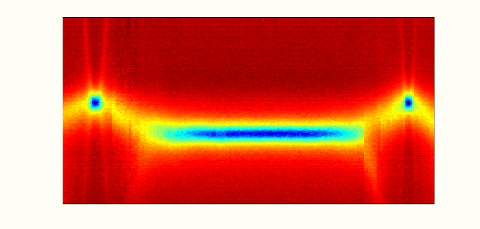
CPB/NR/LC
Absorption
Spectrum
Plus some new ideas these systems have inspired related to quantum networking
Image: LC Circuit-CPB-NR Spectroscopy
Hybrid Quantum Systems Composed of Superconducting Qubits, Nanomechanics, and Transmission Line Metamaterials
Matt LaHaye – Syracuse University
Number-state-resolved Stark shift of transmon due to CPW Cavity Dispersive Interaction
Rabi Oscillations of transmon while coupled to NR and CPW Cavity
CPB-NR-LC Absorption Spectrum
Photonics for Quantum Workshop$−$RIT $−$ 24 January 2019

Slide 2
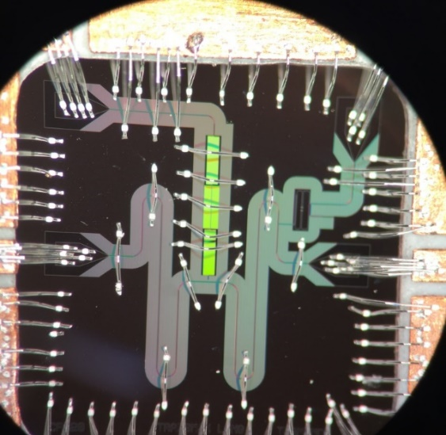
Outline
LaHaye Group
Recent Motivating Work
- Transmon-Coupled Nanoresonators
(LaHaye Group)
Image from Plourde Group
- Superconducting Metamaterial Transmission Lines (Plourde Group)
New Ideas:
- Metamaterials coupled to NR and superconducting qubits… potential applications for QIP (e.g. memory, transduction…)
From Tacchino et al. PRB 97, 214302 (2018)
- ~Recently published papers by theory collaborators using arrays/networks of transmon-coupled NRs for quantum simulation

Slide 3
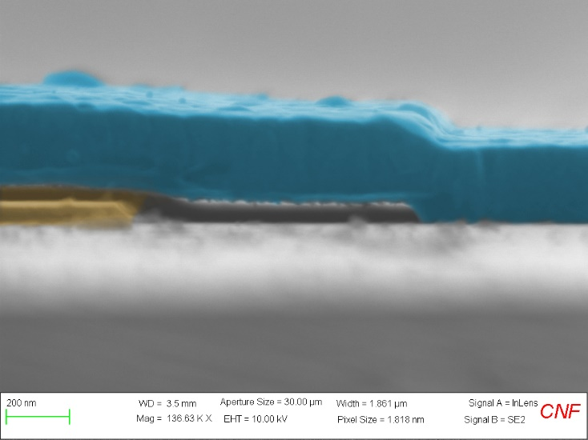
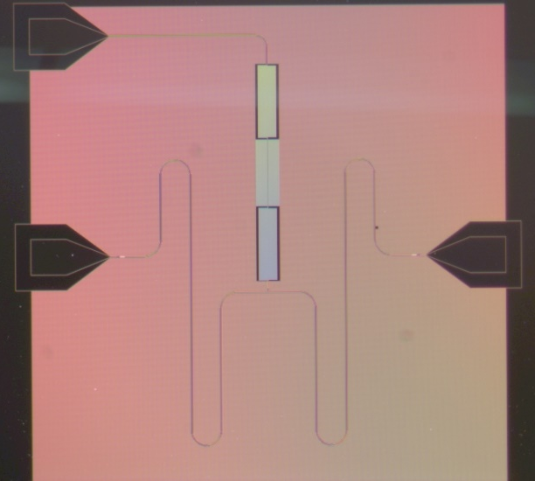
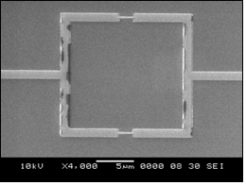
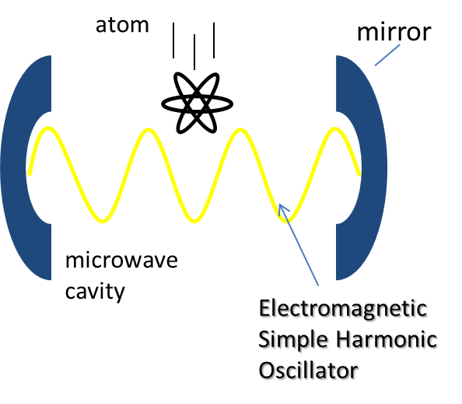



Suspended Mechanical Elements
$$1 mm$$
Josephson-Junction based qubits
Integrate
Integrate
$$200 nm$$
DC-Biased Superconducting Microwave Cavities
$$5 μm$$
Images from LaHaye Group (Fab by Hao and Rouxinol)
Development of Qubit-Coupled Mechanical Systems in the LaHaye Group at Syracuse
Fabrication at CNF & in Plourde Lab (SU)
Impetus: Develop qubit-coupled nano/micro/larger (!) mechanical systems as an architecture for exploring/utilizing quantum properties of motion at macroscale
Impetus: Develop the system as a resource for quantum information & quantum thermodynamics
Systems are analogous to circuit/cavity quantum electrodynamics (c/CQED) systems

Slide 4
cQED/CQED: A Resource for Mechanics
JJ-based qubits + cQED Technology offer the following
Fluxonium Qubit (Devoret Group)
From I. Pop et al. Nature 508, 370 (2014)
Strong non-linearities
Exquisite control
High quality coherence
Characteristics used for explorations of quantum behavior in EM oscillators and QIP
By analogy, this technology can be utilized for engineering/measuring quantum mechanical states of motion & QIP with electromechanical elements
Measurement of Microwave cavity number statistics via transmon (Schoelkopf Group) From D. Schuster et al. Nature 445, 515 (2007)
Asymmetric transmon (Plourde group & IBM) From M.Hutchings et al. Phy. Rev. Appl. 8, 044033 (2017)

Slide 5
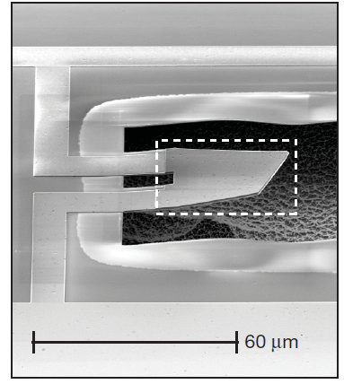
LaHaye et al. 2009 (Roukes Group)
O’Connell et al. 2010
(Cleland Group)
Pirkalainen et al. 2013
(Sillanpaa Group)
Abridged History of Quantum Electromechanics with Superconducting Qubits and Mechanical Modes
Short List of Qubit-Mechanics References
Initial idea published on qubit-nanoresonator
- A. Armour, M. Blencowe, & K.C. Schwab, PRL (2002)
First experimental demonstration
- M.D. LaHaye et al., Nature (2009)
- A. O’Connell et al., Nature (2010)
Increasingly sophisticated
Experiments
Using better circuitry/qubits
from cQED!
- J. M. Pirkalainen et al., Nature (2013)
LaHaye
Group
- F. Rouxinol et al., Nanotechnology (2016)
- Y. Chu, et al., Science (2017), Nature (2018)
(Schoelkopf group) Mechanical quantum state control

Slide 6
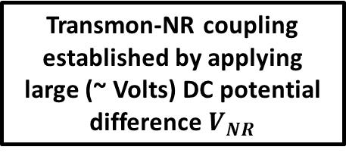
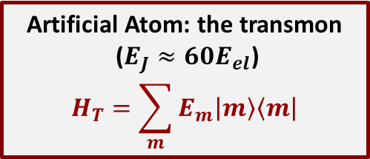
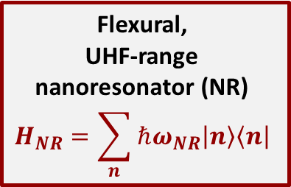
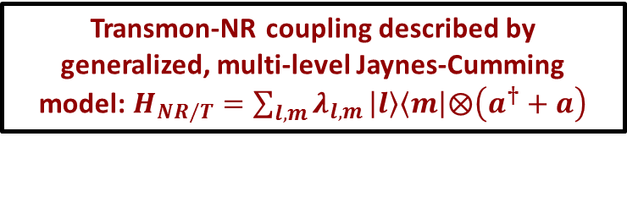
Quantum Electromechanical Schematic – Transmon qubit, NR, CPW Cavity
F. Rouxinol, Y. Hao, F. Brito, A. Caldeira, E.K. Irish, and M. LaHaye. Nanotechnology 27, 364003(2016)
Flexural,
UHF-range nanoresonator (NR)
$$H_{NR}=\sum_{n}{ℏω_{NR}\left.\left|n\right.\right\rangle \left\langle \left.n\right|\right.}$$
Transmon-NR coupling established by applying large (~ Volts) DC potential difference $V_{NR}$
Superconducting
CPW Cavity
Artificial Atom: the transmon
($E_{J}≈60E_{el}$)
$$H_{T}=\sum_{m}{E_{m}\left.\left|m\right.\right\rangle \left\langle \left.m\right|\right.}$$
Transmon-NR coupling described by generalized, multi-level Jaynes-Cumming model: $H_{NR/T}=\sum_{l,m}{λ_{l,m}}\left.\left|l\right.\right\rangle \left\langle \left.m\right|\right.⨂\left(a^{†}+a\right)$

Slide 7

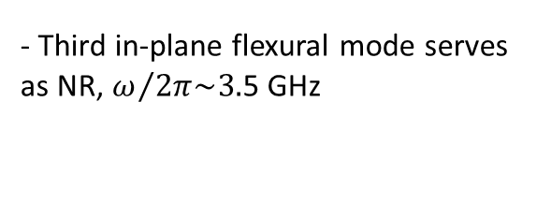
Design of Qubit-Mechanics Samples
F. Rouxinol, Y. Hao, F. Brito, A. Caldeira, E.K. Irish, and M. LaHaye. Nanotechnology 27, 364003(2016)
SEM Image of Nanoresonator (NR)
SEM Image of Transmon Qubit and Circuitry
Silicon substrate
Large Nb shunt capacitor
35 nm
Al Josephson junctions
Nb Flux
Bias loop
Nb ground plane
- Suspended nanostructure fabricated from Al
- Devices engineered at CNF and SU (Plourde Lab), using optical/e-beam lithography and RIE etchs
- Separated from qubit by 35 nm
*Fab performed by F. Rouxinol, Y. Hao*
- Third in-plane flexural mode serves as NR, $ω/{2π\sim 3.}$5 GHz
- Transmon embedded in ground plane of CPW cavity near a voltage anti-node of fundamental mode
Can tune qubit $ΔE$ thru this frequency
- Flux bias loop on chip for tuning transmon transition energy
Low thermal occupation at mK temps

Slide 8
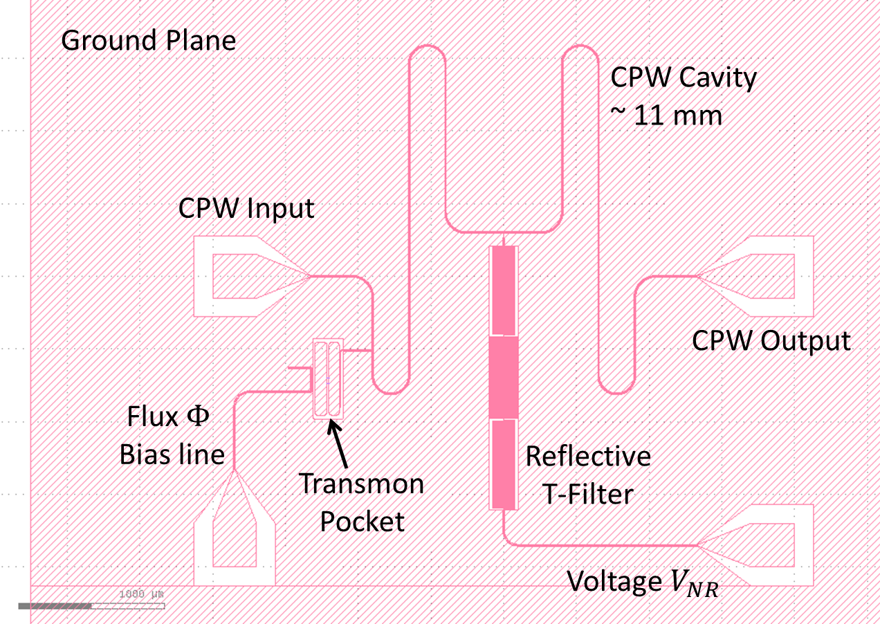
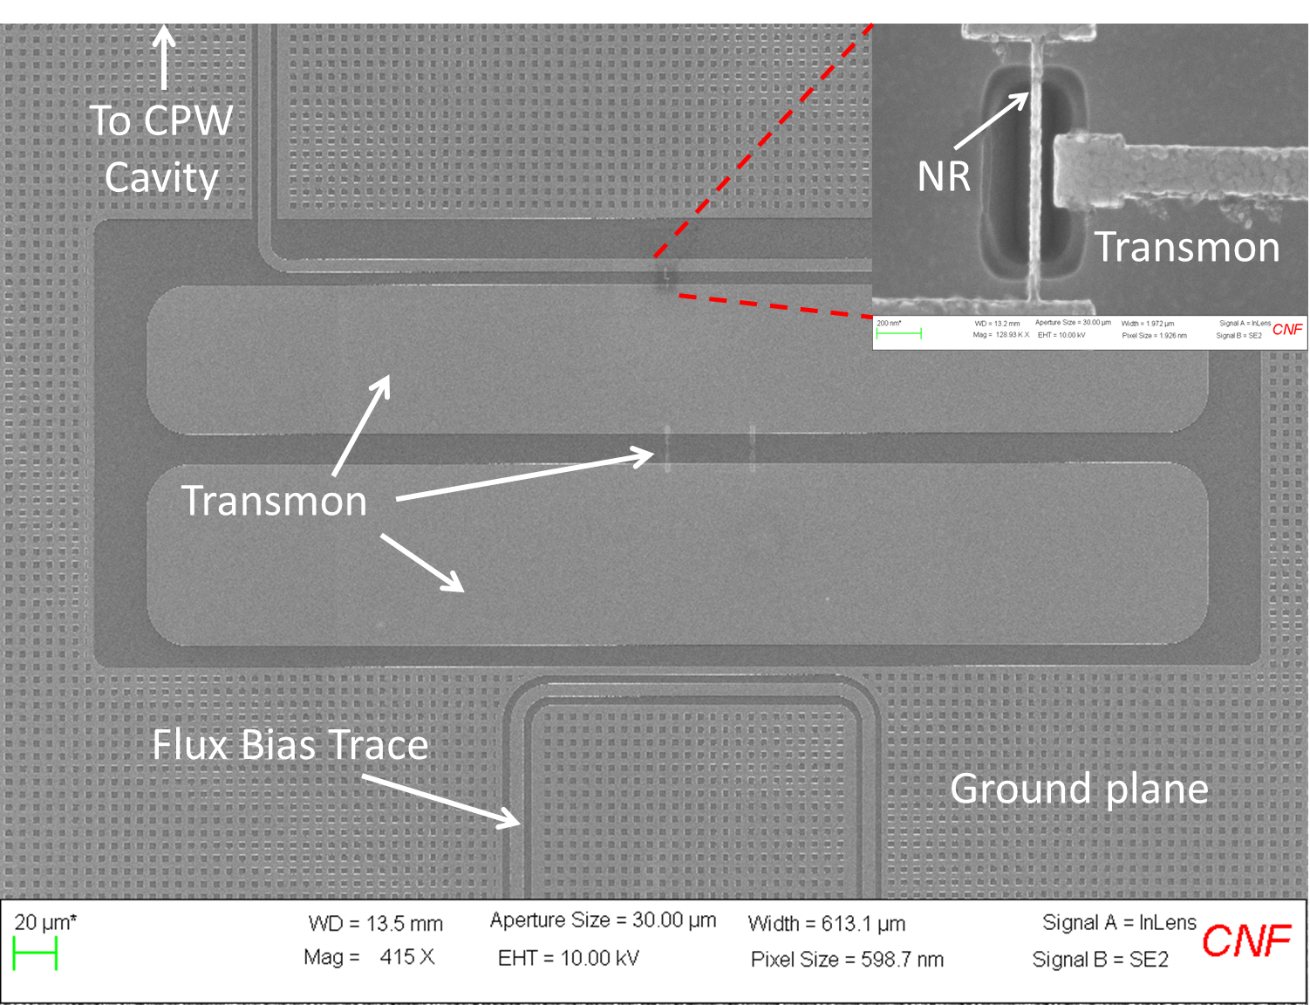
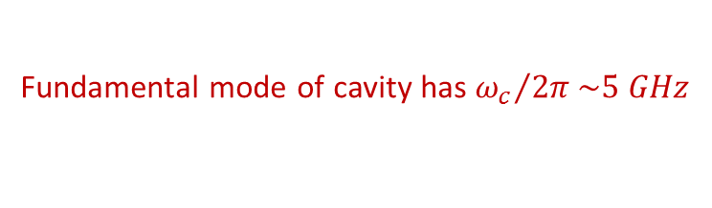
CPW Cavity for Read-Out of Qubit-Mechanics
F. Rouxinol, Y. Hao, F. Brito, A. Caldeira, E.K. Irish, and M. LaHaye. Nanotechnology 27, 364003(2016)
CAD Drawing of Coplanar Waveguide Cavity
Integrate transmon & NR into high-Q CPW cavity for dispersive measurement
Transmission of microwaves through CPW depends on state of the qubit
Coupling Capacitors
T-filter allows application of DC coupling voltage V_{NR} without degrading Q-factor of the CPW (Q’s as high as 200,000 achieved)
See Hao, Rouxinol, LaHaye APL 105, 222603 (2014) for filter details
Coupling
Capacitor
Fundamental mode of cavity has ${ω_{c}}/{2π}\sim 5 GHz$
Embed qubit+NR in ground-plane near voltage anti-node of fundamental mode

Slide 9



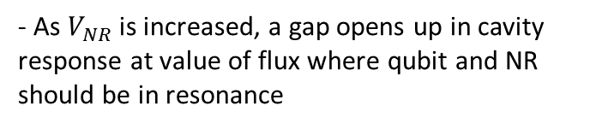



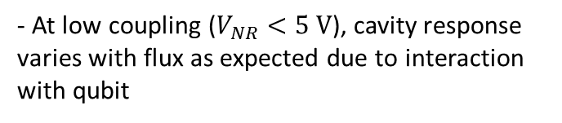



Measurements of Resonant Interaction with NR (Perfromed by F. Rouxinol, Y. Hao)
Transmission Measurements of the Microwave Cavity with Qubit-NR Coupling Applied
(Sample on fridge at 30 mK)
Amplitude (dBm)
Amplitude (dBm)
Usual cavity response
Qubit energy = NR energy
Cavity Probe Tone ($GHz)$
Cavity Probe Tone ($GHz)$
$$V_{NR}=4.5 V$$
$$V_{NR}=5.5 V$$
Qubit Flux ($Φ_{0})$
Qubit Flux ($Φ_{0})$
Amplitude (dBm)
- At low coupling ($V_{NR}<5 V$), cavity response varies with flux as expected due to interaction with qubit
Qubit energy = NR energy
Cavity Probe Tone ($GHz)$
- As $V_{NR}$ is increased, a gap opens up in cavity response at value of flux where qubit and NR should be in resonance
$$V_{NR}=6.5 V$$
- Resonant interaction between qubit and NR leads to hybridization* and shifts cavity response
Qubit Flux ($Φ_{0})$

Slide 10



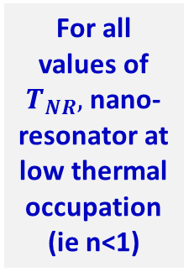







Measurement and Simulation of Resonant Interaction
F. Rouxinol, Y. Hao, F. Brito, A. Caldeira, E.K. Irish, and M. LaHaye. Nanotechnology 27, 364003(2016)
Data
Data
Data
Heating of NR is a design flaw that we know how to fix
$$V_{NR}=4.5 V$$
$$V_{NR}=5.5 V$$
$$V_{NR}=6.5 V$$
Cavity Probe Tone (GHz)
$$λ=1.35 MHz$$
$$λ=1.65 MHz$$
$$λ=1.95 MHz$$
For all values of $T_{NR},$ nano-resonator at low thermal occupation
(ie n<1)
$$T_{NR}=30 mK$$
$$T_{NR}=100 mK$$
$$T_{NR}=180 mK$$
Simulation
Simulation
Simulation
Magnetic Flux Applied to Qubit ($Φ_{0}$)
Simulation: Lindblad master equation with coupled dynamics of CPW, qubit, & NR; relaxation & temperature terms for all three - Performed by collaborators: F. Brito (Sao Carlos), A. Caldeira (Campinas), E. Irish (Southampton)
$T_{NR}$ only free parameter in the simulation – all others determined through other measurements

Slide 11
Measurement and Simulation of Resonant Interaction
F. Rouxinol, Y. Hao, F. Brito, A. Caldeira, E.K. Irish, and M. LaHaye. Nanotechnology 27, 364003(2016)
Data
Data
Data
$$V_{NR}=4.5 V$$
$$V_{NR}=5.5 V$$
$$V_{NR}=6.5 V$$
Did not observe quantum Rabi swapping or other coupled dynamics due to two design flaws: heating of NR due to parasitic substrate current and and low NR quality factor (clamping loss)
Cavity Probe Tone (GHz)
$$λ=1.35 MHz$$
$$λ=1.65 MHz$$
$$λ=1.95 MHz$$
$$T_{NR}=30 mK$$
$$T_{NR}=100 mK$$
$$T_{NR}=180 mK$$
Simulation
Simulation
Simulation
Magnetic Flux Applied to Qubit ($Φ_{0}$)
Simulation: Lindblad master equation with coupled dynamics of CPW, qubit, & NR; relaxation & temperature terms for all three (Performed by collaborators: F. Brito (Sao Carlos), A. Caldeira (Campinas), E. Irish (Southampton)
$T_{NR}$ only free parameter in the simulation – all others determined through other measurements

Slide 12


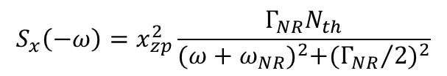


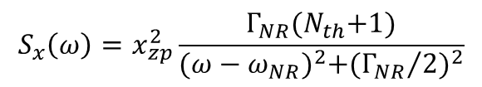
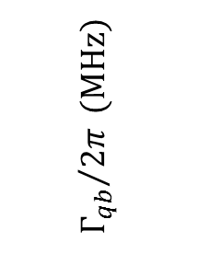




Qubit as a Spectrometer* of NR Noise
F. Rouxinol, Y. Hao, F. Brito, A. Caldeira, E.K. Irish, and M. LaHaye. Nanotechnology 27, 364003(2016)
Measurement of Qubit Linewidth Vs. Transition Energy
NR quality factor was very low
$$\frac{λ^{2}}{ℏ^{2}}S_{x}\left(ΔE\right)$$
$$Q_{NR}≈150$$
$${Γ_{qb}}/{2π} (MHz)$$
$$\frac{Γ_{NR}}{2π}≈3 MHz$$
$$> λ$$
$$ΔE/ℏ=ω_{NR}$$
Future Experiments to probe both +/- frequency noise terms also motivates using NR as an engineered reservoir quantum thermodynamics
Weak-coupling limit
$$∆E (GHz)$$
In weak-coupling limit, NR acts like a dissipative bath*, leading to an increase in qubit linewidth as qubit is tuned through resonance with NR
$$N_{th}⟶0$$
$$S_{x}\left(ω\right)=x_{zp}^{2}\frac{Γ_{NR}{(N}_{th}+1)}{{(ω−ω_{NR})}^{2}+{({Γ_{NR}}/2)}^{2}}$$
$${ΔΓ}_{qb}=\frac{λ^{2}}{ℏ^{2}}\left[S_{x}\left(ω\right)+S_{x}(−ω)\right]$$
$$\frac{λ^{2}}{ℏ^{2}}S_{x}\left(ω\right)$$
NR Absorption
NR Spectral Densities
$$S_{x}\left(−ω\right)=x_{zp}^{2}\frac{Γ_{NR}N_{th}}{{(ω+ω_{NR})}^{2}+{({Γ_{NR}}/2)}^{2}}$$
*See Schoelkopf et al. arXiv:cond-mat/0210247 (2003)
NR Emission

Slide 13
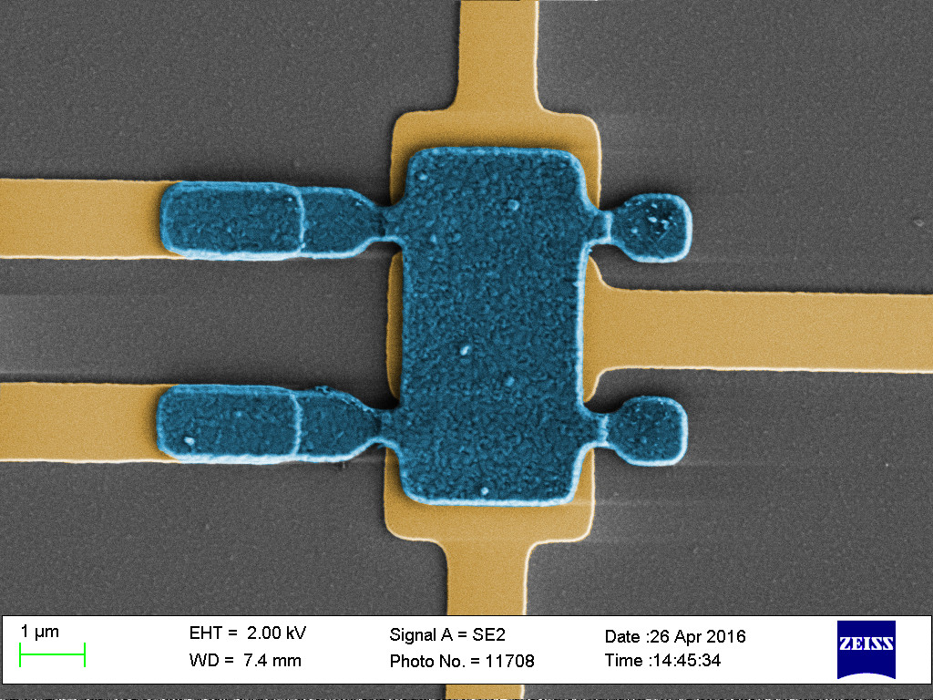
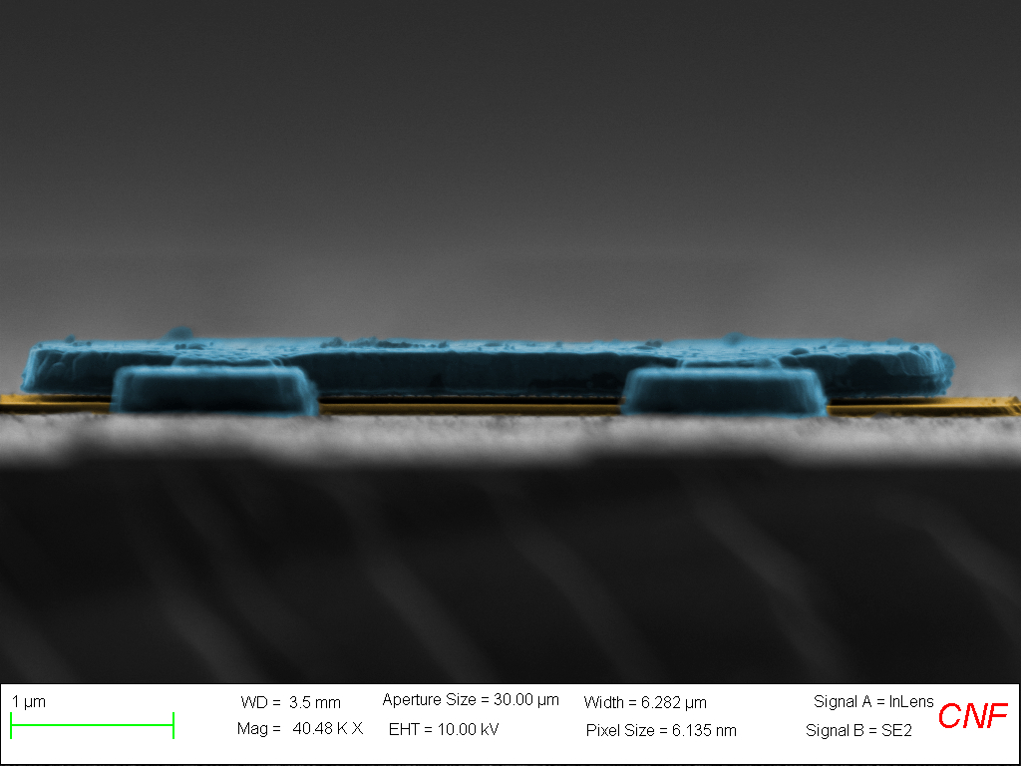
New Mechanical Plate/Membrane Elements
Engineer strong coupling to transmons
Higher Q mechanical modes
Fabrication by Y. Hao
Unfortunately, ran out of funding at this point…
Lowest Mode Frequency ~ 80 MHz
Have not tested properties at milli-Kelvin temperatures
Have higher Q: Q~1000 at 77K

Slide 14
Outline
LaHaye Group
Recent Motivating Work
- Transmon-Coupled Nanoresonators
(LaHaye Group)
Image from
Plourde Group
- Superconducting Metamaterial Transmission Lines (Plourde Group)
New Ideas:
- Metamaterials coupled to NR and superconducting qubits… potential applications for QIP (e.g. memory, transduction…)
From Tacchino et al. PRB 97, 214302 (2018)
- ~Recently published papers by theory collaborators using transmon-coupled NRs for quantum simulation

Slide 15
Superconducting Metamaterial Transmission Lines - Motivation
Location of inductors and capacitors swapped in LHTL
Spatial overlap of modes in RHTL enables modes to strongly coupled to a nearby qubit
Coupling a left-handed transmission line (LHTL) with a right-handed one (RHTL), results in dispersion relation that yields a dense set of modes that can couple strongly to a qubit (multi-mode strong coupling regime).
Potential for multipartite entanglement generation, quantum simulation (e.g. spin boson model)

Slide 16
Superconducting Metamaterial Transmission Lines – Periodic Array of Reactances
*Circuit schematics, figure from Plourde Group – H. Wang et al. arXiv:1812.02579v1 *
- To implement, need to fabricate a periodic array of lumped-element reactances
‘Falling’ Dispersion Relation
Density of modes diverges at zone edge
Infrared
Cut-off
- Of course, real components have parasitic reactances
Parasites
Gap Opens in Dispersion Relation
See H. Wang et al. arXiv:1812.02579v1 for full expression

Slide 17
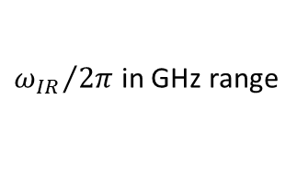
Superconducting Metamaterial Transmission Lines – Periodic Array of Reactances
*Circuit schematics, figure from Plourde Group – H. Wang et al. arXiv:1812.02579v1 *
- To implement, need to fabricate a periodic array of lumped-element reactances
‘Falling’ Dispersion Relation
Density of modes diverges at zone edge
Still have infrared cut-off and divergence of density of modes
- Of course, real components have parasitic reactances
Parasites
${ω_{IR}}/{2π}$ in GHz range
Gap Opens in Dispersion Relation
See H. Wang et al. arXiv:1812.02579v1 for full expression

Slide 18
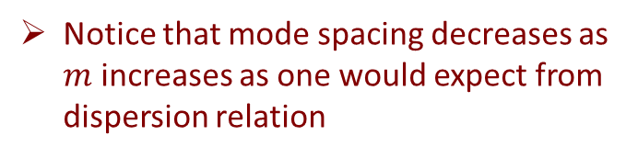
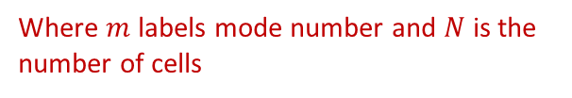
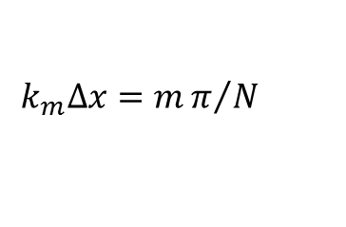

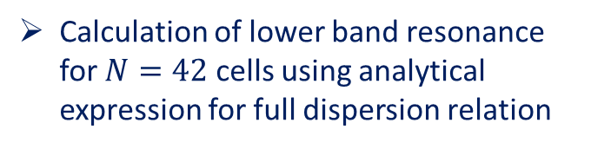

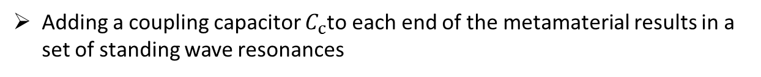

Superconducting Metamaterial Transmission Line Cavity – Resonant Modes
*Circuit schematics, figure from Plourde Group – H. Wang et al. arXiv:1812.02579v1 *
Adding a coupling capacitor $C_{c}$to each end of the metamaterial results in a set of standing wave resonances
Coupling capacitor
Usual Standing Wave Relation
$$k_{m}∆x=mπ/N$$
Where $m$ labels mode number and $N$ is the number of cells
$$m=1$$
Calculation of lower band resonance for $N=42$ cells using analytical expression for full dispersion relation
$$k\left(ω\right)∆x=\cos^{−1}\left[1−\frac{1}{2}\left(ωL_{R}−\frac{1}{ωC_{L}}\right)\left(ωC_{R}−\frac{1}{ωL_{L}}\right)\right]$$
$$m=41$$
Notice that mode spacing decreases as $m$ increases as one would expect from dispersion relation

Slide 19
Superconducting Metamaterial Transmission Line Cavity – Implementation (Plourde Group)
*Haozhi Wang et al. arXiv:1812.02579v1 *
Slide courtesy of
B. Plourde

Slide 20
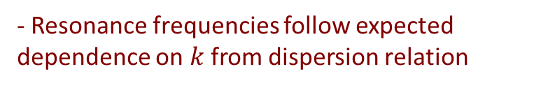
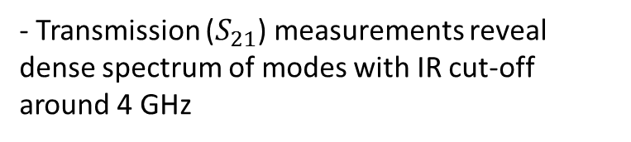
Superconducting Metamaterial Transmission Line Cavity – Transmission Characteristics (Plourde Group)
*Figures from Plourde Group – H. Wang et al. arXiv:1812.02579v1*
Minimum mode spacing ~147 MHz
- Transmission ($S_{21}$) measurements reveal dense spectrum of modes with IR cut-off around 4 GHz
- Resonance frequencies follow expected dependence on $k$ from dispersion relation

Slide 21
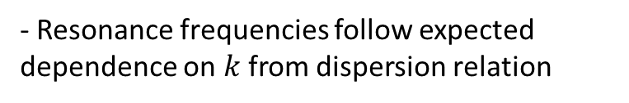
Superconducting Metamaterial Transmission Line Cavity – Transmission Characteristics (Plourde Group)
*Figures from Plourde Group – H. Wang et al. arXiv:1812.02579v1*
Using Laser scanning microscopy (LSM) demonstrate spatial profile agrees with simulation & theory
LSM Imaging: Ustinov (Karlsruhe), Zhuravel (Verkin)
Minimum mode spacing ~147 MHz
- Transmission ($S_{21}$) measurements reveal dense spectrum of modes with IR cut-off around 4 GHz
- Resonance frequencies follow expected dependence on $k$ from dispersion relation

Slide 22
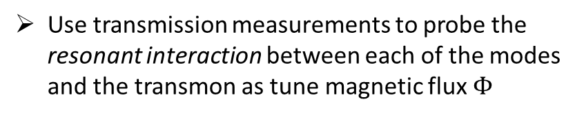
Superconducting Hybrid Transmission Line Cavity – Integration with Transmon (Plourde Group)
*Figures from Plourde Group – Indrajeet *
Capacitively couple transmon to resonant modes of hybrid (LHTL-RHTL) transmission line
Microwave tone routed to metamaterial
LHTL
RHTL
Use transmission measurements to probe the resonant interaction between each of the modes and the transmon as tune magnetic flux $Φ$
transmon
JC Model
For Each Mode

Slide 23
Outline
LaHaye Group
Recent Motivating Work
- Transmon-Coupled Nanoresonators
(LaHaye Group)
Image from
Plourde Group
- Superconducting Metamaterial Transmission Lines (Plourde Group)
New Ideas:
- Metamaterials coupled to NR and superconducting qubits… potential applications for QIP (e.g. memory, transduction…)
From Tacchino et al. PRB 97, 214302 (2018)
- ~Recently published papers by theory collaborators using transmon-coupled NRs for quantum simulation

Slide 24

New Idea: Integrate Metamaterial-Nanoresonator-Superconducting Qubit for Quantum Networking Apps.
High-Q, MHz-range mode
LHTL
RHTL
High-Q, GHz-range mode
LaHaye Group
transmon
Plourde Group
Integration of these systems could yield multi-functional quantum network element
Integrate high-Q mechanics with LHTL/RHTL for enhanced parametric quantum transducer for data egress to photonic circuitry for distribution to larger network
Integrate high-Q mechanics with transmon for implementing transmon-mediated quantum registry

Slide 25
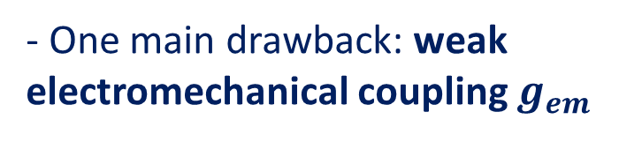
Application to Optical/Microwave Transduction
- One of the most promising approaches to optical/microwave transduction is based on opto-electro-mechanical devices
OPTOMECHANICAL CRYSTAL AND PIEZO IDT
Groblacher (Delft)
- Mechanism: parametric modulation of microwave and optical cavity by mechanical motion leads to up/down conversion of photons via
Regal,Lehenert (JILA)
$${\hat{H}}_{int}=ℏg_{em}\left(a^{†}b+b^{†}a\right)+ℏg_{om}(a^{†}c+c^{†}a)$$
Superconducting LC Circuit and Optical Cavity
- One main drawback: weak electromechanical coupling $g_{em}$
Weak electromechanical anti-stokes process

Slide 26


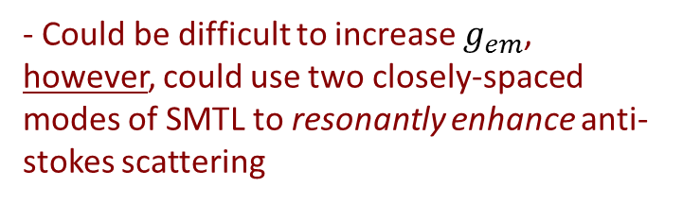





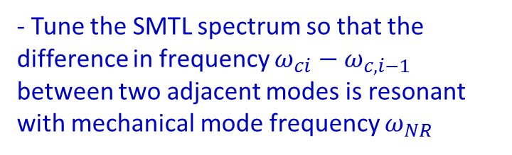
Metamaterial-Enhanced Optical/Microwave Transducer
- Could be difficult to increase $g_{em}$, however, could use two closely-spaced modes of SMTL to resonantly enhance anti-stokes scattering
Typical Anti-Stokes Scattering of Photons
$$ω_{NR}$$
Stokes
Suppressed
Anti-Stokes
$$ω_{Drive}$$
$$ω_{C}$$
Integrate Mechanical Element into SMTL
Resonantly Enhanced Anti-Stokes Scattering of Photons Using SMTL
$$ω_{NR}$$
- Tune the SMTL spectrum so that the difference in frequency $ω_{ci}−ω_{c,i−1}$ between two adjacent modes is resonant with mechanical mode frequency $ω_{NR}$
Stokes still
Suppressed
Anti-Stokes
enhanced
- Could this “boost” be enhanced further using more than two modes? Theory needs to be worked out.
$$ω_{Drive}$$
$$=ω_{C,i−1}$$
$$ω_{C,i}$$
“Dual Mode” Transduction Theory Paper: Kippenberg, PRL 2010

Slide 27
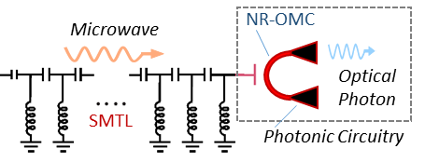
Metamaterial-Enhanced Optical/Microwave Transducer
Integrate Optomechanical crystal with SMTL
Typical Anti-Stokes Scattering of Photons
$$ω_{NR}$$
Stokes
Suppressed
Anti-Stokes
Possibly use 3D integration techniques to engineer tight SMTL—NR-OMC coupling
$$ω_{Drive}$$
$$ω_{C}$$
Discussions with Plourde (SU), Papa Rao (SUNY Poly), Bhattacharya (RIT), Anlage (UMDCP), Hamilton & Adams (Auburn), Rouxinol (UNICAMP), Brito (Sao Carlos)
Resonantly Enhanced Anti-Stokes Scattering of Photons Using SMTL
$$ω_{NR}$$
- Tune the SMTL spectrum so that the difference in frequency $ω_{ci}−ω_{c,i−1}$ between two adjacent modes is resonant with mechanical mode frequency $ω_{NR}$
Stokes still
Suppressed
Anti-Stokes
enhanced
- Could this “boost” be enhanced further using more than two modes? Theory needs to be worked out.
$$ω_{Drive}$$
$$=ω_{C,i−1}$$
$$ω_{C,i}$$
“Dual Mode” Transduction Theory Paper: Kippenberg, PRL 2010

Slide 28
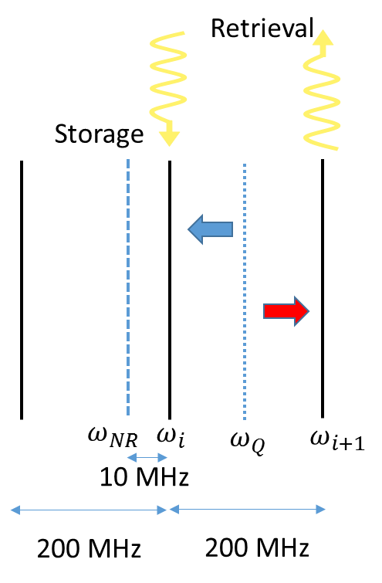
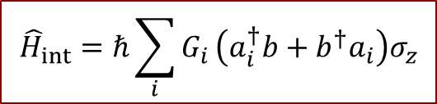
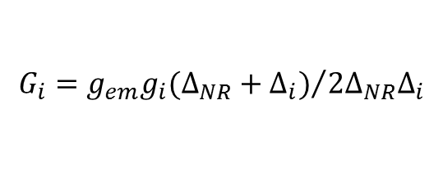
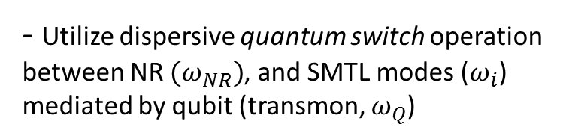
Quantum Electromechanical Memory/Registry
LHTL
RHTL
- Another promising possibility involves integration of SMTL, Transmon, & NR for implementation of quantum registry
Transmon
NR
- Utilize dispersive quantum switch operation between NR $(ω_{NR})$, and SMTL modes ($ω_{i}$) mediated by qubit (transmon, $ω_{Q}$)
Quantum
Switch
$${\hat{H}}_{int}=ℏ\sum_{i}{G_{i}}\left(a_{i}^{†}b+b^{†}a_{i}\right)σ_{z}$$
$$G_{i}={g_{em}g_{i}(Δ_{NR}+Δ_{i})}/{2Δ_{NR}Δ_{i}}$$
See: M. Mariantoni et al. Phys. Rev. B. 2008
- Mechanical Q’s in excess of a million demonstrated using phonon bandgap engineering (Painter, arXiv:1808.04874)

Slide 29
Quantum Electromechanical Simulators
- Potential directions could be opened up with intensive investment of resources
ARRAYS OF QUANTUM NANORESONATOR FOR QUANTUM SIMULATION/SENSING
Possibility of dense NR-Qubit arrays/networks for analog & digital quantum simulators
J. Lozada-Vera, O. Neto, J. Moqadam, MD LaHaye & M.C. Oliveira. EPJ Quantum Tech. 3:9 (2016)
F. Tacchino, A. Chiesa, M.D. LaHaye, S. Carretta, & D. Gerace. PRB 97, 214302 (2018)

Slide 30

Points to take home
Hybrid systems with superconducting metamaterials, NRs, and transmons could be versatile tools for Quantum Networking:
Generation of complex entangled states
Quantum Simulation
Optomechanical quantum transduction
Quantum electromechanical memory
Transmon/NR Experiments
At SYR: Francisco Rouxinol (UNICAMP) & Yu Hao (SiTimes)
Theory Support: Fred Brito (Sao Carlos), Amir Caldeira (UNICAMP)
and Elinor Irish (Southampton)
Funding was provided by NSF-DMR Career Award #1056423/NSF-DMR Materials World Network Award #1312421
Plourde Group Metamaterial Experiments:
B.L.T. Plourde, H.Wang, Indrajeet, M. Hutchins
Metamaterial Collaborators:
F. Wilhelm (Saarbrucken), A.V. Ustinov (Karlsruhe), F. Rouxinol, Y. Hao, B. Taketani (Saarbrucken), A.P. Zhuravel (Verkin)

