Slide 2
Agenda
Introduction Figer 12:00-12:15
One-slide Summaries All 12:15-1:00
New Hires and New Headquarters Figer
FPI Funding Profile Bond
ERC Hubbard
REU Rommel
Quantum Computing Opportunity Preble
Starshot Figer
Realization and Commercialization Murthy/DeMartino
FPI Branding Meader
FPI Web Site Figer
Communications Finnerty
Government Relations Smith
Development Butkas
Breakouts All 2:00-3:00
Breakout Presentations All 3:00-3:30
Synthesis All 3:30-4:00

Slide 3
Introduction

Slide 4
Questions for This Meeting
Are the World Maps complete?
What should our goals be?
Who will lead the ERC proposal?
What is the FPI communications plan?
Which companies should FPI pursue for the Industrial Affiliate Program?
Who should FPI have on the External Board of Advisors?
What state-level funding mechanisms should FPI pursue?

Slide 5
Future Photon Initiative
FPI will develop advanced photonics and apply them to solve the most pressing problems in the world.

Slide 6
FPI R&D Areas
Integrated Photonics
Scaled Electronics
Photovoltaics
Detectors

Slide 7
FPI Grand Challenge Questions
Are we alone in the Universe?
Would it be possible to meet aliens?
How does the human brain develop?
Can we go to Mars without getting cancer?
Can we improve outcomes for breast cancer survivors?
Can we “see in the dark” and through obstructions to ensure national security?
What is the nature of dark energy and dark matter?
Is it possible to build ultra-high speed fully secure global computer networks?

Slide 8





FPI Personnel
FPI is led by 21 professors in five colleges and has ~70 personnel in total, including students.

Slide 9
21 Principals of the FPI
Mishkat Bhattacharya | Parsian Mohseni
Richard DeMartino | Raj Murthy
Don Figer | Zoran Ninkov
Ed Hach | Rob Pearson
Karl Hirschman | Stefan Preble
Seth Hubbard | Roger Remington
Bruce Smith | Sean Rommel
Santosh Kurinec | Michael Zemcov
Zhaolin Lu | Jing Zhang
Drew Maywar | Ben Zwickl
Bruce Meader

Slide 10
FPI Sub-Units
Center for Detectors
Integrated Photonics Group
NanoPower Research Labs
Nanolithography Research Lab
Semiconductor & Microsystems Fabrication Laboratory
Novel Material Photonics Group
Photonic Systems Laboratory
Laboratory for Advanced Instrumentation Research
Semiconductor Photonics and Electronics Group
Photonics and Optics Workforce Education Research Project
Simone Center for Innovation and Entrepreneurship
Vignelli Center for Design Studies

Slide 11
FPI Endorsements
NASA, Advanced Concepts, JWST, WFIRST | Intel
NASA, Lead for AIM Photonics | Nikon Research of America, President
Air Force Research Laboratory, Kirtland | Harris, Chief Technologist
Air Force Research Lab, Rome | Optimax, CEO
Army Research Lab, Lead for AIM Photonics | Raytheon Vision Systems
IMEC, President and CEO | Veeco
SPIE | MicroLink Devices
University College London

Slide 12
Cost Share Commitments
College of Science
  A faculty line in support of Future Photon Initiative (year 2)
  $10,000 in travel support
  Three course releases in support of Future Photon Initiative
Kate Gleason College of Engineering
  $150,000 for cost share match for Jing Zhang equipment proposal
  A faculty line in support of Future Photon Initiative (Parsian Mohseni)
  Three course releases in support of Future Photon Initiative
College of Applied Science and Technology
  One course release (years 1 and 2 only)
  $2,000 cash (years 1 and 2 only)

Slide 13
FPI World Maps

Slide 14
FPI World Maps: Research Expertise

Slide 15
FPI World Maps: Customers

Slide 16
New Personnel
Assistant Director: 2380BR
Executive Assistant: 2381BR

Slide 17
Industrial Affiliate Program
FPI will have an industrial affiliate program.
The program benefits companies by giving them access to AIM, research, students.

Slide 18
External Board of Advisors
FPI will have a board of advisors.
The people on the board could represent a mixture of technical expertise, prior accomplishment, business savvy, depth of political connections, international networks, and/or funding conduits. Please recommend who you would nominate for the board.

Slide 19
Conferences
FPI will have a conference booth.
The booth will be at Photonics West every year.
We should have a booth at Frontiers in Optics (at least in 2016).

Slide 20
One-slide Summaries

Slide 21
One-Slide Summary
Status: What is the state of your research program (# people, students, funding)?
Directions: In what directions will your research go in 5 years?
Desired RIT Collaborators: With whom at RIT will you collaborate?
Needs: What do you need?
Desired Industry Collaborators: With what companies do you want to collaborate?

Slide 22
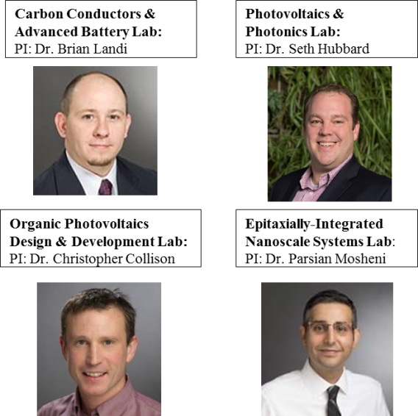

One-Slide Summary: NanoPower Research Laboratories (NPPRL)
Founded in 2001 by current VPR, Dr. Ryne Raffaelle
  Dr. Hubbard appointed Director in Oct. 2015
Multidisciplinary consortium of 4 RIT faculty
  10 staff and ~30 Grads & Undergrads
Research space spans 6 labs with over 10,000 sq. feet
  Photovoltaic fabrication and characterization
  III-V Materials Synthesis
  Materials and Device characterization
  Battery testing
  CNT production

Slide 23
One-Slide Summary: NPRL Today

Slide 24




One-Slide Summary: NPRL Strategic Alliances
Current Federal Sponsors
Dept. of Energy
National Reconnaissance Office
Air Force Research Lab
National Science Foundation
US Army Research Laboratory
Naval Research Labs
Office of Naval Research
NASA
Collaborators
Lockheed Martin
Spectrolab
CFD Research Corporation
FireFly Technologies, Inc
Microlink Devices
Nanocomp Technologies
Tyco Electronics
BAE
A123
Emcore
Univ. of Toledo
Rensselaer Polytechnic Institute
SUNY Polytechnic
University of California/ UCLA
Stanford University
Quallion

Slide 25
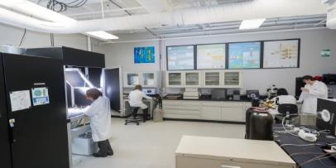
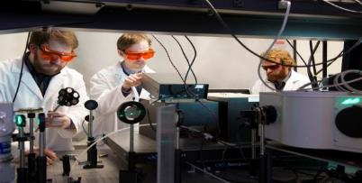
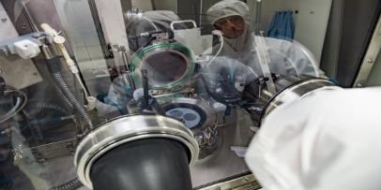
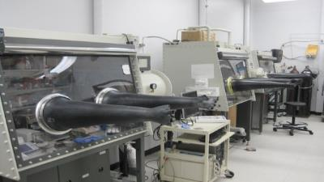
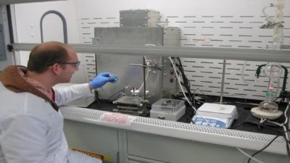
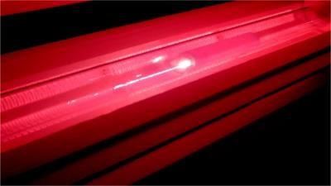
One-Slide Summary: NPRL Capabilities
Solar and Devices
III-V Materials
Spectroscopy
300mm Class A 2-Zone Solar Simulator
High sensitivity EQE
Synopsis modeling for solar devices
Horiba MicOS PL mapping
Deep Level Spectroscopy
EL imaging
Photoreflectance
Aixtron 3x2” CCS MOVPE
LayTec EpiCurveTT
SMFL Solar Cell Fabrication line
Batteries and Wires
CNT Synthesis
Purification
Inert Atmosphere Glove Boxes
Arbin BT2000
Conventional wet chemistry for organic and inorganic processes
Alexandrite Laser Reactor
Nd-YAG Laser Reactors

Slide 26
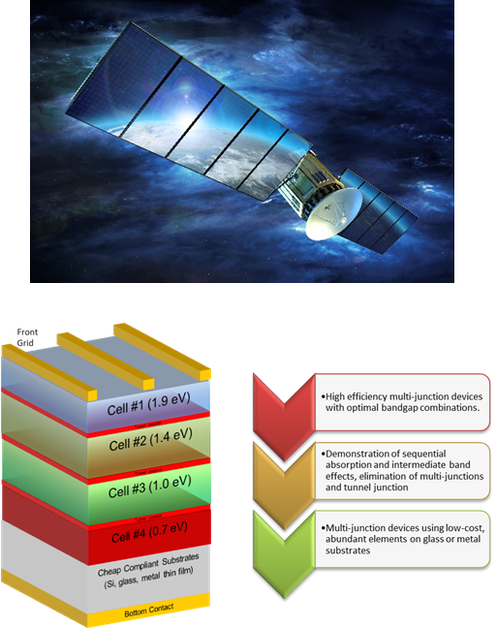
One-Slide Summary: Seth Hubbard
Status, Personnel, Funding
  New materials and structures for conversion of light to electricity
  Expertise in III-V materials, photovoltaic devices and vapor phase epitaxy
  5 PhD student, 2-3 postdocs, ~$0.5-1 M/yr (NSF/NASA/DoE/DoD)
Directions
  Epitaxial Crystal Growth by Metalorganic Vapor Phase Epitaxy (MOVPE)
  Low cost approaches to high efficiency III-V epitaxy
  Sb-based materials for multijunction solar cells
  Space PV and Radiation Hardening using QD and QW
  Intermediate band effects in As, P and Sb based QD solar cells
  Light management and photonic light trapping applied to nanostructures solar cells
Desired RIT Collaborators
  Preble, Figer: III/V on Si materials for integrated silicon photonics
  Mohseni: Nanowire for solar
  Zemcov: long life power for deep space missions
  Other collaborations: III-V materials for opto or electronic devices
Needs
  ~$1M/yr
Desired Industry Collaborators
  SolAero, Boeing Spectalab, Microlink Devices
  Small business working on novel concepts for space or terrestrial III-V PV
  Larger aerospace companies (Lockheed) for space based power systems

Slide 27
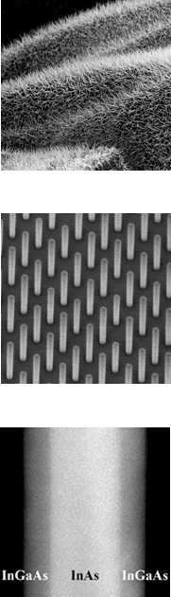
One-Slide Summary: Mohseni
Status
  Starting Phase: Lab setup, student training, proof-of-concept
  Personnel: 2 Ph.D., 1 M.Sc., 1 B.S.
  Funding: Startup funds and internal grants
Directions
  Flexible PV/OE via III-V on 2-D nano-hybrid systems
  Coaxial GaAsP/GaP/GaN Nanowire LEDs
  Epitaxially Integrated GaSb/InAs NWs on Si for PV and IR detection
  Si and III-V MacEtch nanofabrication
Desired RIT Collaborators
  Hubbard on crystal growth, PV, characterization
  Zhang on multispectral LEDs
  Rommel on integrated GaSb/InAs systems
Needs
  ~$250k/yr
Desired Industry Collaborators
  IMEC, Raytheon, SanDisk, First Solar, SunPower

Slide 28
One-Slide Summary: Center for Detectors (CfD)
Status, Personnel, Funding
  Figer, Ninkov, Zemcov, Preble, Mohseni, Zhang
Directions
  design/develop 4Kx4K MCT/Si detectors
  develop single-photon optical detectors
  develop integrated sensor systems on a wafer (Starshot?)
  determine massive star content in the Local Group of galaxies
  develop integrated silicon photonics
  develop outer-solar system sensing platforms
  develop nanowire sensors
  develop wide-band gap materials/devices
  develop THz and polarization sensing detectors
Desired RIT Collaborators
  see individual slides
Needs
  ~$3M/yr
Desired Industry Collaborators
  see individual slides

Slide 29
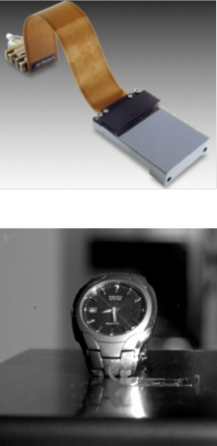
One-Slide Summary: Figer
Status, Personnel, Funding
  advancing MCT/SI, single-photon counting detectors
  half dozen staff/students, ~$1-1.5M/yr (NSF/NASA)
Directions
  design/develop 4Kx4K MCT/Si detectors
  develop single-photon optical detectors
  develop integrated sensor systems on a wafer (Starshot?)
  determine massive star content in the Local Group of galaxies
Desired RIT Collaborators
  Preble, Hubbard on single photon integrated silicon photonics
  Zemcov on detectors and instruments for astronomy
Needs
  ~$2M/yr
Desired Industry Collaborators
  Raytheon
  new company to commercialize single-photon optical detectors

Slide 30
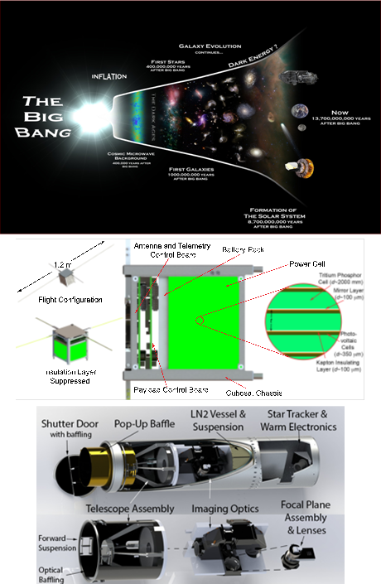
One-Slide Summary: Zemcov
Status:
  Started at RIT in Aug 2015.
  Involved in a variety of NASA and NSF projects to study large scale structure and history of the universe.
  Currently employing ~6 undergrads and ~2 graduate students; hope to hire postdocs in the near future.
Directions:
  Working on a variety of ground-based, sub-orbital and orbital experiments.
  Interested in deploying CMOS devices for astronomy; astrophysics from the outer solar system; niche cosmological and physics experiments requiring bespoke instrumentation.
Desired RIT Collaborators:
  Working with Hubbard and Puchades on power systems for outer solar system SmallSats.
  Collaborating with Figer on single-photon CMOS devices.
  Possible collaboration with Bhattacharya (Preble?) on ”Quantum Telescopes”.
Needs:
  A postdoc or two.
  Additional laboratory space.
  More proactive assistance from RIT in proposal preparation.
Desired Industry Collaborators: With what companies do you want to collaborate?
  Would like to submit an SBIR for advanced space-borne cryogenic optics for the near-IR. Talking with Peregrine Corporation, but progress is slow.

Slide 31
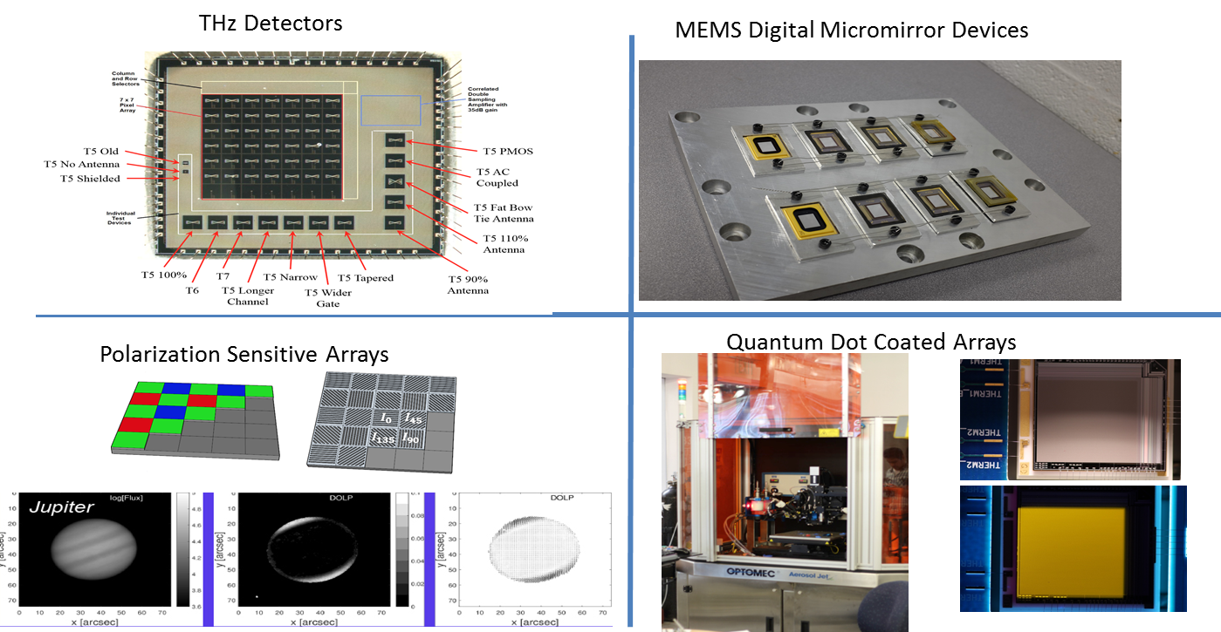
One-Slide Summary: Ninkov

Slide 32
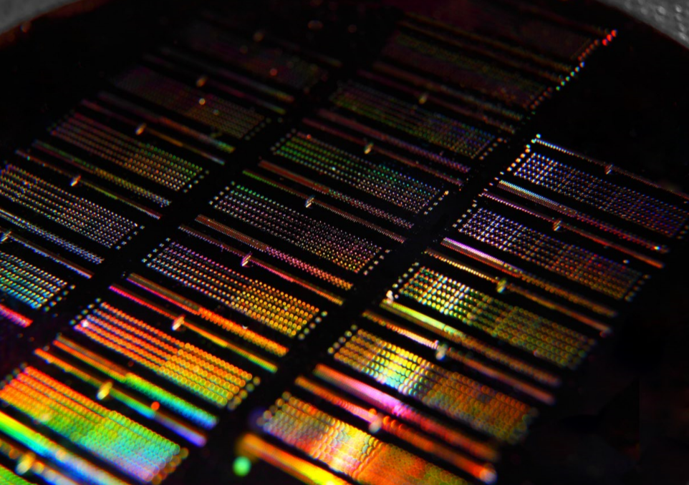
One-Slide Summary: Preble
Status:
  Postdoc (Dr. Paul Thomas), 3 Ph.D. Students (Mike Fanto, Jeff Steidle, Zihao Wang)
  Funding :
    NSF (Integrated Quantum Photonics & III-V Quantum Dot Lasers)
    AFRL (UV Integrated Quantum Photonics)
    AIM Photonics (Packaging – fiber attachment, Education, Laser integration)
    Gordon and Betty Moore Foundation (Protein sensing) – Co-PI Jiandi Wan
Directions:
    Quantum Computing, Communication and Sensing
    Photonics Packaging
    Integrated photonics education
Desired RIT Collaborators: With whom at RIT will you collaborate?
    Quantum: Figer, Hubbard, Maywar, Hach, Bhattacharya
    III-V’s, III-N’s - Hubbard, Mohseni, Zhang
    Packaging: Maywar, Ramkumar, Anselm, Lu
    Education: Pearson, Ewbank, Maywar, Ramkumar, Anselm, Zwickl, Hach, Bhattacharya
Needs: What do you need?
  SMFL upgrades (equipment – AIM, MRI’s, DURIP’s, NYS)
Desired Industry Collaborators: With what companies do you want to collaborate?
  IBM, Intel, Cisco, HPe, Corning, Lockheed Martin, Mentor Graphics, FiconTEC, etc.

Slide 33

One-Slide Summary: Zwickl
Status:
Collab with Prof. Kelly Martin in Communication
2 postdocs in physics (education research)
2 MS students in communication
4 undergrads in physics
$1,050,000 over 2015-2020.
Directions: Study career pathways in photonics, and other STEM fields. Bridging workforce development (including AIM) with education research on undergrad learning.
Desired RIT Collaborators: Faculty interested in program or curriculum development in photonics/optics. Faculty who advise grad students in photonics.
Needs: Visibility for research group. Support for possible photonics outreach efforts (e.g., RIT K12 summer class)
Desired Industry Collaborators: Broad (but shallow) connections across Rochester region and in integrated photonics. We collect data about workplace skills and knowledge.

Slide 34
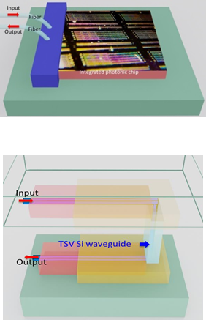
One-Slide Summary: Zhaolin Lu
Status, Personnel, Funding
  Field-Effect Optical Modulators, Wafer-Level Electronic-Photonic Co-Packaging
  Six students (two PhD students), one visiting scholar, ~$200k/yr (NSF/Army/Air Force)
Directions
  Nanoscale electro-absorption modulators
  Nanoscale plasmonic waveguides
  Efficient fiber-to-waveguide coupling
  Novel 3D chip-to-chip coupling
  Novel 2D semiconductor photonic devices
Desired RIT Collaborators
  Preble, Zhang on integrated photonics
  Zemcov on detectors and instruments for astronomy
Needs
  ~$500k/yr
Desired Industry Collaborators
  Intel, IBM, PSI (STTR project)
  new company to commercialize fiber-to-waveguide links

Slide 35
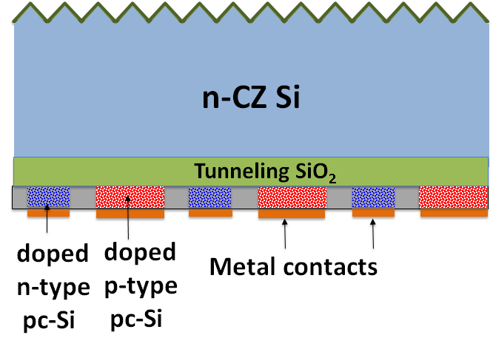
One-Slide Summary: Kurinec
Status, Personnel, Funding
  Photovoltaics: Development of passivated contacts
  Two Masters Students
  DOE Funding: $97K, Just ended.
  $1M/3 years sought- Made it to the final round but declined, encouraged to apply again.
  NSF EAGER on Ferroelectric memristors, $180K, 2 years.
Directions
  Develop novel doping for interdigitated back contact high efficiency cells
  Investigate ohmic contacts to wide bandgap semiconductors
  Investigate ferroelectric thin films for photonic applications
Desired RIT Collaborators
  NPRL, Stefan Preble
  Scott Williams, Chemistry, Jing Zhang, EME
Needs
  ~$1M/ 3 yr
Desired Industry Collaborators
  Intrinsiq, Solar City, 1366 Technologies
  NREL

Slide 36
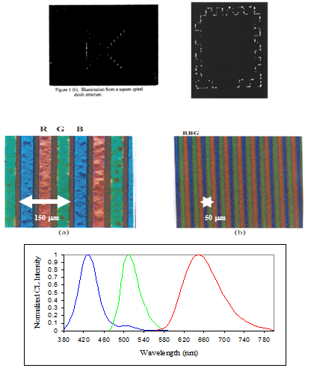
One-Slide Summary: Where photons meet electronic materials, a brief history- Kurinec
Late Eighties: Strategic Defense Initiative (SDI) funded research on light emission from silicon at FSU. Developed luminescent diodes with VBR < 10V
Later light emission from porous Si was discovered. Led to collaboration with Prof. Fauchet at UR and Dr. Hirschman conducted his PhD.
Made 3 color phosphor display using lithography and electrophoretic deposition (Hughes Aircraft)
Discovered blue emission from Tantalum Zinc Oxide phosphor
Reflective properties of Al alloys for micro mirrors (Texas Instruments)
Development of models for charge injection devices operated in time domain integration mode for CIDTEC company in Liverpool, NY.
Modeled quantum efficiency of SiC UV photodetectors
Copper/NiSi metallization for Si PV

Slide 37
One-Slide Summary: Related Publications in Photo Electronic Materials/Devices
Performance Analysis of a “Green” Building Photovoltaic System Felipe Freire, Ricardo Dias, Thomas Trabold, Santosh Kurinec, 43rd PVSC, Portland, 2016
Nickel Silicide Metallization for Passivated Tunneling Contacts for Silicon Solar Cells , Alexander Marshall, Karine Florent, Astha Tapriya, Benjamin Lee, Santosh K Kurinec, David L Young, 43rd PVSC, Portland, 2016
Modeling Quantum Efficiency of Ultraviolet 6H-SiC Photodiodes, Alexander Panferov and Santosh Kurinec, IEEE Trans. Electron Devices, vol. 58, no. 11, 2011, pp. 3976-3982, Article DOI: 10.1109/TED.2011.2165720.
Optical, Electrical, and Structural Properties of Sputtered Aluminum Alloy Thin Films with Copper, Titanium and Chromium Additions, Lance Barron, Jason Neidrich and Santosh Kurinec, Thin Solid Films, 2006, 515, Issues 7-8, 26 February 2007, Pages 3363-3372
Electrophoretic Deposition of Monochrome and Color Phosphor Screens for Information Displays J. Talbot, Esther Sluzky and Santosh K. Kurinec, , Journal of Materials Science, 39(3), pp 771-778, February 2004
Unit Cell Indexing of Luminescent Type I Tantalum Zinc Oxide, Santosh K. Kurinec, Philip Rack, Michael Potter and Tom Blanton, Journal of Materials Research, Vol 15, No. 6, June 2000, p.1320
Negative Ion Re-sputtering in Ta₂Zn₃O₈ Thin Films, Philip D. Rack, Michael D. Potter, Andrew Woodard and Santosh Kurinec, Journal of Vacuum Science and Technology, Vol. 17, No. 5, p. 2805-10, 1999.
A New Material for Thin Film Low Voltage Blue Phosphors, R.J. Langley, G.F. Pettis, S.K. Kurinec and M.D. Potter, Journal of the Society of Information Display, Vol. 6, No. 3, p. 181-4, 1998.
Luminescence Properties of Thin Film Ta₂Zn₃O₈ and Mn Doped Ta₂Zn₃O₈, Philip D. Rack, Michael D. Potter, Santosh Kurinec, Wounjhang Park, John Penczek, Brent K Wagner and Christopher J. Summers, Journal of Applied Physics, Vol. 84, No. 8, p. 4466-70, 1998.
Fabrication of Ultra High Resolution Three Color Phosphor Screens, S.K. Kurinec, E. Sluzky, Journal of the SID, 4/4, p. 1996, 1997.
Porous Microcrystalline Silicon Solar Cells, S.P. Duttagupta, S.K. Kurinec, and P.M. Fauchet, Proc. Mat. Res. Soc. Symp. Advances in Microcrystalline and Nanocrystalline Semiconductors, Vol. 452, p. 625, 1997.
Attenuated Phase Shift Mask Materials for 248 and 193 nm Lithography, B.W. Smith, S. Butt, Z. Alam, S. Kurinec, and R.L. Lane, J. Vac. Sci. Technol. B 14(6), p. 3719, Nov/Dec 1996.
Enhancement and Suppression of the Formation of Porous Silicon, S. P. Duttagupta, C. Peng, P. M. Fauchet, S. Kurinec, and T.N. Blanton, J. Vac. Sci. and Technology, B, Vol 13, p. 1230, May-June 1995.
Micron-size and Submicron-size Light-Emitting Porous Silicon Structures, S. P. Duttagupta, P. M. Fauchet, C. Peng, S. K. Kurinec, K. Hirschman, and T.N. Blanton, Mat. Res. Soc. Symp. Proc., Vol. 358, p. 647, 1995.
Carrier Transport in Porous Silicon Light-Emitting Diodes, C. Peng, P.M. Fauchet, K.D. Hirschman and S.K. Kurinec, Mat. Res. Soc. Symp Proc., Vol. 358, p. 689, 1995.
Ion Implantation of Porous Silicon, C.Peng, P. M. Fauchet, J.M. Rehm, G.L. McLendon, F. Seiferth and S. K. Kurinec, Applied Phy. Lett., Vol 64, No. 10, p. 1259. March 1994.
Light-Emitting Porous Silicon after Standard Microelectronic Processing, C. Peng, L. Tsybeskov, P. M. Fauchet, F. Seiferth, S. K. Kurinec, J.M. Rehm, and G.L. Mclendon, Mat. Res. Soc. Symp.Proc. Vol. 298, p.179, 1993.
Can Oxidation and other Treatments Help us Understand the Nature of Light-Emitting Porous Silicon, P.M. Fauchet, E. Ettedgul, A. Raisanen, L.J. Brillson, F. Seiferth, S.K. Kurinec, Y. Gao, C. Peng and L. Tsybeskov, Mat. Res. Soc. Symp Proc., Vol. 298, p. 271, 1993.

Slide 38
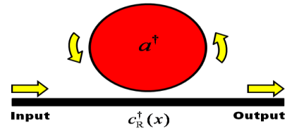
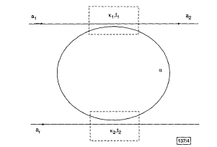
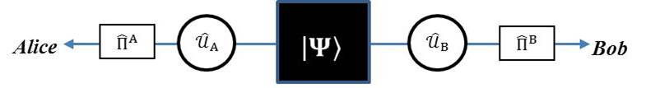
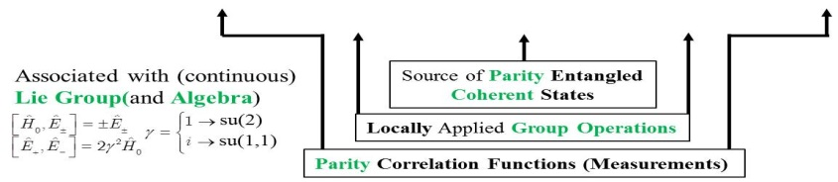
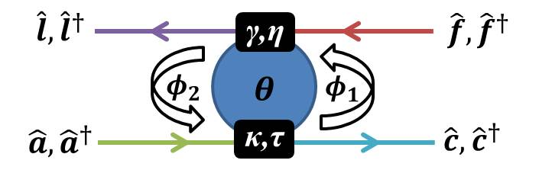
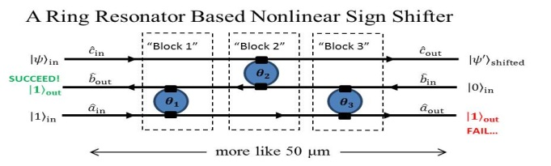
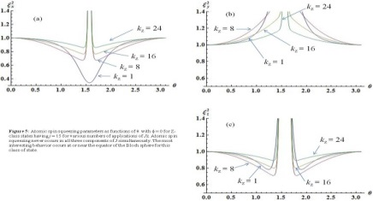
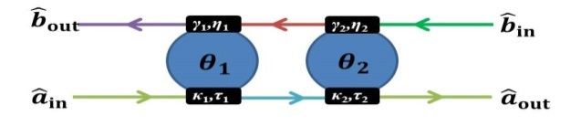
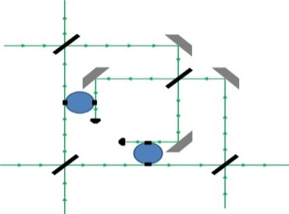



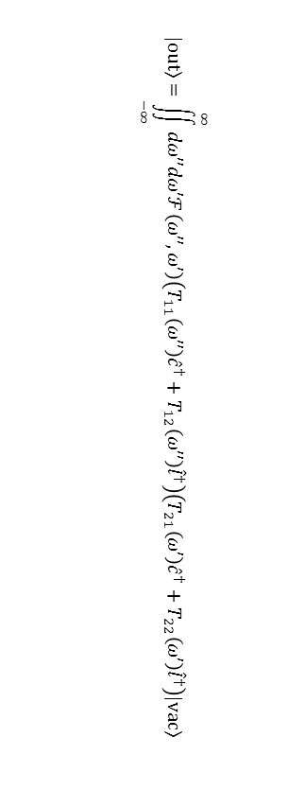
Edwin E. Hach, III, Assistant Professor, SoPA
Photonic Quantum Information Processing
Quantum Information Processing with
Continuous Variables
Single Photon Response
QFT
Overarching Theme: quantum entanglement as a practically manageable resource
Bell-Clauser-Horne-Shimony-Holt Violations
A. Yariv, Elec. Lett. 36, 321 (2000)
EEHIII, AWE, & SFP, Phys. Rev. A82, 063839(2010)
(10011 citations)*
Fundamental QOIP Circuit Element
Coherent States
EEHIII, SFP, AWE, PMA, & MLF, Phys. Rev. A89, 043805(2014)
EEHIII, Elec. Lett. (2015, in prep)
SU(2): CCG, AB, EEHIII & JA, Phys. Rev. A 79, 022111(2009 )
On-Chip Quantum Information Processing
SU(1,1): EEHIII, CCG & PMA, Phys. Rev. A (2015, in AFRL clearance)
SU(2) Spin Squeezing/Atomic State Purity
EEHIII, CCG , RB & PMA, Phys. Rev. A (2015, in prep)
$$\left|\left.out\right\rangle =\right.\iint_{−∞}^{∞}{dω′′dω′ℱ\left(ω′′,ω′\right)\left(T_{11}\left(ω′′\right){\hat{c}}^{†}+T_{12}\left(ω′′\right){\hat{l}}^{†}\right)\left(T_{21}\left(ω′\right){\hat{c}}^{†}+T_{22}\left(ω′\right){\hat{l}}^{†}\right)\left|\left.vac\right\rangle \right.}$$
Valued Collaborators
Dr. Stefan F. Preble, RIT
Dr. Christopher C. Gerry, CUNY
Dr. Paul M. Alsing, AFRL
Michael Fanto, AFRL
Jeffrey A. Steidle, RIT
Richard Birrattella, CUNY
Ryan E. Scott, SoPA , RIT
On-Chip Compressive Sensing
Sept 2014 – Present Highlights
Phase-Partition Metrology/Tomography
Appreciated Support
External: $30k, AFRL/RI (EEH3)
Internal: $3500, CoS UG Fellowship (RES)
Public Display
NYSAAPT, 21 Mar, RIT(EEH3)
SPIE-DSS, 23 Apr, Baltimore(EEH3)
NYAPSQCC, 24 Apr, Fredonia (RES)
CoS URS, 7 Aug, RIT (RES)
*This number is expressed in the binary system

Slide 39
One-Slide Summary: Bhattacharya
Status, Personnel, Funding
  Working on optics+nanomechanics based quantum sensors
  2 postdocs (Brandon Rodenburg, Wenchao Ge)
  +3 undergraduates (Stefano Marin, Tyler Godat, Wyatt Wetzel)
  ~$250K/yr (ONR/NSF/RCSA)
Directions
  design force sensors to go beyond the standard quantum limit
  develop single-photon optical detectors
Desired RIT Collaborators
  Preble, on quantum information processing
  Zemcov, on quantum cloning (?)
Needs
  ~$200 K/yr
Desired Industry Collaborators
  ?

Slide 40
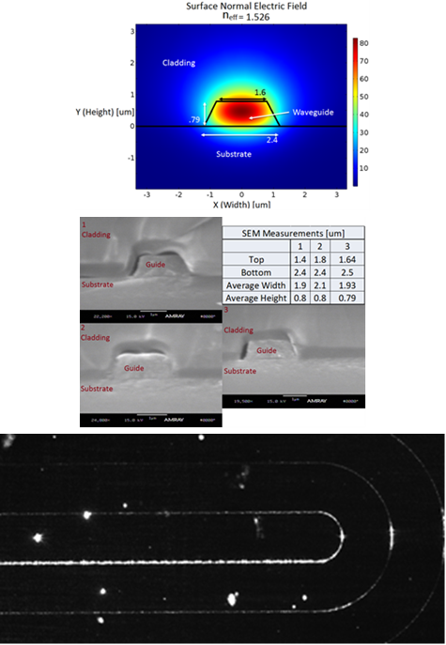
One-Slide: Robert Pearson – Photons & Microelectronics - Photonics
Status: AIM Photonics Education team.
  Development of Photonics ME/Certificate program modelled after the Microelectronics ME program. (2 faculty for now, myself and Dale Ewbank, 1-2 MS students, 1 BS student, ~40k per year)
Directions:
  In the next 5 years we will have a set of courses and lab experiences to support a possible ME program in Photonics
RIT Collaborators:
  Dale Ewbank, Stefan Preble, Drew Maywar, Martin Anselm, Ben Zwickl, Anne Leak
Needs:
  Unlimited Funds ☺, Faculty release time, Consumables budget, MS student stipends
  Newer wafer saw, Newer single head CMP tool
Desired Industry Collaborators:
  Anybody interested in fabrication, SUNY Poly, Mentor Graphics

Slide 41
New Hires and New Headquarters

Slide 42
Assistant Director
We received ~15 applications.
Two applicants were invited for interviews.
Their application materials are available.
\\Hawk\ridl\products\talks\Phil Schofield\Schofield Presentation.MOV
\\Hawk\ridl\products\talks\Frank Razavi\Razavi Presentation.MOV

Slide 43
Executive Assistant
We received ~120 applications.
A dozen or so were interviewed.
We hired Robyn Rosechandler.

Slide 44
Faculty Lines
We have one promised line in COS to be advertised next year.
We may be able to get more lines in a cluster hire.

Slide 45
New Headquarters
FPI Headquarters will be in the former Research Computing room in ENG.

Slide 46
FPI Funding Profile

Slide 47
FPI Sponsored Research FY14 – FY16

Slide 48
FY 17 Federal R&D Budget
President’s budget proposal funds R&D at 0.75 – 0.78 of GDP, lowest since Sputnik
Priorities include
  Applied energy R&D
  Defense technology, “downstream” development, NNSA
  Cancer research
  Competitive agricultural research
Negative priorities
  NASA, Science Missions Directorate, exploration development
  Defense basic research

Slide 49
Global Photonic Sensors, 2015 - 2020
2015 Market Size: $8.4B
2020 Market Size: $17.42B
Largest application segment: military devices (>25% of global market share)
Fastest growing application segments: homeland security and energy sectors
Source: Global Photonic Sensor Market, 2016- 2020, Technavio.com

Slide 50
Major Manufacturers
Baumer (Switzerland): sensor-related products
Banner Engineering (US): photonic, fiber-optic, vision or image, and laser sensors
OMRON (Japan): sensor technologies
Hamamatsu Photonics (Japan): optical sensors
Source: Global Photonic Sensor Market, 2016- 2020, Technavio.com

Slide 51
Prominent US & Canadian Vendors
BaySpec: vertically integrated spectral sensing
Banpil Photonics: multispectral image sensors
Brandywine Photonics: hyperspectral imagers
Fiso Tech: fiber-optic sensors
Honeywell: wide range of products
Prime Photonics: DoD, NASA, DOE, NSF
Source: Global Photonic Sensor Market, 2016- 2020, Technavio.com

Slide 52
Photonic R&D Investments
Investment in R&D by photonics companies runs from 5% to as high as 20% of sales, with 8% to 12% the more common choice.
Breakdown of available R&D Funding:
  20% to mature product lines
  50% to upgraded products
  30% to totally new products
Source: Laser Focus World, August 1, 2012

Slide 53
Suggestions
Frost & Sullivan reports: www.frost.com
BCC Research: www.bccresearch.com
SBIR awardees: https://www.sbir.gov/sbirsearch/award/all

Slide 54
ERC

Slide 55
NSF Engineering Research Center (ERC)
The goal of the ERC Program is to integrate engineering research and education with technological innovation to transform national prosperity, health, and security. ERCs create an innovative, inclusive culture in engineering to cultivate new ideas and pursue engineering discovery that achieves a significant science, technology, and societal outcome within the 10-year timeframe of NSF support. For information on individual ERCs and their achievements, go to: ERC-assoc.org.
Those who submit proposals in response to this solicitation will need to address the following questions:
  What is the compelling new idea and how does it relate to national needs?
  Why is a center necessary to tackle the idea?
  How will the ERC's infrastructure integrate and implement research, workforce development and innovation ecosystem development efforts to achieve its vision?

Slide 56
Scope
Very large multi-university entity
  One lead university
  Up to four partner university sites
  Cost sharing required, adequate space required, strong university commitment
  Industrial Partnerships, innovation ecosystem
Funding for 10 years
  Total funding up to $50 M over 10 years
Deadlines:
  Preliminary Proposal Due Date: October, 2017 (15 pages)
  Full Proposal Deadline: June, 2018 (40 pages)

Slide 57
NSF Industry/University Cooperative Research Centers ProgramI/UCRC
I/UCRC enables industrially-relevant, pre-competitive research via a multi-member, sustained partnerships between industry, academe, and government. NSF supports the development and evolution of I/UCRCs, providing a financial and procedural framework for membership and operations in addition to best practices learned over decades of fostering public/private partnerships that provide significant value to the nation, industry and university faculty and students.
Centers bring together: Faculty and students from different academic institutions, Companies, State/Federal/Local government and non-profits to perform cutting-edge pre-competitive fundamental research in science, engineering, technology area(s) of interest to industry and that can drive innovation and the U.S. economy. Members guide the direction of Center research through active involvement and mentoring.
Proposal Due Date:
  Fall, 2016

Slide 58
ERC Goals and Key Features

Slide 59
ERCs Build University Cultures that Join Discovery & Innovation in Partnership with Industry
Create a culture to join scientific discovery to technological innovation through transformational engineered systems research and education
Build partnerships with industry to strengthen the innovative capacity of the U.S. in a global context
Produce diverse engineering graduates who are creative innovators in a global economy
http://erc-assoc.org/content/welcome-erc-program

Slide 60
Key Features of an ERC
Guiding strategic vision for transforming engineered systems and
the development of a globally competitive and diverse engineering workforce
Strategic plans for research, education, & diversity to realize the vision:
Integrated, interdisciplinary research program -- fundamental to systems research and proof-of-concept test beds;
Integrating research and education from pre-college to practitioners (courses, course modules, new degree programs)
Partnership with industry/practitioners to formulate and evolve the strategic plan, strengthen research and education, speed technology transfer;
Leadership, cohesive and diverse interdisciplinary team, effective management;
Cross-institutional commitment to facilitate and foster the
interdisciplinary culture and diversity of the ERC
Substantial financial and other commitments from the academic, industrial, and other partners to support and sustain the ERCs

Slide 61
Additional Gen-3 ERC Key Features
Gen-3 ERCs bridge discovery to innovation by expanding the ERC culture to:
  Partner in translational research with small firms
  Partner with economic development organizations
  Develop more creative & innovative engineers
  Sustain long-term pre-college partnerships
  Reward mentoring
  Partner with 1-3 foreign universities to provide cross-cultural research and education experiences

Slide 62
What’s an Engineered System?
An engineered system is a combination of components working in synergy to collectively perform a useful function
A purposefully broad definition to encompass many fields

Slide 63
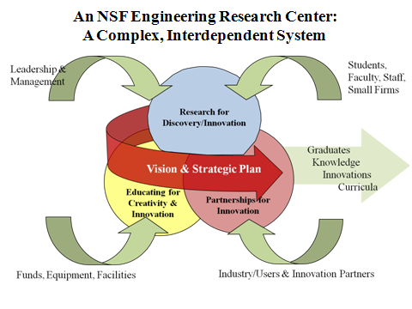

Slide 64
Gen-3 ERCs Convert “Valley of Death” into “Challenge Basin”
ENG overall
NSF overall
ERCs
Existing
Commercialization
Resources
Innovation Partners/Facilitators
Translational research
Resources
Challenge Basin
Existing
Research
Resources
Innovation Infrastructure
Research at
Universities
New Products Sold by Companies
Level of Development
Adapted from chart by
Deborah Jackson, ERC Program Director
Notes:
64
See “What is an Innovation Ecosystem?” by Deborah Jackson, ERC Program Director
http://www.erc-assoc.org/docs/innovation_ecosystem.pdf

Slide 65
Engineering Workforce Development
Strategically designed to produce graduates with skill sets to be:
  Creative, adaptive, and innovative
  Familiar with industrial practice, technology advancement, entrepreneurship, and innovation
Research will enrich the curriculum
Bring engineering concepts and experiences to the K-12 classroom, through:
  Research Experiences for Teachers Program
  Engaging pre-college students in ERC’s research and education programs

Slide 66
Innovation Ecosystem
Sectors and types of firms/agencies strategically targeted along the value chain
University and/or state and local government partners/facilitators of innovation and entrepreneurship
Role for translational research in partnership with small firms when member firms do not license IP
Strategic configuration would result in highly effective approach to industrial collaboration and innovation

Slide 67
ERC Infrastructure
Configuration and Leadership
Culture of Inclusion
Management Efforts
Resources and University Commitment

Slide 68
ERC: Research
Potentially Transformative; well motivated; significant impact; exciting; compelling; credible
Fundamental Translational Research
10 year support by NSF & DOE
ERC driven by an Engineered System

Slide 69
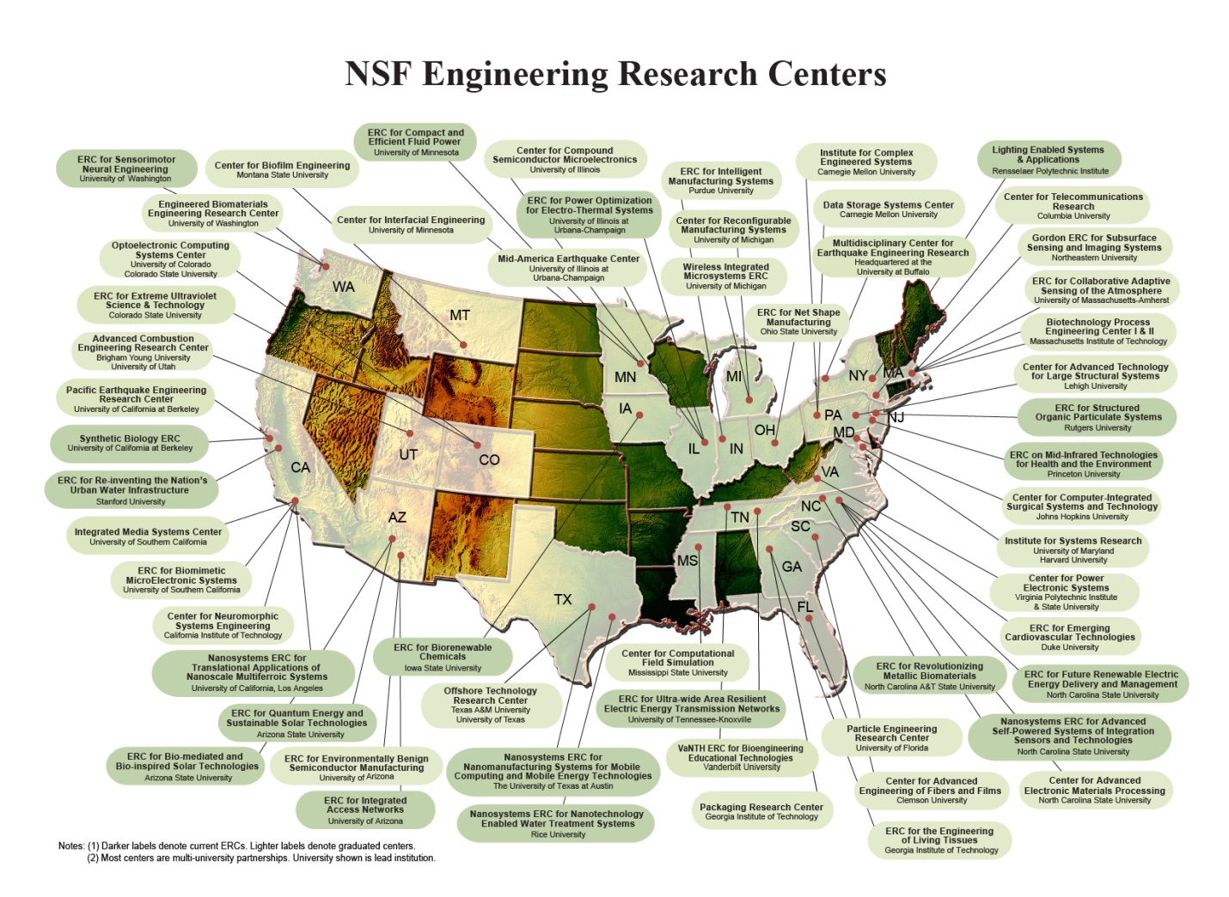
Location of ERCs
http://erc-assoc.org/content/welcome-erc-program

Slide 70
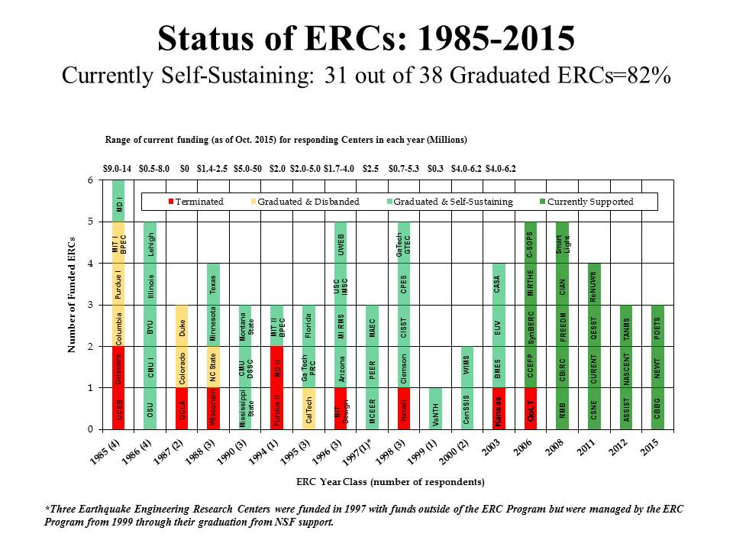
Status of ERCs

Slide 71

Quantum Energy and Sustainable Solar Technologies
“QESST's goal is to design and build novel PV cells and modules that circumvent trade-offs between cost and efficiency, making them higher efficiency, lower cost, scalable, and sustainable. The approach is to broadly to fuse technologies from different technological bases which are historical siloed, and that are intrinsically sustainable and scalable to meet the Terawatt Challenge.”
Engineering Research Center Arizona State University in partnership with the California Institute of Technology, the University of Delaware, the Massachusetts Institute of Technology, and the University of New Mexico
Christiana Honsberg, Director Harry Atwater, Deputy Director Matthew Fraser, Executive Director

Slide 72
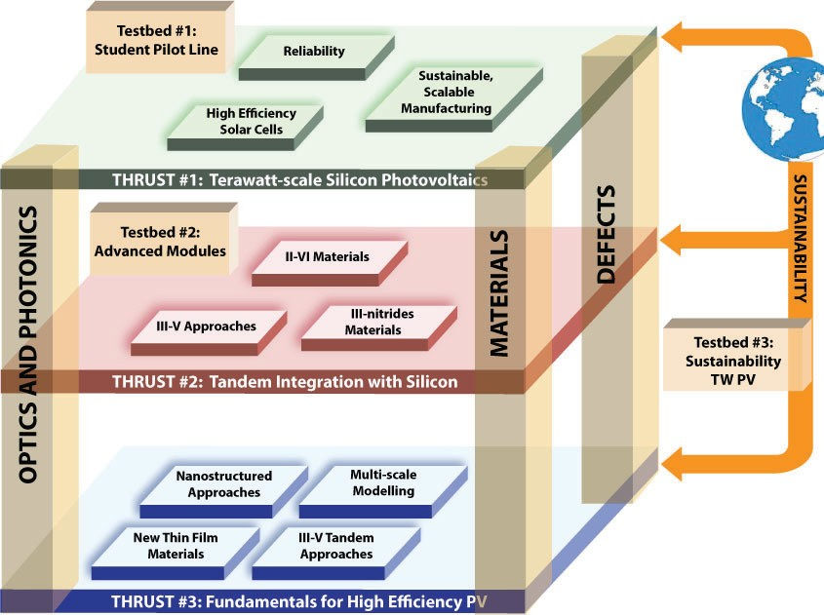
QESST Three Level Strategic Plan

Slide 73
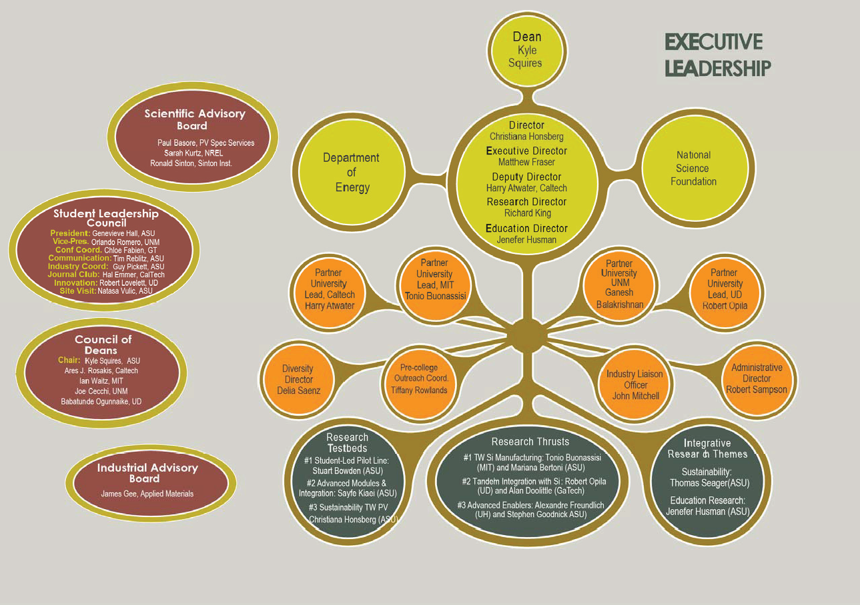
QESST Organizational Chart

Slide 74
Discussion and Brainstorming
Is something of this magnitude feasible for us to even consider?
  Perhaps, given right partners and resources, but need to start planning now for Fall 2017 submission.
What is the compelling new idea and how does it relate to national needs?
  Photonics certainly fits this bill, and AIMPhotonics has made this case successfully.
Wide or limited area focus within photonics
  Wide: FPI is wide focus, BUT, will this work to provide a strong engineered system concept with compelling vision?
  Limited: an ERC focused on specific areas within photonics that can together represent a “combination of components working in synergy to collectively perform a useful function”
Relevant efforts already in progress:
  QESST: solar energy focused
  Advanced Self-Powered Systems of Integrated Sensors and Technologies (ASSIST)
  Nanomanufacturing Systems for Mobile Computing and Mobile Energy Technologies (NASCENT)

Slide 75
Discussion and Brainstorming
What is our Engineered System?
What is our Vision?
Who are our Partners?
Thoughts on a 3-plane diagram?

