Slide 1
Effective CCD Pixel Sizes as a function of collected charges P.Antilogus , LPNHE , Paris
The data included in this presentation are from :
LSST ( CCD e2v 250) : Data collected on the Harvard LSST sensor characterization test bench with the close collaboration of P. Doherty .
Remark : the work presented here started within the LSST sensor group.
CFHT/ Megacam data (e2v CCD 42-90 ) : CFHT Legacy Survey data
DECam/CTIO data (Dalsa/LBNL CCD) : Dark Energy Survey data
All the analysis/studies have been done at LPNHE, Paris, by
P.Antilogus, P.Astier , A.Guyonet , N.Regnault
sdw2013 - Florence, 7-11 October 2013

Slide 2
Talk Overview
Photon Transfer Curve, based on flat fields, shows in many CCD a pixel flux variance < flux in at least ½ of the higher flux range and not “=“ as expected for a poisson process.
Taking into account the correlations between pixels solves this apparent problem.
This known fact (see Mark Downing work on the subject) is the starting point and the core of this talk :
What are these correlations ?
How do they impact star/spot psf ?
can we understand this effect and remove it from astronomical images?
PTC for ccd e2v 250
Residue in ADU to a linearfit :
Gain(e-/ADU) = flux / var(flux)
35000 ADU ~ 175 ke-

Slide 3
CCD Pixel to Pixel correlations : first look

Slide 4
Vertical-// cor +/-1,2,3 pix
Horizontal-serial cor +/-1,2,3 pix
Correlations in
CCD e2v 250 at
different Flux level
Correlation➔
ADU➔
A clear linear increases of the correlations is observed with the flux
Correlations are measured up to 4% for the closest pixels in the // direction ( R(0,1) ) and are still at the .1 % level 3 pixels away .
R(0,1) ~ 4 x R(1,0) , but all other correlations at an equivalent “distance” are of the same order .
There is a clear reduction of the correlations with the distance but indeed the number of pixels concerned increases with the distance …
Correlations
Observed in
CCD e2v 250
For ½ full well
35000 ADU ~ 175 ke-
Long range cor +/- 2,3 pix

Slide 5
Correlations seen in flat field for # CCD kind
LSST-e2v CCD 250: pixels 10x10 μm, 4 phases, red-sensitive 100 μm thick, fully depleted,
DES - LBNL/Dalsa : pixels 15x15 μm, 3 phases, red-sensitive 250 μm thick, fully depleted,
CCD e2v 44-82 : pixels 15x15 μm, 3 phases, 16 μm thick
CFHTLS-CCD e2v 42-90 : pixels 13.5x13.5 μm, 3 phases,
Correlation with +/-1 pixel in // direction (Y)
Correlation with +/-1 pixel in serial direction (X)

Slide 6
Correlations dependencies
Can we better understand the source of these correlations

Slide 7
Correlations independent of λ
Below correlations measured in a thick (100 μm) e2v 250 at 3 wavelengths :
No significant (<5%) dependency of the correlations with wavelengths is observed
➔ Source of the correlations is close to the e- storage area
35000 ADU ~ 175 ke-

Slide 8
Correlations/PTC independent of Temperature
no KT dependency observed for e2v 250 (- 70 V on Back Substrate)

Slide 9
Correlations/PTC dependency with Clock HV
Correlation for +/-1 pixels in // direction
in function of the flux
Photon transfer curve
As well than for the blooming/full well , there is a clear dependency of the correlation R(0,1) (+/-1 pixel in // direction) with the clock upper Voltage. The other correlations are unchanged!

Slide 10
Correlations/PTC : Preliminary conclusion
The non-significant dependency of the correlations in λ and T , and the clear dependency in clock V , is in favor of an electrostatic effect near the storage area.
Still there is at least 2 “surprising” points :
The correlation difference between the +/- 1 pixel in // and serial direction : corr // ~ 4 corr serial. But at longer range (+/-2 …) corr // ~ corr serial ( observed in all sensors we looked at )
There is an apparent contradiction in the fact that there is no λ dependency observed (~ short range effect near the storage area ) and the fact that we see correlation up to 4 pixels (~ 40 microns)
Correlations Observed in
CCD e2v 250 For ½ full well

Slide 11
Spot studies
If there is pixel to pixel correlations
If the size of these correlations is function of the pixel content
➔ We expect an effect on the PSF / star shape versus flux

Slide 12
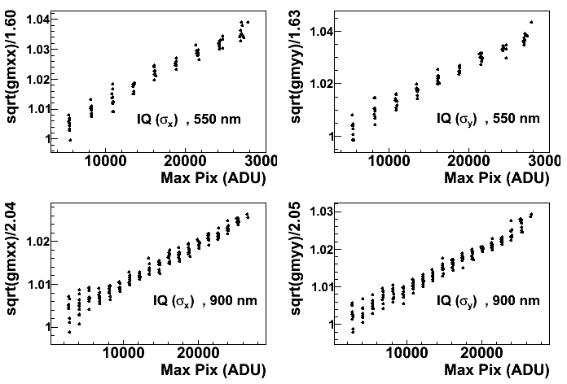
Spot size increase with the flux / Brighter-Fatter
Setup : a spot with a “star like” size (σ _{PSF} ~ 1.5-2 pixels) , exposure time from 1s to 800s ( above/close to saturation of the “max pixel” for the # λ ) , measurements performed at different λ and done more than once to confirm that the slow variation of the spot position overtime was correctly handled in the analysis.
σ _{PSF}➔
We observe a linear increase of the spot size/σ with the flux
➔ « Brighter – Fatter effect »
The effect is only slightly stronger in Y (// direction) than in X (serial direction) ➔ +10-20% for the “small” spot used.
No seen/significant lambda dependency of the effect : the # in spot variation is < 5 % between 550nm and 900nm .
➔
30000 ADU ~ 150 ke-

Slide 13
Spot shape change with flux
Difference of a 200-s spot (900 nm) from a sum of 20-s spots after geometrical alignement via a flux-conserving resampling and proper normalisation to integration times. The broader wings and lower peak of the brighter spot shows up clearly.
Remark : this looks like an anti-correlation between bright and faint pixels : bright pixels get fainter and faint pixels get brighter, instead on flat we have a positive correlation : Poisson fluctuation propagate to nearby pixel .
200s - 1/2 20x20s = diff(bright-faint)
(Bright-faint) normalized to max pixel

Slide 14
PSF versus intensity measured on stars in DES and CFHTLS
IQ =Image quality ~ sigma of the psf of the stars
Delta IQ = ( IQ “at saturation” – IQ “extrapolated at no flux”)
DES (for # filters)
Megacam/CFHT r
The effect is there in all the data set we looked at.
1% relative change on the sigma of the psf between high/low flux will generate ~1% offset in a psf photometry if the psf of the high flux is used to extract the low flux star.

Slide 15
First attempt of modeling / correction

Slide 16
Collected charges = Electrostatic effect = Pixel boundaries shift
The brighter-fatter effect can be described/explained by a basic electrostatic model , which displaces ( δ^{X}) the pixels effective boundaries (X for one of the 4 pixel boundaries) proportionally (a^{X}_{ij}) to the pixels content (q_{ij}) . ➔ δ^{X} = Σ_{ij} a^{X}_{ij} q_{ij}
Remark : Then it can be demonstrated that at first order correlations are linear in flux and in Σ_{X} a^{X}_{ij}
In the light of this hypothesis we can understand the origin of some of the surprising behavior of the correlations :
The origin of the correlation extend more in the pixel plane than in the pixel depth
➔ this is a simple geometric effect - cos() term : what matter to move a pixel boundary is the transverse field applied to the drift lines near this boundary : it’s the only way you can move an e- drift line from one pixel to an other one .
e- drift lines (crude CCD modeling)
With 50 ke- (red) – lower right
With no e- (black)
Pixels boundaries
100 μm ➔
50 ke-

Slide 17
Collected charges = Electrostatic effect = Pixel boundaries shift
An other effect clarified :
The correlation at +/-1 pixel is (much) higher in the // direction than in the serial one but at +/-2 pixels and above this asymmetry is ~ gone
➔ pixels boundaries have # origins between serial (implant) and // (// clock line) . // boundaries are weaker (blooming first)
➔ for // direction, the pixel boundaries region contributing to the charge exchange between pixels , ends closer to the charge storage .
➔ An increasing clocks upper voltage, will push away the “exchange area” from the “storage area” , reducing the impact of the charge collected on pixel boundary – reducing the correlation
➔ We got higher correlation where a small “change in length” matter which is at short distance / for the closer boundary. ➔ // - serial correlations differences will almost vanish as distances increase .
e- drift lines (crude CCD modeling)
With 50 ke- (red) – lower right
With no e- (black)
Pixels boundaries
100 μm ➔
50 ke-

Slide 18
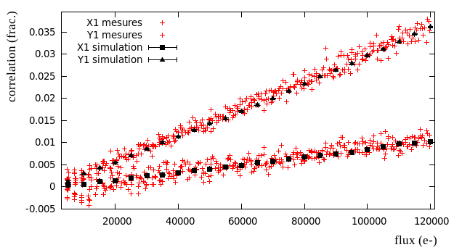
Correction of the images/spots on the e2v CCD 250
Step 1 : implement a pixel to pixel charge exchange
it will in particular estimate how much a charge in a given pixel will offset the boundaries of all other pixels. We tried many things, the best results were obtained with a simplified electrostatic model , which provide an attenuation low in function of the distance to the charge.
the model has to know the photon/charge density at the pixel boundaries : knowing how much the boundaries change doesn’t matter if you don’t know how many charges it concerns . Here , we used the average of the charges collected by both pixels sharing the boundary. (only ok at first order for spot/star)
Our current model for a given sensor is fitted using all measured correlations in flat fields (in practice full PTC needed) . It uses a law versus distance for the impact of a charge on pixels boundary + 2 parameters for the X (serial) and Y (//) offset/scale .
Step 2 : we check from a simulated “scrambled” flat, using these pixels to pixels charges exchange , that we find back the initial correlation.
Success
But no real surprise : these correlations where used in the fit. It just confirm that with this model you do get a linear variation of the correlation with the flux

Slide 19
Correction of the images/spots on the e2v CCD 250
Step 3 : “unscramble” ccd images using the fitted pixel to pixel charges exchange function with the opposite sign :
We applied this to our spot images , and re-measured the sigma of our spot versus flux .
➔ (non trivial) success !
We also compared our 200 s – 20 s spot shape difference after this correction :
some over correction in the core at
+1% level (instead of -3.8% ) , still most of the effect is gone.
Today We are implementing such correction in astronomical data . Stay tuned.
Raw data
σ_{y}
unscrambled
σ_{x}
Raw data
unscrambled
σ_{y}
σ_{x}
Raw data

Slide 20
Conclusion
Non-uniform charges distribution among pixels induces changes in the effective pixel boundary/size.
Such electrostatic effect impact CCD data :
the generated positive correlation between pixels in response to a flat field Poisson noise should be considered to compute the total variance / PTC .
“star like”/psf will suffer a brighter-fatter effect : negative correlation between bright/faint pixels will linearly increase the PSF width with the flux.
We showed that a per pixel correction of the images based on correlations measured on PTC gives good results on psf (good PTC needed )
The brighter-fatter effect/pixel boundary change may impact other CCD data ( psf based extraction of spectra in IFU , estimation of electron diffusion in CCD by knife edge or MTF methods ,…? )
In photometric survey bright objects are used to calibrate faint objects ( photometric psf , psf calibration in weak lensing studies… ) , the brighter-fatter effect has to be taken into account in the current/future large photometric sky survey to reach the expected resolution ( “< 1% “ ).
➔ this is part of the current « worries » that will address the coming workshop on on Precision Astronomy with Fully Depleted CCDs the 18-19 Nov 2013 at BNL.

Slide 21
Brookhaven National Lab
Long Island, New York
http://www.bnl.gov/cosmo2013/
register by Oct. 18

