Slide 1
Diffraction Limited Imaging from the Largest Ground-Based Telescopes in the Visible
Craig Mackay, Jonathan Crass, David L. King
Institute of Astronomy, University of Cambridge.

Slide 2
Introduction and Outline
Astronomical objects are a very long way away.
Our galaxy at a z~1 is virtually unresoved from the ground.
Hubble improved resolution ~x8 in the visible.
Ground-based telescopes have equalled that in IR with AO.
All need bright and scarce reference stars.
In the visible only Lucky Imaging has worked to give Hubble resolution on faint targets from the ground.
Key technology is high-speed photon counting (EMCCD) cameras.

Slide 3
Key Technology: Photon-Counting EMCCDs
Lucky Imaging in the visible only possible because of photon-counting EMCCDs.
But need high-speed, wide field imaging capability.
All CCDs can run faster, but only with compromises.
Need very careful front-end electronic design and layout.
We need fast clocking rates, low clock-induced charge levels and high gain.
Do not need parallel full well, so reduce clock swings.
Run at 27-30 MHz pixel rate, gains of ~1000-2000, and CIC < 10⁻³ per pixel/frame.

Slide 4
High Resolution Imaging from the Ground in the Visible
The only technique that can routinely deliver Hubble resolution images on Hubble size (~2.4m) telescopes in the visible on the ground is Lucky Imaging.
High-speed photon counting CCD cameras freeze the motion due to atmospheric turbulence.
Use 1024x1024 pixel EMCCDs running at 30MHz pixel rate, 25Hz frame rate to freeze motion due to turbulence.
A moderately bright ( I<16.5 mag ) reference star in the field allows image sharpness to be measured.
By shifting and adding the best images we can produce near diffraction limited resolution in the visible.

Slide 5
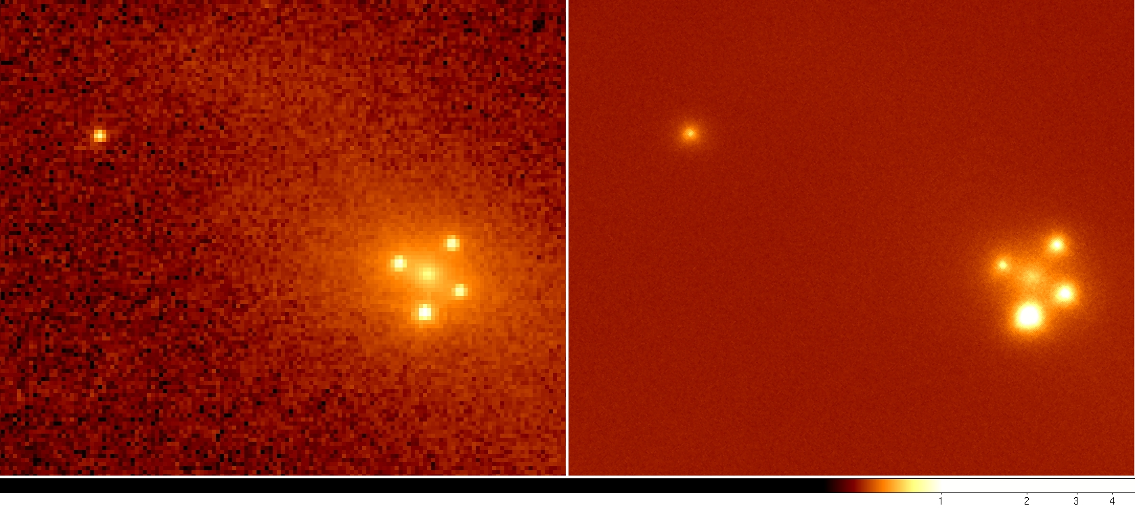
The Einstein Cross
(Left) is from the HST Advanced Camera for Surveys (ACS) while(Right) is the lucky image taken on the 2.5m NOT in July 2009 through dust.
The central fuzzy object is the core of a nearby Zwicky galaxy, ZW 2237+030 that gives four gravitationally lensed images of a quasar at z~1.7

Slide 6
Lucky Imaging on Large Telescopes
On telescopes larger than Hubble (4-10 meter diameter), the chance of a sharp image becomes negligible.
There are too many turbulent cells of size ~r₀ over the telescope aperture.
Most of the turbulent power is on the largest scales.
If they are removed, the effective turbulent cell size, r₀, is increased, and the number over the aperture is reduced.
This increases the chance of a sharp Lucky Image.
Demonstrated 5 years ago on the Palomar 5 m telescope with our lucky camera behind the PALMAO AO system.

Slide 7
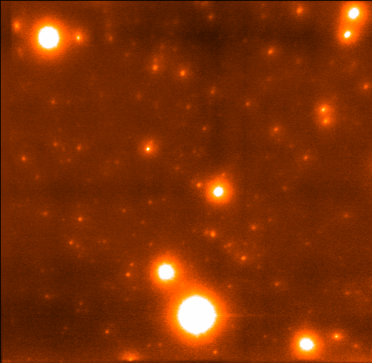
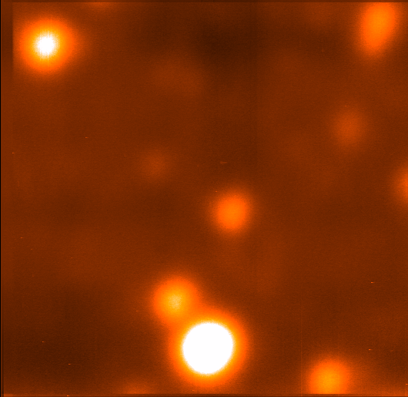
Large Telescope Lucky Imaging.
Globular cluster M13 on the Palomar 5m.
Seeing ~650 mas.
PALMAO system and our EMCCD Camera.
Achieved 17% Strehl ratio in I-band, giving ~35 mas resolution.
This is the highest resolution image ever taken in the visible.

Slide 8
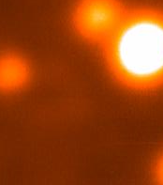
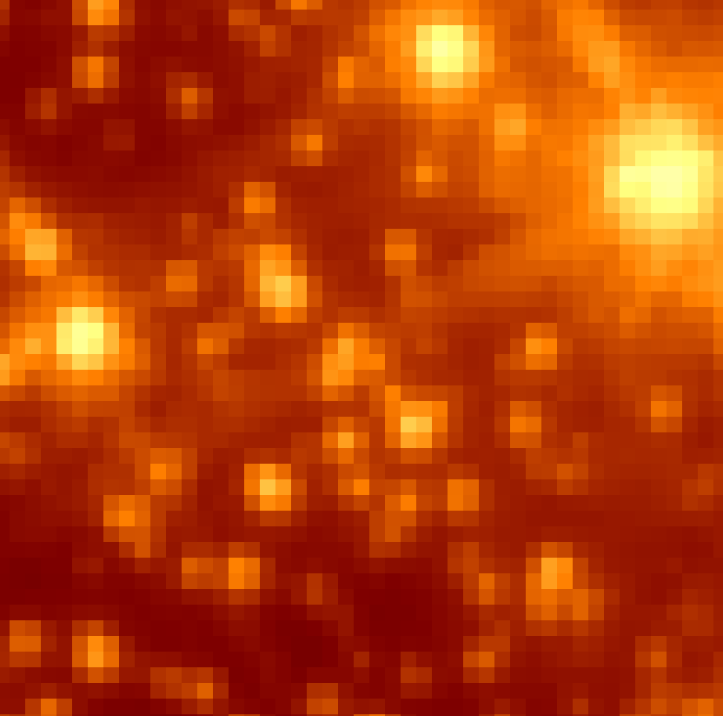
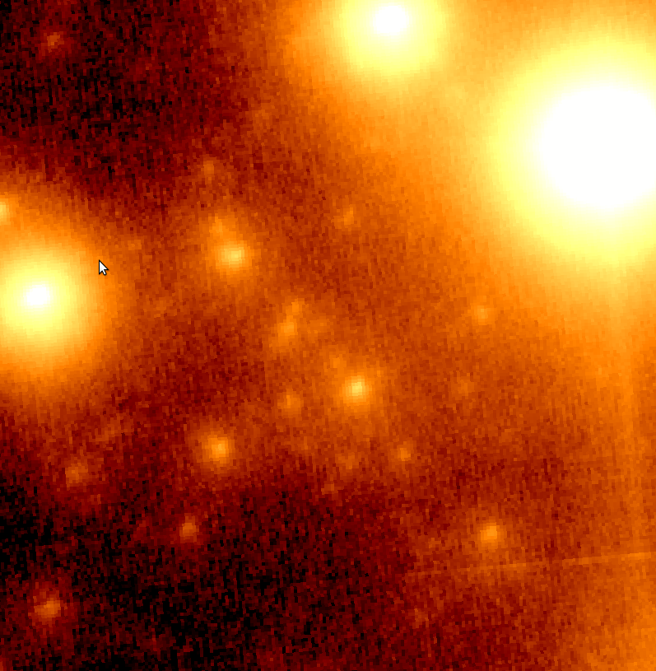
Large Telescope Lucky Imaging.
Compare Lucky/AO and Hubble Advanced Camera (ACS) is quite dramatic.
The Lucky/AO images have a resolution ~35 milliarcseconds or ~3 times that of Hubble.

Slide 9
AOLI (Adaptive Optics Lucky Imager)
AO usually needs a bright reference star.
We use a new non-linear curvature wavefront sensor (Guyon).
Much more sensitive than S-H sensors for low-order AO (Racine).
We use 4 out-of-pupil images, and fit the wavefront curvature.
Reference star x100-1000 fainter than S/H.
Wavefront fit quality gives Lucky Image selection and full PSF info.
(From Olivier Guyon, Subaru telescope, Hawaii).

Slide 10
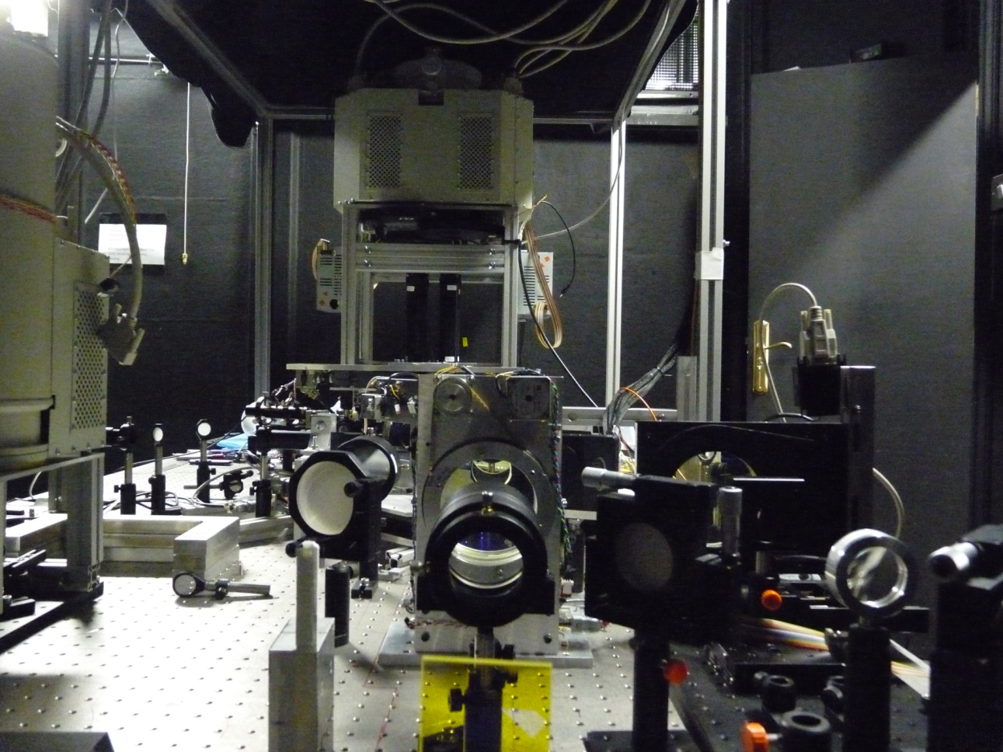
AOLI Layout.
AOLI uses a 241 element long stroke ALPAO deformable mirror.
The reference star is always on the optical axis, and the science field may be offset by up to 2 arc minutes.
It feeds the science camera, 4 EMCCDs, optically butted to give 2048 x 2048 pixel field of view.
Just had first light on 4.2m WHT on La Palma.
All looks really good (apart from dreadful weather, >3 arcsec seeing).
Sensitivity appears to be as predicted.

Slide 11
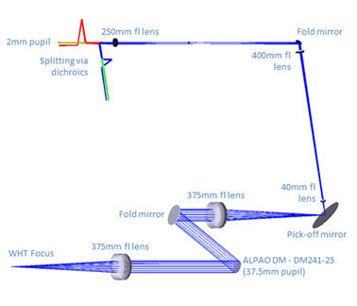
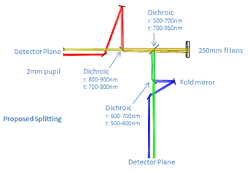
Curvature Sensor Layout.
The reference star light is split 4 ways with dichroic beam splitters.
Two photon counting EMCCDs at 100 Hz, sync with science EMCCDs record a 2 pairs of near pupil images.
Each set of 4 images allows the wavefront to be reconstructed and the deformable mirror driven quickly.
Reference star limiting I-band magnitude should be 17.5-18 mag for the WHT 4.2 m, and 18.5-19 mag for the GTC 10.4 m

Slide 12
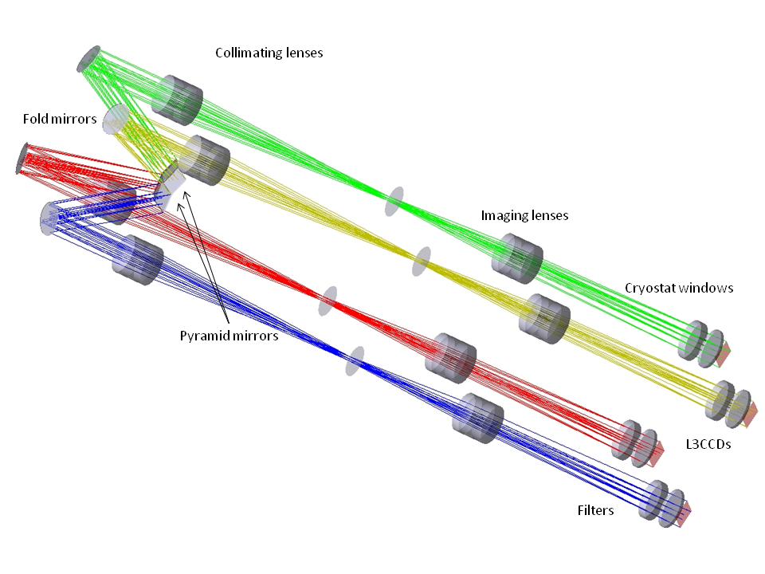
Science Camera Layout.
EMCCDs are not optically buttable so we follow the original Hubble WF/PC concept of using a shallow angle prism to split the beam giving a contiguous 2048 x 2048 pixel field of view.
Magnification is variable: from 6-60 milliarcseconds per pixel.
Each CCD may have a different filter.

Slide 13
Enhanced Efficiency Lucky Imaging
With Lucky Imaging, the sharpest images come from the smallest fraction of images.
Often the less good images are smeared in one direction only yet still showing excellent resolution in other directions.
Garrel et al (PASP, 2012) suggested making the lucky selection in Fourier space rather than image space. Results below:
Globular cluster M13,770nm : HST/ACS, lucky selection of 10% in image space, 20% and 50% in Fourier space. FOV 2.0 x 1.5 arcseconds, 35 mas resolution.

Slide 14
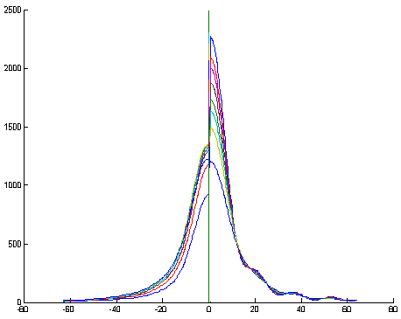
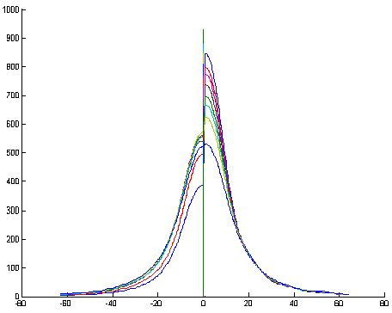
Enhanced Efficiency Lucky Imaging
With Lucky Imaging, the sharpest images come from the smallest fraction of images.
Before & after plots from the globular cluster field. Left-hand image very near reference star, right-hand image 12 arcseconds away. Profiles show different selection percentages.
These curves show selection percentages from 1% (top) to 50%. 1-50% seln.

Slide 15
Conclusions
The combination of Lucky Imaging and a low order non-linear curvature wavefront based AO system looks to be very powerful.
It should allow near-diffraction limited imaging on large ground-based telescopes in the visible over much of the sky.
The key technology is the availability of high-speed, high quantum efficiency photon counting EMCCD detectors.
AOLI has the potential to feed not only an imaging camera but also an integral field spectrograph or other instruments.
AOLI allows astronomers enables entirely new kinds of research at the very faintest levels with exceptional image resolution.
These techniques on a 10m telescope in the visible carry over directly to an ELT class telescope in the near-IR.

Slide 16
Lucky Imaging Group Institute of Astronomy University of Cambridge, UK cdm@ast.cam.ac.uk
Type “Lucky Imaging” into Google, click “I’m Feeling Lucky” to find out much more.

