Slide 1












Visible and Infrared Wavefront Sensing detectors review
Philippe feautrier
Institut de planetologie et d’astrophysique de Grenoble
FIRST LIGHT Imaging SAS
Jean-Luc Gach, Mark Downing, Paul Jorden, Johann Kolb, Johan Rothman, Thierry Fusco, Philippe Balard, Eric Stadler, Christian Guillaume, David Boutolleau, Gérard Destefanis, Nicolas Lhermet, Olivier Pacaud, Michel Vuillermet, Alexandre Kerlain, Norbert Hubin, Javier Reyes, Markus Kasper, Olaf Ivert, Wolfgang Suske, Andrew Walker, Michael Skegg, Sophie Derelle, Joel Deschamps, Clélia Robert , Nicolas Vedrenne, Didier Rabaud, Julien Tanchon, Thierry Trollier , Alain Ravex, Thibaut Moulin, Alain Delboulbé, Olivier Preis, Sylvain Rochat, Pierre Kern, Gérard Zins, Jean-Baptiste Lebouquin, Sylvain Guieu, Luc Boucher, Dolores Bello, javier Castro Lopez …
Philippe.Feautrier@obs.ujf-grenoble.fr philippe.feautrier@firstlight.fr

Slide 2
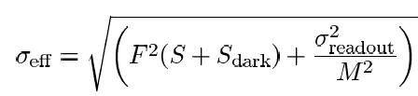
Noise and fast readout paradigm
The only way to have fast readout and low noise at the same time is to have (noiseless) signal amplification xM inside the detector…
F x Photon noise
Readout noise (input referred)
M: mean gain
F: excess noise factor
Total noise (input referred)
Unfortunately excess noise F is always > 1

Slide 3
Content of this talk
Fast infrared APD devices: the RAPID project
Fast EMCCD WFS: CCD220 and OCAM
CMOS state of the art development: NGSD

Slide 4

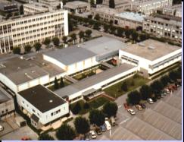
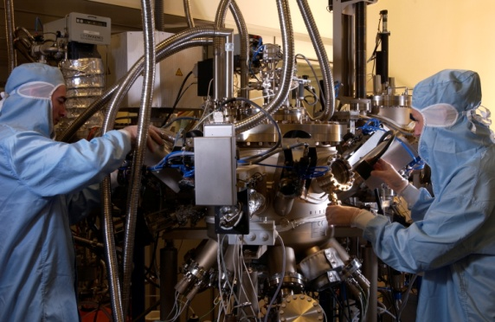
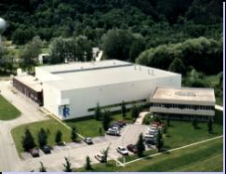
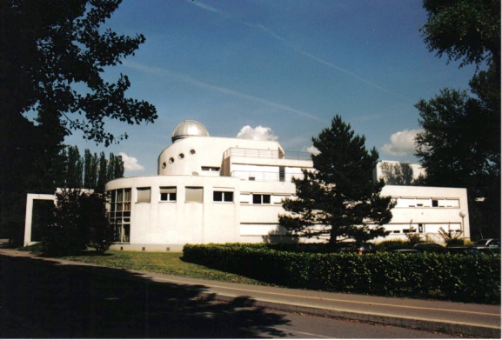
The RAPID e-APD development:
a system approach
INFRARED APD
Revolutionary Avalanche
Photodiode Infrared Detector
Sofradir – BiospaceLab – CEA / LETI – LAM – IPAG – Onera

Slide 5

320x255 IR APD
Detector specification:
  SOFRADIR 320 x 255 pixels APD array, 8 outputs of 32 columns, 30 µm pitch
  Pixel architecture : CTIA amplifier, integrated CDS
  Wavelength: 0.4 – 3.3 µm
  Full frame readout: 1600 Hz min, up to 2 kHz, pixel frequency 20 MHz
  Windows: one rectangular window of any number of lines, each line read in 2.7 µs
  System Noise: <2 e at 1600 Hz frame rate (with gain nx10)
  Dark: 100 e/s/pixel
  Full well: 37 000 e (with gain x1)
  Operability: ∼ 99.5%
  Power consumption: 210 mW (→ cryocoolers)
Devices available by end 2013.
80 K operation
Vis to IR

Slide 6
RAPID IR APD layout
Programmable window possible to speed up frame rate
Start line
Window
255 pixels
End line
320 pixels
8 outputs @ 20 MHz
Operational temperature T= 77 K
Nominal Frame rate: 1.6 KHz (pixel rate 20 MHz)
Cut-off wavelength λ_{c} = 3 to 3.3 µm

Slide 7
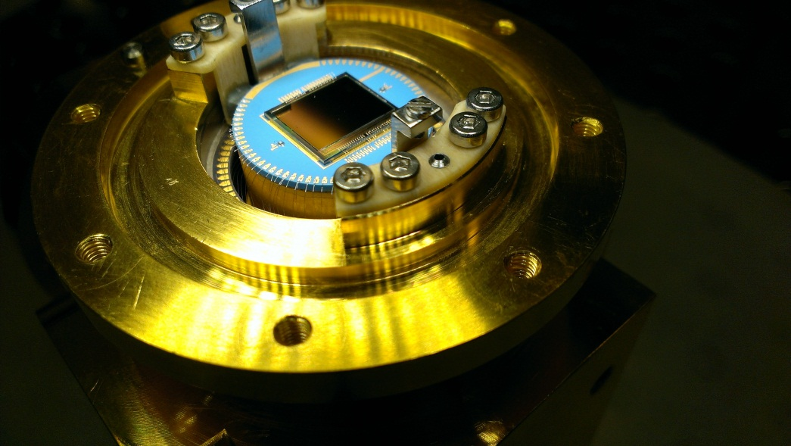
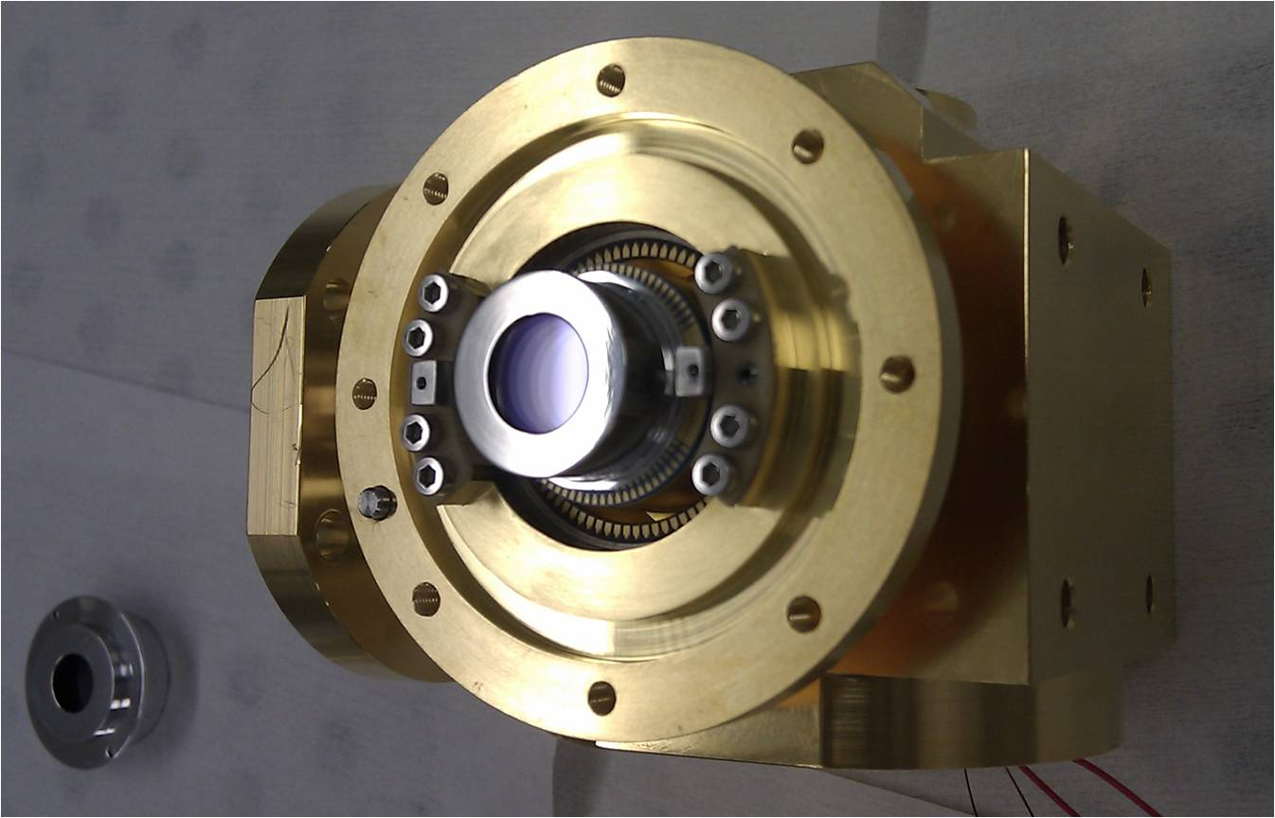
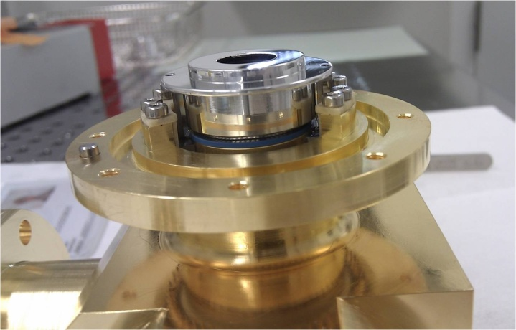
The RAPID pulse tube cryostat
Compact design
Already optimized for operation on telescope
No more liquid nitrogen, just pulse tube
A complete system approach

Slide 8
RAPID 3.3 µm Gain=30.8 (-8V, T=77K)
Very few defects at modest temperature (liquid nitrogen)
APD with gain x31 and T=77K looks like a normal IRCMOS device…
M = 30.8
Operability = 99.5%
Huge gain of x31 at modest voltage: -8V and 80K
Gain map M=30.8 (-8V)
Gain histogram

Slide 9
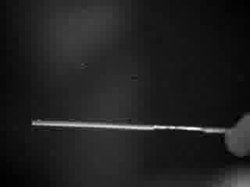
RAPID 1600 fps operation
1600 fps record in the infrared
Just bias image substraction, no image processing…

Slide 10
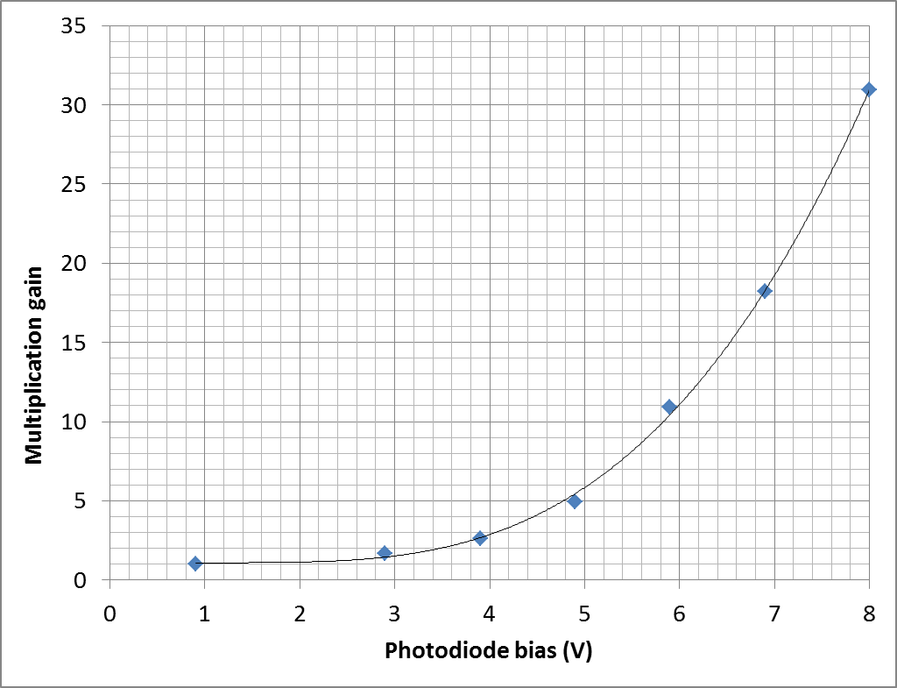
RAPID Gain – 3.3 µm photodiodes – 75 K

Slide 11
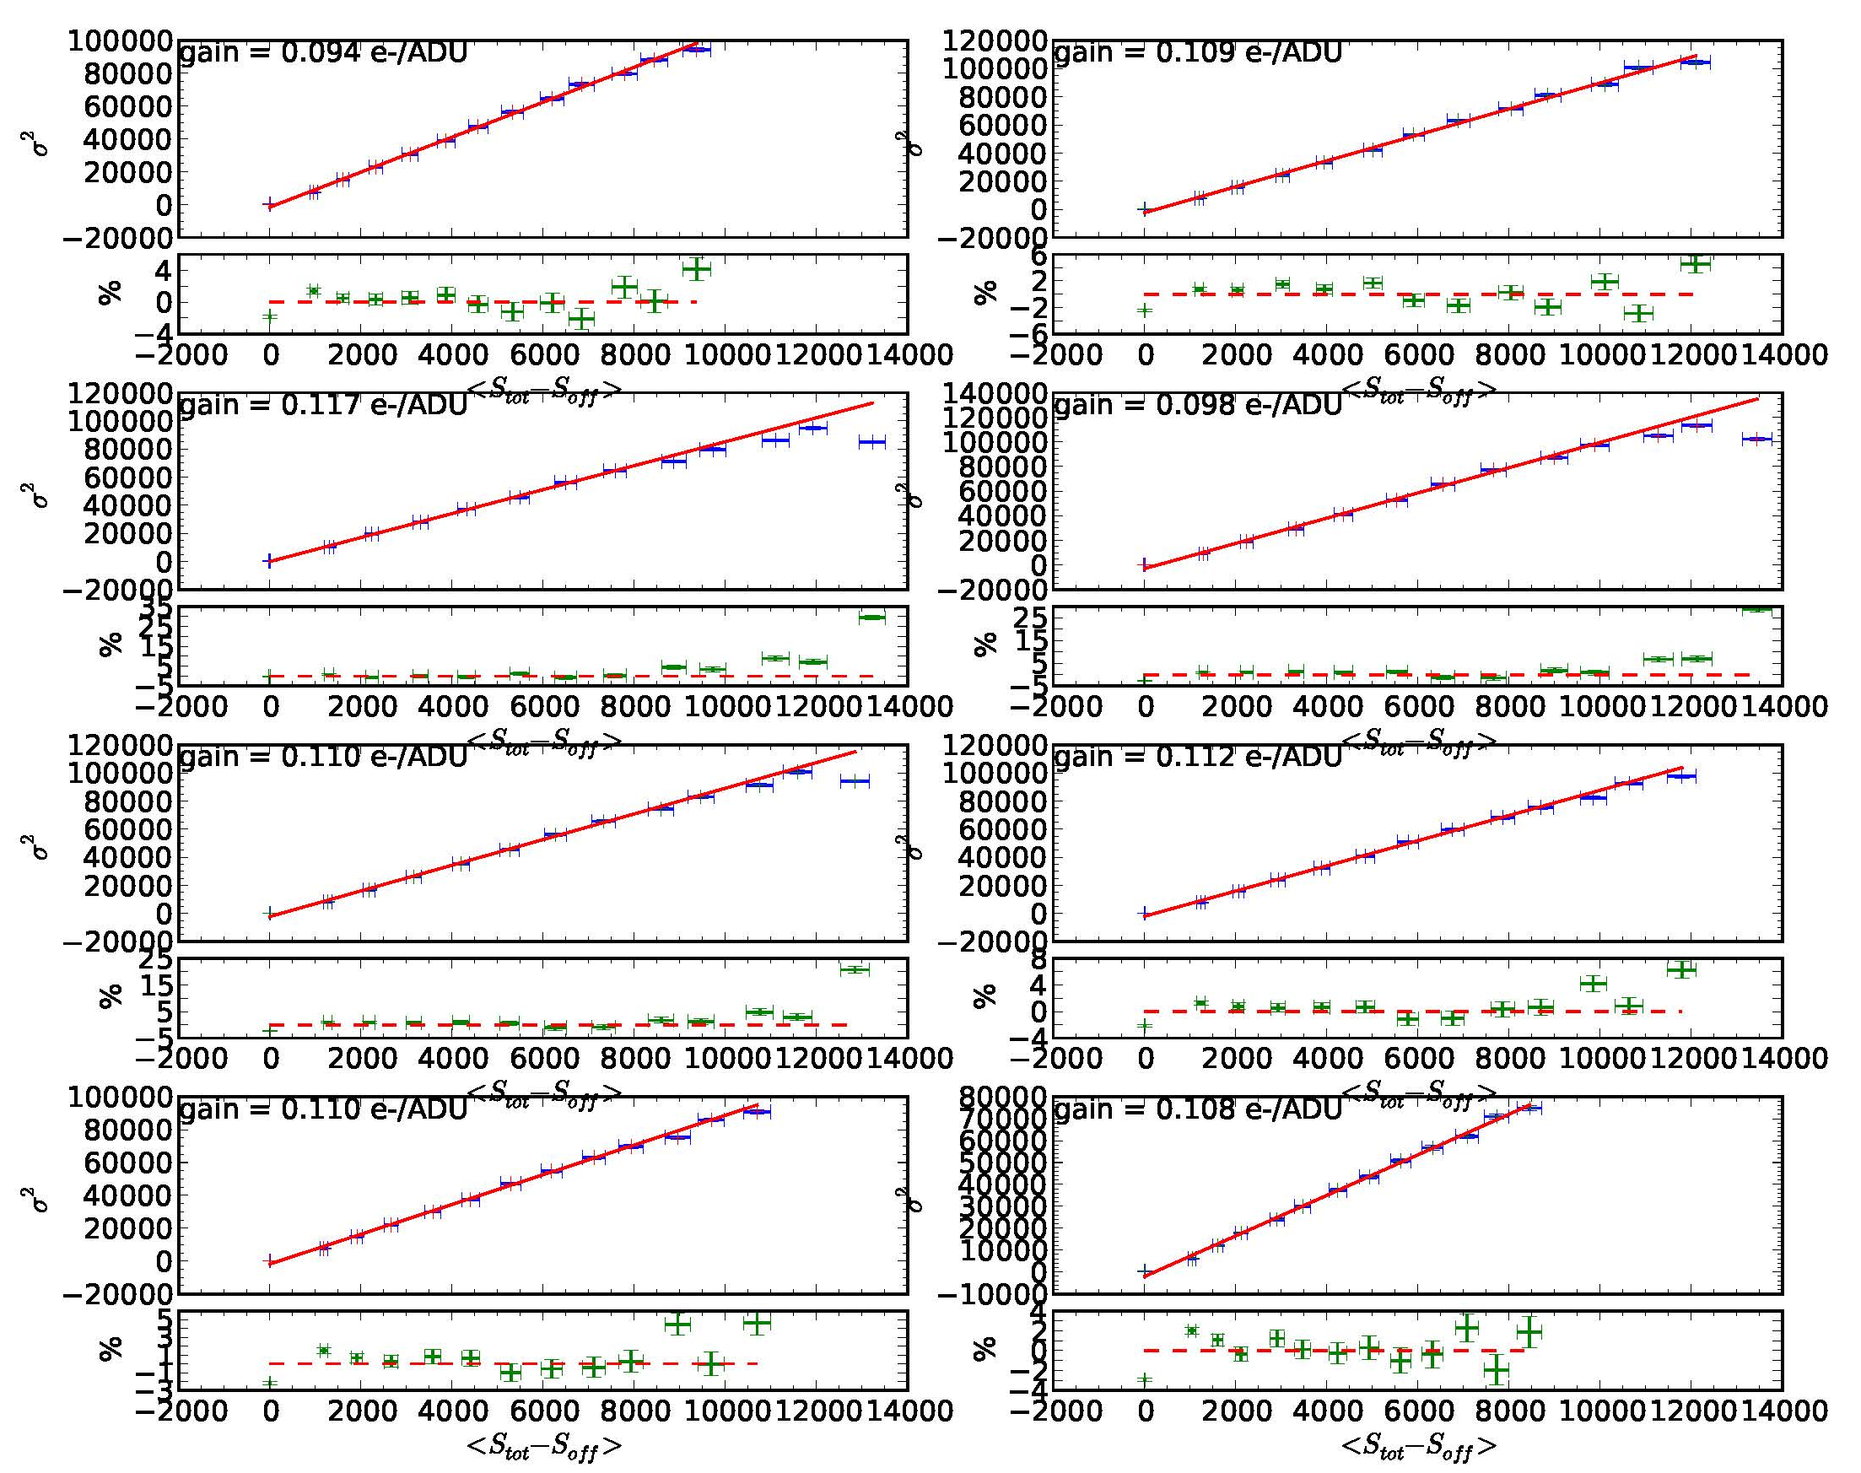
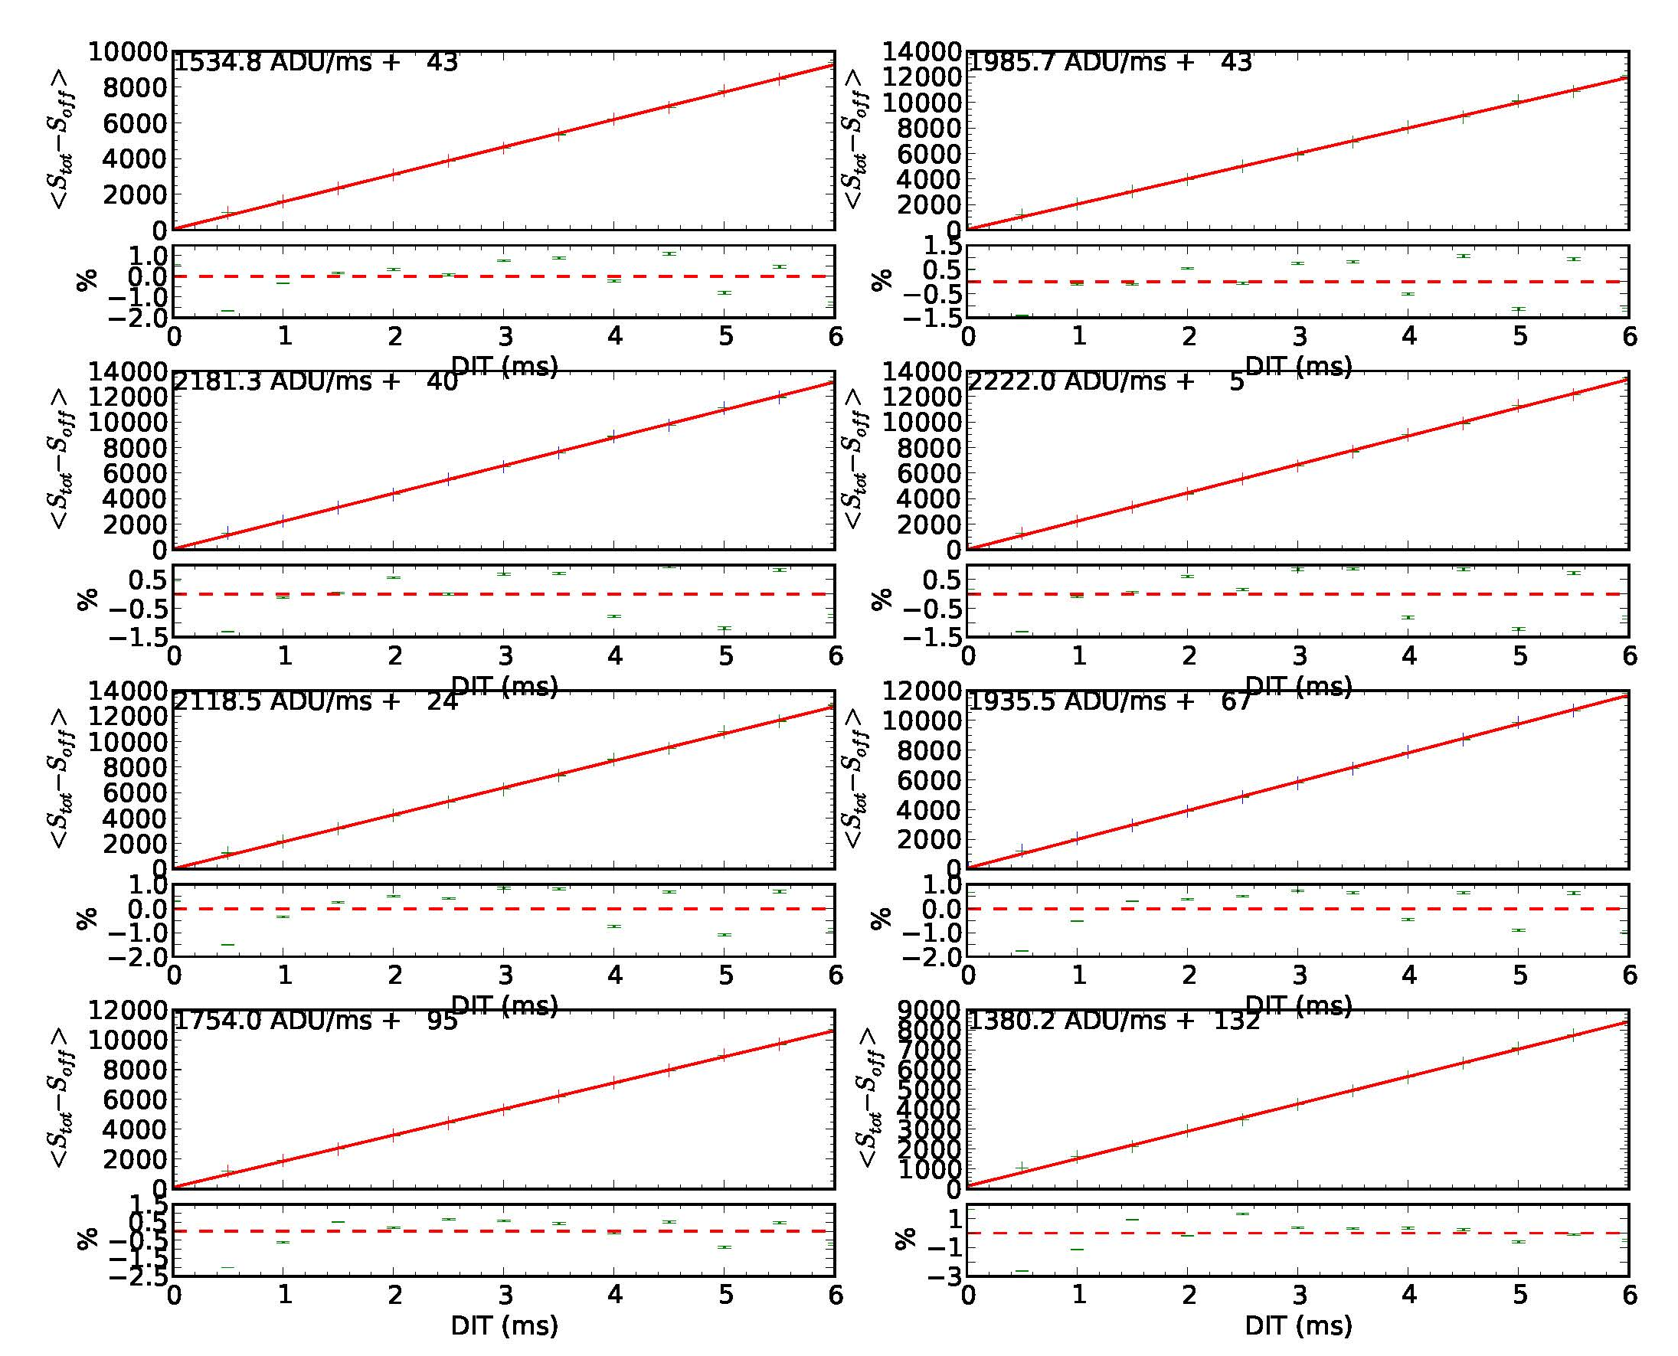
RAPID linearity 1600 fps at gain M x31
Photon transfer curve @ M=31
Linearity = f (DIT) @ M=31
Due to its CTIA amplifier architecture with integrated CDS inside pixel, the RAPID device is extremely linear …
And low noise !

Slide 12
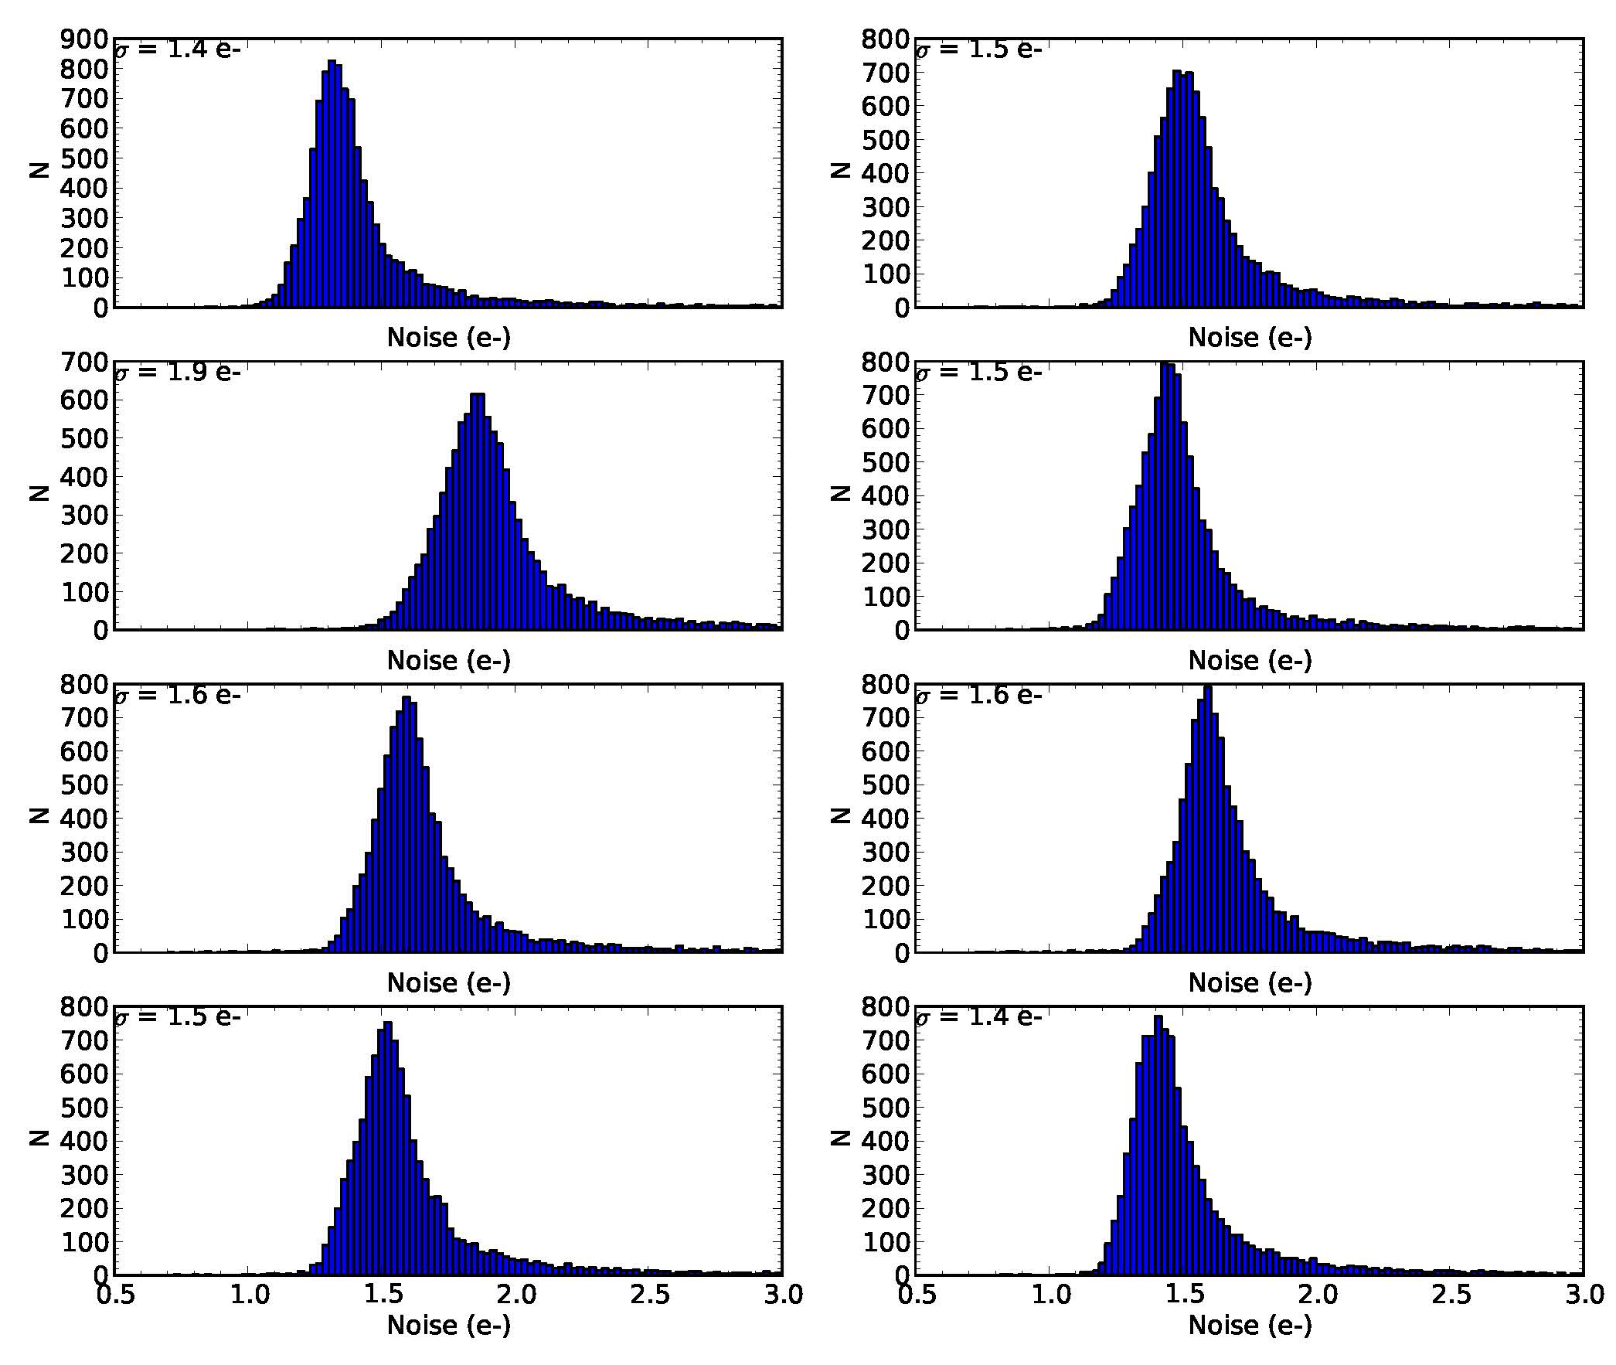
RAPID Noise histograms in dark @ 1600 fps
1.5 e @ 1600 fps

Slide 13
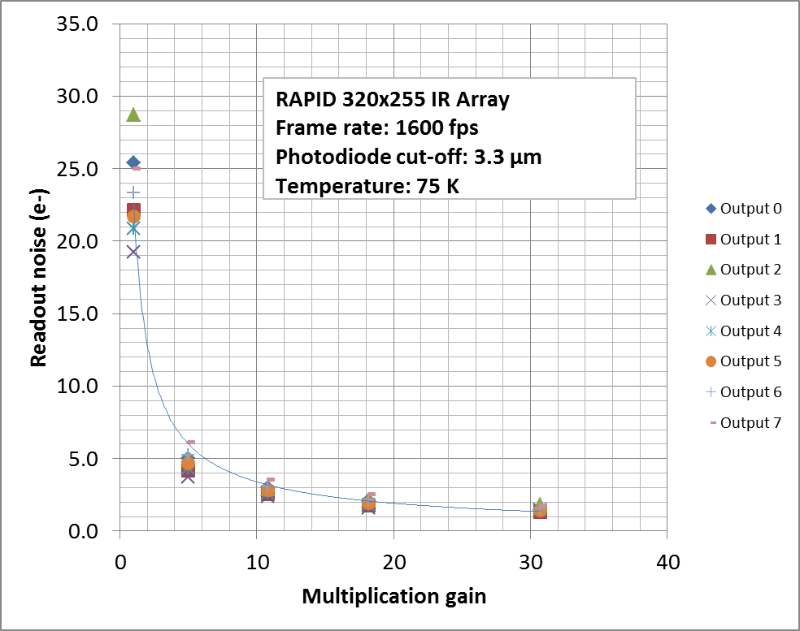
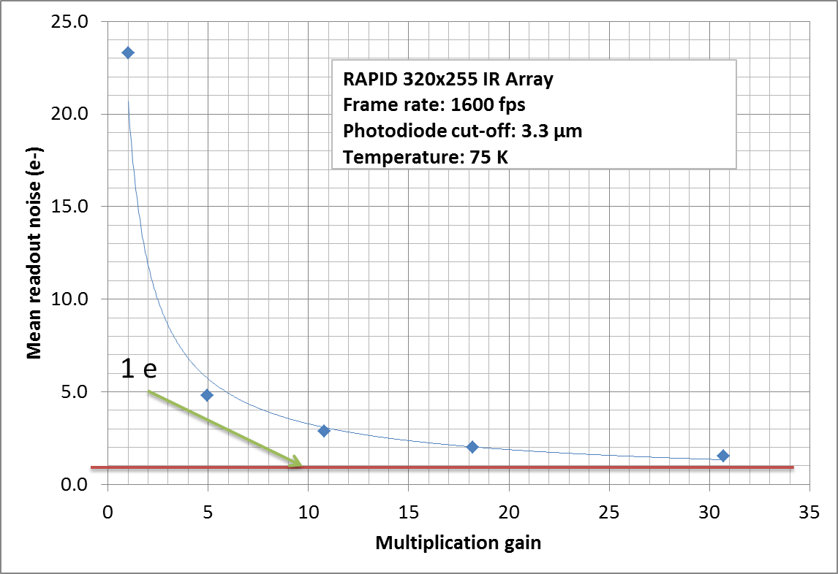
RAPID Noise 1600 fps
3.3 µm photodiodes – 75 K
Observation run foreseen at Paranal ESO VLTI in December 2013 with Pionier instrument
1.5 e @ 1600 fps

Slide 14
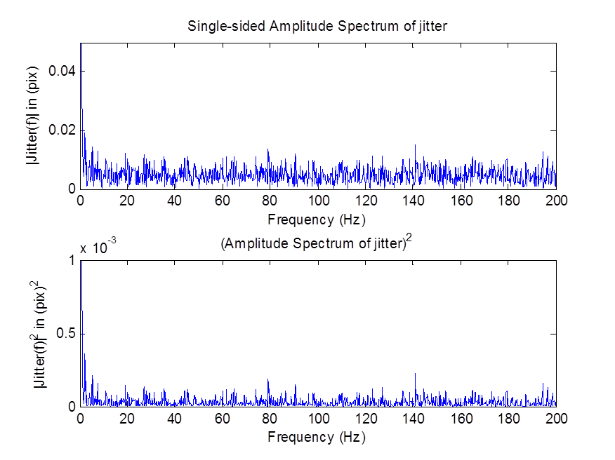
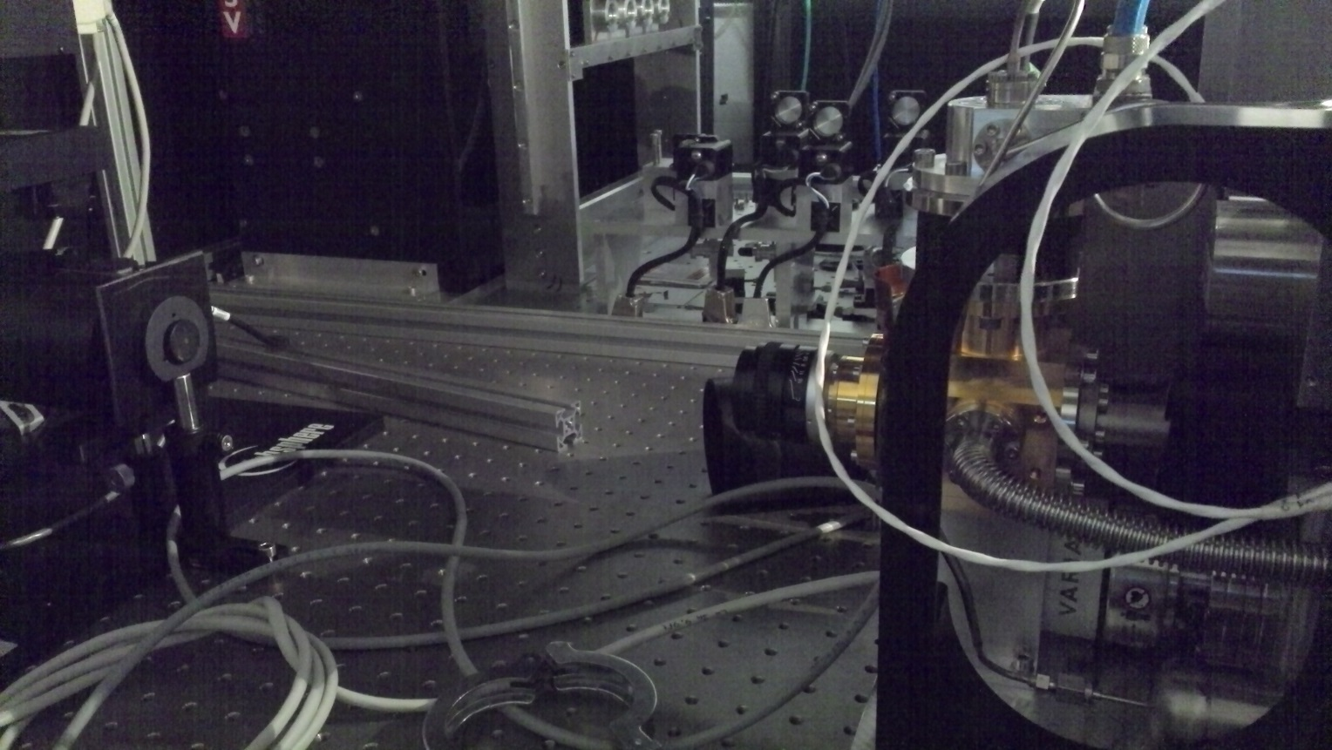
RAPID Pulse tube vibration analysis
Setup
Pulse tube frequency: 50 Hz
No vibration detected in centroid FFT spectrum

Slide 15
CCD220 and OCAM2
Visible EMCCD

Slide 16
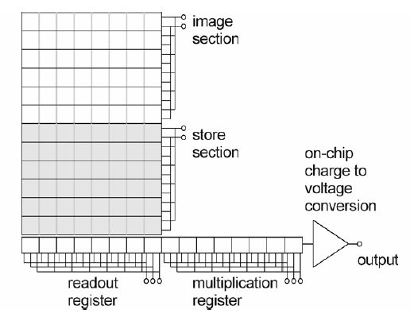
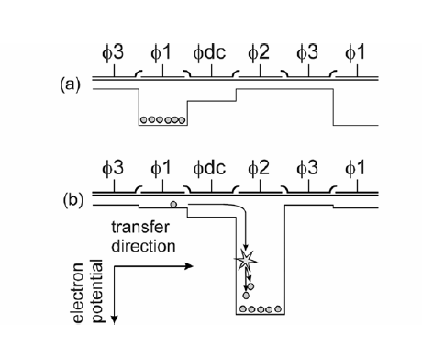
EMCCD: Electron Multiplying CCD
M: mean gain
F: excess noise factor
For Si EMCCD:
F = 2 but σ _{readout}/M ∼ 0

Slide 17
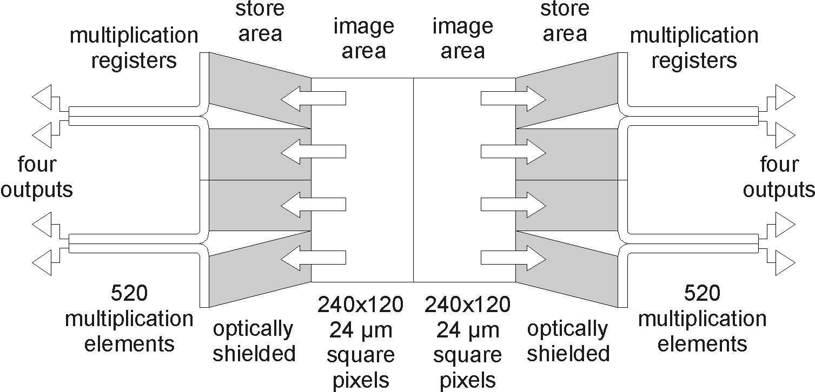


The e2v CCD220 EMCCD
240 x 240 pixels with 24 µm pitch
8 EMCCD outputs split frame transfer => 110 Mpixels/s
Nominal frame rate: 1500 frames/sec
Peltier cooled @ - 45 °C
Very challenging to use properly

Slide 18

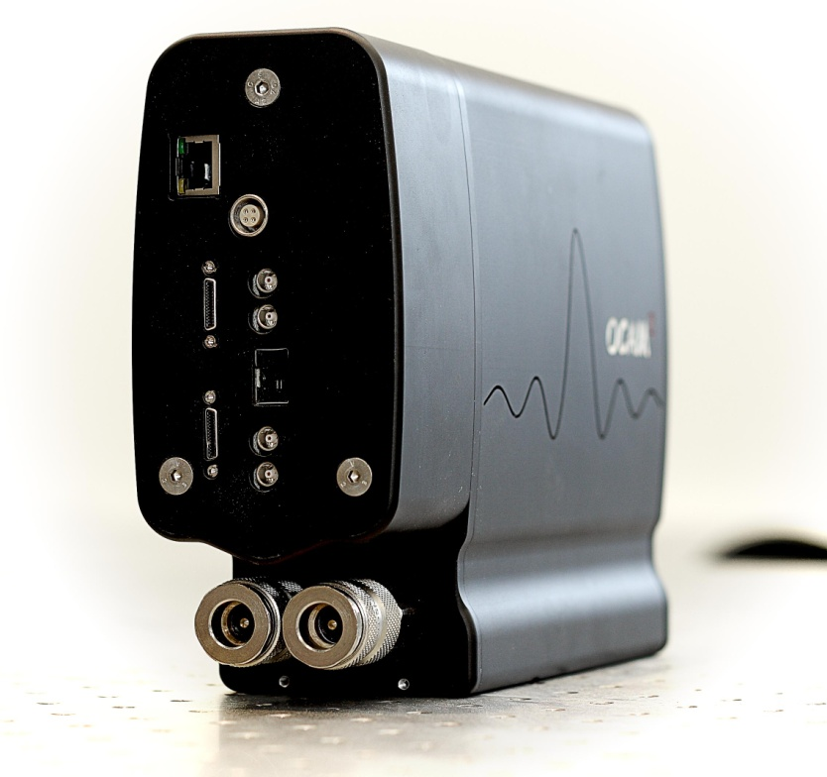
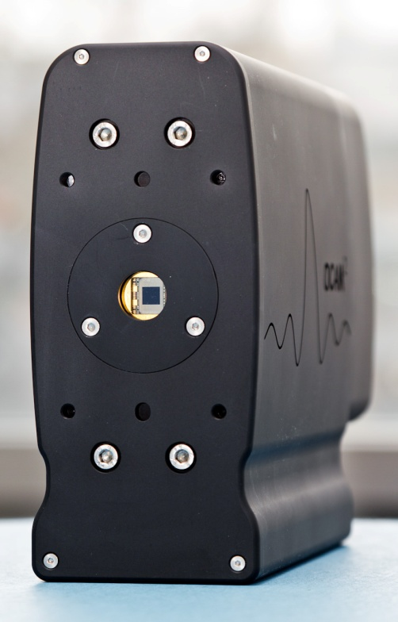
OCAM2 by First Light www.firstlight.fr

Slide 19








First Light Business
The biggest telescopes in the world.
The sharpest labs and institutes.
Some advanced industrial companies.

Slide 20
OCAM2 QE (standard and DD)
FLI is the only company in the world to provide EMCCDs cameras with Deep depletion silicon sensors providing superior red response

Slide 21

Centroiding with 5 photons…
Shack hartmann centroiding possible only with a few photons @ 1500 FPS
Central peak is only 5 photons/frame amplitude (mean value)
1503 FPS
Gain x 800
0.2 e noise

Slide 22
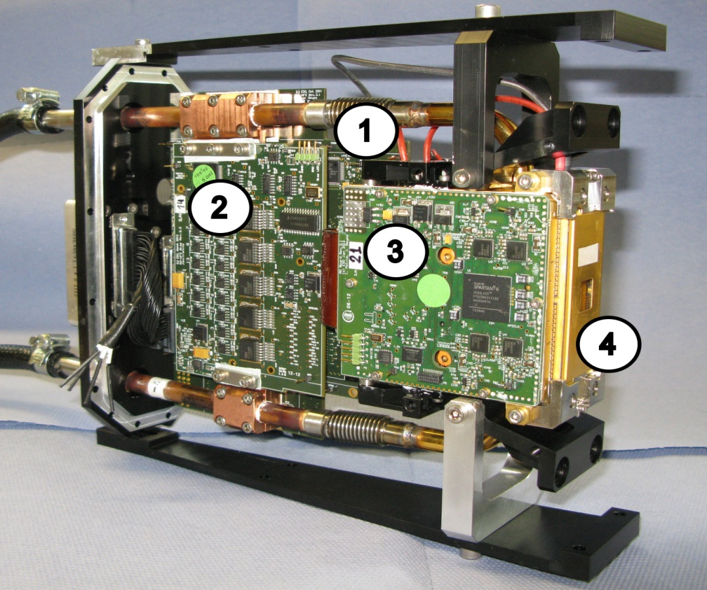
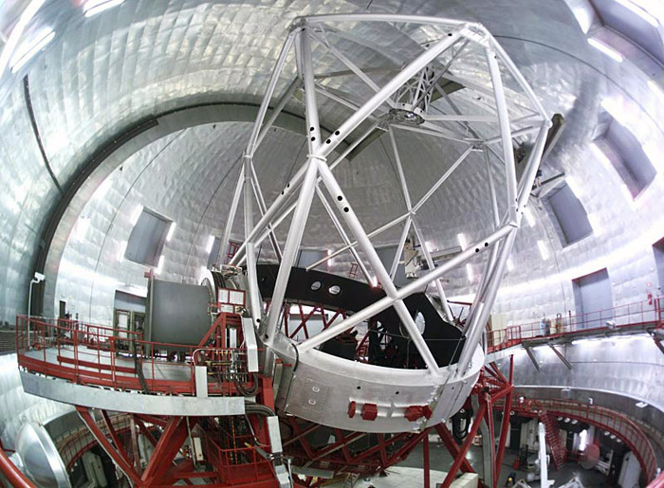
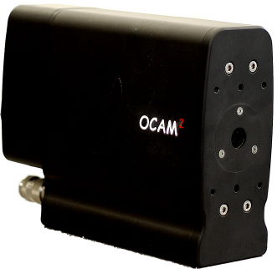
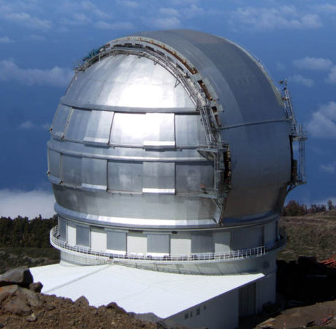

OCAM2 technology in Europe
ESO WFS camera with Ocam technology (First Light front end).
OCam2: WFS camera for Grantecan
2 systems on site since Oct 2011

Slide 23

RAPID/OCAM SNR
$$SNR=\sqrt{N_{ph}}$$
F _{EMCCD} = 2
F _{MCT APD} = 1.25

Slide 24
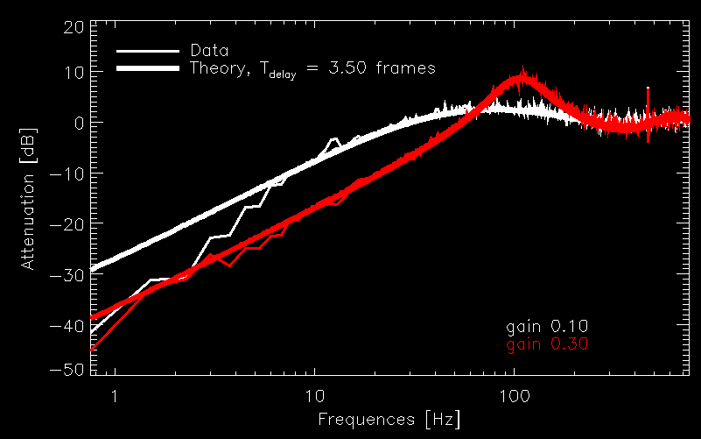
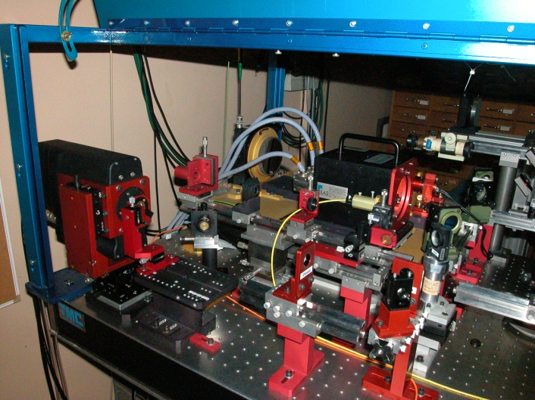
OCAM2 closed loop on the sky - ONERA
9x9 DM
Rejection transfer function of the AO loop system. Sampling frequency is 1503 Hz.
Shakti RTC
Courtesy of T. Fusco & al., SPIE Amsterdam 2012 [8447-68]
OCAM2
8x8 microlenses

Slide 25
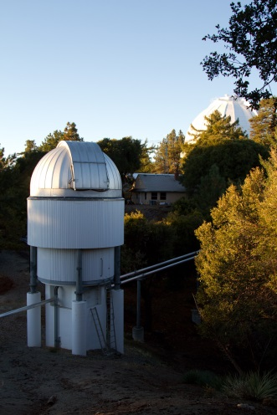
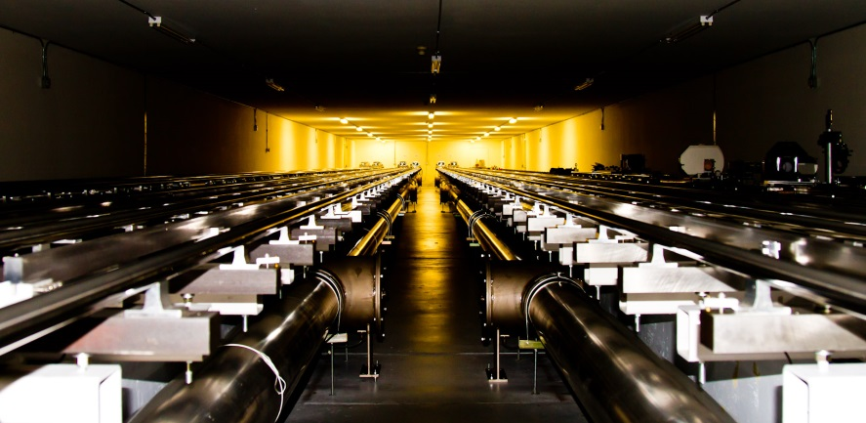
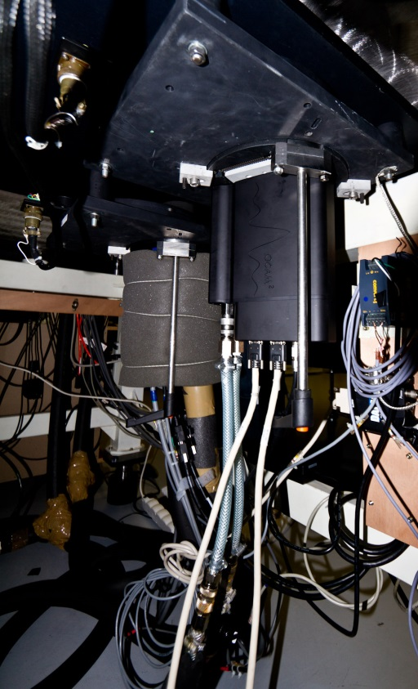
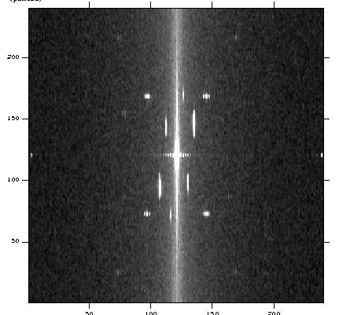
OCAM2 observation run on CHARA interferometer (CA)
Telescopes (6 x 1m)
Delay lines
Beam recombinator
focus
HD58923 FFT
3T observation
Photon counting mode
Results courtesy of
P. Berio
Obs. Côte d’Azur
OCAM²

Slide 26
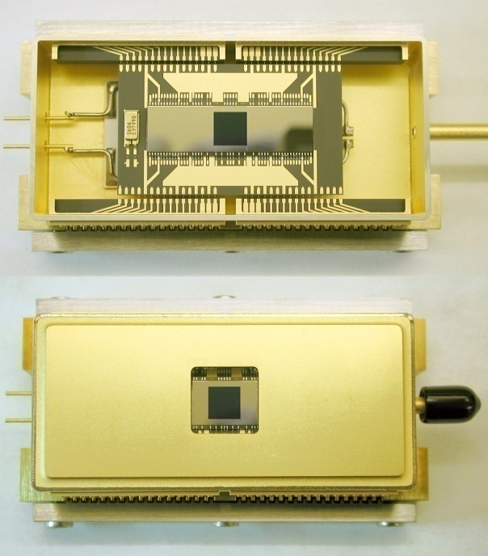
The OCAM^{2K} First Light product
Development carried by First Light Imaging with internal ressources
Goal : increase the OCAM2 camera speed to more than 2000 FPS.
Need to overcome the CCD intrinsic limitations: designed for 1200 FPS min, 1500 goal
18.6 Mpixel rate : unprecedented L3CCD readout speed

Slide 27
Readout noise
Measured noise : no noise degradation, made possible with better preamp and sensivity loss countermeasures
OCAM2
OCAM2^{K}
1.5 Kfps
2 Kfps
1 e-
1 e-

Slide 28
OCAM² vs OCAM^{2K}
Test measurement | OCAM² | OCAM^{2K} | Unit
Nominal speed (full frame) | 1503 | 2067 | FPS
Mean readout noise (full frame, full speed) | 0.13 | 0.13 | e-
Pure Latency | 60 | 43 | μs
Dark signal at 1503 fps | 0.0023 | 0.002 | e-/pix/ frame
Detector operating temperature | - 45 | -45 | °C
Peak Quantum Efficiency at 650 nm | 94 | 94 | %
Linearity at gain x1000 from 10 to 150 ke | <3 | <3 | %
Image area Full Well Capacity at gain x1, 1503 fps | 300 | 300 | ke⁻
Parallel CTE at gain x1, 1503 fps | 0.9999 | 0.9999 | N/A
Serial CTE at gain x1, 1503 fps | 0.9999 | 0.9999 | N/A
No performances degradation with OCAM ^{2K}

Slide 29
A 880X800 700 HZ CMOS DEVICE FOR NATURAL/LASER GUIDE STAR WAVEFRONT SENSING ON ELT
Fast visible CMOS

Slide 30
The CMOS NGSD characteristics
Pixel number (including dark reference pixels) | “Natural Guide Star Detector” NGSD - 880x840 pixels with 840x840 sensitive pixels
Detector technology | Thinned backside illuminated CMOS 0.18µm
Pixel Pitch | 24µm
Pixel topology | 4T pinned photodiode pixel
Sub-aperture | 20x20 pixels
Array architecture | 42x42 sub-apertures of 20x20 pixels
Pixel full well | 4000 e-
Read noise including ADC | < 3.0 e⁻_{RMS}
ADCs configuration | 20 x 880 column ADCs, 9 (goal 10) bits
Number of parallel LVDS channels | 22
Serial LVDS channel bit rate | 210 Mb/s baseline, up to 420 Mb/s (desired)
Frame rate | 700 fps up to 1000 fps with degraded performance

Slide 31
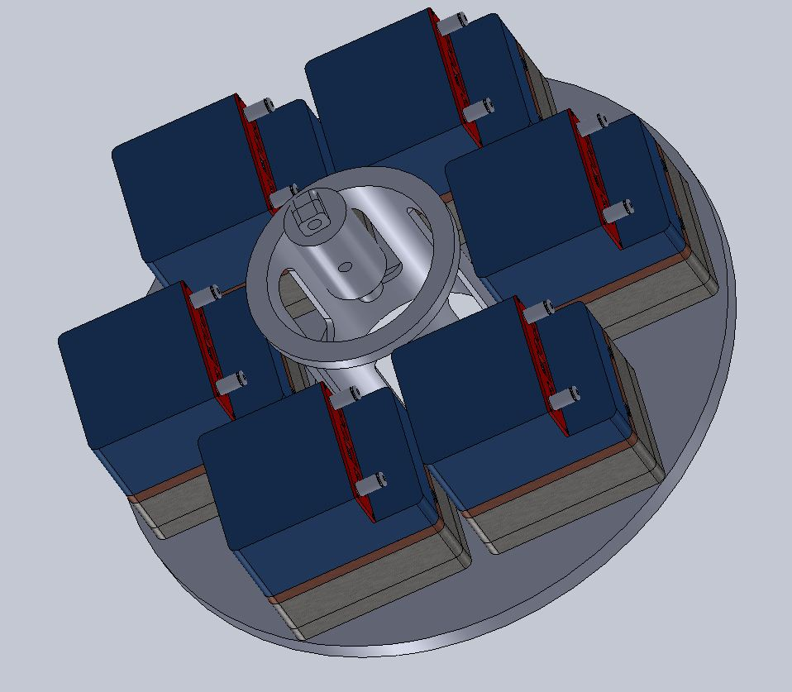
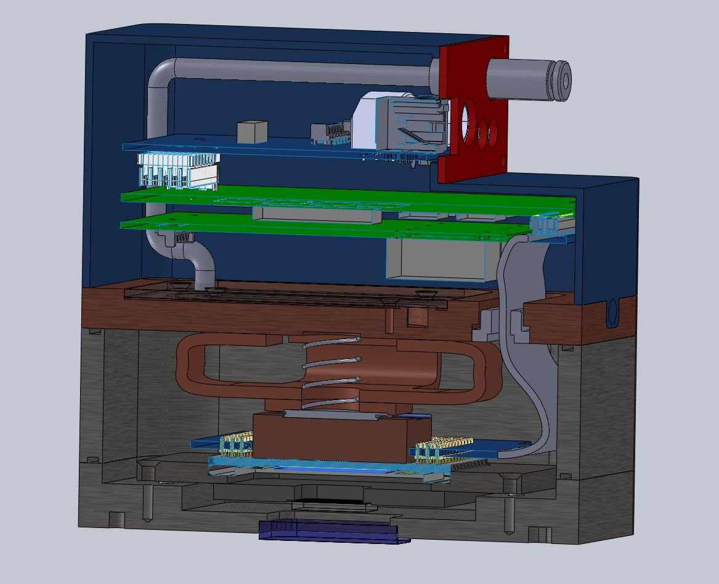
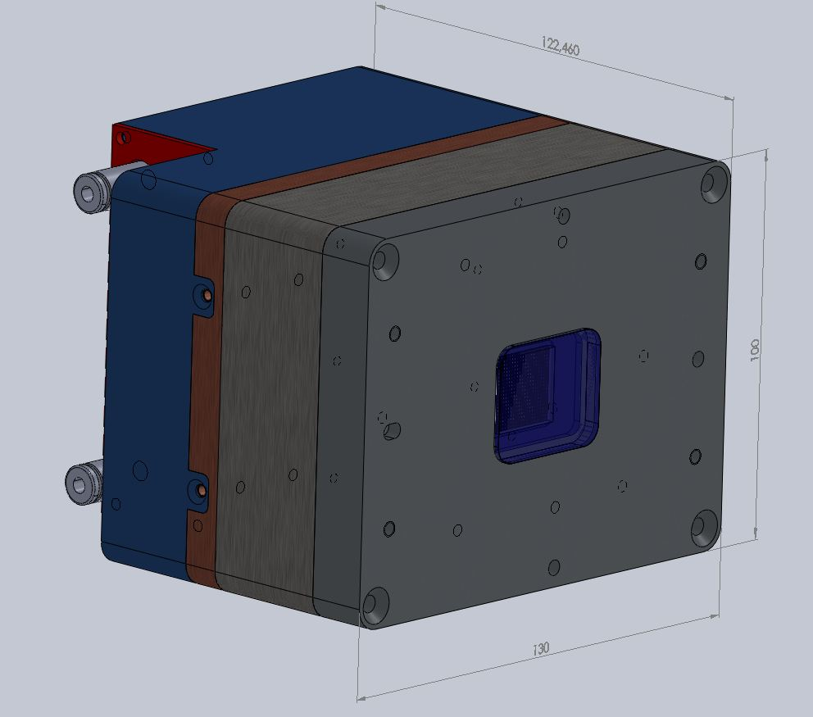
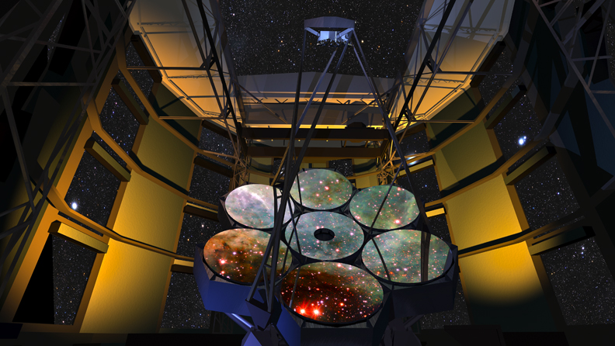


OCAM 3 coming soon at
First Light imaging…

Slide 32
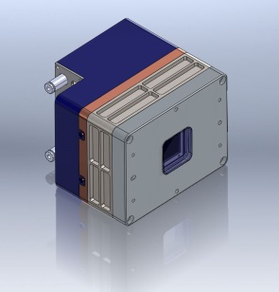
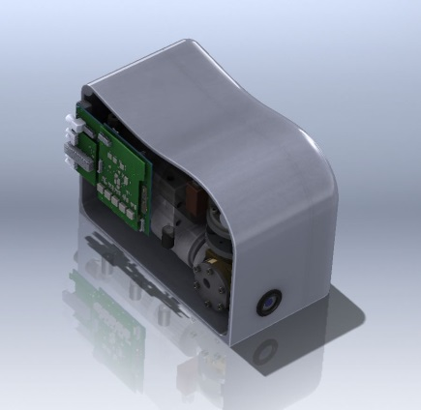
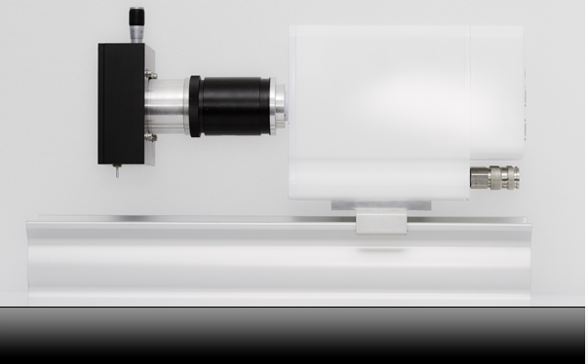
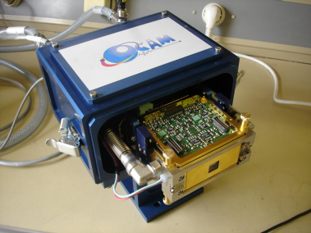
FLI WFS development roadmap
Q3 2011 : First Light Imaging created
OCAM 3
Q2 2015
Q3 2011
Q2 2013
Q1 2014
Q2 2009
OCAM IR
OCAM 2K
OCAM
OCAM II
With Sofradir and Selex device

Slide 33
Conclusion
Joint effort from many European institutes for more than 1 decade on low noise fast detectors for AO wavefront sensing
OCAM2K with CCD220 is world fastest lowest noise visible WFS camera (0.5 e noise @ 2 K fps with modest gain x500).
OCAM2 and OCAM 2K are is now a mature First Light Imaging commercial product producing on sky data
RAPID is:
  Fast low noise 320x255 1600 fps vis & infrared array dedicated to AO
  Amazing noise performance for an IR device (1.6 Kfps 1.5 e at gain x31)
  Incredible wavelength coverage from visible to IR with flat QE
“OCAM-IR” commercialized by First Light Imaging in 2014 with both Sofradir and Selex infrared APD devices.
Large CMOS devices are now developed with e2v and ESO for LGS wavefront sensing and ELT: NGSD 880x840 700 fps 3e noise CMOS coming soon in 2014 → OCAM 3, commercialized by First Light Imaging.

Slide 34
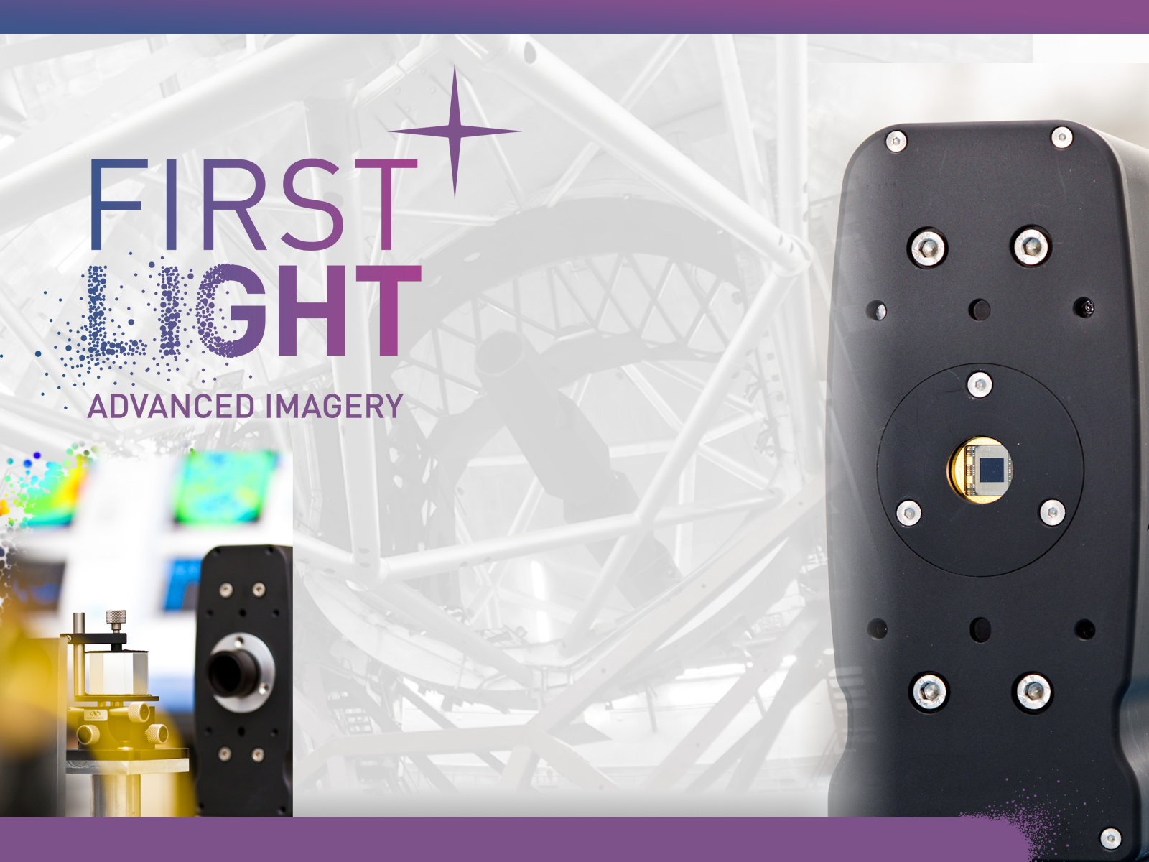


www.firstlight.fr
Many thanks for listening
Acknowledgments
European Commission: FP6 and FP7 Opticon
DGA and FUI OSEO
ESO

