Slide 1
CCD or CMOS- what is the best sensor for Planetary Exploration missions
H. Michaelis¹, T. Behnke¹, R. Bredthauer³, A. Holland² , James Janesick⁴ , R. Jaumann¹, , Uwe Keller⁵, S. Mottola¹, Peter Smith⁶, Nicolas Thomas⁷

Slide 2
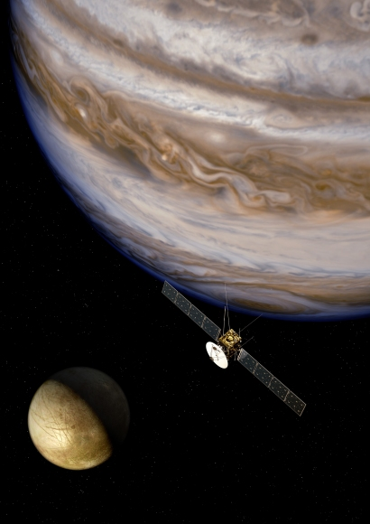
Opening Remarks
The question is, what are the particular requirements of planetary imaging systems and what are the best sensors to use for them?

Slide 3
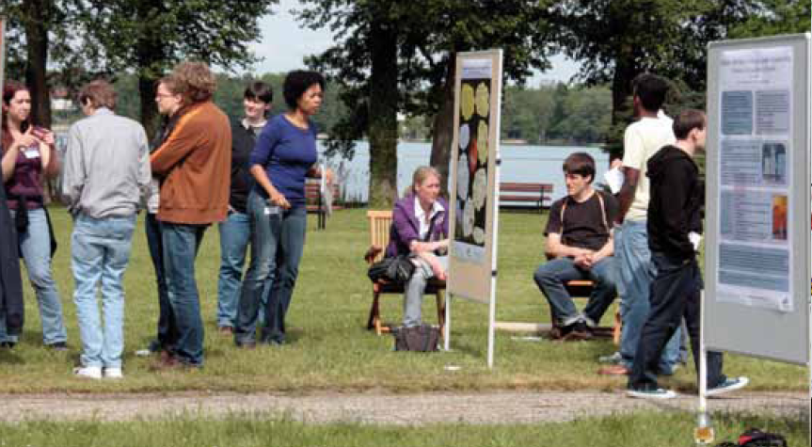
Contents
Introduction Planetary Exploration - Objects & Mission Examples
Key Requirements on the image sensor
Evaluation of CCD and CMOS for planetary imaging
Future mission needs
Summary and Outlook

Slide 4
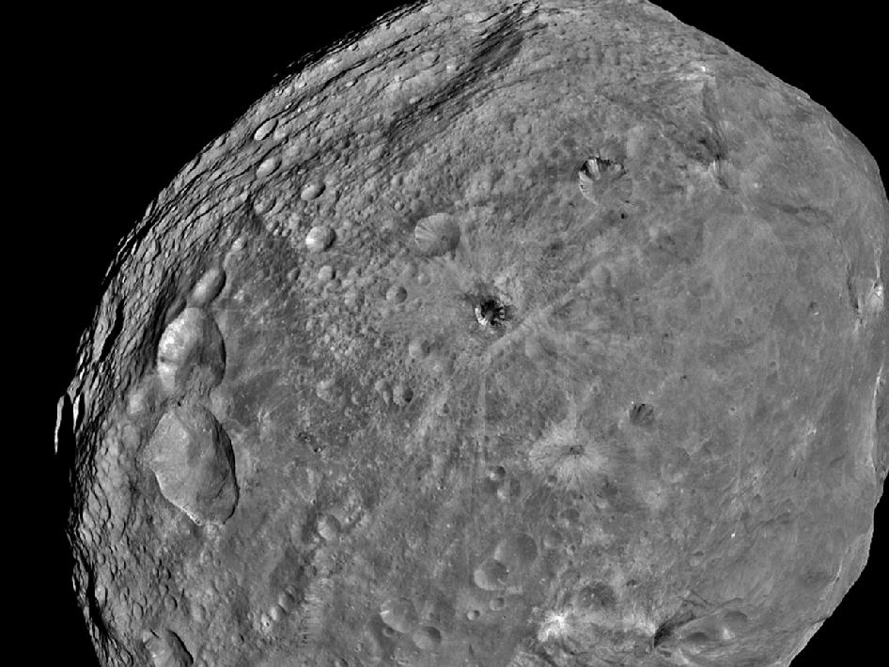
Introduction Planetary Exploration

Slide 5
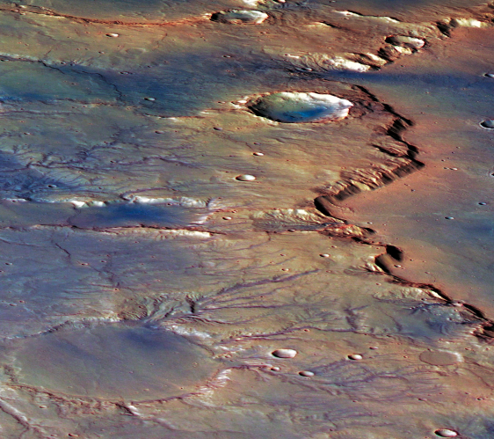
Planetary Exploration
  The subject of Planetary Exploration is the research on origin, evolution of the planets, their moons, asteroids and comets.
  Techniques employed include remote sensing and in-situ investigations using instruments carried on spacecraft, astronomical observations from the ground, theoretical modeling, and laboratory experiments.

Slide 6
Planetary Exploration
Major progress in our knowledge about our solar system was reached over the last decades by planetary exploration missions to all of our planets and to several smaller bodies of the solar system - asteroids and comets.

Slide 7
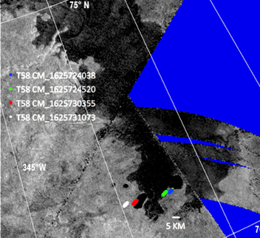
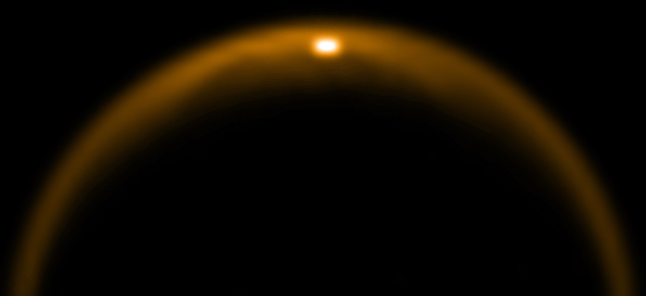
Key Tools for Planetary Exploration
The key tools of planetary exploration missions are scientific instruments for detection-, measurements and observational tasks, where scientific imaging instruments play an important role in most of the missions.
Scientific imagers in planetary are used for:

Slide 8
Task of Scientific Imagers in Planetary Exploration
Detection of objects (e.g. asteroids or extrasolar planets)
To study and to characterize planetary surface (topography, dynamics and processes)
Photogrammetric modeling
Observe atmosphere surface interactions and climate related processes
spectral mapping (e.g. for mineralogy studies of planetary surfaces and atmospheres)

Slide 9
Mission Examples

Slide 10
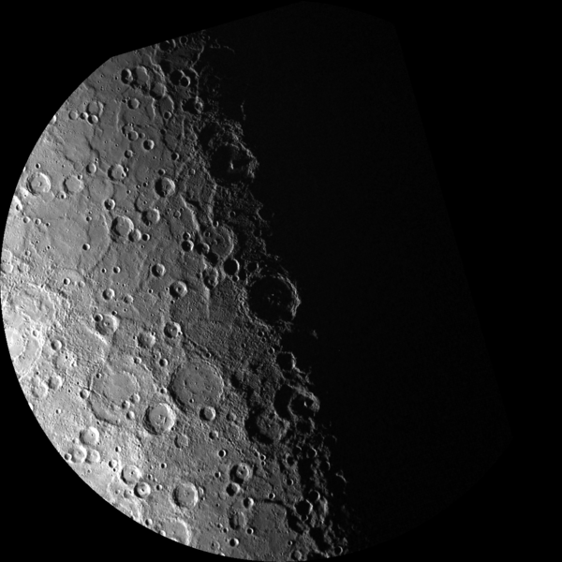
Mission Examples
There are only few missions to Mercury, the plane closest to the sun.
First image of Mercury’s surfaces were taken by Mariner-10 with a Vidicon- based camera in 1975.
Currently, Messenger (launched in 2004) is still in orbit since 2011at the planet and
Bepi-Colombo (ESA- mission) is in preparation, which will carry DLR-instrument onboard.
South Polar Projection of Mercury from MESSENGER

Slide 11
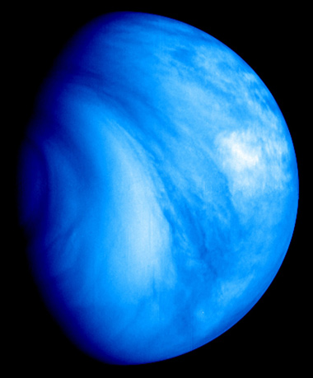
Mission Examples
Venus, the closest planet from Earth, was object of the very first planetary missions.
The first successful Venus-mission that provided fly-by- images from Venus- atmosphere was Mariner 10 Vidicon- narrow-angle and wide-angle cameras in 1974) . The Russian Venera 9 spacecraft transmitted the first images from the surface of Venus in 1975 after successful landing
False colour images of Venus were taken in the ultraviolet by the Venus Monitoring Camera (VMC).

Slide 12
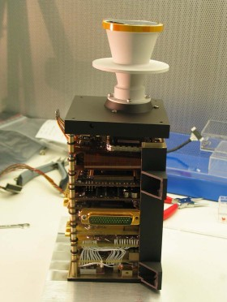
Mission Examples
Venus Express (ESA) launched in 2005 with Venus Monitoring Camera (VMC) – based on 1kx1k IL – CCD from Kodak
VIS, UV and NIR channel
Study of cloud dynamics
Global mapping
VMC is a wide-angle multi-channel camera that is able to take images of the planet in the near infrared, ultraviolet and visible

Slide 13
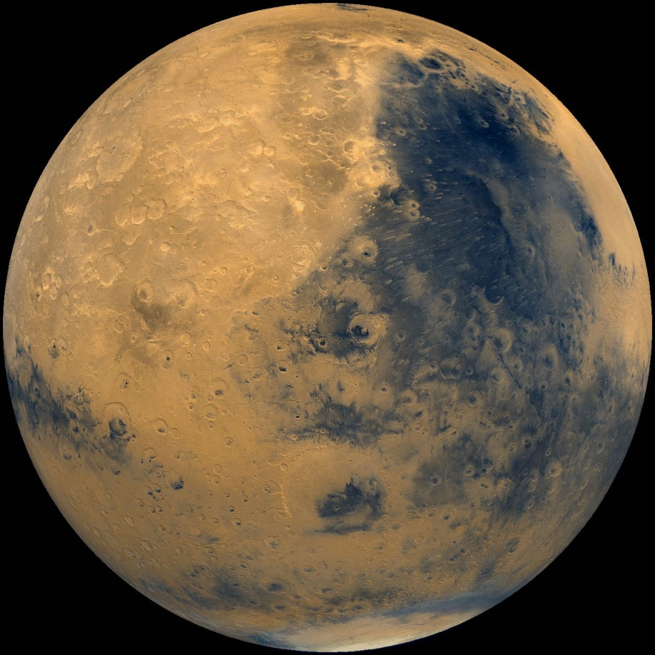
Mission Examples
Mars is the planet with the highest activity in planetary exploration missions with imaging instruments
First fly-by images by Mariner 4 in 1965 with a Vidicon-camera but that provided only poor spatial and radiometric resolution; much more successful: Viking 1 and 2 in 1975
Mars – Viking 1 (1980 - NASA).

Slide 14
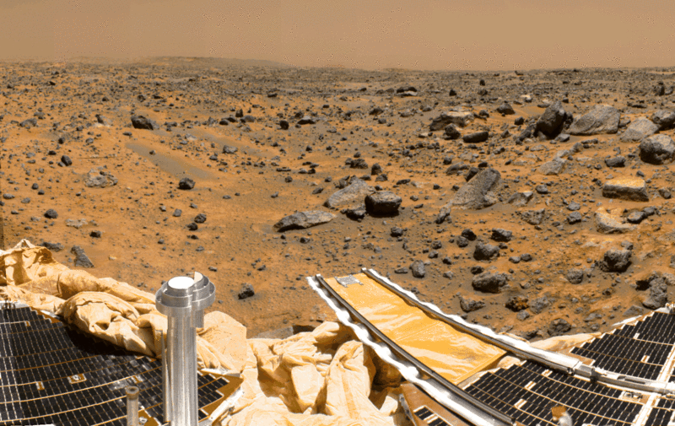
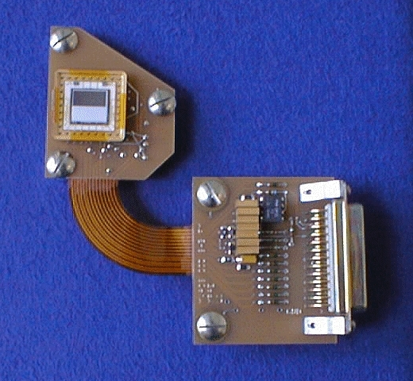
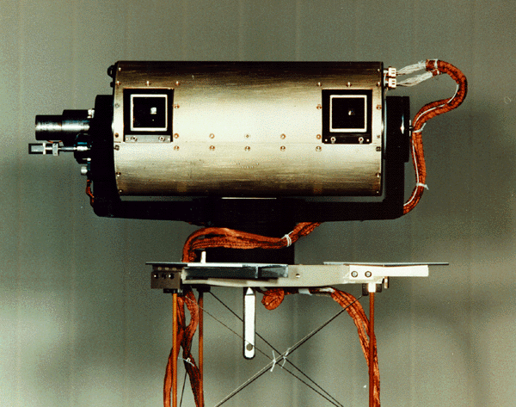
Mission Examples - Mars
Next first successful lander mission: Mars-Pathfinder with a stereo-camera based on 512x256 frame-transfer CCD from Loral-Faichild. It provided the first high resolution stereo images from the Martian surface in color.
Mars- PathFinder – (1997 - NASA).

Slide 15
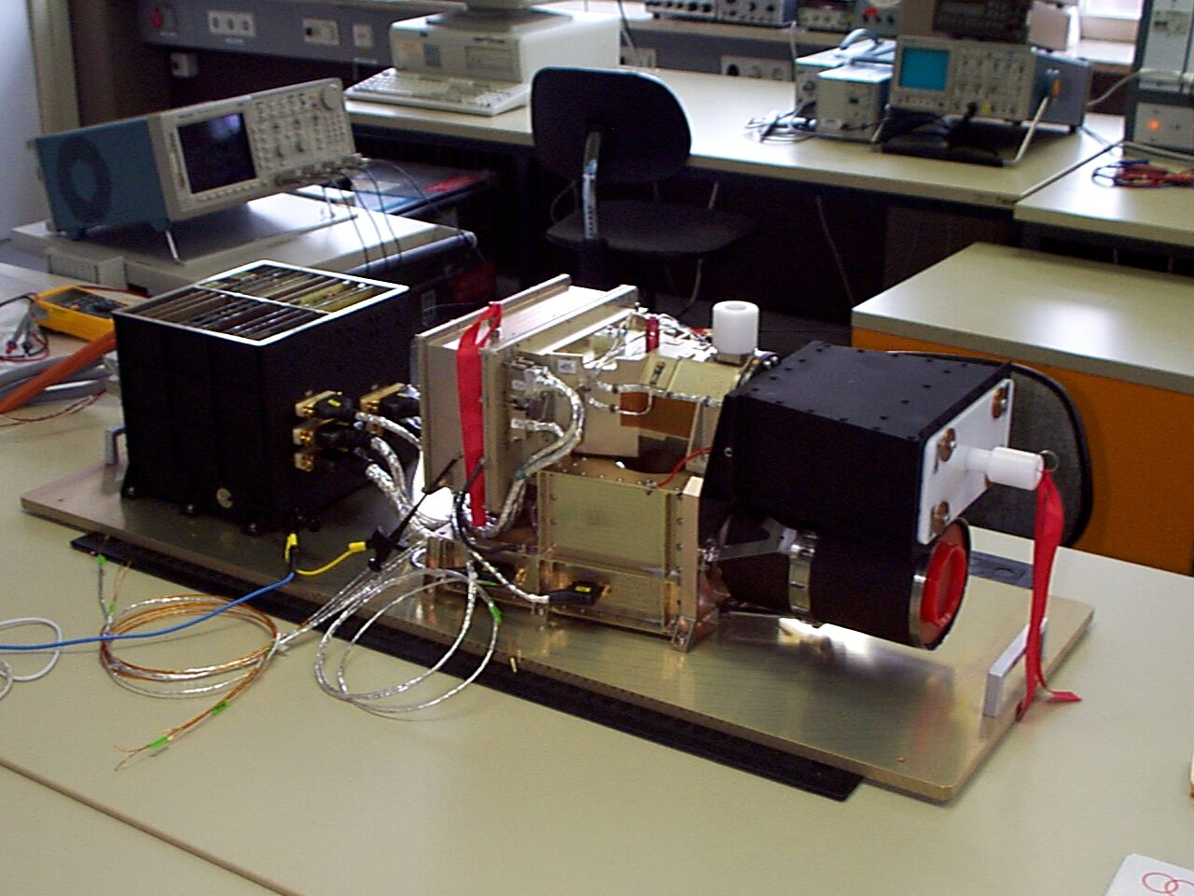
Mars- Express- HRSC
The first successful mission from ESA was Mars-Express, launched in 2003. Mars-Express has High-resolution Stereo Camera (HRSC) onboard which provides 3-D stereo and color data simultaneously.
Image of the Martian surface taken by the HRSC showing the Coprates Catena, a graben like structure in the canyon system of the Valles Marineris on Mars (image credit ESA/DLR/FUB).

Slide 16
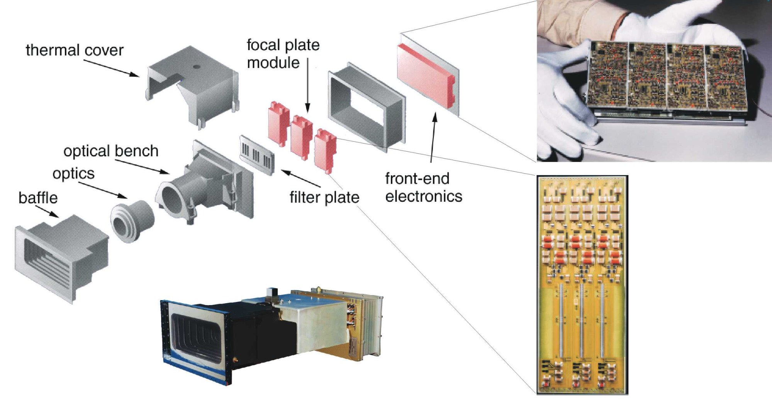
Mars- Express- HRSC
The HRSC Camera Head contains nine linear CCD sensors for parallel operation in pushbroom mode providing high-resolution stereo, multicolour and multi-phase images

Slide 17
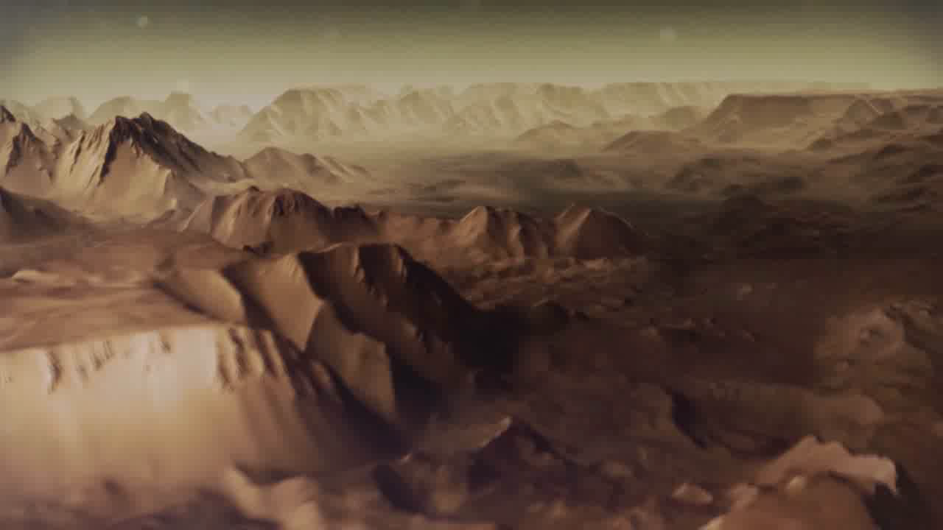

Slide 18
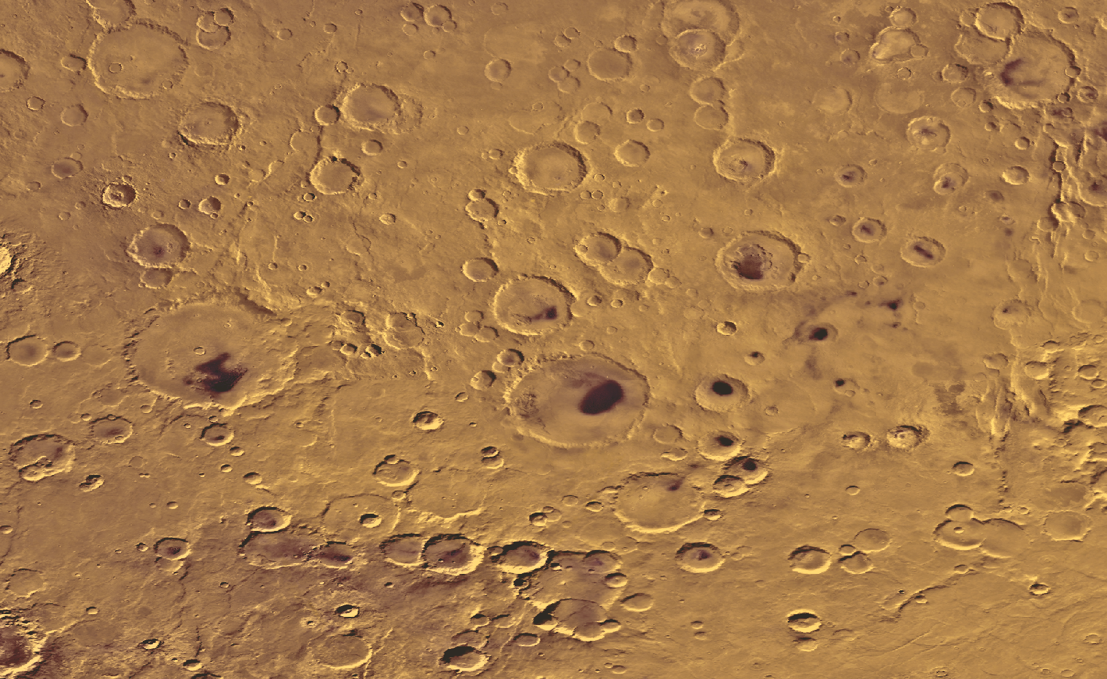
Dünen auf dem Mars - Hintergrund
150 km
Viking Farbmosaik von Noachis Terra

Slide 19
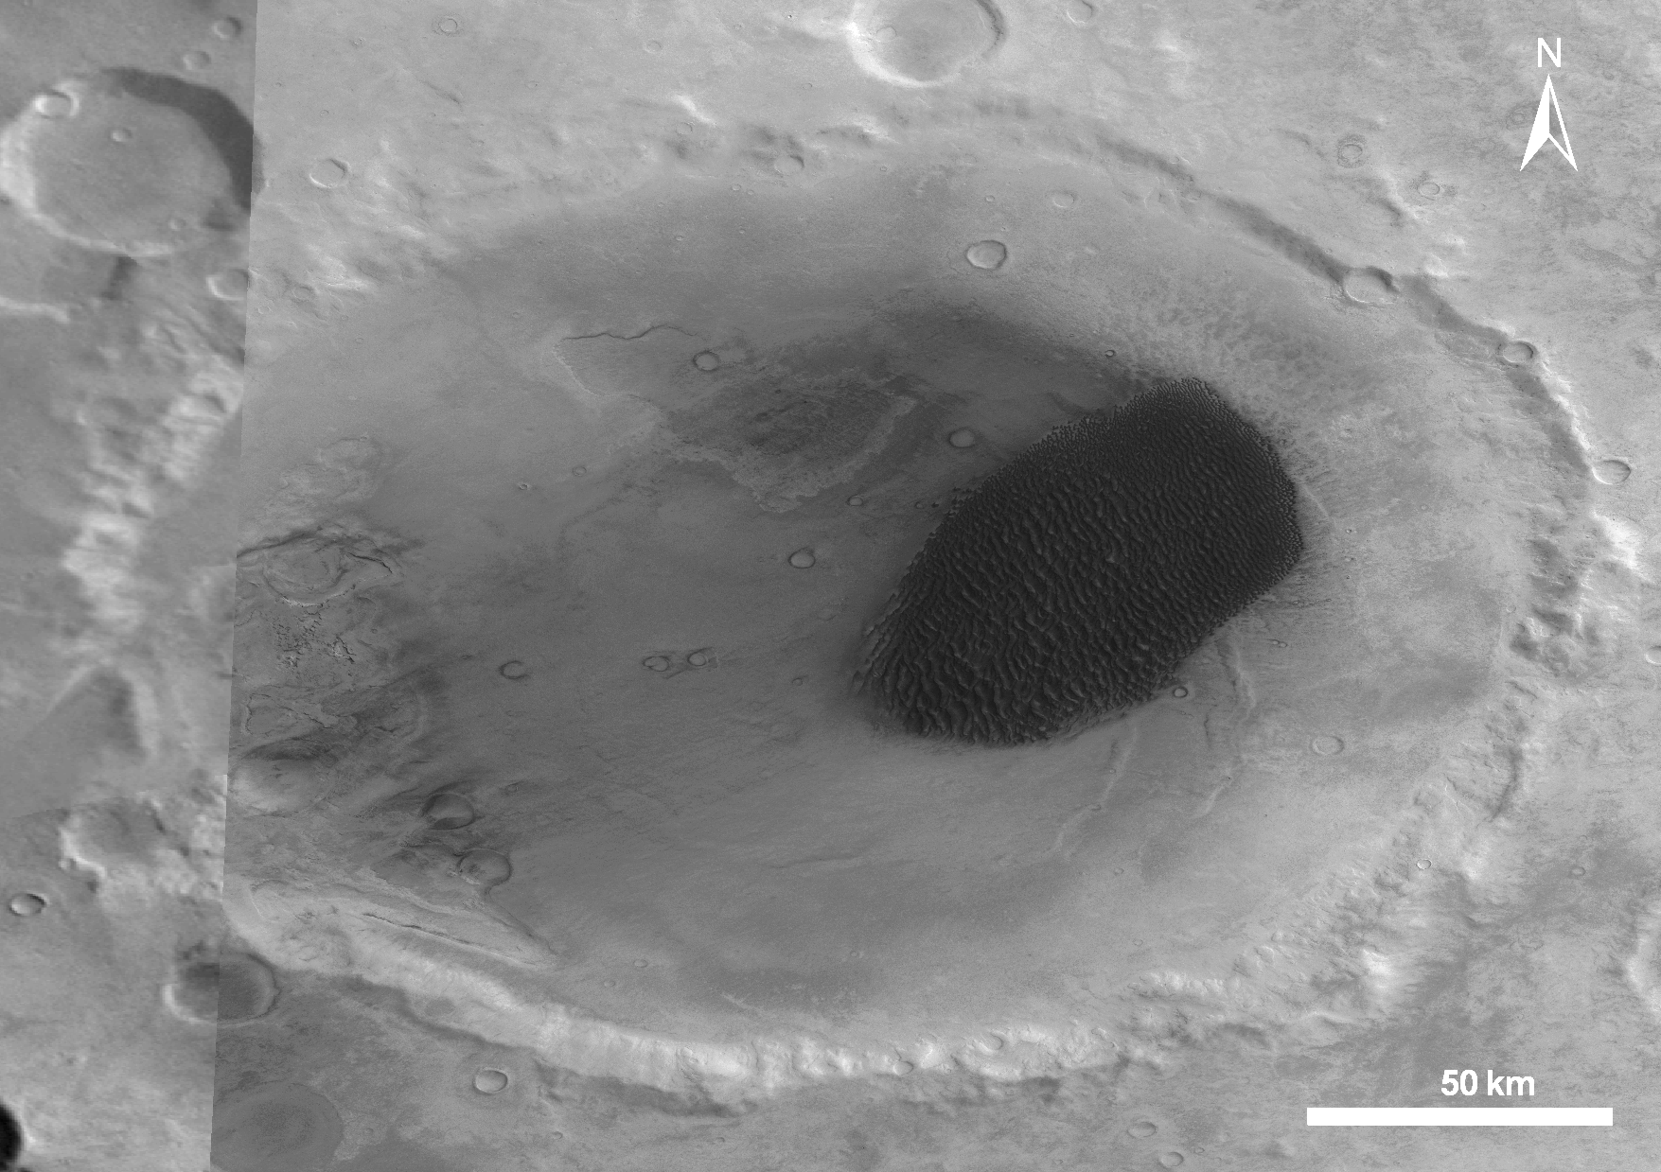
Dünen auf dem Mars - Hintergrund
Dünenfeld im Krater Proctor (HRSC Nadir-Bild)

Slide 20
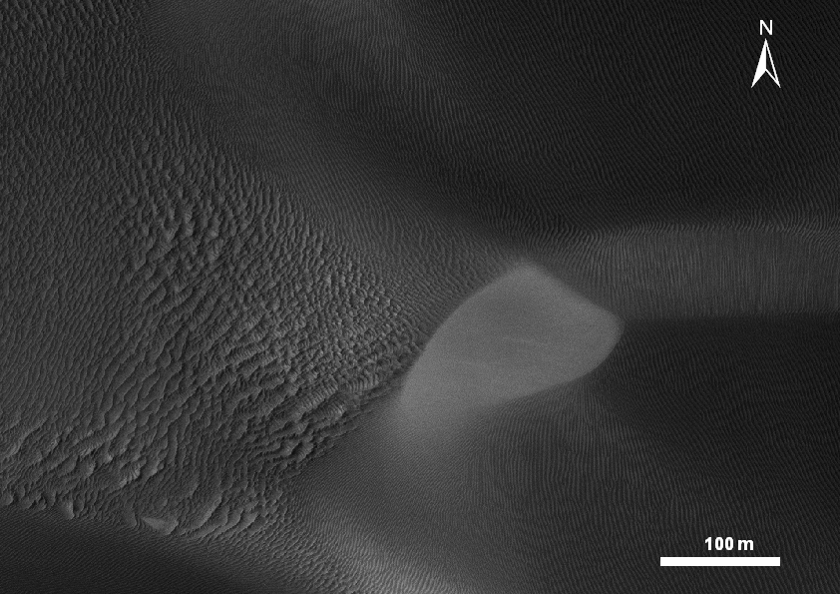
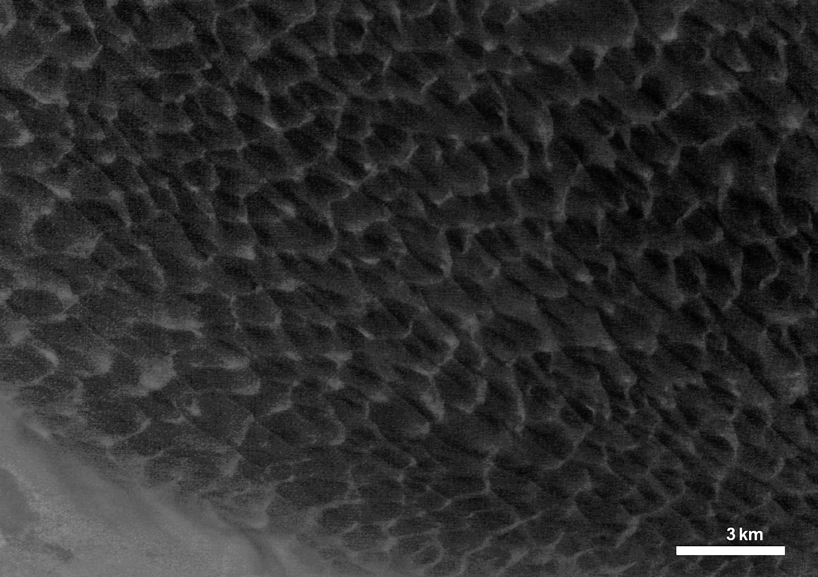
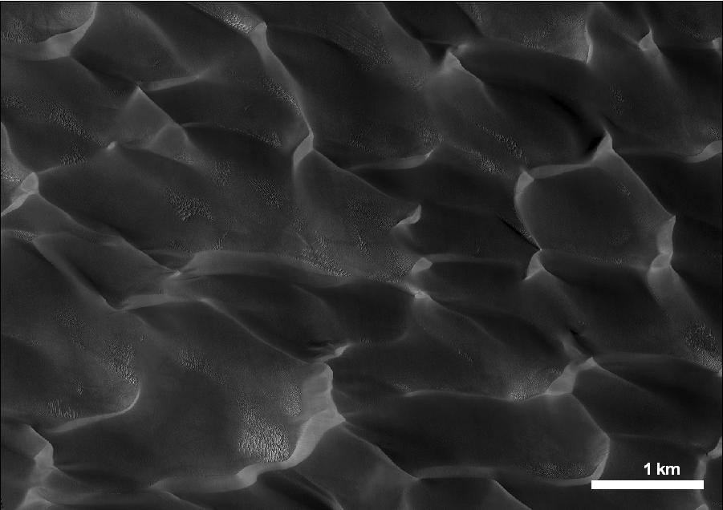
Dünen auf dem Mars - Hintergrund
Zoom in das Dünenfeld im Krater Proctor (HiRISE, 25 cm/px)
Zoom in das Dünenfeld im Krater Proctor (HRSC Nadir, 12.5 m/px)

Slide 21
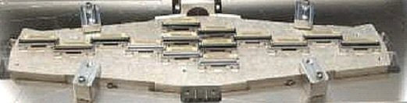
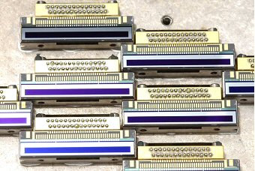
Mars- Reconnaissance Orbiter- HIRISE
The Mars Reconnaissance Orbiter carries the High Resolution Imaging Science Experiment (HIRISE), launched in 2005 which has a 12m focal length optics (f#24) with 0.5m diameter that provide an ultra- high resolution of 0.3m/px at 300km nadir distance
The HIRISE detectors are 2048x128 BSI CCDs with 12um pixel where the 128 TDI stages are oriented in the along-track direction. By means of TDI the integration time can be increased by a factor of up to 128.
Tint= k*s/vg;
with s=required smearing free-resolution
vg: ground velocity (e.g. 3km/s)
k: smearing factor (0.25 – 1)
14 CCDs mounted to FPA substrate).

Slide 22
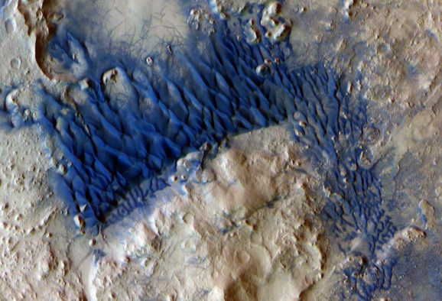
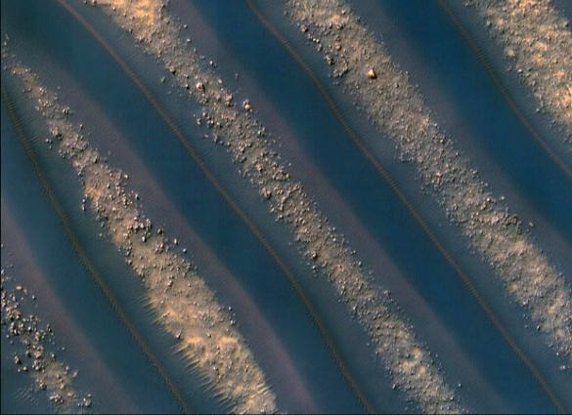
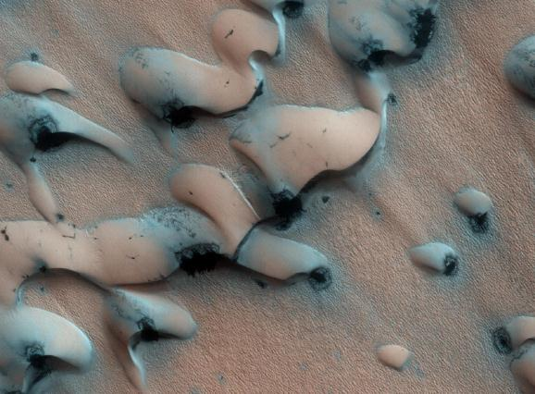
Dünen auf dem Mars - Hintergrund
HRSC
THEMIS
HiRISE
HiRISE

Slide 23
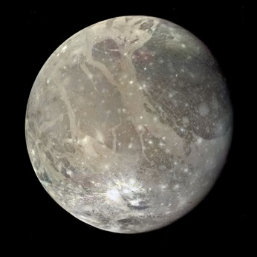
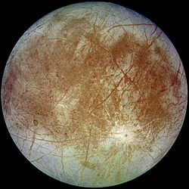
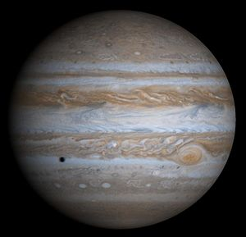
Mission Examples
Jupiter: is the largest planet in our solar system (11x)
First images of Jupiter were taken by Pioneer 10/11 in 1973(74) and it was photographed by the Voyager 1/2 in 1979
The highest resolution images of Jupiter (with global coverage and in colour) were taken by the Cassini Imaging Science Subsystem (ISS) in 2000 on its path to Saturn.
Jupiter in natural colors; with shadow from the moon Europa taken by Sassini-ISS at 7. December 2000

Slide 24
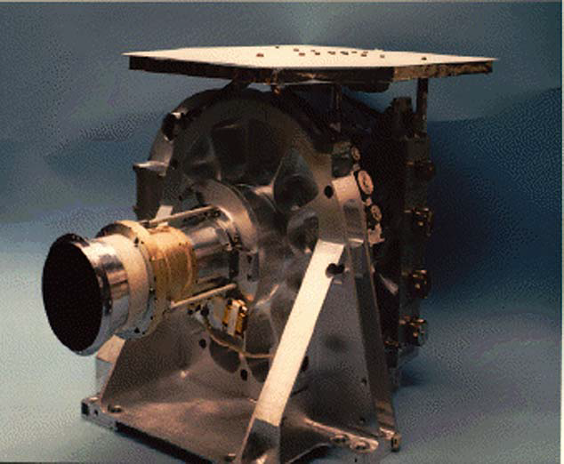
Mission Examples
Jupiter:
The ISS consist of a narrow angle camera with 2m focal length and a wide angle camera with 200mm focal length,
both equipped with a 1kx1k full-frame front-side CCD detectors with 12 um pixel; Lumogen coated;produced by Fairchild (now BAE Systems)
Cassini ISS- Wide-angle camera Head Assembly

Slide 25
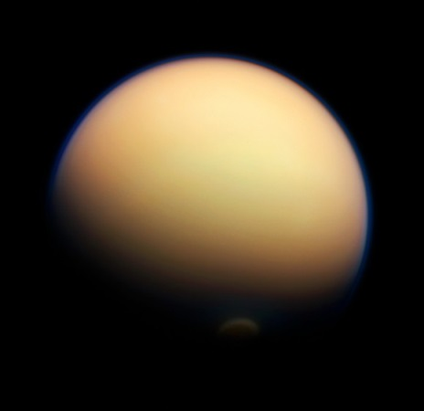
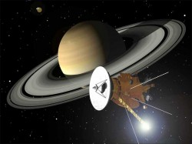
Mission Examples
Saturn is probably the most beautiful planet in our system with its characteristic ring system.
The Cassini Imaging System arrived at Saturn in 2004 and delivered high resolution images of Saturn, its ring system and the icy moons.
The Cassini spacecraft was equipped with the European Space Agency's Huygens probe that carried the DISR imaging system (DISR: Descent Imager/Spectral Radiometer).
Artists impression of the Cassini spacecraft at Saturn. Credit: NASA
x

Slide 26
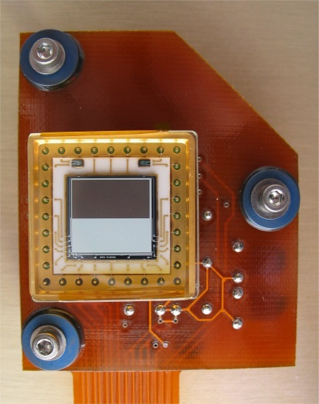
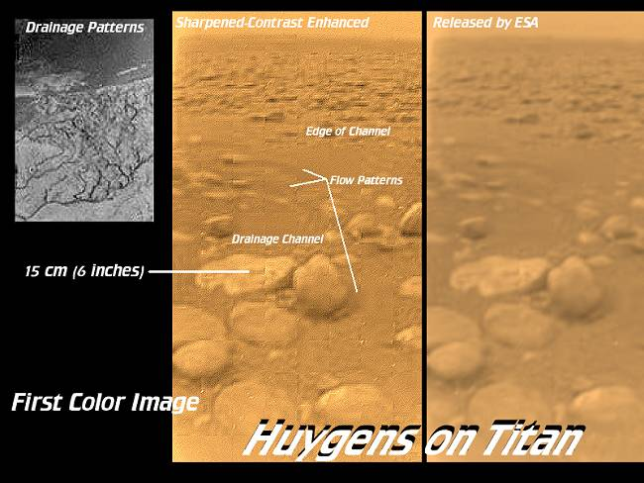
Mission Examples
The Huygens probe land on Titan at 14 January 2004 and made a sequence of images during the 147-minute plunge through Titan’s thick atmosphere and after soft landing.
The VIS-NIR detector of DISR is the same 512x256 FT CCD as the one used for the Imager for Mars Pathfinder
The detector electronics was designed in Germany by the Max-Planck Institute for Solar System Research (MPS) – with Uwe Keller as the responsible CoI)
Artists impression of the Cassini spacecraft at Saturn. Credit: NASA
x

Slide 27
Mission Examples
Small bodies: asteroids and comets
There are countless small bodies like asteroids and comets - in our solar system. Most of the known asteroids are located in the so called main belt – between Mars and Jupiter.
The vast majority of the icy objects are at the edge of our solar system –at the Kuiper belt and the Oort cloud.
In 1991, on its way to Jupiter, NASA’s Galileo probe transmitted first close-up image of an asteroid to Earth – Gaspra.

Slide 28
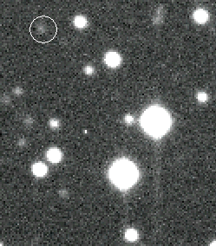
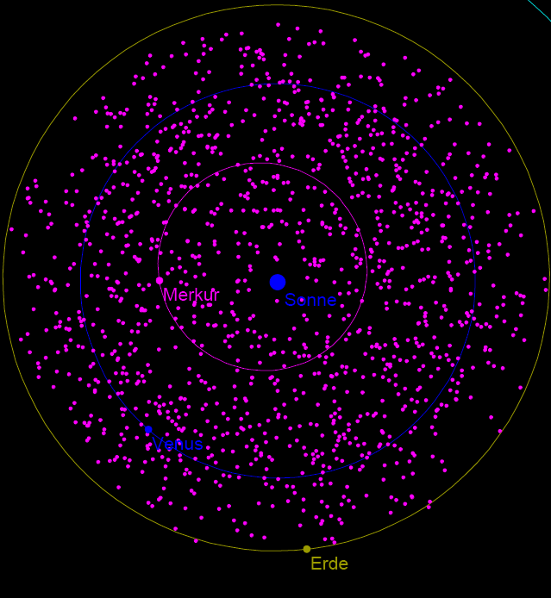
Asteroids- detection
Satellite z-axis pointing in the general Sun direction
Telescope scans the region at small solar elongation.
Sunshield and optical design allow observations down to 30° elongation
Straylight and radiators constraints are held by adjusting the roll angle
Images are relayed to ground and asteroids are identified through their apparent motion across subsequent images.

Slide 29
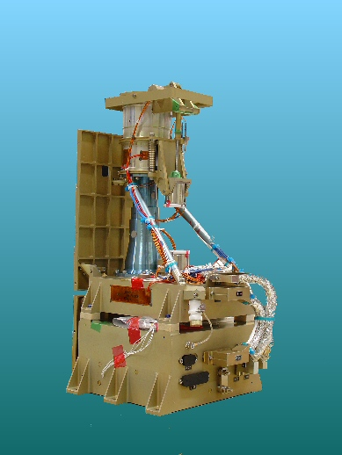
Mission Examples- Asteroids
www.DLR.de • Chart 29
Asteroids
are increasingly becoming the targets of space missions.
DLR developed in close collaboration with the MPS (PI: Max Planck Institute for Solar System Research) the detector electronics for the DAWN framing camera.
The DAWN mission has completed the mapping of Vesta in 2012 and is now on travel to Ceres, the largest small planet in the main belt (arrival in February 2015).

Slide 30
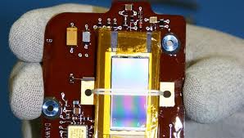
Mission Examples - Asteroids
www.DLR.de • Chart 30
Asteroids
are increasingly becoming the targets of space missions.
DLR developed in close collaboration with the MPS (Max Planck Institute for Solar System Research) the detector electronics for the DAWN framing camera.
The DAWN mission has completed the mapping of Vesta in 2012 and is now on travel to Ceres, the largest small planet in the main belt (arrival in February 2015).

Slide 31
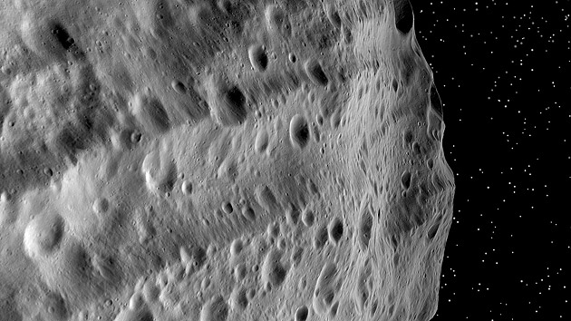
Mission Examples – DAWN at Vesta
www.DLR.de • Chart 31
This image shows two troughs in the Divalia Fossa system, running parallel to the lower edge of the image. They are the result of two large asteroid impacts at the South Pole,

Slide 32
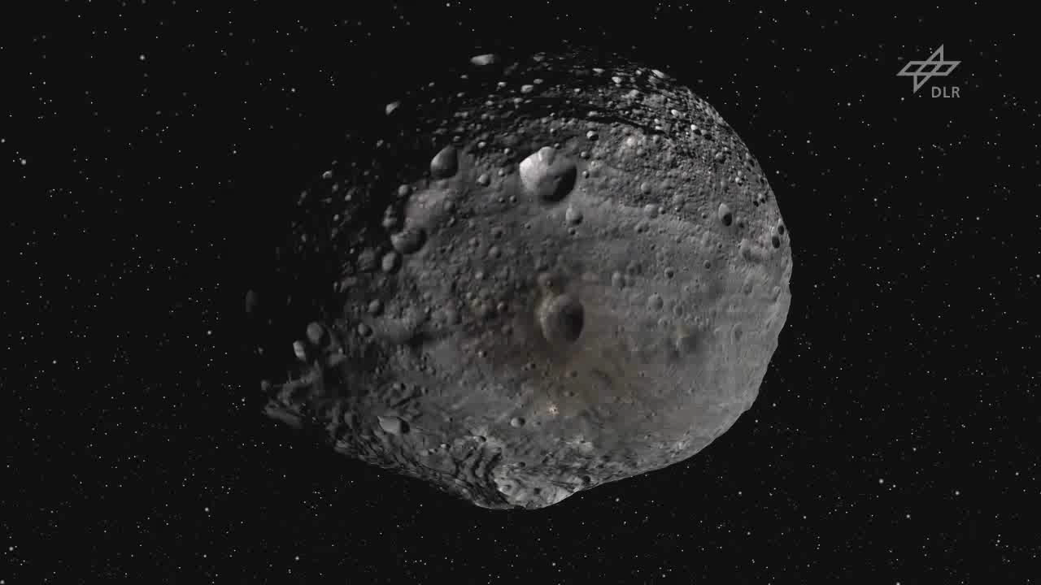
DAWN at Vesta

Slide 33
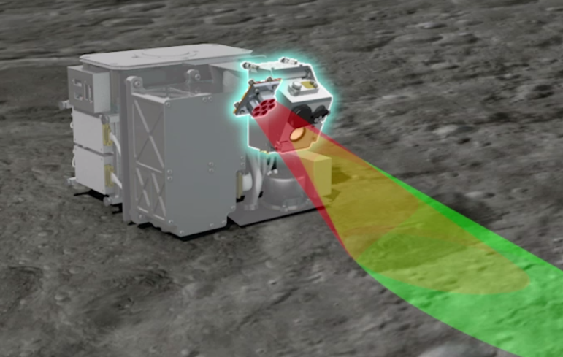
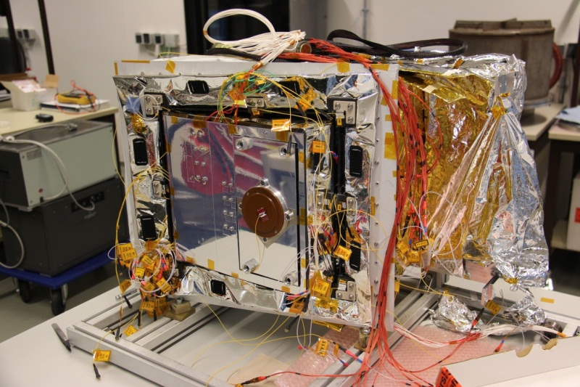
Mascot on Hayabusa II, Asteroid and Solar System Science
Return a sample from a C-type asteroid and provide the „context“ for the sample acquisition
Determine the surface properties of the target asteroid
German/French contribution a mobile (hopping) surface instrument package with a camera and a radiometer from DLR

Slide 34
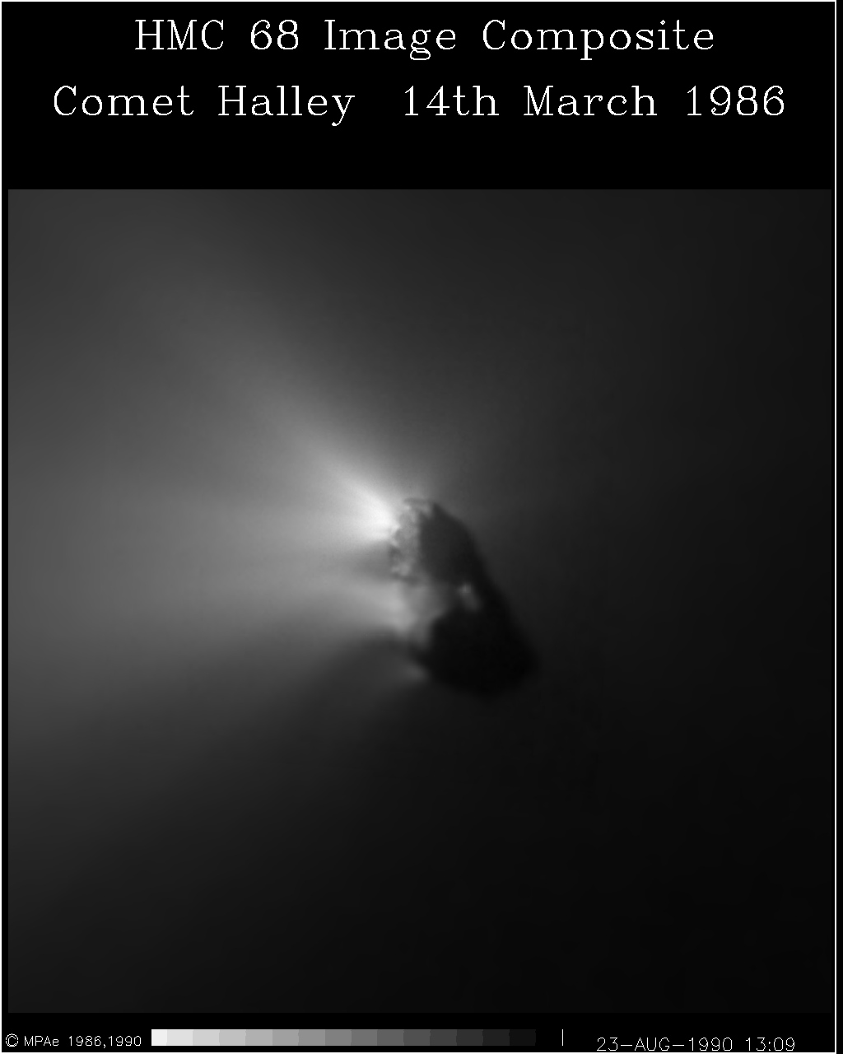
Mission Examples
www.DLR.de • Chart 34
Comets
The first mission to a comet was the Halley mission 1986. The main mission, the Giotto mission, sponsored by ESA, was equipped with the HMC (Halley Multicolour Camera), the first CCD camera used for a planetary exploration– build in Germany at the MPS (Max-Planck-Institut für Sonnensystemforschung)

Slide 35
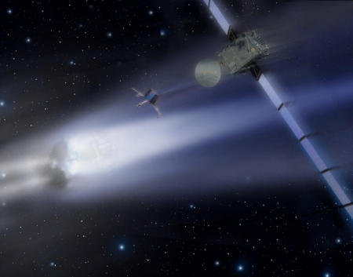
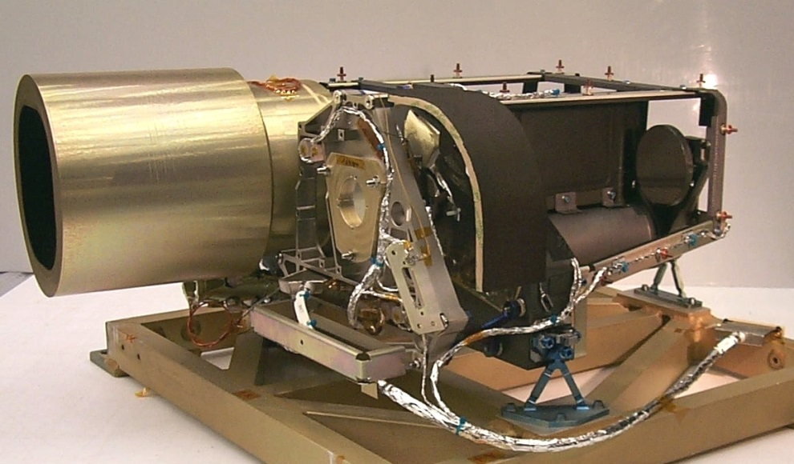
Mission Examples
www.DLR.de • Chart 35
Comets - Rosetta
Currently, the ESA mission ‚Rosetta‘ is on travel to the comet Chuyumov-Gerasimenko where it will arrive in May 2014 and is trying to land in November 2014 with the lander called Philae.
Rosetta is equipped with the OSIRIS imaging system on the orbiter that consist of a narrow angle (NAC- see right) and wide angle camera (WAC). Both camera’s detectors are 2kx2k full-frame back-illuminated CCDs from e2v (CCD42-40).

Slide 36
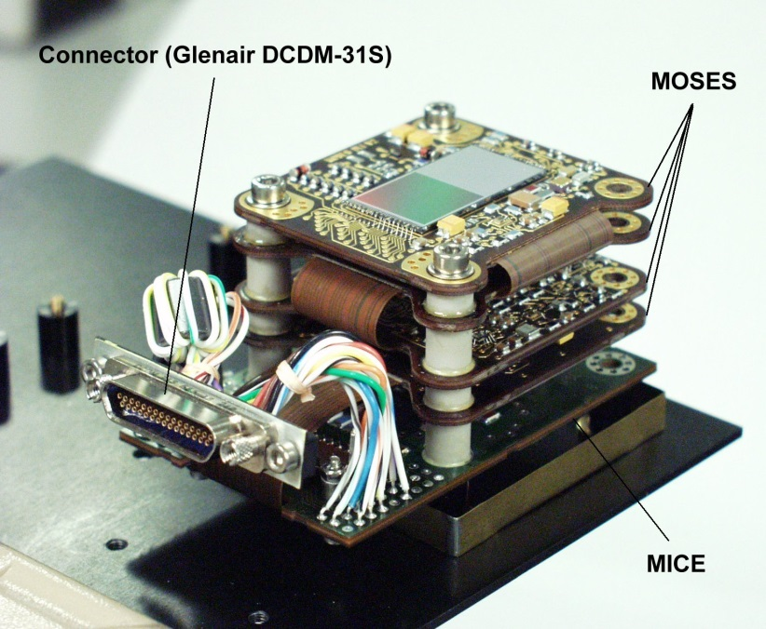
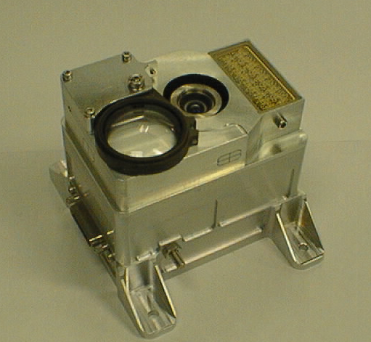
Mission Examples
www.DLR.de • Chart 36
Rosetta- Lander - ROLIS
During Descent and after landing images are taken by the ROLIS imaging system (see Figure) which is based on DLR’s Modular Sensor Electronics System (MOSES) equipped with a 1kx1k CCD frame transfer CCD from e2v (former Thomson then Atmel) –
The advantage of the used detector (CCD TH7887) is the fast frame transfer time of about 1 millisecond that prevents smearing during the descent phase.

Slide 37
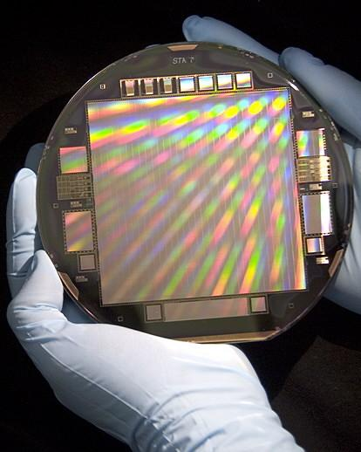
Key detector requirements for planetary imaging instruments
STA1600LN

Slide 38
Key requirements on the image sensor
The requirements on the image sensor (as the key-component of a planetary scientific imaging system) depend mainly on:
The scientific-and instrument requirements
the environment at which the instrument + sensor has to operate
Particularly, it is important what the observational conditions are:
  Detection or observation of star-like or areal objects
  brightness and object contrast
  What is the maximum dwell-time: Tdwell = IFOV/vg
  What is the spectral range and bandwidth?

Slide 39
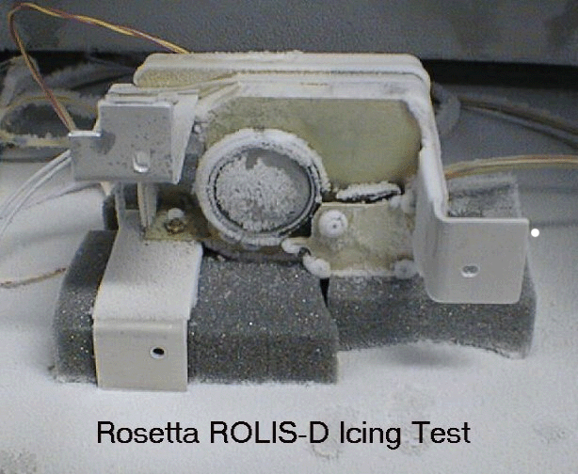
Characteristics of image sensor requirements
Low mass, low power, low data rate
Harsh environment (temperature, radiation)
Areal objects
High contrast
Color
Short dwell time at fly-bys, descent and high resolution imaging

Slide 40
Typical detector specification - discussion
Parameter | Specification | Comment
Spectral Range | 400 - 1000nm | In most cases the NUV/VIS/NIR range is sufficient
Quantum efficiency | 400nm: >0.1 600nm: >0.5 900nm: >0.1 | Higher QE only in asteroid-and exo-planet search-, outer-planets- and resolution imagers (fly-by or in orbit)

Slide 41
Typical detector specification - discussion
Parameter | Specification | Comment
Architecture: Linear array TDI array Area array&FT | 4k – 12k 2k-10k x (16…128) 1kx1k …4kx4k | -Push-broom, medium resolution Fly-bys, high resolution mapping Lander cameras, mapping

Slide 42
Typical detector specification - discussion
Parameter | Specification | Comment
Pixel Size | Typically 5µm – 15µm | Related to FW Related optics (focal length)
Full Well (FW) | Typ. 100ke | Related to dynamic range
Dark signal | <<1nA(cm2) | Important at low light levels and hot environment
Noise | <10e- rms | Important at low light level Related to dynamic range

Slide 43
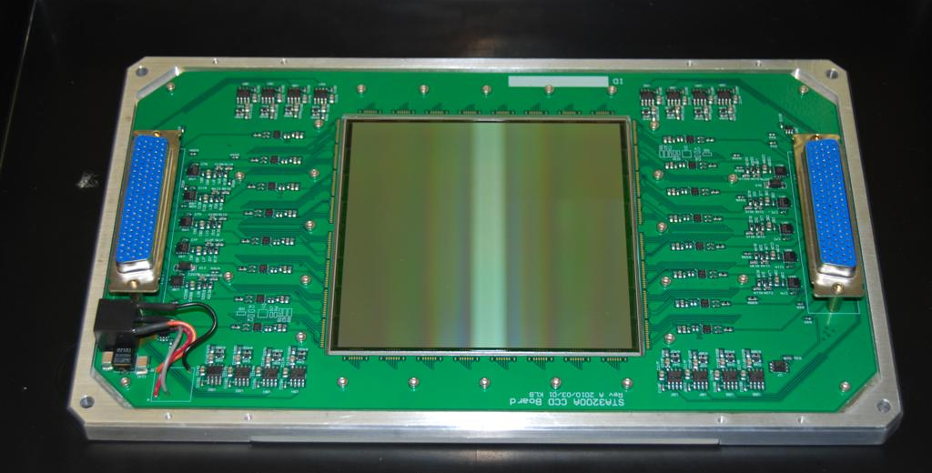


CCD vs CMOS
CIS107 (e2v)
SOLOHI (SRI, Jim Janesick))
STA3200 (STA , R. Bredthauer)

Slide 44
CCDs – characteristics and advantages (I)
It is a proven mature technology used in many space missions
Despite its sensitivity to high energy cosmic radiation it is sufficient radiation tolerant for most planetary missions
Design and processing is much more straightforward than CMOS resulting in shorter schedule for customized devices and lower costs
Excellent performance off-chip electronics EEE parts available for signal processing
Very high QE also at NIR spectral range

Slide 45
CCDs – characteristics and advantages (II)
TDI implementation (in charge domain- without noise summation) is straightforward
Many scientifically applicable devices readily available in different architectures and size (pixel size and pixel number)
Large dynamic range; very useful – in planetary imaging
Electron multiplication available (impact ionization applied during charge transport) resulting effectively in very low noise

Slide 46
CMOS – characteristics and advantages (I)
CMOS- imaging sensors are based on silicon technology originally developed for complex integrated circuits of digital- and analog electronics. The general key-advantages are:
Very high level of integration; each pixel contains several transistors; ultra-small pixel possible
Possibility to integrate further electronics for signal processing and control (core-policy); e.g. for CDS, ADC
Low voltages, low power consumption

Slide 47
CMOS – characteristics and advantages (II)
Radiation: No CTE issue because of single clock transfer ; no radiation induced degradation of CTE
Radiation: Possibility to implement radiation-hard- design rules; considerable less flat-band voltage shift for ultrathin gate oxides (<5nm)
Random x-y- addressing and windowing (x-y addressing to read pixels, rows, columns individually). CCD reads serially
parallel architecture. Each pixel has its own amplifier and each column has its own readout (amplifier, CDS, ADC)
less bandwidth per amplifier
lower noise and high readout speed.

Slide 48
CCD vs CMOS
All this appears as very advantageous for CMOS- imagers.
However, the question is, is all that really so important for planetary imaging that CIS will replace CCDs in near future?

Slide 49
CCD vs CIS – Discussion & Evaluation
Parameter | Evaluation | Comments
Spectral Range & QE | CCD+
Architecture & Availability | CCD+ | TDI
Pixel Size; Dynamic Range | (CCD+)
Dark Signal | -
Readout Noise | CIS | at high frame rates
Radiation | CIS
..

Slide 50
The dynamic range of the Dawn FC2 camera
Prepared by: U. Carsenty, DLR Planetary Research, Berlin
Date : 21.03.2012

Slide 51

Dawn at Vesta
Low Mapping Orbit
An average of 200km above
the surface. Corresponding
to 20m/pixel.
FC2 image #22503 (level 1a)
14bit
300ke- full well charge
DN(min) = 278
DN(max) = 5373
The illumination is from the
right

Slide 52


Histogram of the previous image
The entire DN range, and a stretching
of the N axis.
The scene outside the shadow is in
The DN range between 400 and 5373
The low DN range and a full scale N axis.
The scene in the shadow is hiding
In the DN range between 310 and 400

Slide 53

The scene
“under the shadow”
DN(min) = 278
DN(max) = 400
The illumination is from
the left
A reflection from the
crater rim

Slide 54


Slide 55
CCD vs CIS – First conclusion
There is no clear winner
Generally, it can be said that CCDs are still very interesting candidates for planetary imagers because of their electro-optical performance, their availability and heritage
Low mass, power, high frame rate, radiation: CIS have (potentially) advantages
((CCD = FPGA CMOS= ASIC))

Slide 56
Future Mission & Requirements
There are no doubts that the exploration of Mars will continue with landers and sets of imaging instruments
autonomous, small robotic vehicles with low power but highly sensitive imaging instruments are required
Asteroid and comet sample and return mission: It requires high sensitive but low power imaging instruments with sufficiently high frame rate for object navigation, approach and sample acquisition.
The exploration the large (habitable-) moons in our solar system which could contain liquid water below their ice-crust (e.g. Europa and Ganymede at Jupiter) → radiation hardness is a key issue
Exoplanet: detection and characterization: high electro-optical performace (QE, dynamic range, low frame rate)

Slide 57
Summary & Conclusions
Summary and Conclusion (Outlook)
The CCD was and is for many missions the detector of choice because of availability, heritage and electro-optical performance
In exo-planet-mission (detection- and characterization) the CCD is still the baseline for future missions
Many future planetary missions to Mars (lander), asteroids and comets (sample and return) would profit from monolithic CMOS- detectors
Missions to the Jovian moons missions with harsh radiation environment will be based on CMOS- detectors

