Slide 1
Dark Energy Camera – the first year
Tim Abbott
CTIO / NOAO / AURA
SDW 2013

Slide 2
















DES Collaboration
Astronomers, Cosmologists, High Energy Physicists
Started in 2003 with a call for proposals from CTIO, DES is now an international collaboration of ~200 scientists from 27 institutions
Fermilab, UIUC/NCSA, University of Chicago,
LBNL, NOAO, University of Michigan, University of Pennsylvania, Argonne National Laboratory, Ohio State University, Santa-Cruz/SLAC/Stanford Consortium, Texas A&M
UK Consortium
UCL, Cambridge, Edinburgh, Portsmouth, Sussex
ETH Zurich
Ludwig-Maximilians Universität
Spain Consortium
CIEMAT, IEEC, IFAE
Brazil Consortium
Observatorio Nacional, CBPF,Universidade Federal do Rio de Janeiro, Universidade Federal do Rio Grande do Sul
CTIO
Notes:
Came from a DES meeting, 140 attendees, many young scientists

Slide 3
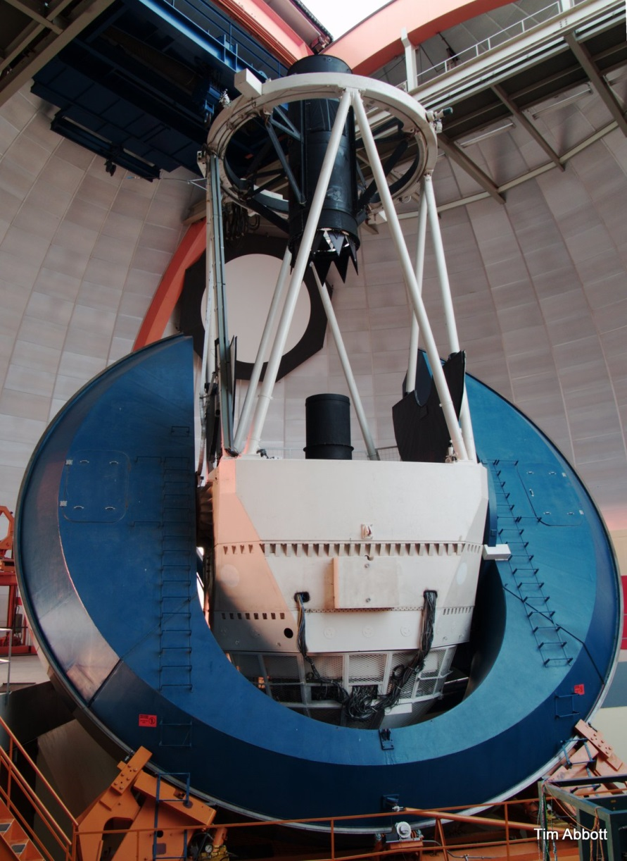
The Dark Energy Survey
The Survey:
  A 5000 sq. deg. survey to 24th mag in the southern galactic cap, including SNe light curves
  Primary science: to measure the Dark Energy parameter, w, with 4 complementary techniques
DECam
  570 MPixel camera, 3 sq deg
  Fully depleted CCDs
  u, g, r, i, z, Y, (VR)
  A FACILITY INSTRUMENT
525 guaranteed Blanco nights over 5 years
  300 million galaxies up to z ~ 1.5
  4000 SNe
Notes:
Telescope now looks like something of a xmas tree.

Slide 4
Timeline
Propose, fund & design: 2003 – 2008
Construction: 2008 – 2011
Delivery to CTIO: 2011 – 2012
Installation: February 2011- August 2011
First Light: September 2012
Commissioning: Sept – Oct 2012
Science Verification: Nov 2012 – Feb 2013
First scheduled community science night: 1 Dec 2012
Early processing data release (100 sq deg pipeline reduced): April – May 2013
DES survey started: 31 Aug 2013

Slide 5
Blanco improvements - highlights
Retrofitting and refurbishing a (mid)20th-century telescope to carry a 21st century instrument
Since the radial support replacement in April 2009 none have failed; the mirror demonstrates repeatable, flexure-dominated movements which are compensated with DECam’s hexapod.
The aluminizing chamber upgraded.
The telescope operating system (TCS) was upgraded.
Built an instrument maintenance facility incorporating a high quality (approximately class 1000) cleanroom with humidity control.
The DECam liquid nitrogen supply system.
New control room & computer room
A new all-sky mid-infrared cloud camera (RASICAM).
A new flat-field calibration screen and illumination system.
Improvements to the Environmental Control System are ongoing.

Slide 6
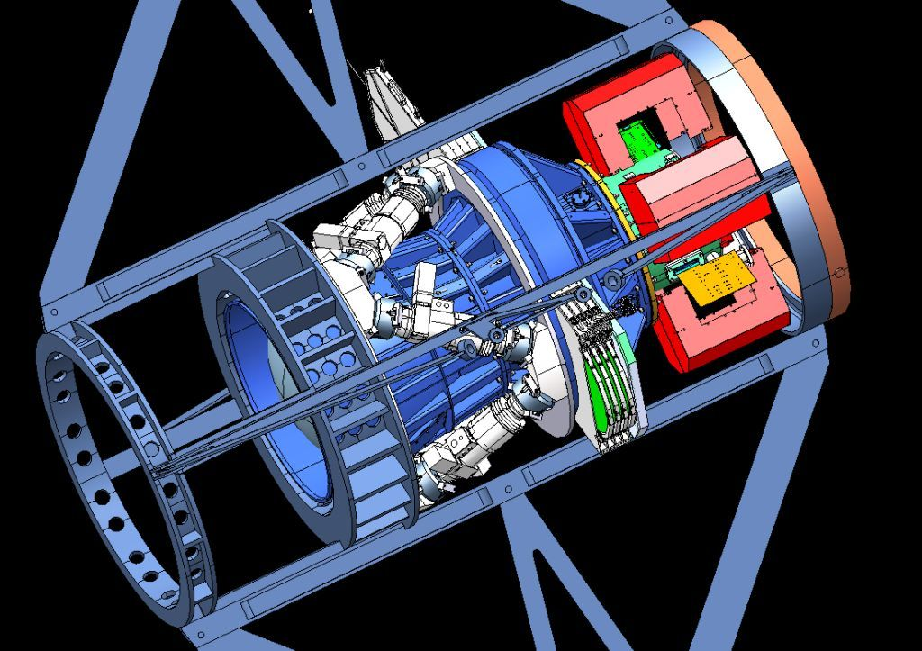
DECam Components
Complete top-end replacement
  Spider & Cage
  Barrel
  Lenses
  Filters
  Shutter
  Hexapod
  Imager
  Electronics
  Cryogenics
  Active cooling
  Controls
  Acquisition h/w
  SISPI
  DQ software

Slide 7
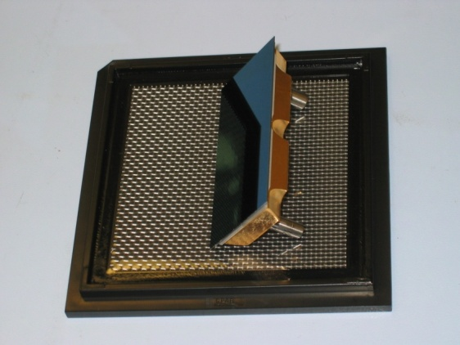
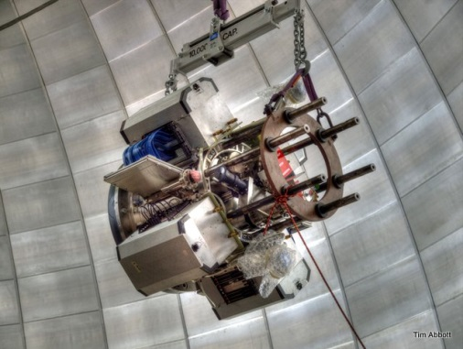
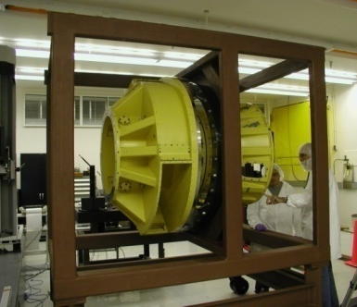
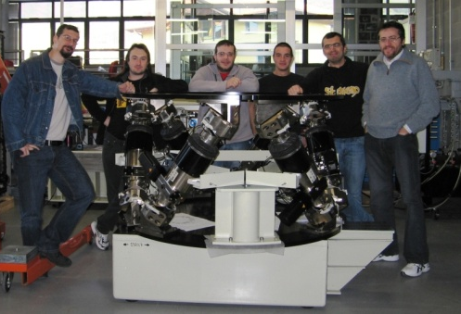
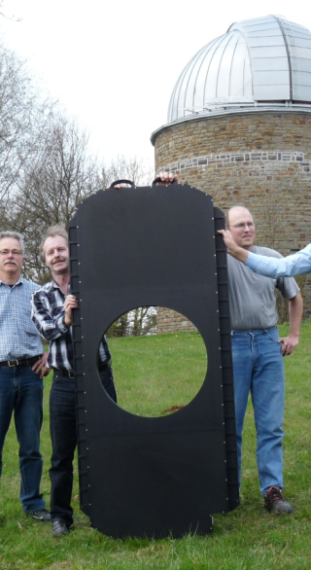
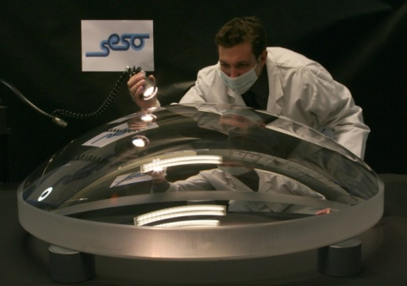
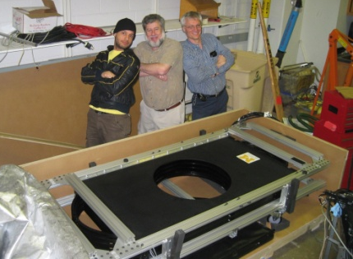
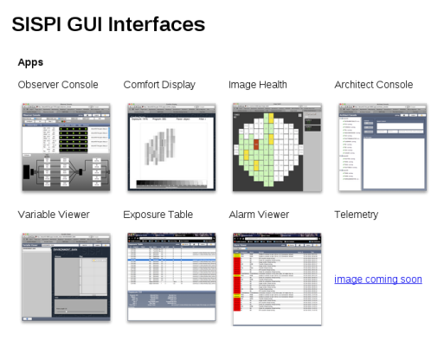
DECam Components
7

Slide 8
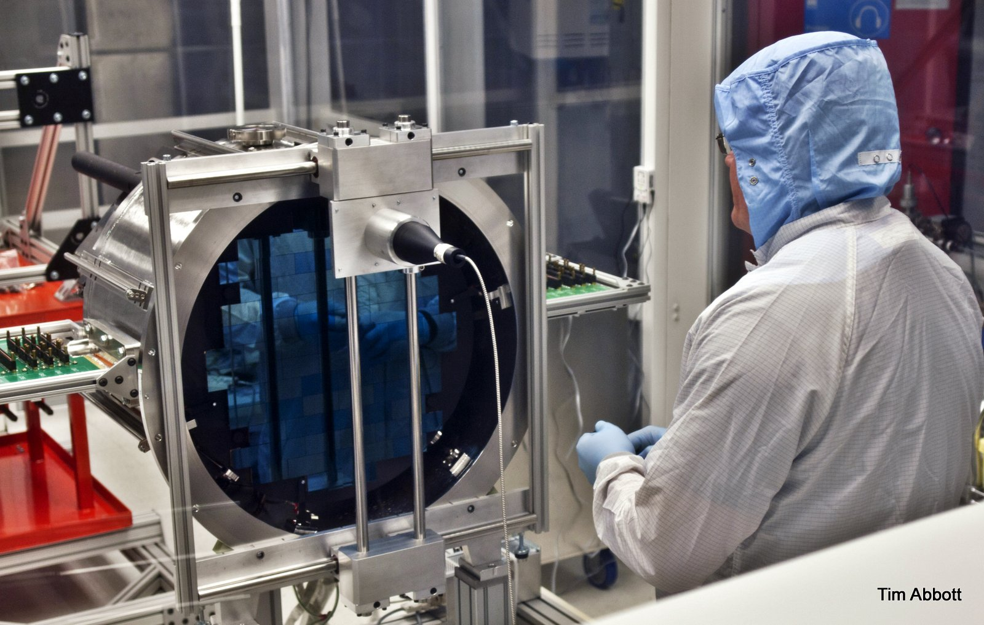
DECam FPA

Slide 9
Cooling system
Closed, 100 PSI, mixed phase N2 system
Vacuum jacketed hose
Navigates 3 wraps
  RA axis is inclined, DEC axis variable orientation but less critical, top ring axis only at NW station.
Immersed LN2 pump
LN2 storage dewar at height
Cryocooler recondenser
Glycol heat extraction
Also
active controller cooling, cage cooling
Dewar vacuum maintained by ion pump (backed by scroll pump, roughing pump)
Notes:
Did investigates of replacement pumps a la that dutch guy go anywhere?

Slide 10
DECam CCDs
Fully depleted
2k × 4k, 15μm pixels, 250 μm thick
Readout speed: 250 kpix/sec
Readout noise: <10 e⁻/pixel
No static protection!
Fab at Teledyne DALSA, thinning & cold probing at LBNL, packaging, test & final selection at Fermilab.
62 Science grade devices on the FPA + 12 guide and intra & extra-focal CCDs for image quality analysis
Accumulated all required plus a full set of spares
See Bebek, et al. SPIE 2012.
Controller: Monsoon by NOAO, modded by DECam project

Slide 11
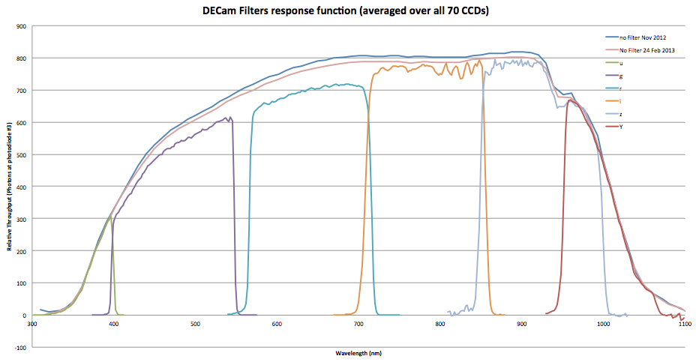
DECam spectral response

Slide 12
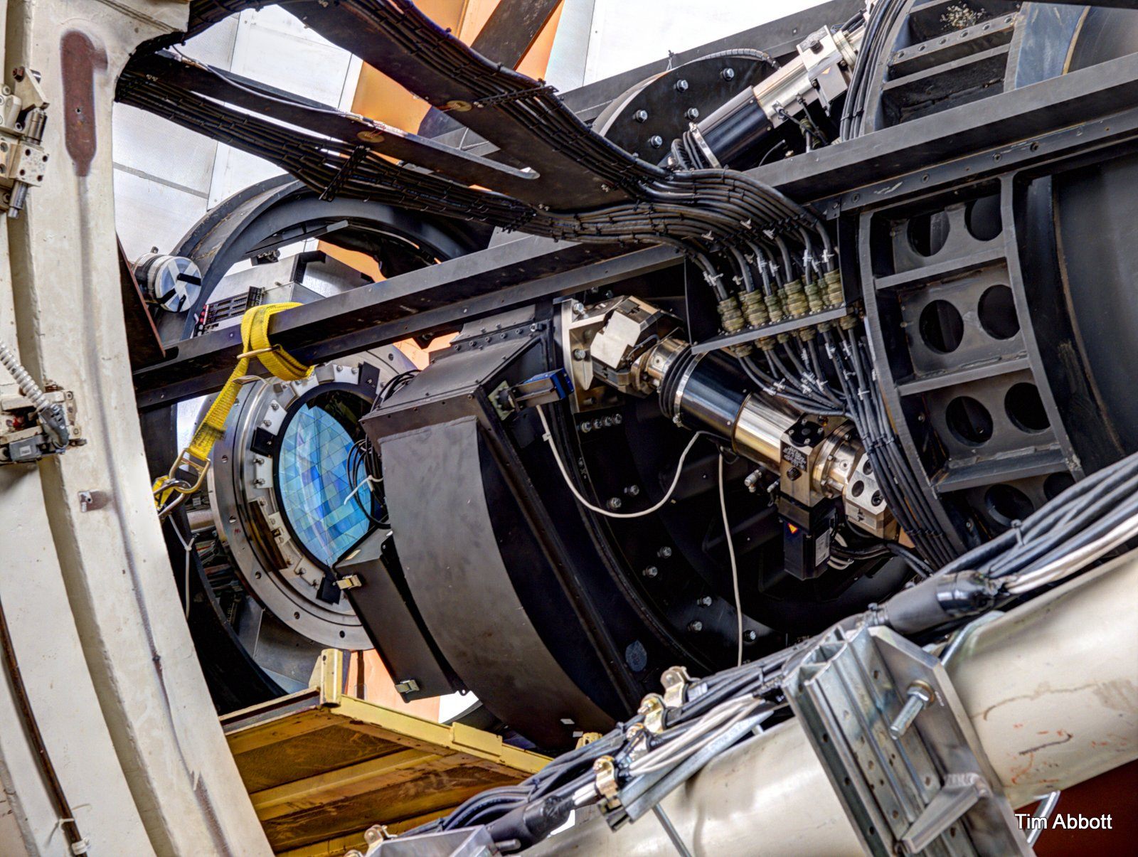
Imager installation

Slide 13
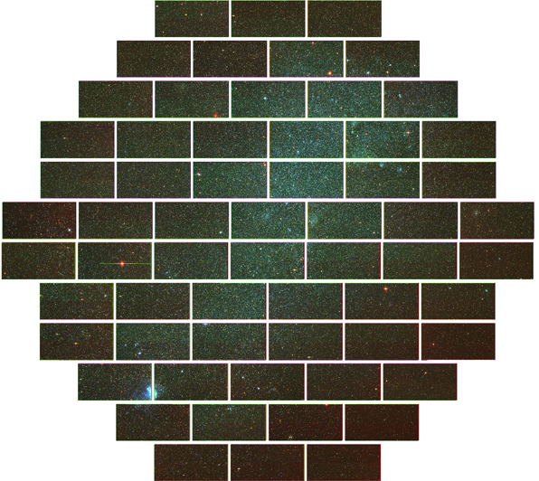
First Light
The SMC

Slide 14
So far so good…
Total Data Collected
  >100,000 images taken
  All Automatically transported via DTS. None lost.
  Average nighttime shutter close to delivery is ~2 min
Record setting nights (Bloom et al.) in March 2013
  >700 images in a single night
Y band images as good as 0.64 arcsec FWHM
1mmag relative photometry is being demonstrated
Non-scheduled off-sky time is very low, with the exception of LN2 system failures in May 2013

Slide 15
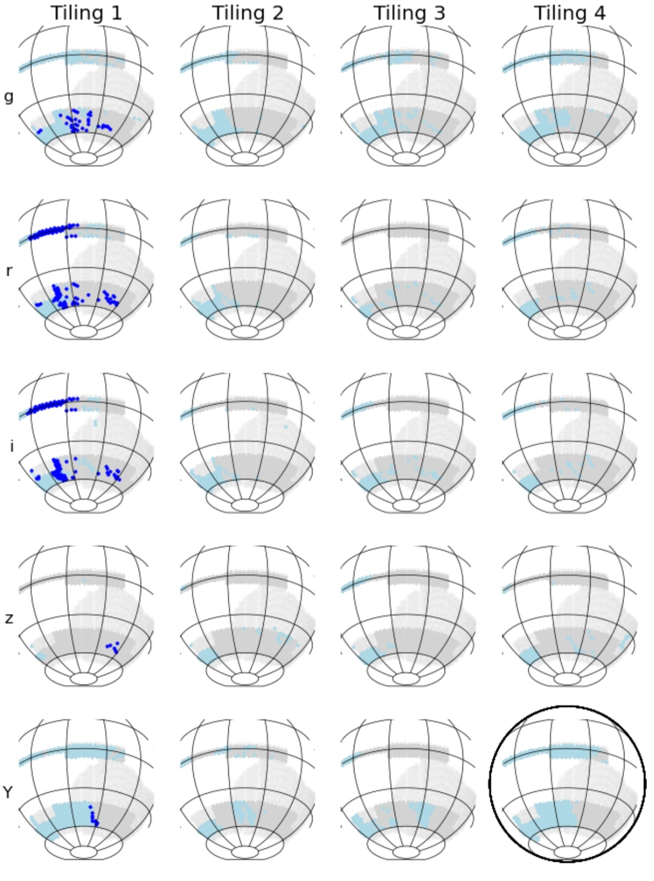
Survey status
Daily map, this one is from 30 Sept 2013.
Dark blue observed previous night, light blue observed earlier, grey is pending.

Slide 16
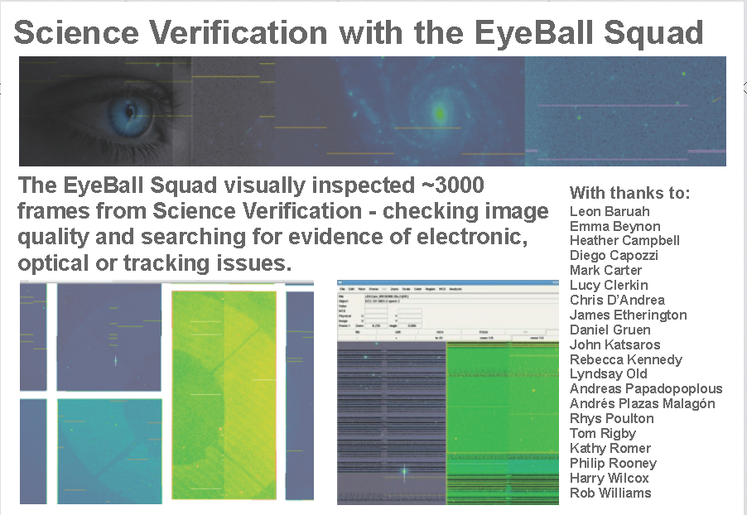
M. March (Sussex)
16

Slide 17
CCD Novelties
☠ Full well loss due to over-illumination💀💀💀 ☠
Nonlinearities at high and low signal level
  CCD #31 low is not stable with time, otherwise nothing special.
Crosstalk: intra-CCD, inter-CCD, inter-DA board – no surprises
Effects of filling pixels – pixel boundaries are (slightly) dynamical (Astier, Regnault, Greundl +)
  Brighter stars → fatter
  Variance of flat-fields is smaller than Poisson
  Flat-fields exhibit correlations
    Linearly increasing with illumination
Glowing edges & “tape bumps"
“Tree rings”
Strong blooming widens at serial register, cause unknown
Flat field changes on warmup
  Tape bumps
Fringing in z & Y, concentrated in the center, not stable with time
Bad pixels – edge cut, poor bridge corrections, serial register and bulk traps
Unusual cosmic rays
Notes:
Factory production, individual CCD optmization not particularly extensive

Slide 18
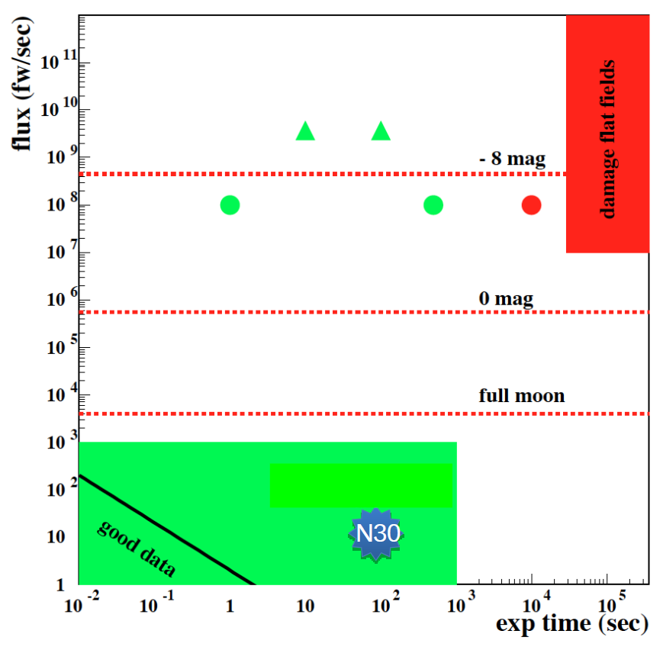
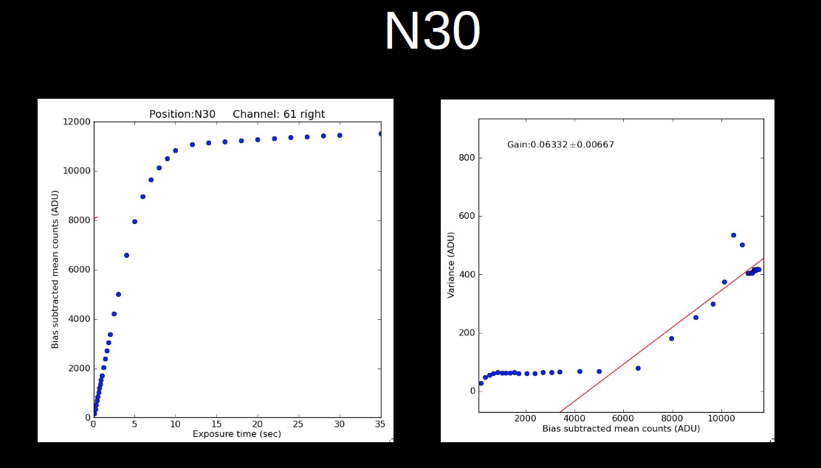
Full well loss due to over-illumination
Trapping of charge at the Si-SiO2 interface under very high illumination until the electric field in the biased substrate vanishes.
This detector was working normally until Nov when it started showing a very
small “full-well” capacity. There was an incident of unusually high illumination
(during twilight flats, which are now banned) just before we started seeing this
problem. However, the level measured by the PDs was not dangerous
according to studies at FNAL.
Juan Estrada

Slide 19
Variable pixel catchment volumes
Pixels have a 15μm x 15μm footprint but are 250μm tall "skyscrapers" which makes them susceptible to deformation by stray electric fields.
"Glowing edges"
"Tape bumps"
"Tree rings"
These are not flat field effects
"Most of the structure in flat fields is due to pixel size variation" (Bernstein)
Charge is conserved, but may not land in the pixel potential well under the point in the CCD bulk where it was generated.

Slide 20
Glowing edges
Effective collection area for pixels near the edge can extend considerably beyond the boundary of the CCD producing “glowing edges” which generate apparent astrometric errors.
Various mitigation technologies have been developed, but were not available for DECam. There is nothing for it but to discard these columns from every image.
S.E. Holland, W.F. Kolbe, and C.J. Bebek, “Device design for a 12.3-Megapixel, fully depleted, back-illuminated, high-voltage compatible charge-coupled device,” IEEE Trans. Elec. Dev., 56, 2612, (2009).
  http://snap.lbl.gov/ccdweb/2010_ted_for_web_page-1.pdf
Workshop in November, Brookhaven “Precision Astronomy with Fully Depleted CCDs”
  http://www.bnl.gov/cosmo2013/index.php

Slide 21
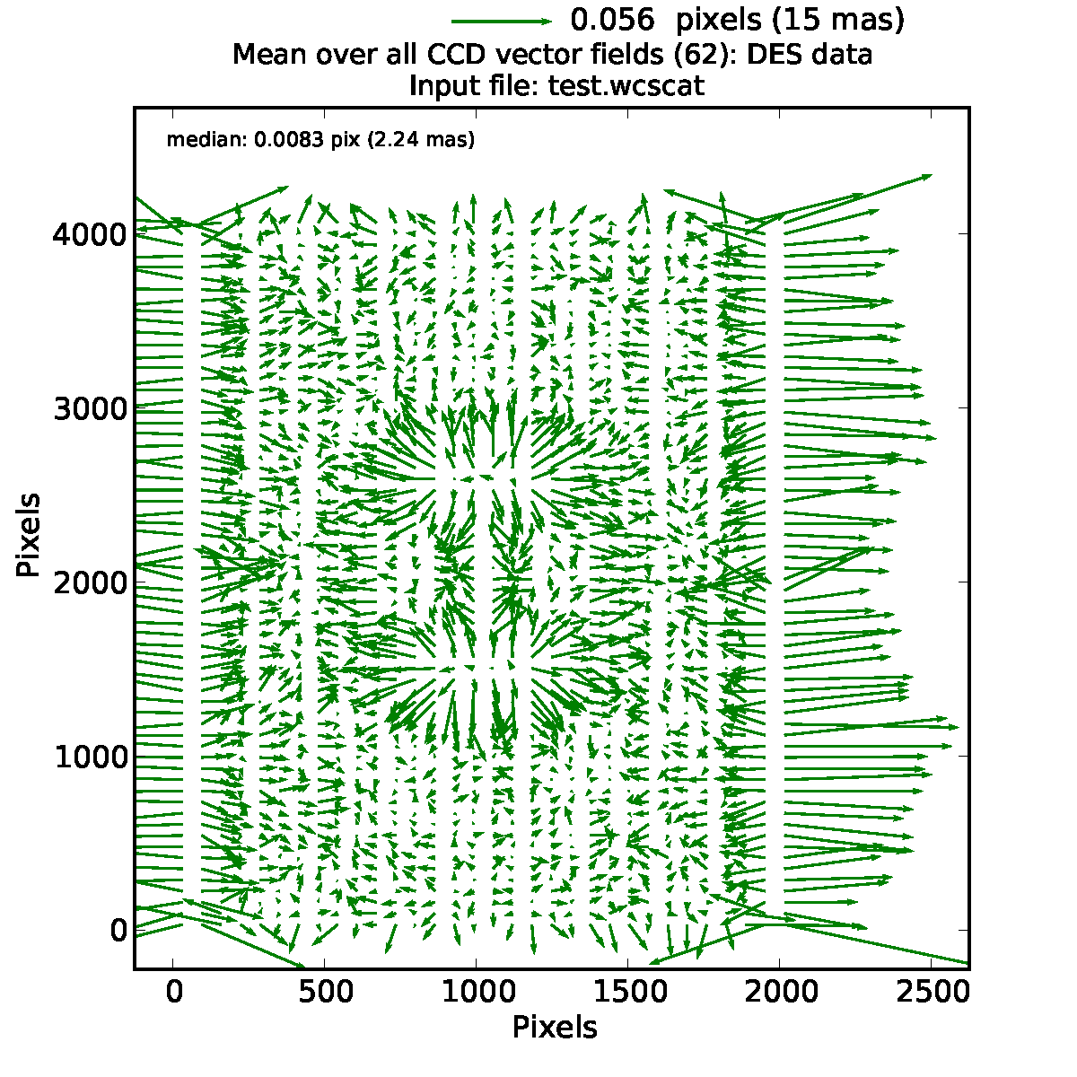
Mean WCS over all 62 CCDs
(Not corrected for amplifier orientation.)
21
Notes:
Green map is average of 62 wcs's, without proper rotation so splat in the middle indicates hole in mount of which there is actually only one.

Slide 22
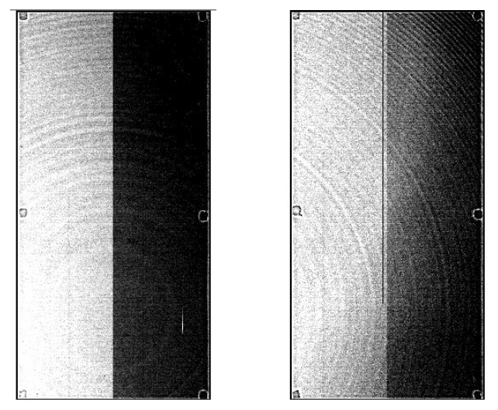
“Tree Rings”
Not QE variations!
Astrometric distortion:
  Predicted from dome flats
  Measured in star flats.
Doping variations in Si crystal manufacture?

Slide 23
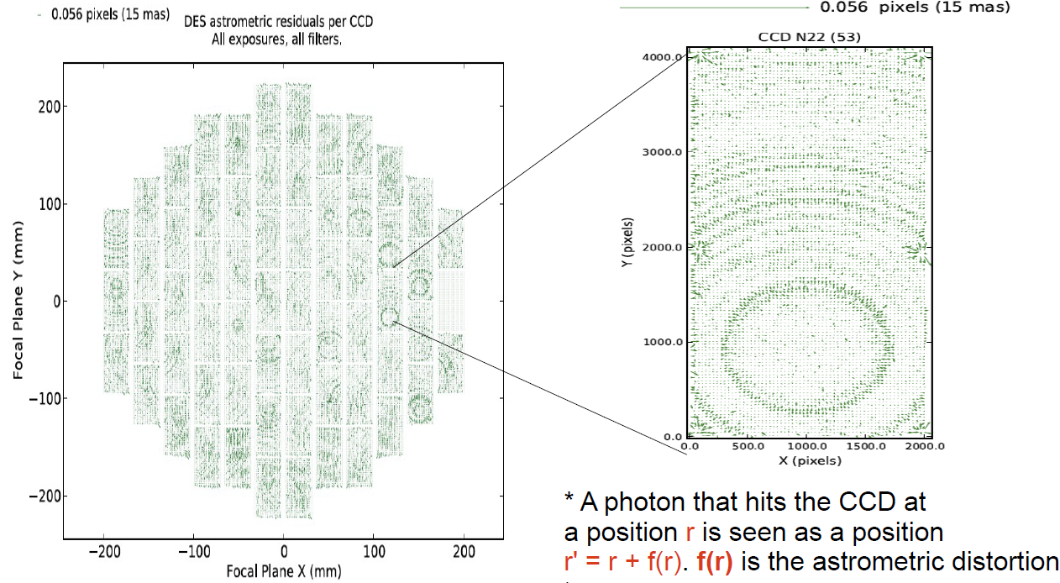
“Tree rings” astrometry
Bernstein
Notes:
Tree rings are stronger in the red which supports interpretation as a bulk effect.
Thin chip surface effects (grinder wheels) get stronger in the blue.
Map is what you get after WCS removal (2 slides ago)

Slide 24
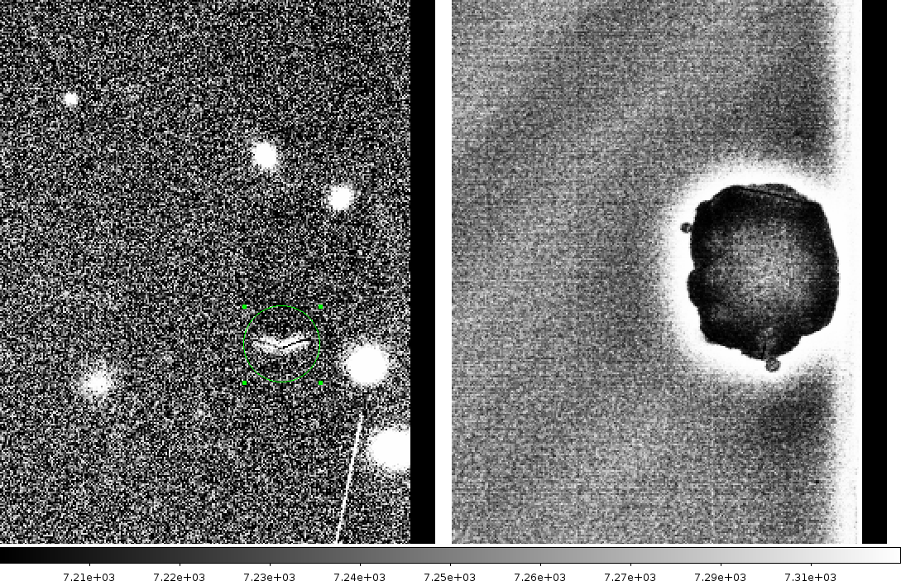
“Tape bumps” evolution
Left: flat-fielded data
Right: flat field from
2 weeks earlier.
There was a warmup in
between

Slide 25
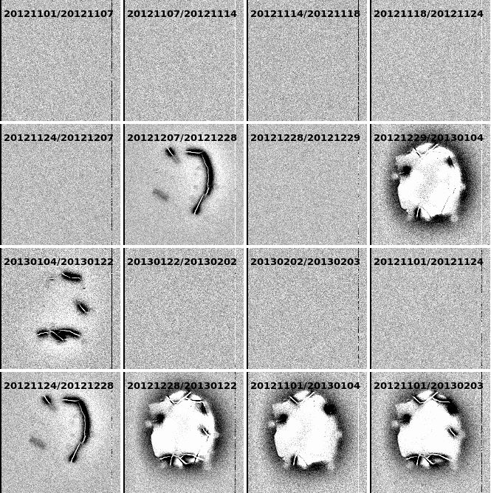
Tape bump evolution
Temperature changes of >2K cause this.
“… flux is conserved […] suggests an electric field effect that is analogous to, but more localized than, the glowing edges.”
(Martini)

Slide 26
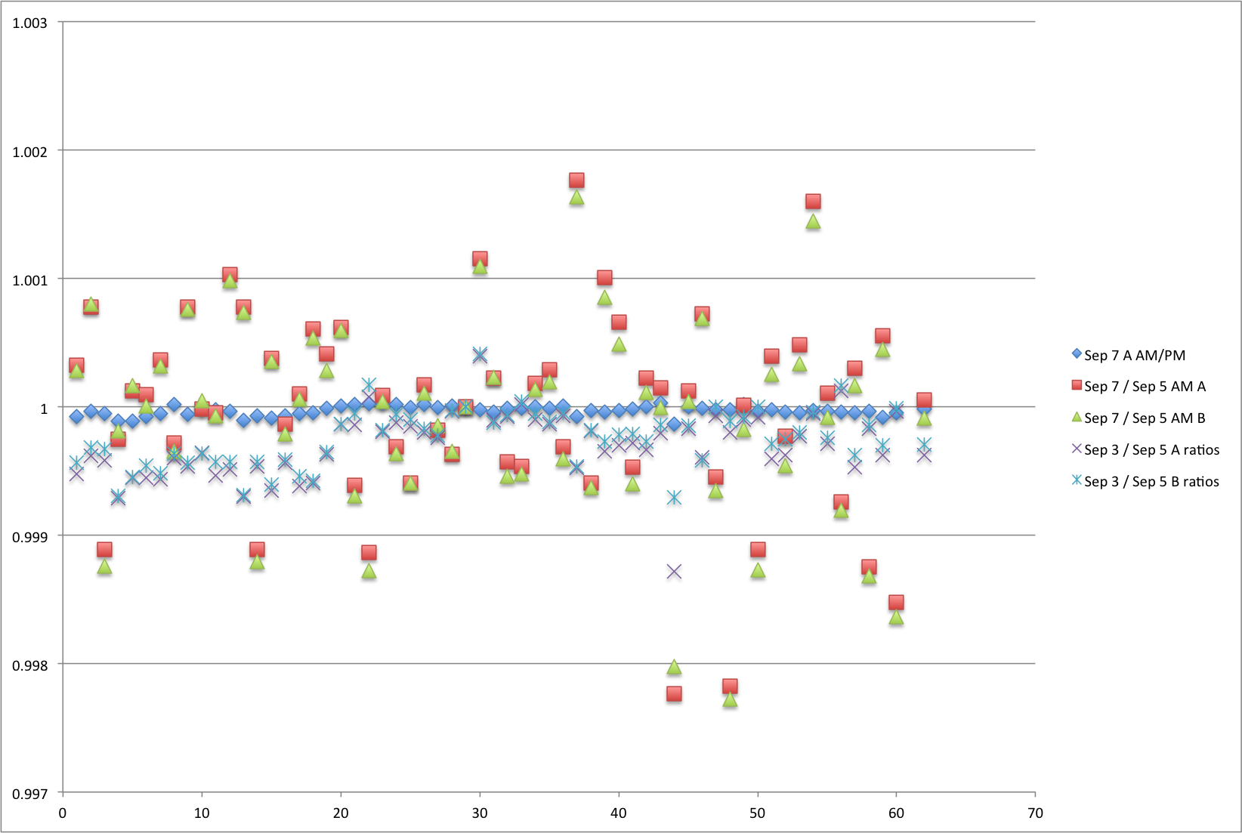
Flat field variations on a 5K temperature control glitch

Slide 27
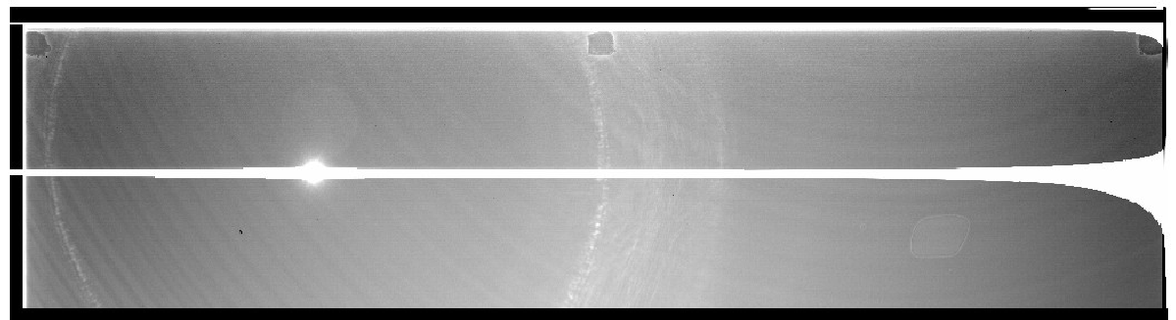
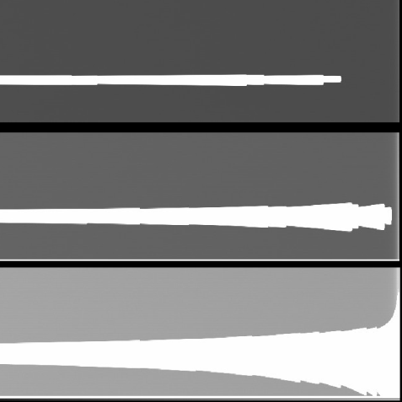
Blooming
A very bright star on the CCD produces bleeding on the column. This bleeding spreads to more columns when it reaches the serial register.
Blooming has more charge at the far end.
Tried:
  1) Lower all the horizontal clocks, the SW and even VOG to let the
  charge flow through the SR and drain.
  2) Same as (1) + continuous RST
  3) Making a Larger TG barrier
  4) Continuous run of the SR clocks --- helped a bit
Cause & solution not known.
Juan Estrada
Notes:
Check with Juan that he still doesn't know what this is.

Slide 28
Spare slides

Slide 29
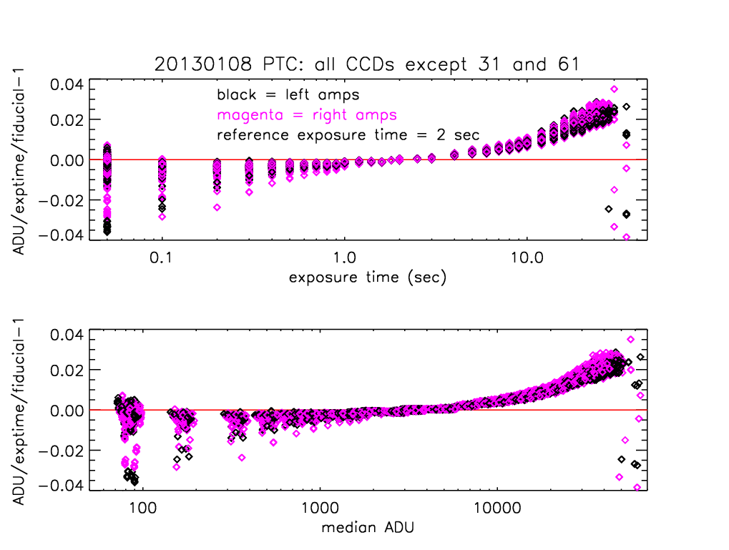
Nonlinearity in photon transfer curves
High light level effect for all CCDs
Amps with low light level nonlinearity
Huan Lin
saturation
High flux nonlinearity corrected with linearization table

Slide 30
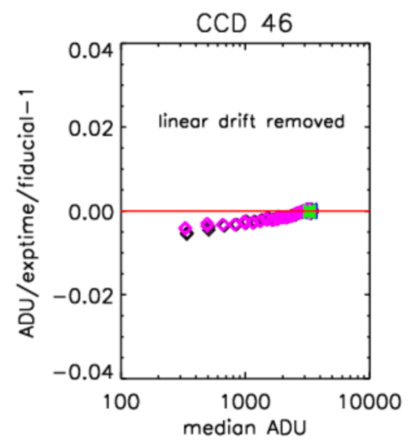
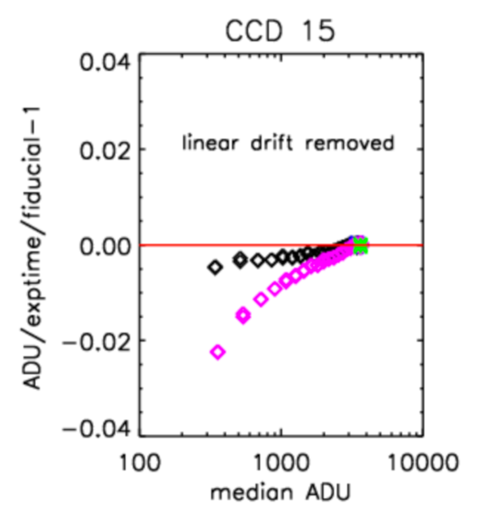
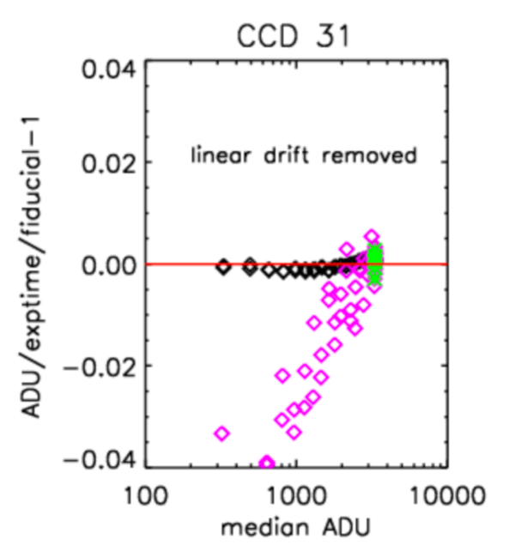
Low light level nonlinearity as seen in photon transfer curve flat-field data
Fractional nonlinearity
Black = left amp
Magenta = right amp
Typical CCD
ADU counts
Worst amp with
low-level nonlinearity
One of ~10 amps with low-level nonlinearity
Low signal nonlinearity not so well understood - reflects relative disinterest from the survey.
Huan Lin

Slide 31
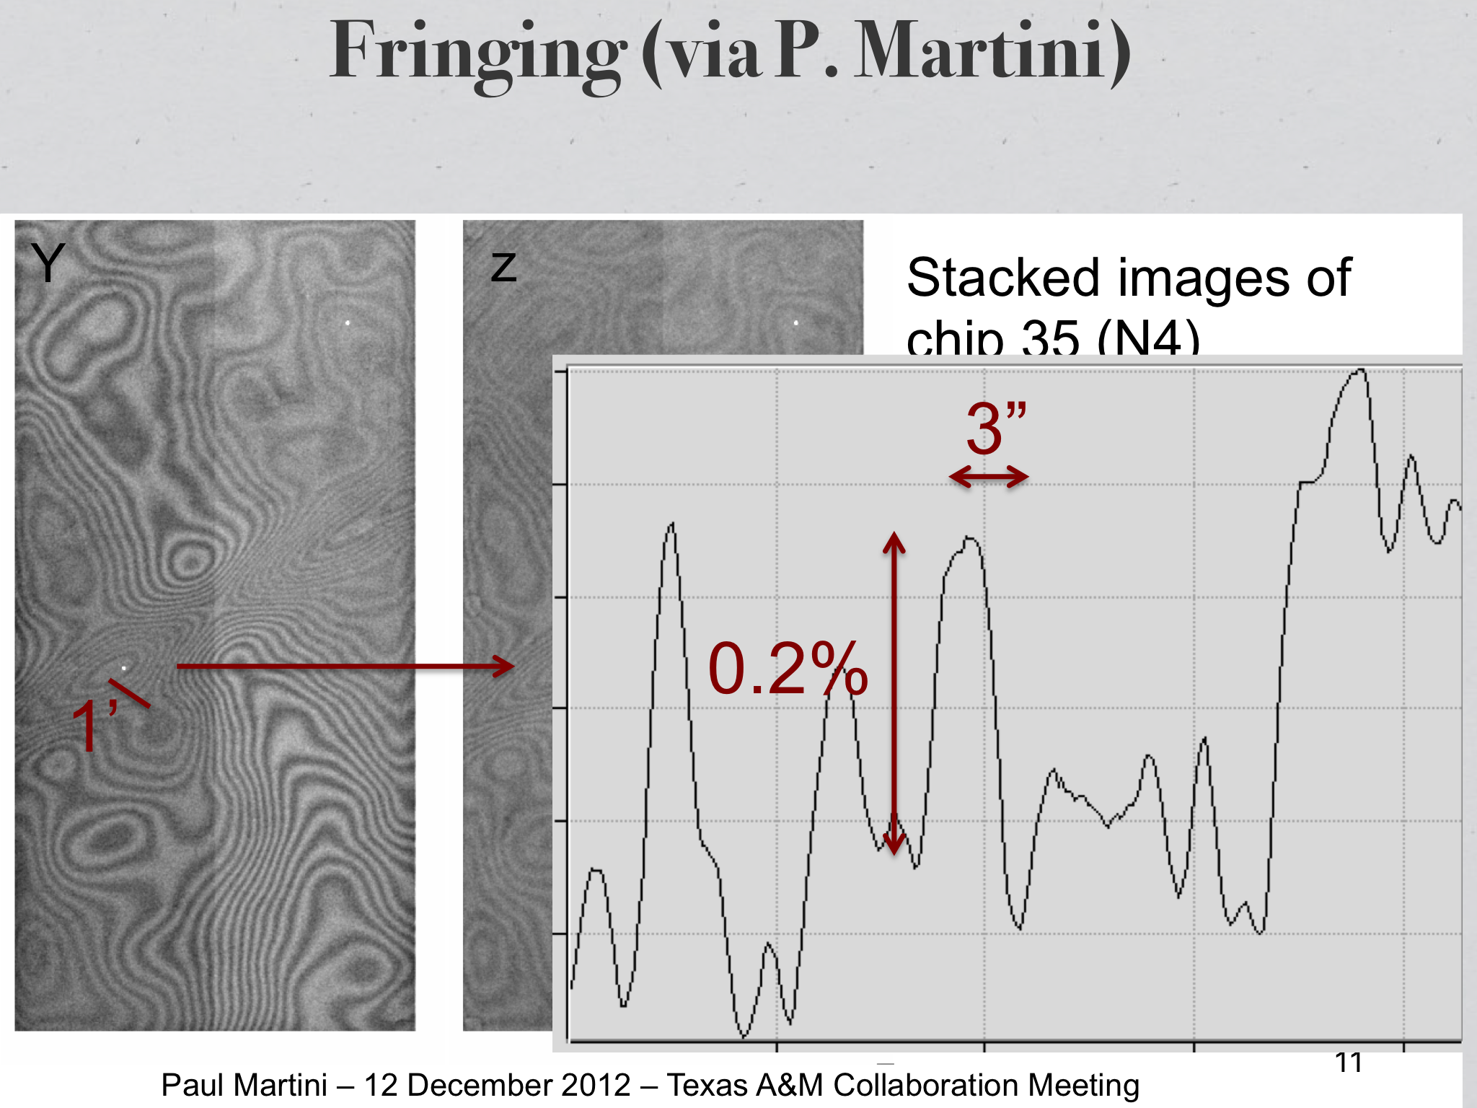
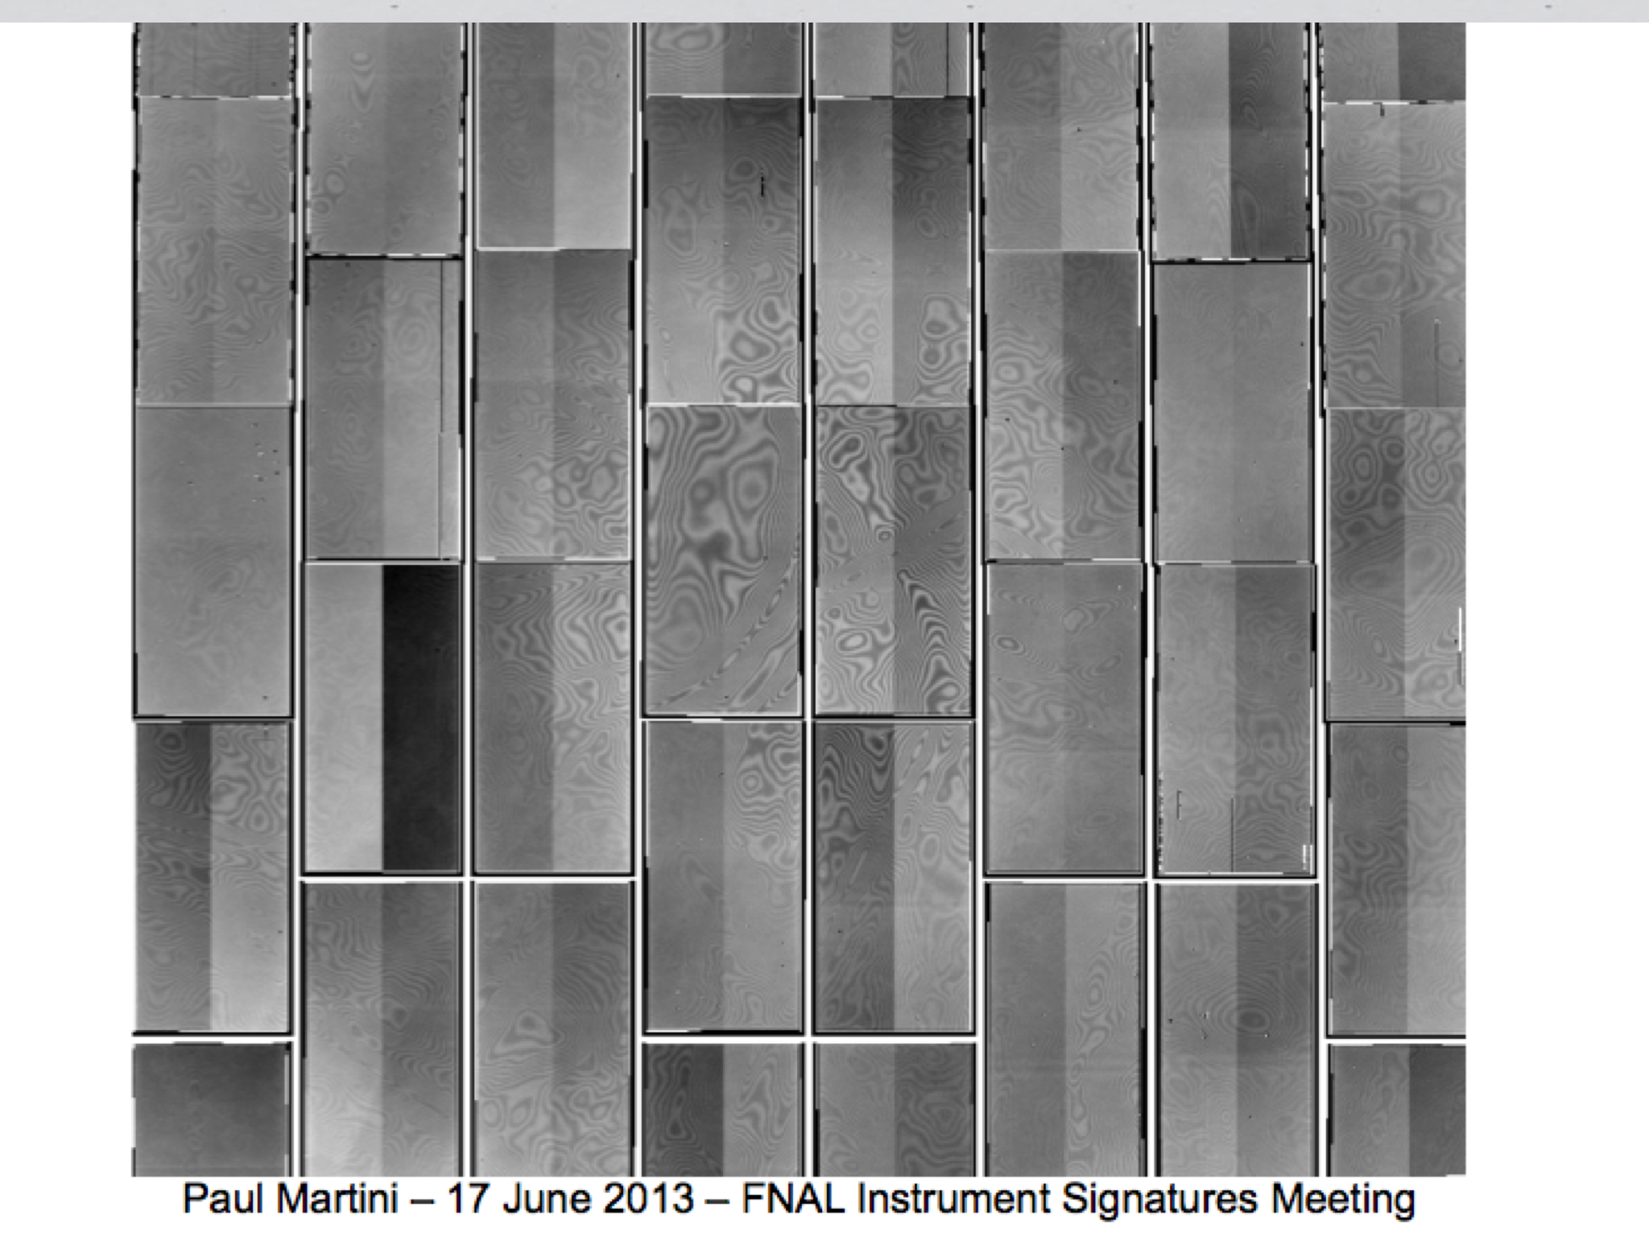
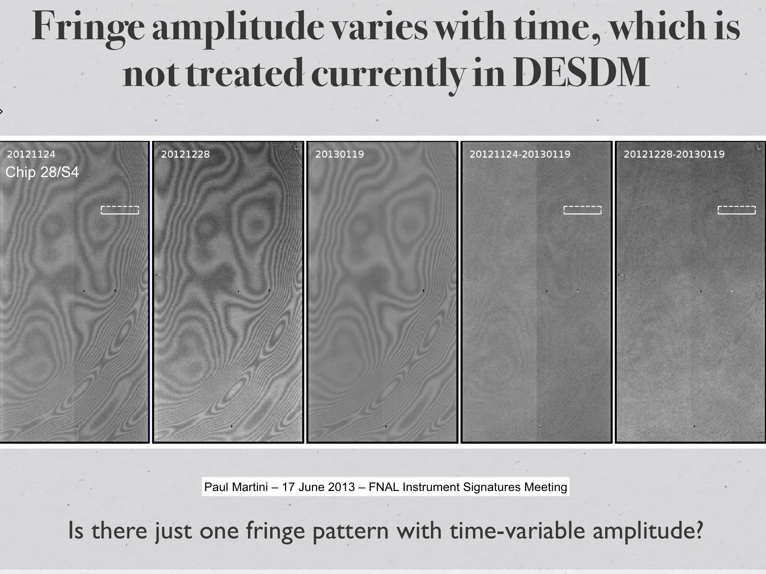
Fringing
Seen in z & Y, strongest in the middle

Slide 32
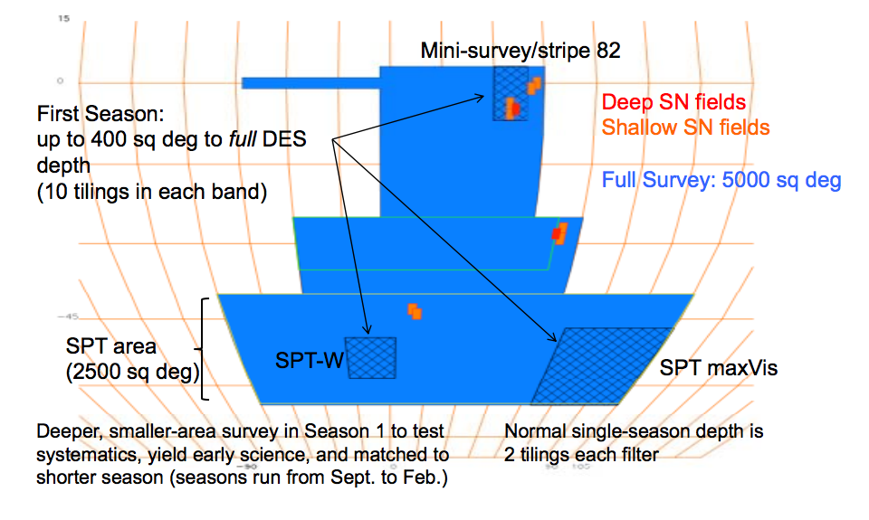
DES Survey Parameters
On our way towards 525 nights in the months from Aug. 2013 to Feb. 2013 to 2018.
The Wide-field survey is 5000 sq-deg of the Southern Galactic Cap. The whole sky (4π) has 41253 sq-deg.
    300M Galaxies: 10σ grizY = 24.6, 24.2, 24.4, 23.8, 21.5
    2% photometric precision
    0.9” FWHM i-band seeing
A 30 sq-deg Supernova Survey in 10 fields
  If field not observed in 10 nights or anytime the “seeing” is poor.
  Fields repeated typically every 4-10 nights. Discover ~4000 SN1A.
Notes:
This is old, put the new one in.

Slide 33
Biggest Camera?
 | Blanco DECam | CFHT MegaCam | WIYN O.D.I. | Subaru HSC | PanStarrs *1 | LSST
Year | 2012 | 2003 | 2013+ | 2012 | 2009 | 2022+
Filters | 62 cm diameter | 30 x 30 cm | 42 x 42 cm | 60 cm diameter |  | 75 cm diameter
Shutter | 60 cm diameter |  | 45 x 45 cm | 58 cm diameter? | 48 x 48 cm
Primary Mirror | 4.0m | 3.6m | 3.5m | 8.2m | 1.8m | 6.5m
1st Lens Corrector | 0.98 m 176 kg | 0.8m | 0.59m 36 kg | 0.82 m | 0.6 m | 1.55 m
Focal Plane | 45 cm | 25 x 25 cm | 40.5 x 41.5 cm | 48 cm diameter | 40 cm | 60 cm diameter
Pixels | 520 M | 340 M | 971 M | 1.0 B | 1.4 B | 3.2 B
F.O.V. | 3 deg^2 | 1 deg^2 | 1 deg^2 | 1.8 deg^2 | 7 deg^2 | 9.5 deg^2
Etendue AΩ | ~32 | ~8 | ~8 | 95 | ~12 | ~340
Time to “do a DECam” | 1 | ~10 | ~10 | 0.5 | ~4 | ~0.1

Slide 34
Biggest Camera?
 | Blanco DECam | CFHT MegaCam | WIYN O.D.I. | Subaru HyS.C. | PanStarrs *1 | LSST
Year | 2012 | 2003 | 2013+ | 2012 | 2009 | 2022+
Total weight | 6000 lbs | 1325 kgs | 2500 lbs |  |  | 2800 kgs
Readout time | 25 sec

Slide 35
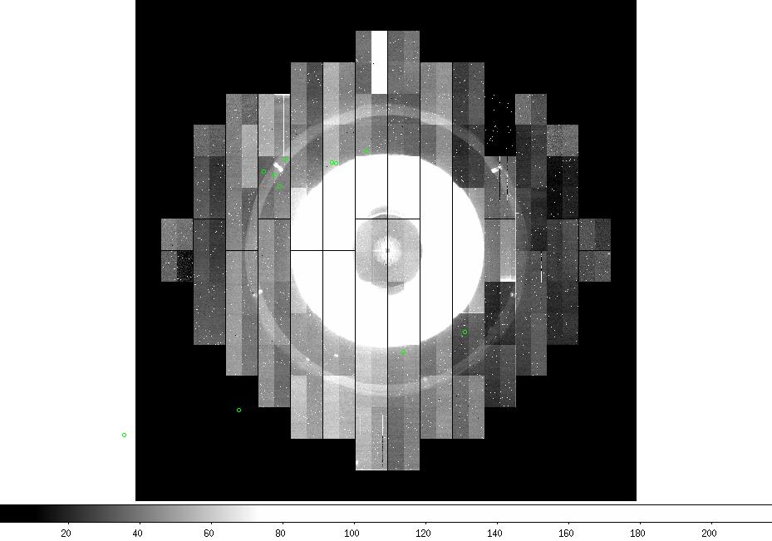

Slide 36
Commissioning Musings
Commissioning is where a lot of things were connected up for the first time
Getting them to talk coherently to each other sometimes took a lot of time
Blanco + DECam is a very different beast than Mosaic - 10 tons heavier for a start
Just about everything was new – DECam, Telescope systems, facility systems, AOS
Everything eventually “worked” – most things very well, some not so well
Well enough to start SV

Slide 37
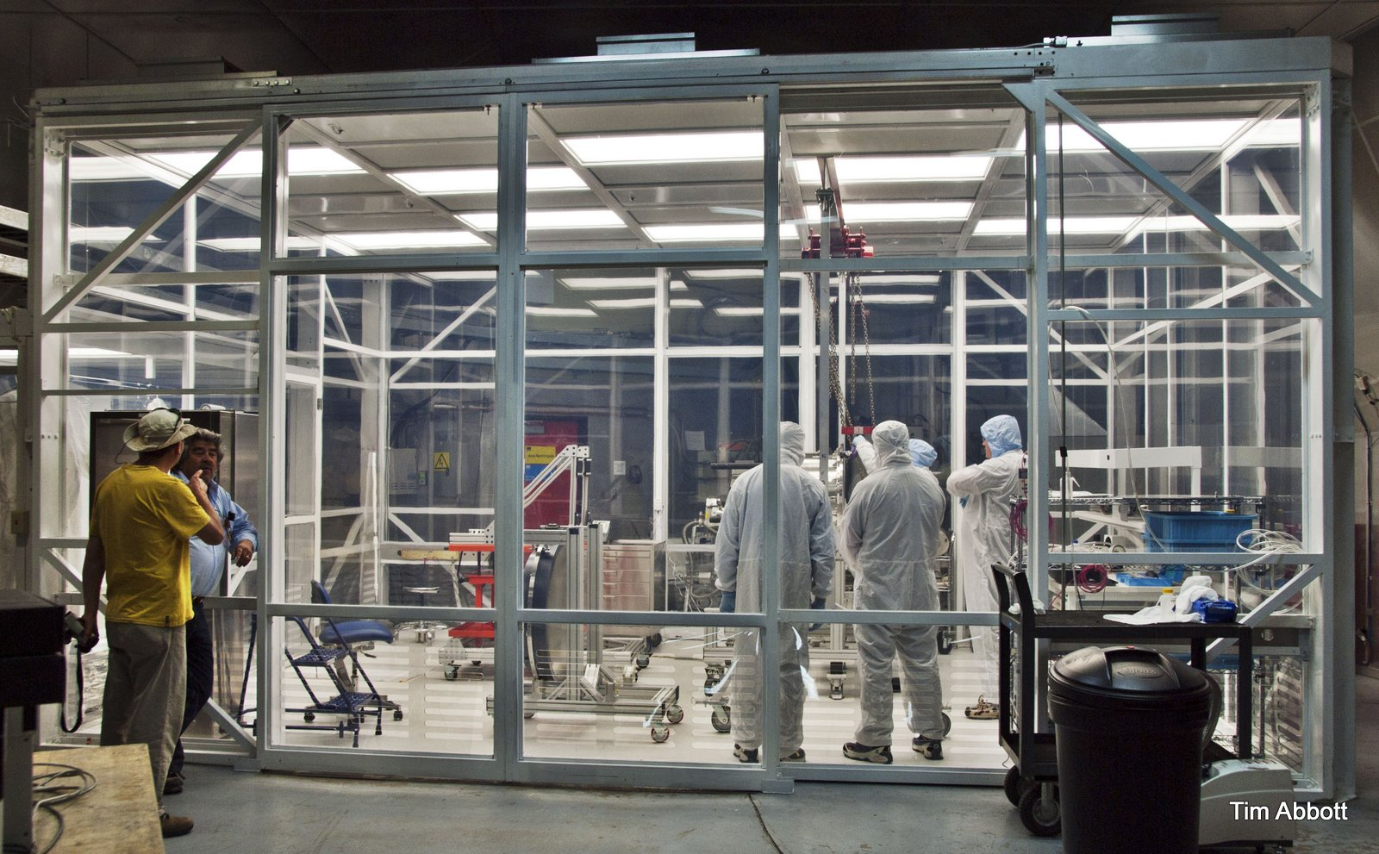
Blanco cleanroom

Slide 38
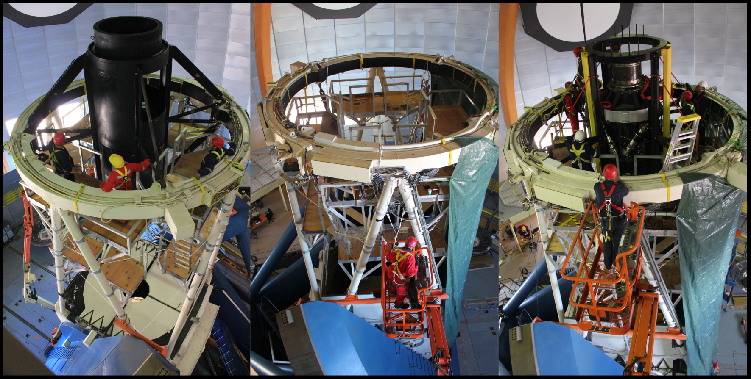
MOSAIC OUT / DECAM IN

Slide 39
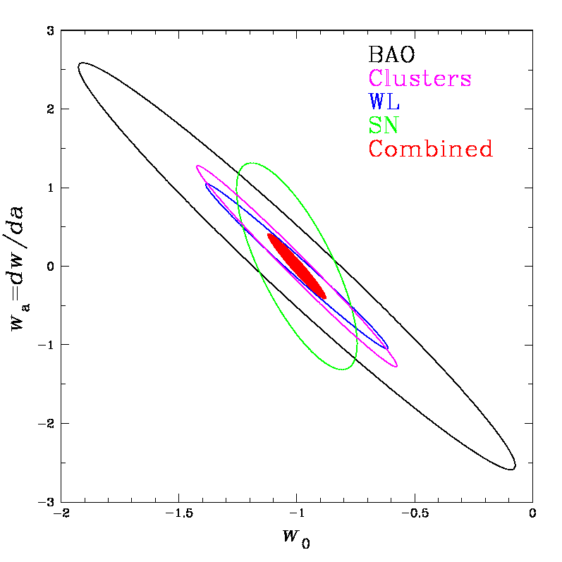
DES Science Summary
Forecast Constraints on DE Equation of State
Four Probes of Dark Energy
Galaxy Clusters
  ~100,000 clusters to z>1
  Synergy with SPT, VHS
  Sensitive to growth of structure and geometry
Weak Lensing
  Shape measurements of 200 million galaxies
  Sensitive to growth of structure and geometry
Baryon Acoustic Oscillations
  300 million galaxies to z = 1 and beyond
  Sensitive to geometry
Supernovae
  30 sq deg time-domain survey
  ~4000 well-sampled SNe Ia to z ~1
  Sensitive to geometry
DES
Planck prior assumed
Factor 3-5 improvement over
Stage II DETF Figure of Merit

Slide 40
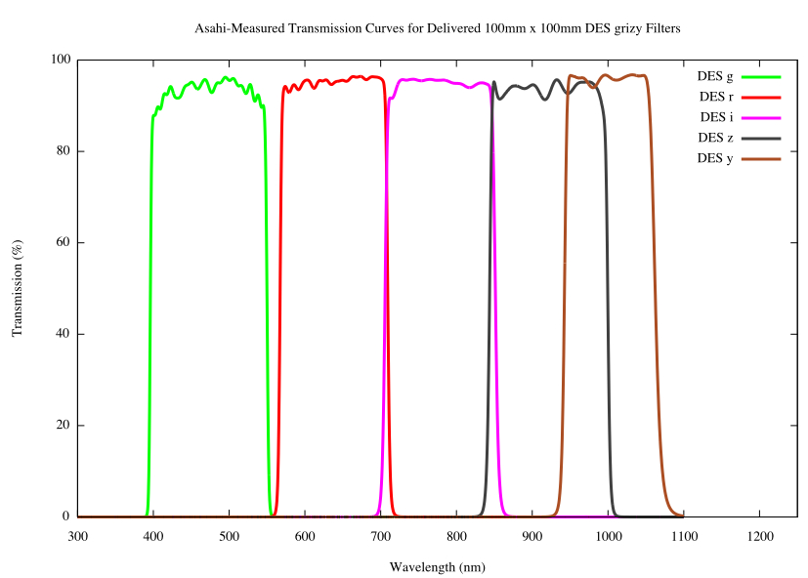
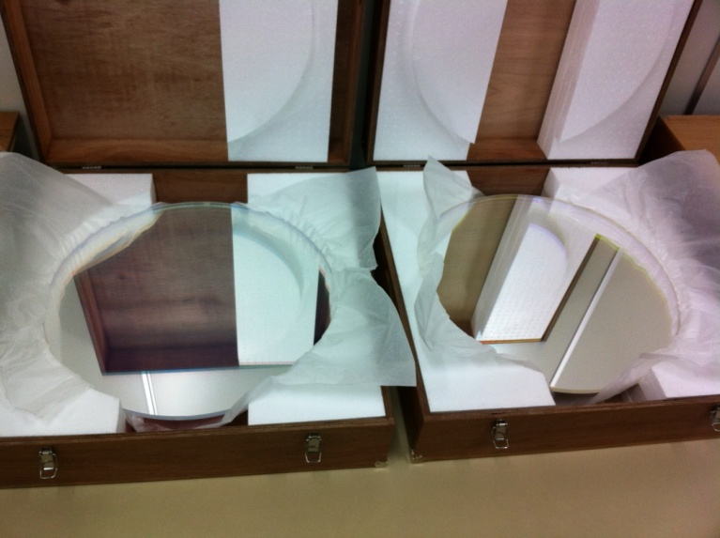
DES Filters & Photometric Z’s
Measure relative flux in grizY filters and track the “4000 Angstrom break”
• Estimate individual galaxy
redshifts with accuracy
σ(z) < 0.1 (~0.02 for clusters)
Filters were produced by
Asahi Spectra (Japan)
Elliptical galaxy spectrum
g
r
i
z
y
4000 A break at z=0
transmission(%)
4000 A break
at z=1
λ(nm)
World’s biggest astronomical filters
(60 cm diameter)
i-band (left) z-band (right)

Slide 41
Installation Time-line & Activities
During 2011: much installation planning and procedural reviews, equipment arrived, was assembled and tested
February 2012, shutdown start, ~6 month activity
  Telescope stripped
    Primary mirror and cell removed
    Very careful metrology
    Prime focus cage and fins removed
  Installation
    Practice installation of the new (empty) prime focus cage
    Real installation of the new prime focus cage plus DECam barrel with optical corrector
    Re-install primary mirror, modified Cass cage with a lot of lead, new cable wraps, utilities
  Installation of the DECam Imager, shutter-filter unit
  TEST

Slide 42
Early Successes
c
The 6-month disassembly and reassembly of the telescope was completely successful
  The best at-zenith figures for the hexapod shifts needed to align the array with the primary optical axis are X =577 microns, Y = -188 microns, xtilt = -38 arcsec , ytilt = -68 arcsec
The Opto-mechanics all work as designed – optics, filters
The DECam cryo-vac system all functions reliably, including the new and untested cable wraps
All moving parts – hexapod, shutter, filters – move when they are meant to move
We zapped LEDs inside the filter-changer
The AOS can keep the telescope in focus
Data flowed…

Slide 43
Dark Energy Summary
Galaxy Clusters
  ~100,000 clusters to z>1
  Synergy with SPT
  Sensitive to growth of structure and geometry
Weak Lensing
  Shape measurements of 200 million galaxies
  Sensitive to growth of structure and geometry
Baryon Acoustic Oscillations
  300 million galaxies to z = 1 and beyond
  Sensitive to geometry
Supernovae
  30 sq deg time-domain survey
  ~4000 well-sampled SNe Ia to z ~1
  Sensitive to geometry
Forecast Constraints on DE Equation of State
Factor 3-5 improvement over
Stage II DETF Figure of Merit

