Slide 1


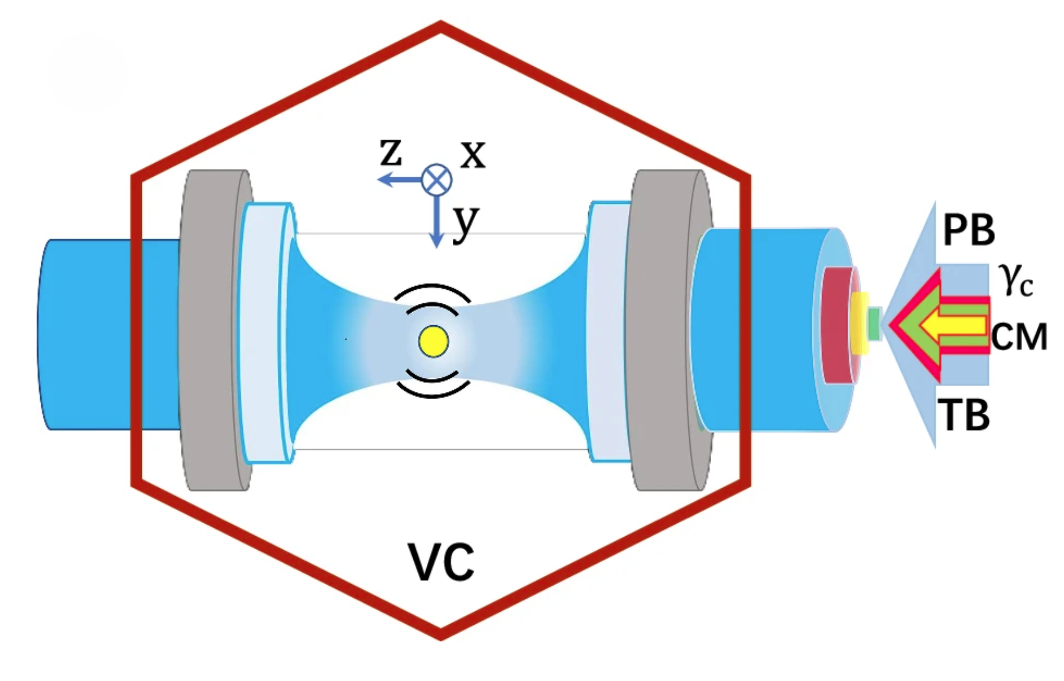
A two-mode thermomechanically squeezed phonon laser
Lasers find ubiquitous use in physics due to their coherence, spectral purity and high intensity. However, the output of a laser does not carry crucial resources such as squeezing and entanglement, and the generation of such properties requires the use of nonlinear media. In the electromagnetic domain, the nonlinearities are weak, resulting in sources of squeezing and entanglement that are not bright. In this work, we exploit the fact that strong nonlinearities can be readily implemented in a mechanical system to enable simultaneous lasing and two-mode squeezing, producing a bright and coherent source of classically correlated phonons: a two-mode thermomechanically squeezed phonon laser. Our device is experimentally implemented by combining nonlinear damping with parametric modulation of the coupling between two center-of-mass oscillation modes of an optically levitated nanoparticle at the sum of their mechanical frequencies. Above the linear stability threshold of the system, we observe parametrically sustained oscillation and subthermal two-mode squeezing coexisting with mechanical lasing. Our device is a substantial addition to the ongoing revolution in optical tweezer physics, important to studies of nonequilibrium systems in mesoscopic classical thermodynamics, and a necessary stepping stone in the longer-term development of a quantum mechanical extension.
Lasers have found an enormous diversity of uses for both fundamental studies as well as applications in physics, due to their coherence, spectral purity and high intensity1. However, the output of a laser does not carry resources such as squeezing and entanglement, which are crucial for measurement science and information processing. In order to generate such resources, laser output needs to further interact with media that possess nonlinear susceptibilities. In the optical domain, where crystalline and gaseous media are typically used, the nonlinearities are weak. This results in sources of squeezing and entanglement that are generically not very bright. Along these lines, the combination of squeezing and lasing has been addressed in single mode photonic systems.
In this work, exploiting the availability of strong mechanical nonlinearities, we present the first report of two-mode (thermomechanical) phonon squeezing in a levitated system, where so far only single mode phonon squeezing has been demonstrated. Further, we show two-mode squeezing to be compatible with lasing, for the first time, for any phononic system. Our demonstration involves the oscillations of an optically levitated nanoparticle and combines the previous realization of a single mode optical tweezer phonon laser using linear gain and nonlinear damping, with the separately demonstrated parametric coupling of two nanoparticle modes. However, it is not clear a priori if the nonlinear damping (and its accompanying fluctuations) used to achieve lasing will
Illustration of a nanoparticle optically levitated by a trapping laser beam (TB) inside a vacuum chamber (VC), with a probe beam (PB) measuring its position. The x and y transverse oscillation modes can be coupled by coherent modulation (CM) of the trapping laser. The nonlinear parametric cooling (γc) is selectively exerted on the nanoparticle in the x and y-directions and the corresponding rates are expressed by γcx and γcy respectively, which can be different or identical. The z-motion is frozen out by feedback cooling and is not considered in our model.
destroy the correlations necessary for two-mode squeezing; nor whether the parametric modulation used to create squeezing can sustain the linear gain required for lasing. In this work, we demonstrate that such a useful combination is indeed possible, and results in a bright source of classically correlated phonons.
The dynamics of our system basically consist of nondegenerate parametric amplification combined with nonlinear damping. Below the threshold of linear instability, we verify that both oscillation modes are in thermal states, and observe thermomechanical squeezing of noise. Above threshold, the system is set into parametrically sustained oscillation and the modes display laser-like behavior - they are each coherent with a normalized second-order correlation near unity, possess narrow linewidth, and display subthermal phonon number squeezing - as well as joint amplitude-difference squeezing. In this regime, the presence of nonlinear parametric cooling provides a saturable nonlinearity, allowing the device to stabilize and to combine the coherence and intensity of a laser with the low noise properties of a correlated source, and thus realize a two-mode squeezed laser. In addition to presenting the first observation of two-mode squeezing in any levitated system, our innovation most immediately brings the powerful tool of two-mode squeezing to the substantial and expanding field of phonon lasers. Such lasers have thus far been associated with fundamental phenomena such as mode competition; PT-symmetry; exceptional points; coupling to photons, polaritons, and spins; synchronization; and multiharmonic output, as well as applications such as force sensing, directional phononics and acoustic frequency combs. Our classical results also represent the first step towards an eventual quantum realization.
Zhang, K., Xiao, K., Bhattacharya, M., and Vamivakas, A. N. 2026, A two-mode thermomechanically squeezed phonon laser, Nature Communications 17, 2882, https://doi.org/10.1038/s41467-026-70564-3, 30 March 2026.

