Slide 1
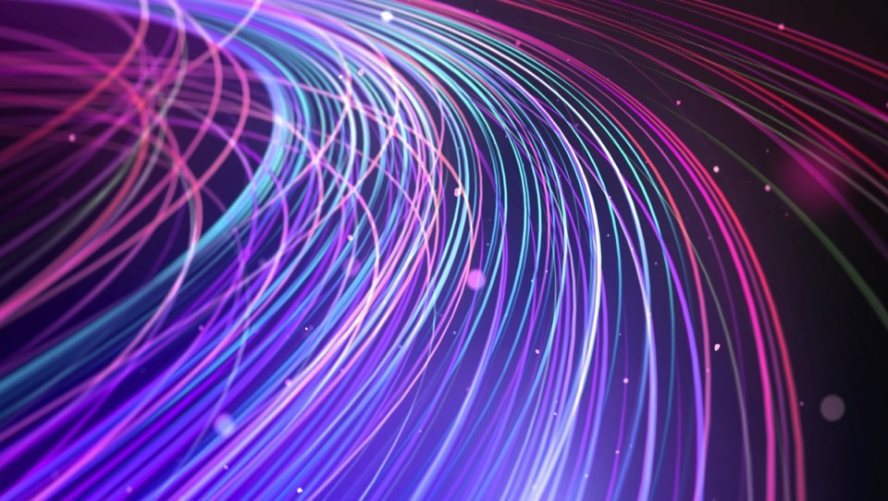

Fibre-optic Quantum Entanglement Sources
July 24, 2020
Li Qian
Department of Electrical & Computer Engineering, University of Toronto

Slide 2
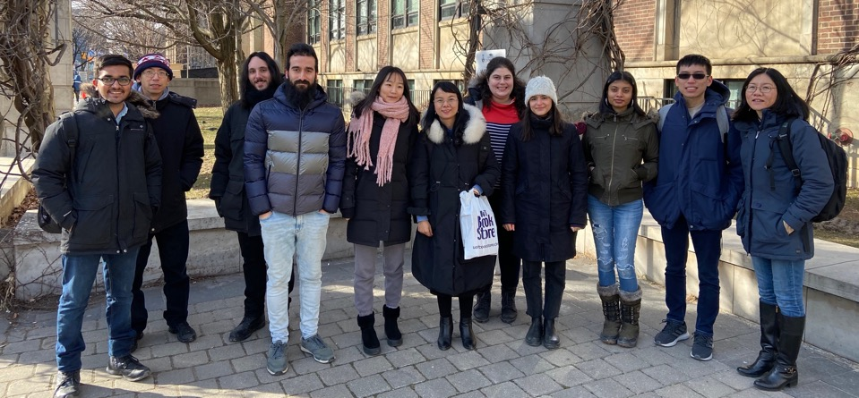
Acknowledgement
Graduate students and postdocs
  Arash Riazi
  Changjia Chen
  Dr. Eric Zhu
Colleagues
  Prof. John Sipe – (Toronto)
  Prof. Peter Kazansky (Southampton)
  Dr. Alexey Gladyshev (Russia)
Postdoc Position Open: l.qian@utoronto.ca

Slide 3
Photon sources as an enabler
$650B
Quantum
Technology
Optical
Technology
Market
First entangled source
First laser
Year
1960
1970
1980
1990
2000
2010
2020
2030
More practical more variety
More practical, more variety
Notes:
Photonics industry source: PHOTONICS MARKET - GROWTH, TRENDS, AND FORECAST (2019 - 2024), Mordor intelligence, https://www.mordorintelligence.com/industry-reports/photonics-market-market

Slide 4
A Practical Source
A Versatile Source

Slide 5
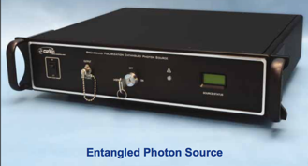
Broadband Polarization Entangled Source
Periodically-Poled Silica Fiber
χ⁽²⁾ SPDC in PPSF
https://www.ozoptics.com/ALLNEW_PDF/DTS0158.pdf
E Y. Zhu, L. Qian et al., PRL, 108, 213902, 2012
E Y. Zhu, L. Qian et al., Opt. Lett., 38, 4397, 2013
C. Chen, L. Qian et al., Opt. Express, 25, 22668, 2017
C. Chen, L. Qian et al., OSA Continuum, 1, 981, 2018
Room-temp, Alignment-free, Compensation-free

Slide 6


The making of PPSF
y
y
χ⁽²⁾= 0
x
x
Thermal Poling
periodic UV erasure
Efficient 3-wave mixing
P.G. Kazansky and P.St.J. Russell, Optics Comm. 110, 611 (1994).
Margulis et al., Opt. Express 17, 15534 (2009)
J. Zhang and L. Qian, JOSA B, 26, 1412 (2008)
P. G. Kazansky et al., Opt. Lett. 34, 2483 (2009)
E. Y. Zhu et al., Opt. Lett. 35, 1530 (2010), JOSA B 27, 2410 (2010)
H. An and S. Fleming, Opt. Express, 20, 7436 (2012)

Slide 7
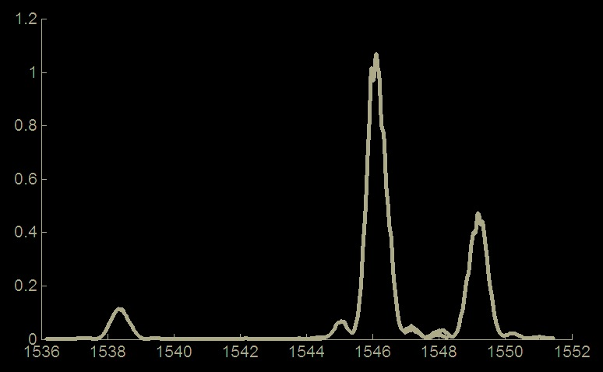
Birefringent phase matching
Type II
SHG Conversion Efficiency
(× 10⁻⁴ W ⁻¹)
768 769 770 771 772 773 774 775 776
Notes:
Multiple sets of frequencies that satisfy phase matching condition

Slide 8
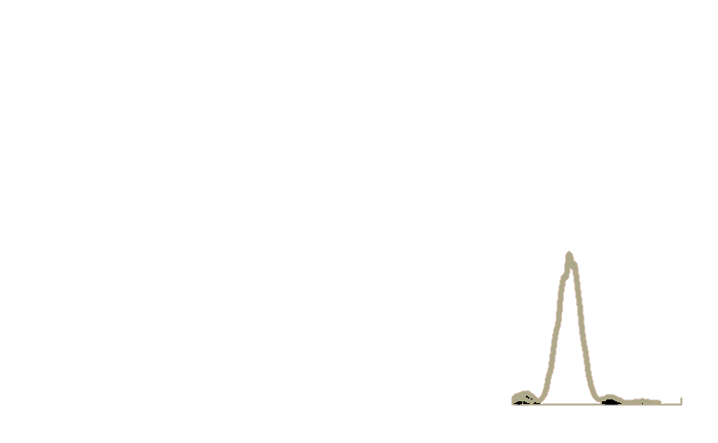

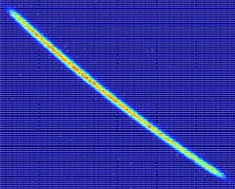
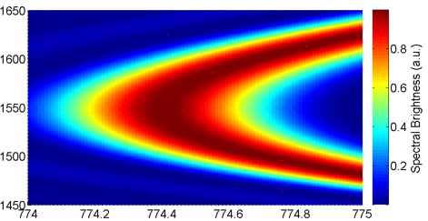
Type II SPDC spectrum
Biphoton Spectral Intensity
Type II SPDC Tuning Curve
1610
Type II
1550
idler λ (nm)
Signal/Idler wavelength (nm)
SHG Conversion Efficiency
(× 10⁻⁴ W ⁻¹)
pump
1490
1490
1550
1610
signal λ(nm)
Pump wavelength (nm)
768 769 770 771 772 773 774 775 776

Slide 9
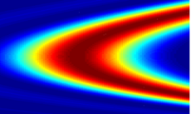
Temporal and spectral distinguishabilities
λ_{idler}
V-polarized
λ_{idler}
H-polarized
λ_{signal}
|f|²
H-polarized
λ_{signal}
V-polarized
|g|²
Temporal distinguishability
Spectral distinguishability

Slide 10
Compensation-free condition
Chromatic Dispersion >> Polarization Mode Dispersion
Both spectral & temporal distinguishabilities are negligible
Compensation-free hyper-entangled source is possible!
C. Chen, L. Qian et al., Opt. Express, 25, 22668, 2017

Slide 11
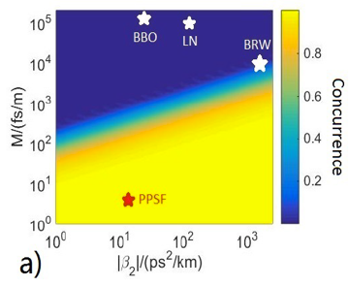
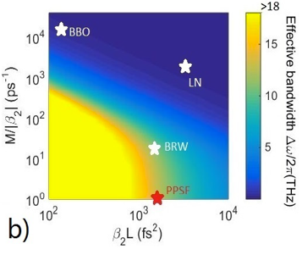
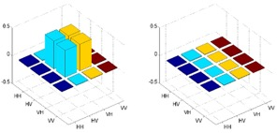
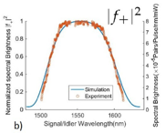
Concurrence and bandwidth
Without
compensation
80nm
C. Chen, L. Qian et al., Opt. Express, 25, 22668, 2017

Slide 12
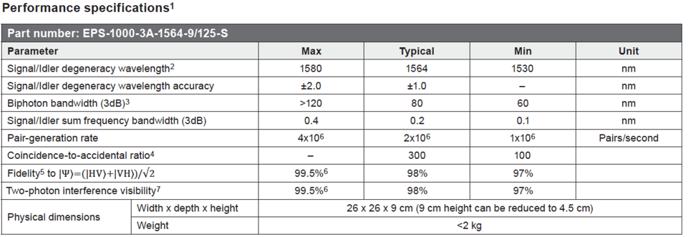
Performance
https://www.ozoptics.com/ALLNEW_PDF/DTS0158.pdf

Slide 13
A Practical Source
A Versatile Source

Slide 14
Variety, variety, variety
Variety of Lasers | Time Domain | Frequency Domain | Polarization
 | Continuous-wave | Narrow linewidth | Linear. Circular, Elliptical, Depolarized
 | Mode-locked pulse train | Broadband frequency combs
 | Arbitrary waveform | Arbitrary spectral shaping
Variety of | Single photons | Time Domain | Frequency Domain | Polarization
 |  | Continuous-wave, Pulsed | Narrow linewidth Broadband | Linear, Circ., Ellipt.

Slide 15
Variety, variety, variety
Variety of Lasers | Time Domain | Frequency Domain | Polarization
 | Continuous-wave | Narrow linewidth | Linear. Circular, Elliptical, Depolarized
 | Mode-locked pulse train | Broadband frequency combs
 | Arbitrary waveform | Arbitrary spectral shaping
Variety of | Single photons | Time Domain | Frequency Domain | Polarization
 |  | Continuous-wave, Pulsed | Narrow linewidth Broadband | Linear, Circ., Ellipt.
 | Bi-photons | Long vs short correlation time Periodically recurrent correlations Arbitrarily shaped temporal correlation | Spectrally correlated vs. uncorrelated Biphoton frequency combs Arbitrary shaped spectral correlation | Entangled Partially entangled Arbitrary state
There is a much larger “space” to explore for biphoton sources

Slide 16
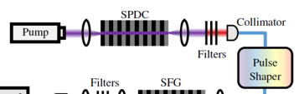
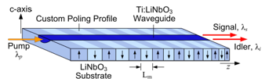
Existing methods of biphoton spectral shaping
biphoton generation in simple nonlinear medium
biphoton generation in complex nonlinear medium
External Spectral
shaping
e.g.
e.g.
Weiner et al. OL, 43, 743, 2018
Sergienko et al. OE, 24, 24947, 2016
Problems:
Wasteful due to filtering
High loss due to coupling
Problems:
Not easily tunable – fixed spectral shape
Fabrication technology dependent
Neither system is capable of shaping polarization at the same time

Slide 17
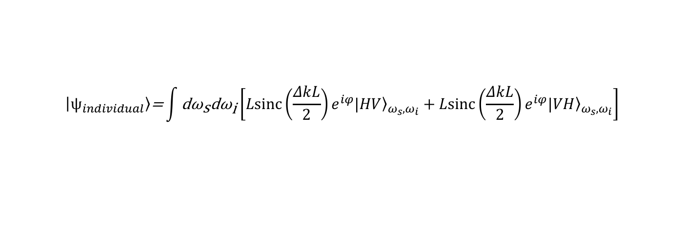
biphoton shaping – nonlinear interference
biphoton generation in simple nonlinear medium (ΔkL)
$$\left|\left.ψ_{individual}\right\rangle \right.\text{=}\int{{\text{dω}}_{\text{s}}{\text{dω}}_{\text{i}}\left[{Lsinc\left(\frac{ΔkL}{2}\right)e^{iφ}\left.|HV\right\rangle }_{ω_{s},ω_{i}}+{Lsinc\left(\frac{ΔkL}{2}\right)e}^{iφ}{\left.|VH\right\rangle }_{ω_{s},ω_{i}}\right]}$$

Slide 18
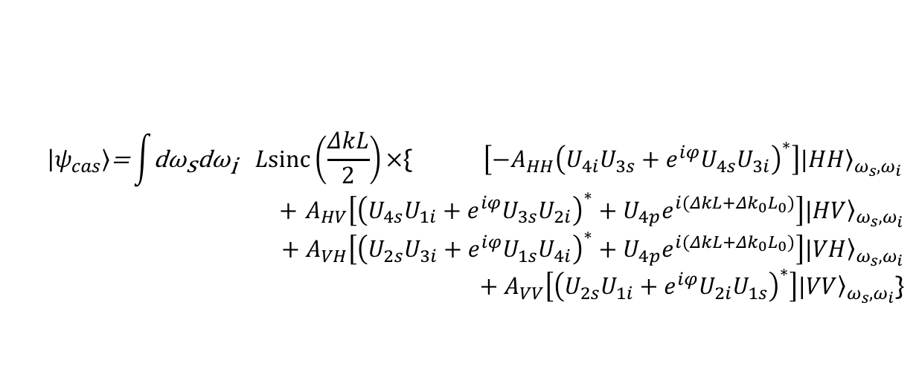
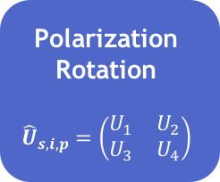
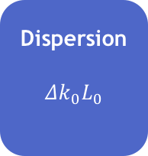
Simultaneous spectral and polarization shaping
Linear medium
biphoton generation in simple nonlinear medium (ΔkL)
Dispersion
$${Δk}_{0}L_{0}$$
Polarization
Rotation
$${\hat{U}}_{s,i,p}=\left(\begin{matrix}U_{1} & U_{2} \\ U_{3} & U_{4}\end{matrix}\right)$$
biphoton generation in simple nonlinear medium (ΔkL)
Spectral
shaping
Polarization
shaping
$$\left|\left.ψ_{cas}\right\rangle \right.\text{=}\int{{\text{dω}}_{\text{s}}{\text{dω}}_{\text{i}} } Lsinc\left(\frac{ΔkL}{2}\right)×\text{\{} \left[−A_{HH}{\left(U_{4i}U_{3s}+{e^{iφ}U}_{4s}U_{3i}\right)}^{∗}\right]{\left.|HH\right\rangle }_{ω_{s},ω_{i}}$$
$+$ $A_{HV}\left[{\left(U_{4s}U_{1i}+e^{iφ}U_{3s}U_{2i}\right)}^{∗}+U_{4p}e^{i(ΔkL+{Δk}_{0}L_{0})}\right]{\left.|HV\right\rangle }_{ω_{s},ω_{i}}$
$$+{ A}_{VH}\left[{\left(U_{2s}U_{3i}+e^{iφ}U_{1s}U_{4i}\right)}^{∗}+U_{4p}e^{i(ΔkL+{Δk}_{0}L_{0})}\right]{\left.|VH\right\rangle }_{ω_{s},ω_{i}}$$
$+{ A}_{VV}\left[{\left(U_{2s}U_{1i}+e^{iφ}U_{2i}U_{1s}\right)}^{∗}\right]{\left.|VV\right\rangle }_{ω_{s},ω_{i}}$}
Riazi, L. Qian et al., npj Quantum Information, 5, 77, 2019
A. Riazi, L. Qian et al., CLEO 2020, FM2C.7

Slide 19

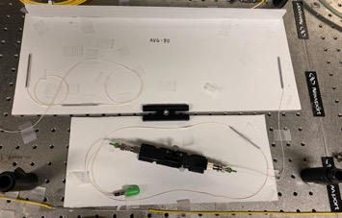


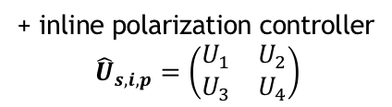
All-fiber implementation - reflection
Linear Section:
Dispersive fiber ${Δk}_{0}L_{0}$
Nonlinear section:
PPSF $ΔkL$
WDM
+ inline polarization controller
$${\hat{U}}_{s,i,p}=\left(\begin{matrix}U_{1} & U_{2} \\ U_{3} & U_{4}\end{matrix}\right)$$
broadband
reflector
PPSF
PC
Broadband reflector
Common-path configuration: pump, signal, idler travel in the same mode and same path – complete phase stability

Slide 20
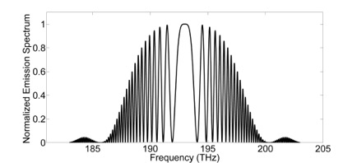
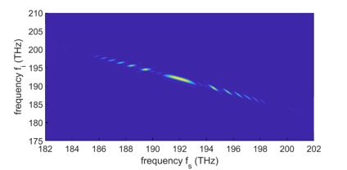
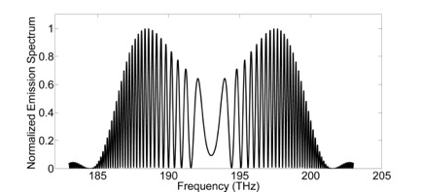
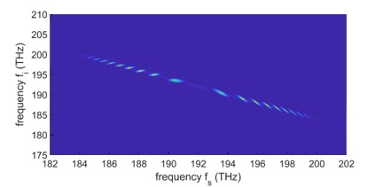
Results: 2-element interference

Slide 21
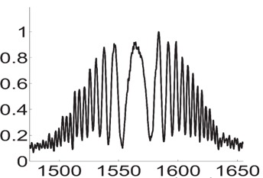
Results: 2-element cascade
Experiment
Emission Spectrum a.u.
Wavelength(nm)

Slide 22
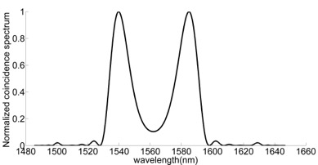
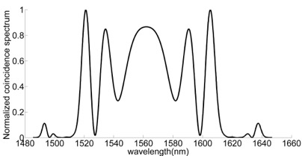
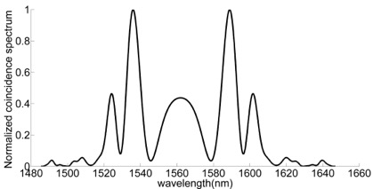
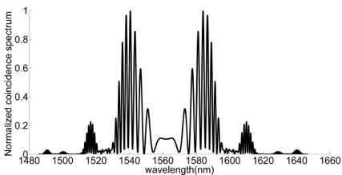
“Arbitrary” spectral shaping
Multiple-element (N≤5) cascade with various linear elements in between

Slide 23
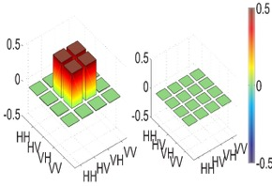
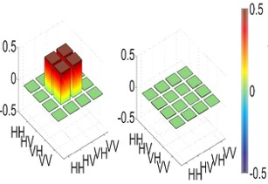
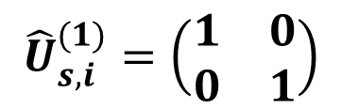
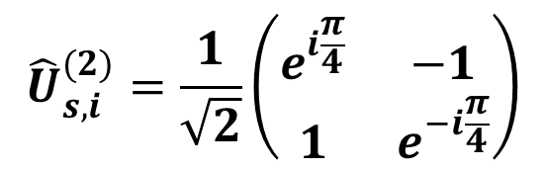
Polarization shaping – incoherent cascade
$${\hat{U}}_{s,i}^{(1)}=\left(\begin{matrix}1 & 0 \\ 0 & 1\end{matrix}\right)$$
$${\hat{U}}_{s,i}^{(2)}=\frac{1}{\sqrt{2}}\left(\begin{matrix}e^{i\frac{π}{4}} & −1 \\ 1 & e^{−i\frac{π}{4}}\end{matrix}\right)$$

Slide 24
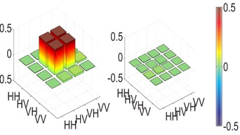
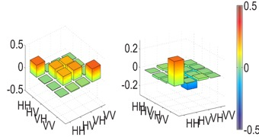
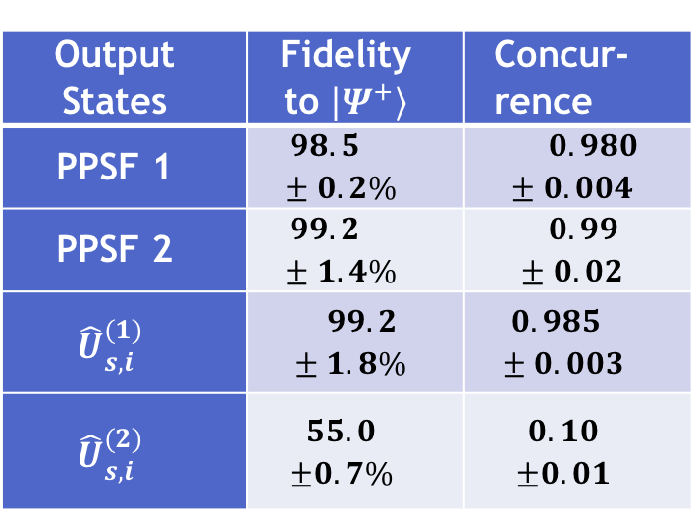
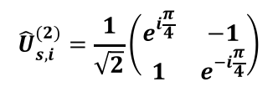

Polarization shaping – incoherent cascade
$${\hat{U}}_{s,i}^{(1)}=\left(\begin{matrix}1 & 0 \\ 0 & 1\end{matrix}\right)$$
Table 1. Fidelity and concurrence of the biphoton state measured in polarization basis.
Output States | Fidelity to $\left|\left.Ψ^{+}\right\rangle \right.$ | Concur-rence
PPSF 1 | $$98.5±0.2\%$$ | $$0.980±0.004$$
PPSF 2 | $$99.2±1.4\%$$ | $$0.99±0.02$$
$${\hat{U}}_{s,i}^{(1)}$$ | $$99.2±1.8\%$$ | $$0.985±0.003$$
$${\hat{U}}_{s,i}^{(2)}$$ | $$55.0$$ $$±0.7\%$$ | $$0.10$$ $$±0.01$$
$${\hat{U}}_{s,i}^{(2)}=\frac{1}{\sqrt{2}}\left(\begin{matrix}e^{i\frac{π}{4}} & −1 \\ 1 & e^{−i\frac{π}{4}}\end{matrix}\right)$$
A. Riazi, L. Qian et al., npj Quantum Information, 5, 77, 2019
Notes:
Incoherent cascade

Slide 25
Spectral and polarization DoF coupling
Linear medium
biphoton generation in simple nonlinear medium (ΔkL)
Dispersion
$${Δk}_{0}L_{0}$$
Polarization
Rotation
$${\hat{U}}_{s,i,p}=\left(\begin{matrix}U_{1} & U_{2} \\ U_{3} & U_{4}\end{matrix}\right)$$
biphoton generation in simple nonlinear medium (ΔkL)
Spectral
Polarization
$$\left|\left.ψ_{cas}\right\rangle \right.\text{=}\int{{\text{dω}}_{\text{s}}{\text{dω}}_{\text{i}} } Lsinc\left(\frac{ΔkL}{2}\right)×\text{\{} \left[−A_{HH}{\left(U_{4i}U_{3s}+{e^{iφ}U}_{4s}U_{3i}\right)}^{∗}\right]{\left.|HH\right\rangle }_{ω_{s},ω_{i}}$$
$+$ $A_{HV}\left[{\left(U_{4s}U_{1i}+e^{iφ}U_{3s}U_{2i}\right)}^{∗}+U_{4p}e^{i(ΔkL+{Δk}_{0}L_{0})}\right]{\left.|HV\right\rangle }_{ω_{s},ω_{i}}$
$$+{ A}_{VH}\left[{\left(U_{2s}U_{3i}+e^{iφ}U_{1s}U_{4i}\right)}^{∗}+U_{4p}e^{i(ΔkL+{Δk}_{0}L_{0})}\right]{\left.|VH\right\rangle }_{ω_{s},ω_{i}}$$
$+{ A}_{VV}\left[{\left(U_{2s}U_{1i}+e^{iφ}U_{2i}U_{1s}\right)}^{∗}\right]{\left.|VV\right\rangle }_{ω_{s},ω_{i}}$}
Riazi, L. Qian et al., npj Quantum Information, 5, 77, 2019
A. Riazi, L. Qian et al., CLEO 2020, FM2C.7

Slide 26
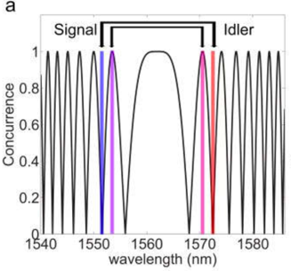
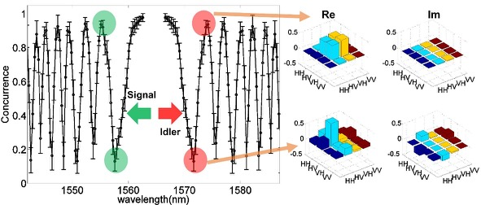
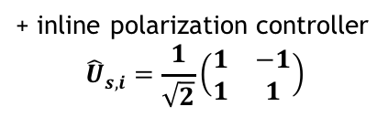


λ-dependent concurrence
PPSF $ΔkL$
Linear dispersive fiber ${Δk}_{0}L_{0}$
WDM
+ inline polarization controller
$${\hat{U}}_{s,i}^{}=\frac{1}{\sqrt{2}}\left(\begin{matrix}1 & −1 \\ 1 & 1\end{matrix}\right)$$
broadband
reflector
A. Riazi, L. Qian et al., CLEO 2020, FM2C.7
Notes:
Coherent cascade

Slide 27
Wavelength-dependent polarization entanglement
PPSF $ΔkL$
Linear dispersive fiber ${Δk}_{0}L_{0}$
WDM
+ inline polarization controller
$${\hat{U}}_{s,i}^{}=\frac{1}{\sqrt{2}}\left(\begin{matrix}1 & −1 \\ 1 & 1\end{matrix}\right)$$
broadband
reflector
Trace over Polarization DoF
A. Riazi, L. Qian et al., CLEO 2020, FM2C.7
Notes:
Coherent cascade

Slide 28
Fibre-based common-path NLI
Novel strategy for biphoton shaping:
  cascading and interfering biphotons from multiple nonlinear sources
  Particularly suited for PPSF-based broadband polarization-entangled sources
Major advantages:
  Simultaneous shaping of spectrum and polarization
  Can be used to generate arbitrary biphoton polarization states
  Tuning the degree of polarization entanglement through frequency tuning
  Common-path configuration: guaranteed phase stability
  Low loss and efficient: all-fiber construction; no post-selection or filtering
Significance:
  A practical way to create versatile entangled biphoton sources

Slide 29
Current and Future Directions
Versatile and tunable entangled photon sources
  Fibre-based broadband entanglement source
  Tunable spectral shape
  Tunable polarization states
  Tunable temporal shape
  Spatially separate hyper-entangled source (polarization + frequency bin)
Applications for entangled photon sources
  Entanglement-based Quantum Key Distribution
  Entanglement distribution in networks
  Clock synchronization
  Quantum measurements
  Quantum sensing

Slide 30
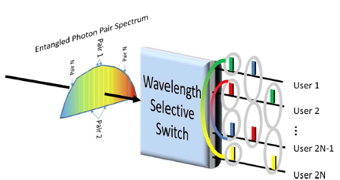
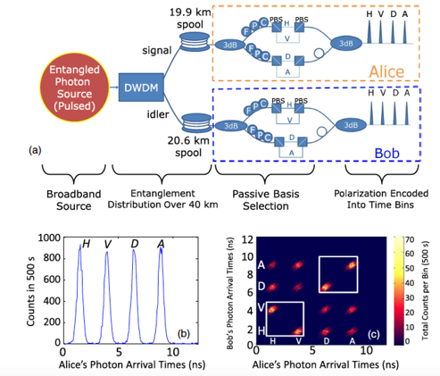
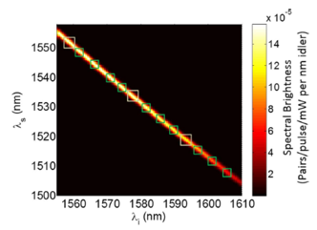
Entanglement based QKD
EY Zhu, L. Qian et al., JOSA B, 36, B1-6, 2019

Slide 31
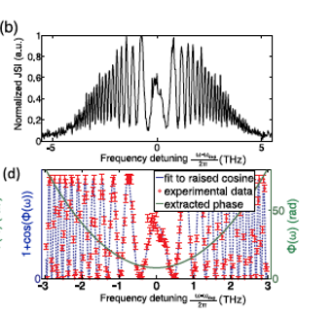
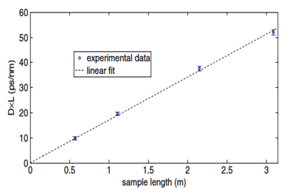


Dispersion measurement using biphotons
Linear Section:
Dispersive fiber ${Δk}_{0}L_{0}$
Nonlinear section:
PPSF $ΔkL$
WDM
A Riazi, L. Qian et al., Opt. Lett., 44, 1484, 2019
A Riazi, L. Qian et al., Opt. Lett., 45, 2034, 2020

Slide 32



Summary
Periodically-Poled Silica Fiber
Nonlinear section
Linear Section
WDM
PPSF
Pol Ctrl + Dispersion
χ⁽²⁾ SPDC in PPSF
Applications:
Arbitrary biphoton state generation
Quantum network – entanglement distr.
Metrology – dispersion, phase measurements

Slide 33
Acknowledgement
Graduate students and postdocs
  Arash Riazi
  Changjia Chen
  Dr. Eric Zhu
Colleagues
  Prof. John Sipe – (Toronto)
  Prof. Peter Kazansky (Southampton)
  Dr. Alexey Gladyshev (Russia)
Postdoc Position Open: l.qian@utoronto.ca

