Slide 1
Fiber to chip packaging with low loss for quantum applications
Juniyali Nauriyal , Meiting Song , Marissa Granados-Baez , Yi Zhang , Jaime Cardenas
Notes:
Good morning, today I will talk about our work in packaging multiple fiber to a photonic device in a single shot

Slide 2
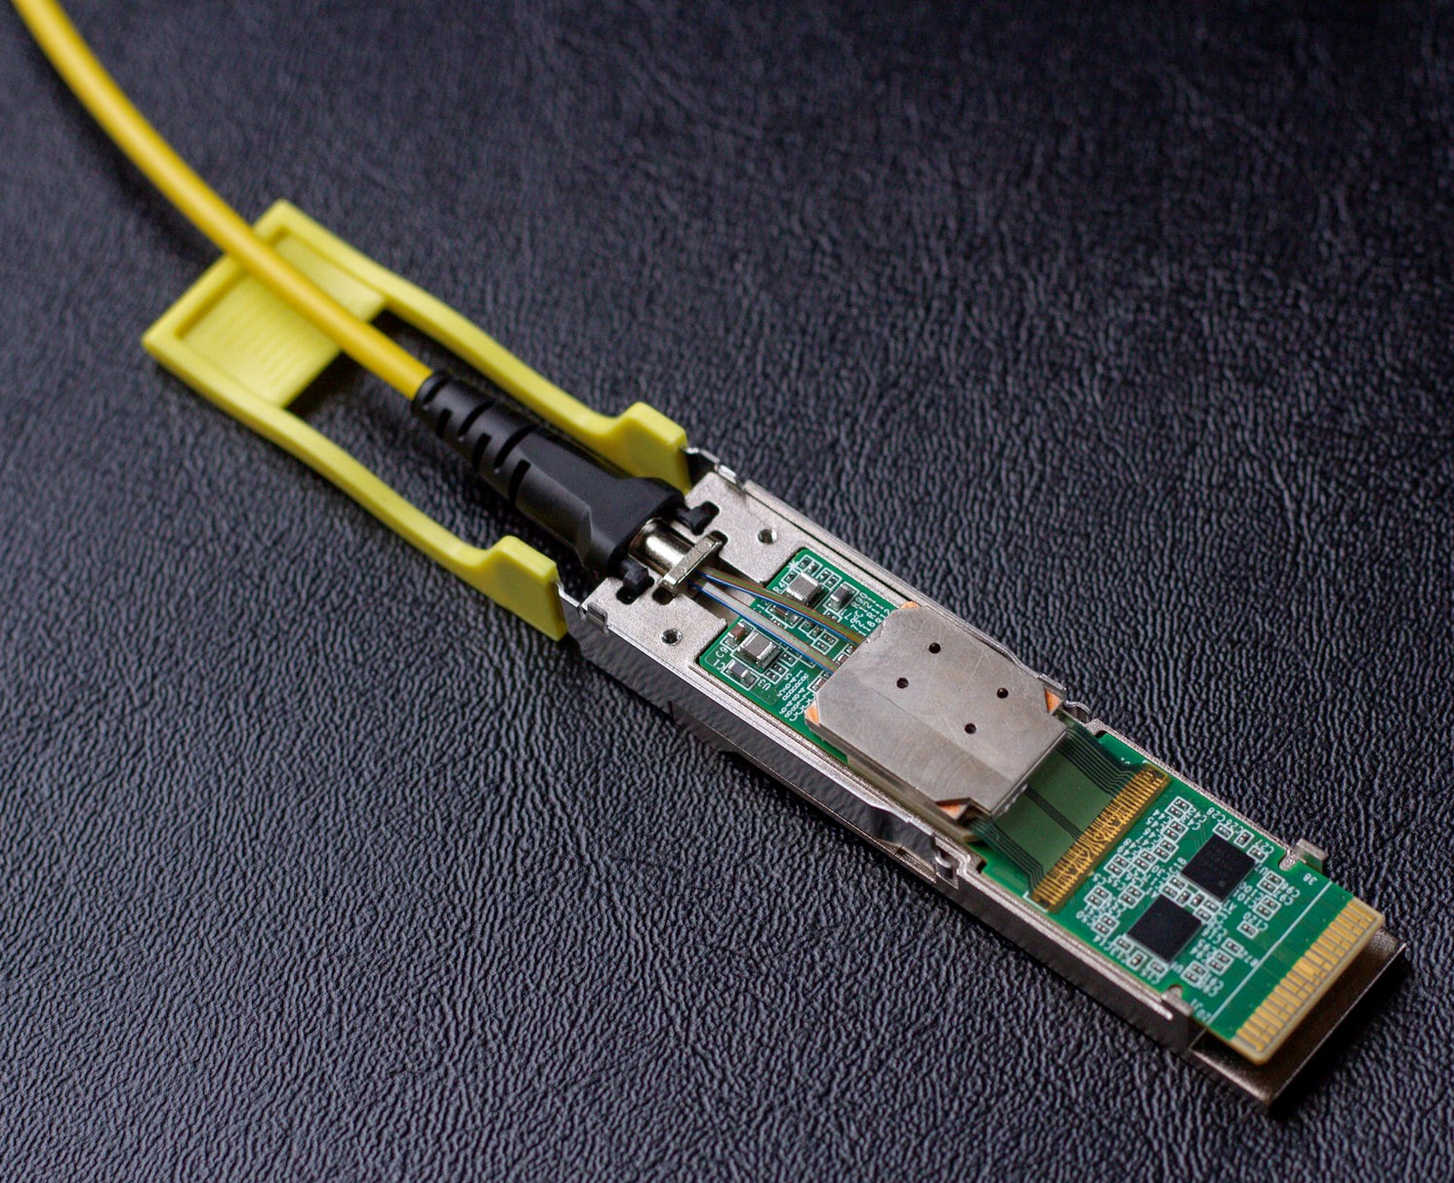
Packaging multiple fibers at once
Optical Transceiver
https://opticalconnectionsnews.com/2019/01/rockley-announces-silicon-photonics-platform-for-advanced-sensing-applications-and-interconnectivity-for-ai/
Notes:
Did you know 80% of the cost of a photonic device comes from packaging?
With the increasing need for higher data rates of the order of few terabytes to zettabytes and the advent of co packaged optics, data centers and optical transceivers are now migrating to integrated photonics. To satisfy the industries requirements a low-cost and low-loss packaging technique for photonic integrated circuits is needed.

Slide 3
Fiber array fusion splicing
Photonic chip
Fiber array
Nitride
tapers
Mode converter
Photonic
chip
Fusion Spot from laser
250µm
125µm
4-fiber array
U-grooves
TOP VIEW
Juniyali Nauriyal, Meiting Song, Raymond Yu, and Jaime Cardenas, "Fiber-to-chip fusion splicing for low-loss photonic packaging," Optica 6, 549-552 (2019)
Notes:
To make packaging more scalable and commercial, we introduce a new packaging method which uses a co2 laser to fuse the chip and the fiber array in a single shot, similar to splicing two fibers.
We introduce a sio2 mode converter which provides an interface to bond the fiber , and also mode matches the fiber and the waveguide on each side.
We fuse a SMF 28 4 fiber array to the chip using a cylindrical beam of C02 laser for 1 second. This method does not require any special fixtures or adhesives.
Here you can see a photograph of a packaged device without the use of adhesive.

Slide 4
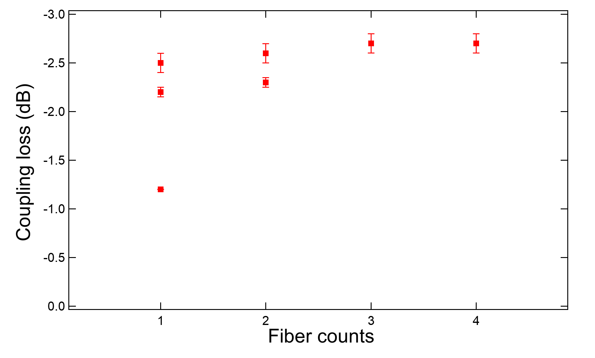
Transmission curve for multiple fibers
Notes:
We measure measure a minimum loss of 2.5dB per facet with a variation of +/-0.1dB across a 4-fiber array.
We also compared losses with a 2 fiber and a single fiber which are 2.2dB and 1.2dB respectively.
We will like to thank our sponsors.

